Slide 1
Introductory Session

Slide 2
Session objectives
This opening session allows you to:
Discuss expectations of the course and relate them to the course objectives.
Define the role of a health care provider in nutrition care and support.

Slide 3
Course objectives
Give participants the knowledge and skills to:
Advocate for and discuss the role of nutrition in care and treatment of people with HIV.
Assess clients’ nutritional status.
Counsel clients on prevention and management of malnutrition.
Prescribe specialised food products and provide other support to malnourished clients.
Monitor and report on NACS services.

Slide 4
Comprehensive care for people with HIV (1)
HIV counselling and testing (HCT)
Antiretroviral therapy (ART)
Treatment of opportunistic infections and counselling on their prevention
Nutrition assessment
Nutrition counselling based on assessment results
Counselling on infant feeding
Counselling on dietary management of symptoms and medication side effects
Counselling on adherence to treatment

Slide 5
Comprehensive care for people with HIV (2)
Counselling on positive living (safer sex, avoidance of drug and alcohol abuse)
Prescription of specialised food products to treat malnutrition
Monitoring of disease progression
Referral to social and economic support
Advice on problems of orphaned children
Advice about legal rights
Psychological and spiritual support

Slide 6
What is NACS?
Nutrition
Assessment,
Counselling and
Support

Slide 7
Objectives of the Nutrition Guidelines for Care and Support of People Living with HIV
Promote advocacy at all levels for prevention and treatment of malnutrition in the general population and among people with HIV.
Mainstream nutrition into the national HIV and response.
Guide NACS services for people with HIV.
Facilitate consistent professional services based on sound technical advice.
Inform training curricula, job aids and SBCC materials.

Slide 8
Session 1. Basic Nutrition

Slide 9
Session objectives
By the end of this session, you should be able to:
Define select nutrition terms.
Describe the conditions for good nutrition.
Discuss food choices to plan a mixed diet.

Slide 10
Definition of select nutrition terms (1)
Food: Anything edible that provides the body with nutrients.

Slide 11
Definition of select nutrition terms (2)
Nutrients: Chemical compounds in food released during digestion to maintain, repair or build body tissues

Slide 12
Definition of select nutrition terms (3)
Nutrition: The body’s process of taking in, digesting, absorbing and using nutrients for growth, development and health.

Slide 13
Definition of select nutrition terms (4)
Malnutrition: The result of food intake not matching the body’s food needs
  Undernutrition: Result of inadequate food intake
    Acute malnutrition: caused by inadequate food intake due to lack of food and/or illness.
    Chronic malnutrition: caused by prolonged undernutrition or repeated episodes of illness; resulting in stunting (low height-for-age)
    Micronutrient deficiencies: result of reduced micronutrient intake and/or absorption

Slide 14
Definition of select nutrition terms (5)
  Overnutrition: arises from excessive intake of more nutrients than the body needs, leading to overweight and obesity

Slide 15
Conditions necessary for good nutrition
Food availability
Food accessibility
Food intake
Food utilisation
Food excretion

Slide 16
What is a mixed diet?
        Eating a variety of foods from all the food groups to provide all the nutrients the body needs to function well
        No single food, except breast milk for the first 6 months of life, provides all the nutrients the body needs to function well.
        Food quality and quantity are as important as variety.

Slide 17
Exercise: Food Composition Tables
  Find out how much energy, protein and iron there is in a 100 g edible portion of:
    Roller mealie meal
    Sweet potato leaves
    Beef

Slide 18
Exercise: Meal planning
Refer to Worksheet 1.5. Meal Planning.
Fill out the worksheet in groups, using Handout 1.3. A Mixed Diet and the Food Composition Tables.
Present results in plenary.

Slide 19
Session 2. Nutrition and Infection

Slide 20
Session objectives
By the end of this session, you should be able to:
Discuss the relationship between nutrition and infection.
Explain why nutrition is important for people with HIV.
Explain the recommended energy and nutrient intake for people with HIV.
List the Critical Nutrition Actions.

Slide 21
Poor nutrition and infection:
A vicious cycle
Poor nutritional status
Weight loss, growth faltering, muscle wasting, micronutrient deficiencies
Impaired appetite and digestion
Increased nutrient needs due to nutrient loss and malabsorption and changed metabolism
Weakened immune system
Poor ability to resist and fight infections
Infection
Increased vulnerability to infections
More frequent, more severe and longer-lasting infections

Slide 22
Importance of good nutrition for people with HIV
They need more energy than uninfected people.
They are vulnerable to infections that deplete energy and nutrients.
Good nutrition helps resist infections and reduces their frequency and duration.
Good nutrition helps maintain healthy weight, manage symptoms, and keep active.
Good nutrition helps medicines work effectively and may reduce side-effects.
Good nutrition may reduce the risk of mother-to-child transmission of HIV.
Good nutrition may delay progression of HIV to AIDS.

Slide 23
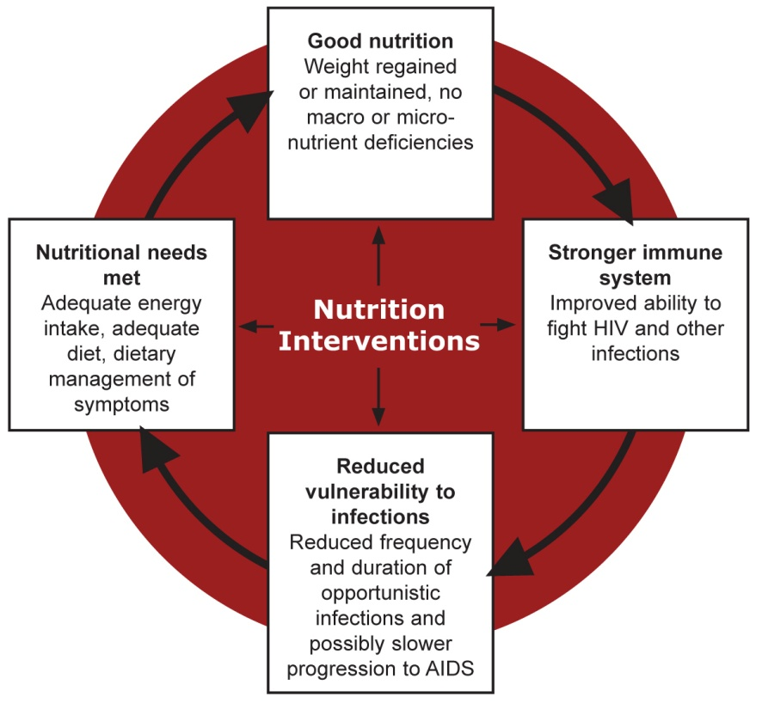
Good nutrition and infection:
A virtuous cycle

Slide 24
Energy and nutrient needs: Adults
Group | Energy needs/day | Food equivalent
HIV-negative adult | 2,000–2,580 kcal | 3 meals of rice cooked with oil, boiled chicken and cassava leaf relish with groundnuts or 1 egg or 1 serving lentils AND 2 snacks (1 slice bread with margarine and jam or 1 chapatti with oil or 1 avocado
HIV-positive adult (asymptomatic) | 10% (200–258 kcal) extra | 1 extra fistful nshima or 1 cup porridge or 2 sweet potatoes or 2 bananas or 2 servings pumpkin or 1 serving meat sauce and vegetables or 2 eggs
HIV-positive adult (symptomatic) | 20–30% (400–630 kcal) extra | An extra 2 eggs plus 2–3 fistfuls nshima or 2–3 cups porridge

Slide 25
Energy and nutrient needs: Children
Group | Energy needs/ day | Food equivalent
HIV-negative child | 1,650–2,800 (6–17 years) | 3 fistfuls of nshima, 1 handful of groundnuts, 2 sweet potatoes, 2 oranges, 2 bananas, 2 servings of beans, 2 chapatis, 3 servings of pumpkin leaves, 1 serving of kapenta and 1 cup milk
HIV-positive child (asymptomatic) | 10% (165–280 kcal) extra | An extra 1 cup of milk and 1 cup of porridge plus 1 banana, 1 egg or 1 slice of bread with groundnut paste
HIV-positive child (symptomatic) | 20–30% (413–700 kcal) extra | An extra 2 cups of milk and 2 cups of porridge plus 2 bananas, 2 eggs or 2 slices of bread with groundnut paste
HIV-positive child (symptomatic and losing weight) | 50–100% (1,200-1,650 kcal) extra | An extra 2–3 cups of milk, 3 slices of bread with groundnut paste and 2 bananas, avocados or eggs

Slide 26
Session 3.
Nutrition Assessment

Slide 27
Session objectives
By the end of this session, you should be able to:
Explain why nutrition assessment is important.
List types of nutrition assessment.
Do accurate anthropometric assessment.
Identify physical signs of malnutrition.
Do simple dietary assessment.
Interpret the results of various assessments to classify nutritional status.

Slide 28
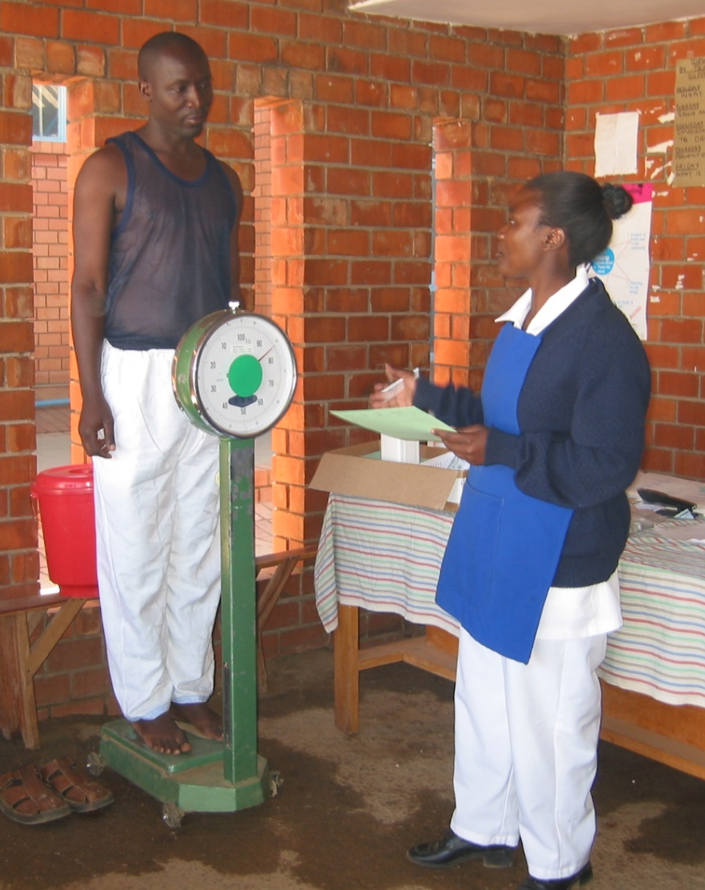
Kinds of nutrition assessment
ABCD
Anthropometric
Clinical
Biochemical
Dietary
Photo: Ian McCllellan

Slide 29
Anthropometric assessment
  Weight
  Height
  Weight for height (WHZ) for children
  Body mass index (BMI) for adults
  BMI-for-age for children and adolescents 5–18 years.
  Mid-upper arm circumference (MUAC) for all groups and always for pregnant women

Slide 30
Classification of nutritional status
        Severe acute malnutrition (SAM) with no appetite or with medical complications
        SAM with appetite and no medical complications
        Moderate acute malnutrition (MAM)
        Normal nutritional status
        Overweight
        Obesity

Slide 31
Z-scores
Undernutrition
Overnutrition

Slide 32
Practice finding WHZ
Boy 26 months of age who is 67 cm long and weighs 7.7 kg
(ANSWER: Normal nutritional status)
Girl 9 months of age who is 65 cm long and weighs 5.5 kg
(ANSWER: – 3, SAM)

Slide 33
Practice finding WHZ
ID | Sex | Height (cm) | Weight (kg) | WHZ | Nutritional status
1 | F | 35 | 98.2 | ≥ –3 to < –2 | MAM
2 | M | 52 | 99.5 | ≥ –2 to ≤ +2 | Normal
3 | M | 9 | 69.9 | ≥ –2 to ≤ +2 | Normal
4 | F | 8 | 68.2 | < – 3 | SAM
5 | M | 21 | 97.2 | ≥ –3 to < –2 | MAM
6 | M | 17 | 89.7 | ≥ –2 to ≤+2 | Normal

Slide 34
Practice finding BMI
Woman who weighs 88 kg and is 176 cm tall
(ANSWER: 28.0, overweight)
Man who weighs 58 kg and is 192 cm tall
(ANSWER: 16.0, moderately malnourished)

Slide 35
Practice finding BMI
ID | Sex | Height (cm) | Weight (kg) | BMI | Nutritional status
1 | F | 178 | 50 | 15.8 | SAM
2 | M | 190 | 68 | 19 | Normal nutritional status
3 | M | 176 | 48 | 15 | SAM
4 | F | 156 | 102 | 42 | Obesity
5 | M | 160 | 38 | 15 | SAM
6 | M | 174 | 84 | 28 | Overweight

Slide 36
Practice finding BMI-for-age
Sex | Age (years, months) | Height (cm) | Weight (kg) | BMI | BMI-for-age/nutritional status
F | 6 years, 2 months | 111 | 18.8 | 15.4 | Normal
M | 11 years, 3 months | 130 | 23.0 | 13.6 | MAM
F | 13 years, 7 months | 145 | 38.0 | 18.1 | Normal
M | 8 years, 4 months | 125 | 19.0 | 12.2 | SAM

Slide 37
Clinical nutrition assessment
Check for medical complications.
Check for signs of malnutrition.
Check for growth/weight changes.
Find out what medications the client is taking.

Slide 38
Clinical signs of malnutrition
Bilateral pitting oedema
Weight loss and wasting
Poor growth in children
Apathy
Hair colour changes
Poor appetite
Dry, flaky skin
Skin lesions
Persistent diarrhoea, nausea or vomiting
Severe anaemia or dehydration
Opportunistic infections

Slide 39
Bilateral pitting oedema
A sign of SAM regardless of anthropometric measurements
Grade | Definition | Action
+ | Mild (in both feet or ankles) | Treat for SAM as outpatient.
++ | Moderate (in both feet plus both lower legs, both hands or both lower arms) | Treat for SAM as outpatient.
+++ | Severe (generalised, in both feet, both legs, both hands, both arms and face) | Treat for SAM as inpatient.

Slide 40
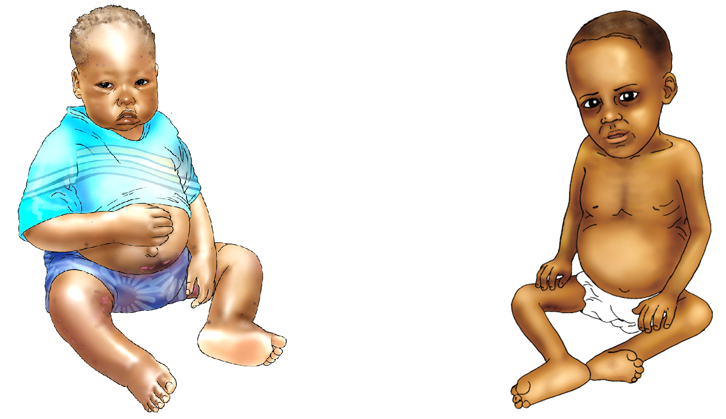
Severe acute malnutrition (SAM) in children
Kwashiokor Marasmus
Source: University Research Co., LLC. 2009. Comprehensive Nutrition Care for People Living with HIV/AIDS: Facility-Based Health Providers Manual. Bethesda, MD: URC.

Slide 41
Biochemical assessment
Haemoglobin (anaemia), glucose, electrolytes
CD4
Cholesterol
Serum triglyceride levels (lipid status to estimate biochemical deficiencies)
Urine (creatinine levels to estimate muscle mass utilisation)
Serum albumin (malnutrition < 3.2 g/dl)
Stool sample (parasites)

Slide 42
Factors that affect dietary intake
Food access
Food availability
Symptoms
Medications
Smoking
Alcohol
Drug abuse
Food taboos
Stigma
Depression
Preparation time
Fuel
Family support

Slide 43
Session 4.
Nutrition Counselling

Slide 44
Session objectives
  By the end of this session, you should be able to:
  Define counselling and list the skills needed for effective counselling.
  List key considerations for planning a counselling session.
  Counsel using the GATHER approach.
  Demonstrate nutrition counselling.

Slide 45
Counselling vs. advice and education
  Giving advice is directive
  Educating is conveying information from one person (the expert) to another (the passive receiver)
  Counselling is non-directive, non-judgemental, dynamic, empathetic interpersonal communication to help someone learn how to use information to make a choice or solve a problem.

Slide 46
Skills that facilitate counselling
  Use helpful non-verbal communication.
  Show interest in what the client says.
  Empathise with the client’s situation.
  Ask open-ended questions.
  Reflect back what the client says.
  Avoid words that sound judgemental.

Slide 47
Skills that build confidence and give support
  Accept what the client thinks and feels.
Praise what the client is doing correctly.
Give practical help.
Give a little relevant information at a time.
Use simple language.
Make one or two suggestions rather than giving commands.

Slide 48
GATHER counselling approach
G – Greet
A – Ask
T – Tell
H – Help
E – Explain
R – Reassure/Return date

Slide 49
Counselling role-plays: Case scenarios
Read the case scenario for your group.
Choose two group members to be the ‘counsellor’ and ‘client’. The rest will be observers.
Discuss what additional nutrition assessments are needed and why.
Plan interventions.
Prioritise a topic for counselling.

Slide 50
Counselling role-plays: Evaluation
Did the counsellor focus on the most important points?
Which interventions did the counsellor choose?
Did the counsellor give correct messages?
What tools did the counsellor use?
What strengths and weaknesses did you observe?

Slide 51
Session 5. Nutrition and Antiretroviral Therapy

Slide 52
Session objectives
By the end of this session, you should be able to:
Describe the interaction between ARVs and food and the effects of ARVs on nutrition.
Counsel on managing medication side-effects and medication-food interactions through diet.
Prepare a medication-food plan for a client on ART.

Slide 53
Medication–food plans
A medication-food plan guides a client on how to take medications correctly (in the right dosage, at the right time and with or without food).
The purpose of a medication-food plan is to minimise medication side effects and maximise medication effectiveness.

Slide 54
Session 6. Food and Water Safety and Hygiene

Slide 55
Session objectives
By the end of this session, you should be able to:
Describe how food and water can be sources of infection.
Describe how to make food and water safe.
Counsel clients on food and water safety and hygiene.

Slide 56
Food and water safety
Food safety is preventing food contamination and food-borne illness through proper preparation, cooking and storage.
Water safety is preventing water contamination and water-borne illness through proper treatment and storage.
Hygiene is conditions or practices that help maintain health and prevent disease, especially through cleanliness.

Slide 57
Importance of food and water safety
Food and water-borne infections can reduce appetite and nutrient absorption, causing weight loss.
Germs in soil and water may cause stunting by causing an intestinal infection that reduces children’s ability to absorb nutrients.
Food and water can carry germs that cause serious infections in people with weak immune systems.

Slide 58
How to reduce the risk of illness from contaminated food or water
  Wash hands correctly.
  Keep surroundings clean.
  Use safe water and raw food materials.
  Separate raw and cooked food.
  Cook food thoroughly.
  Store food and water safely.

Slide 59
Group exercise
  Discuss how easy or difficult would it be for your clients to practice the recommended actions with the resources they have.
  Present your answers in plenary.

Slide 60
Session 7. Nutrition Care for
Pregnant and Breastfeeding Women

Slide 61
Session objectives
By the end of this session, you should be able to:
Explain the nutritional needs of pregnant and lactating women.
Explain the extra energy needs of HIV-positive pregnant and lactating women.
Explain nutrition actions for pregnant and lactating women.
Counsel pregnant and lactating women on good nutrition practices.

Slide 62
Nutritional needs of pregnant and lactating women
More energy (200 kcal extra/day), protein and micronutrients to meet demands for foetal development and milk production
If HIV positive, 300 extra kcal/day if pregnant and 500 if lactating (HIV causes nutrient loss and malabsorption).
Poor nutritional status before, during and after pregnancy increases the risk of mother-to-child transmission of HIV.

Slide 63
Anaemia
Results from low haemoglobin concentration in blood, reducing the oxygen-carrying capacity of red blood cells
Is usually caused by iron deficiency
< 11.0 g/dl in children 6–59 months
< 11.5 g/dl in children 5–11 years
< 12.0 g/dl in children 12–14 years
< 11.0 g/dl in pregnant women
< 12.0 g/dl in non-pregnant women
< 13.0 g/dl in men

Slide 64
Clinical signs and symptoms of anaemia
Pale conjunctiva, gums, nails, and skin
Breathlessness
Rapid pulse
Palpitations
Headaches
Oedema
Fatigue, weakness, dizziness, and drowsiness

Slide 65
How to prevent anaemia
Take iron or iron/folate supplements.
Sleep under insecticide-treated bednets and take antimalarial medications.
Wear shoes and dispose of faeces safely.
Get dewormed in the 2nd trimester of pregnancy and every 6 months if not pregnant.
Space births.
Eat foods rich in iron and vitamin C-rich foods to help absorb iron.
Avoid tea and coffee, which reduce iron absorption.

Slide 66
Session 8. Nutrition Care for Infants and Young Children

Slide 67
Session objectives
By the end of this session, you should be able to:
Describe the risks and benefits of different infant feeding practices.
Counsel mothers on exclusive breastfeeding and complementary feeding.
Counsel caregivers on feeding children over 6 months.
Counsel HIV-positive mothers on infant feeding.

Slide 68
Recommended infant feeding practices in Zambia
Exclusive breastfeeding
Complementary feeding starting at 6 months
Continued breastfeeding until 2 years or more
Responsive feeding (feeding patiently and encouraging, not forcing children to eat)
Feeding fortified foods and giving micronutrient supplements
Handling foods hygienically to avoid infection
Continued feeding during illness

Slide 69
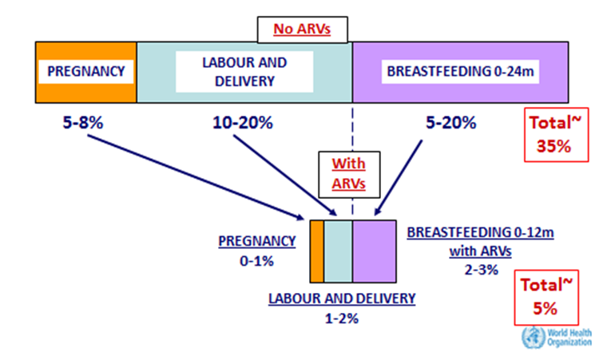
Mother-to-child transmission of HIV with and without ARVs

Slide 70
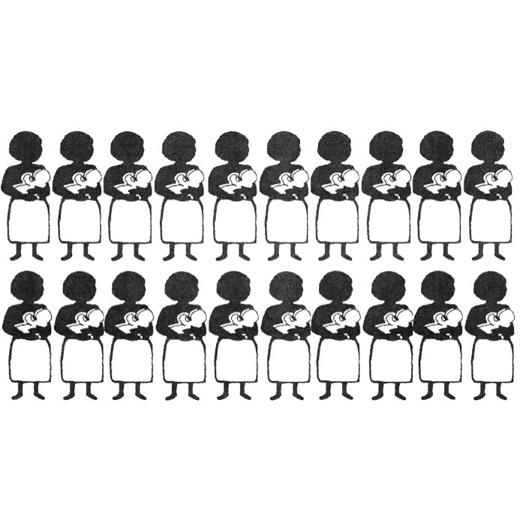
Risk of transmitting HIV through breastfeeding

Slide 71
Infant feeding recommendations for HIV-positive mothers
  Breastfeed exclusively for 6 months, then introduce
  complementary foods and continue breastfeeding for 12 months. Replacement feed ONLY in special circumstances if the mother:
  Has safe water and sanitation
  Can provide enough formula for normal growth and development
  Can prepare formula cleanly and often enough so it is safe and carries a low risk of diarrhoea and malnutrition
  Has family support for this practice
  Can access comprehensive child health services

Slide 72
Session 9.
Nutrition Support

Slide 73
Session objectives
By the end of this session, you should be able to:
List the kinds of nutrition support health care facilities can provide.
Describe the types and purposes of specialised food products.
List entry and exit criteria for specialised food products.
Refer malnourished clients to economic/ livelihood/food security support.

Slide 74
Purpose of specialised food products
  Treat malnutrition.
  Promote adherence to ART or TB treatment.
  Improve the effectiveness of medications and help manage side-effects.
  Improve birth outcomes of HIV-positive pregnant women and promote HIV-free survival of infants and children.
  Improve quality of life.

Slide 75
Difference between specialised food products and food support
Specialised food products are prescribed like medicine for a limited time based on strict entry and exit criteria after nutrition assessment to improve nutrition.
        Food support is distributed to increase food security and consists of household food rations, often staple foods like flour and oil.

Slide 76
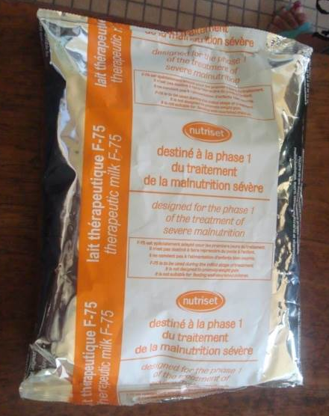
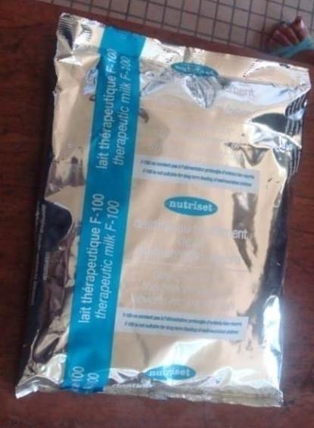
Specialised food products used in Zambia
Therapeutic milks for inpatient treatment of SAM
F-75
F-100

Slide 77
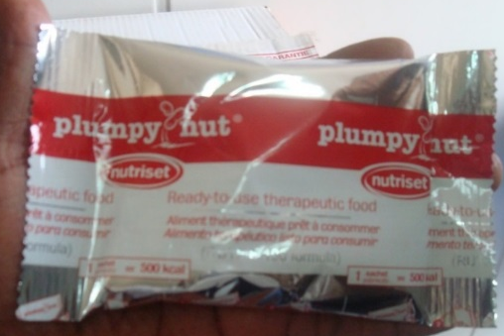


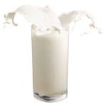

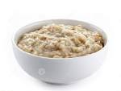

Specialised food products used in Zambia, cont.
Ready-to-use therapeutic food (RUTF) for inpatient and outpatient treatment of SAM
High-energy protein supplement (HEPS) for outpatient treatment of MAM
Easy to make delicious cereal and energy drink
Not suitable for babies younger than 6 months
100g

Slide 78
WARNING!
        Specialised food products (EXCEPT for F-75 and F-100) are not appropriate or nutritionally adequate for infants under
        6 months.
        Counsel clients NOT to give these foods to infants.

Slide 79
NACS supply chain management
Procurement, transport, storage and distribution of commodities, including specialised food products
To ensure availability of commodities when needed, avoid expired commodities and minimise wastage
SUPPLIER
WAREHOUSE
HEALTH FACILITIES
CLIENTS

Slide 80
1. Receiving supplies (1)
Collect supplies from the warehouse using the Internal Requisition Book signed by the facility in-charge.
Inspect deliveries when they arrive. Compare the contents with the Delivery Note. Check the expiry dates to make sure the items are not expired.
Confirm receipt of the commodities by signing the Goods Received Note. This stays at the warehouse or health facility.

Slide 81
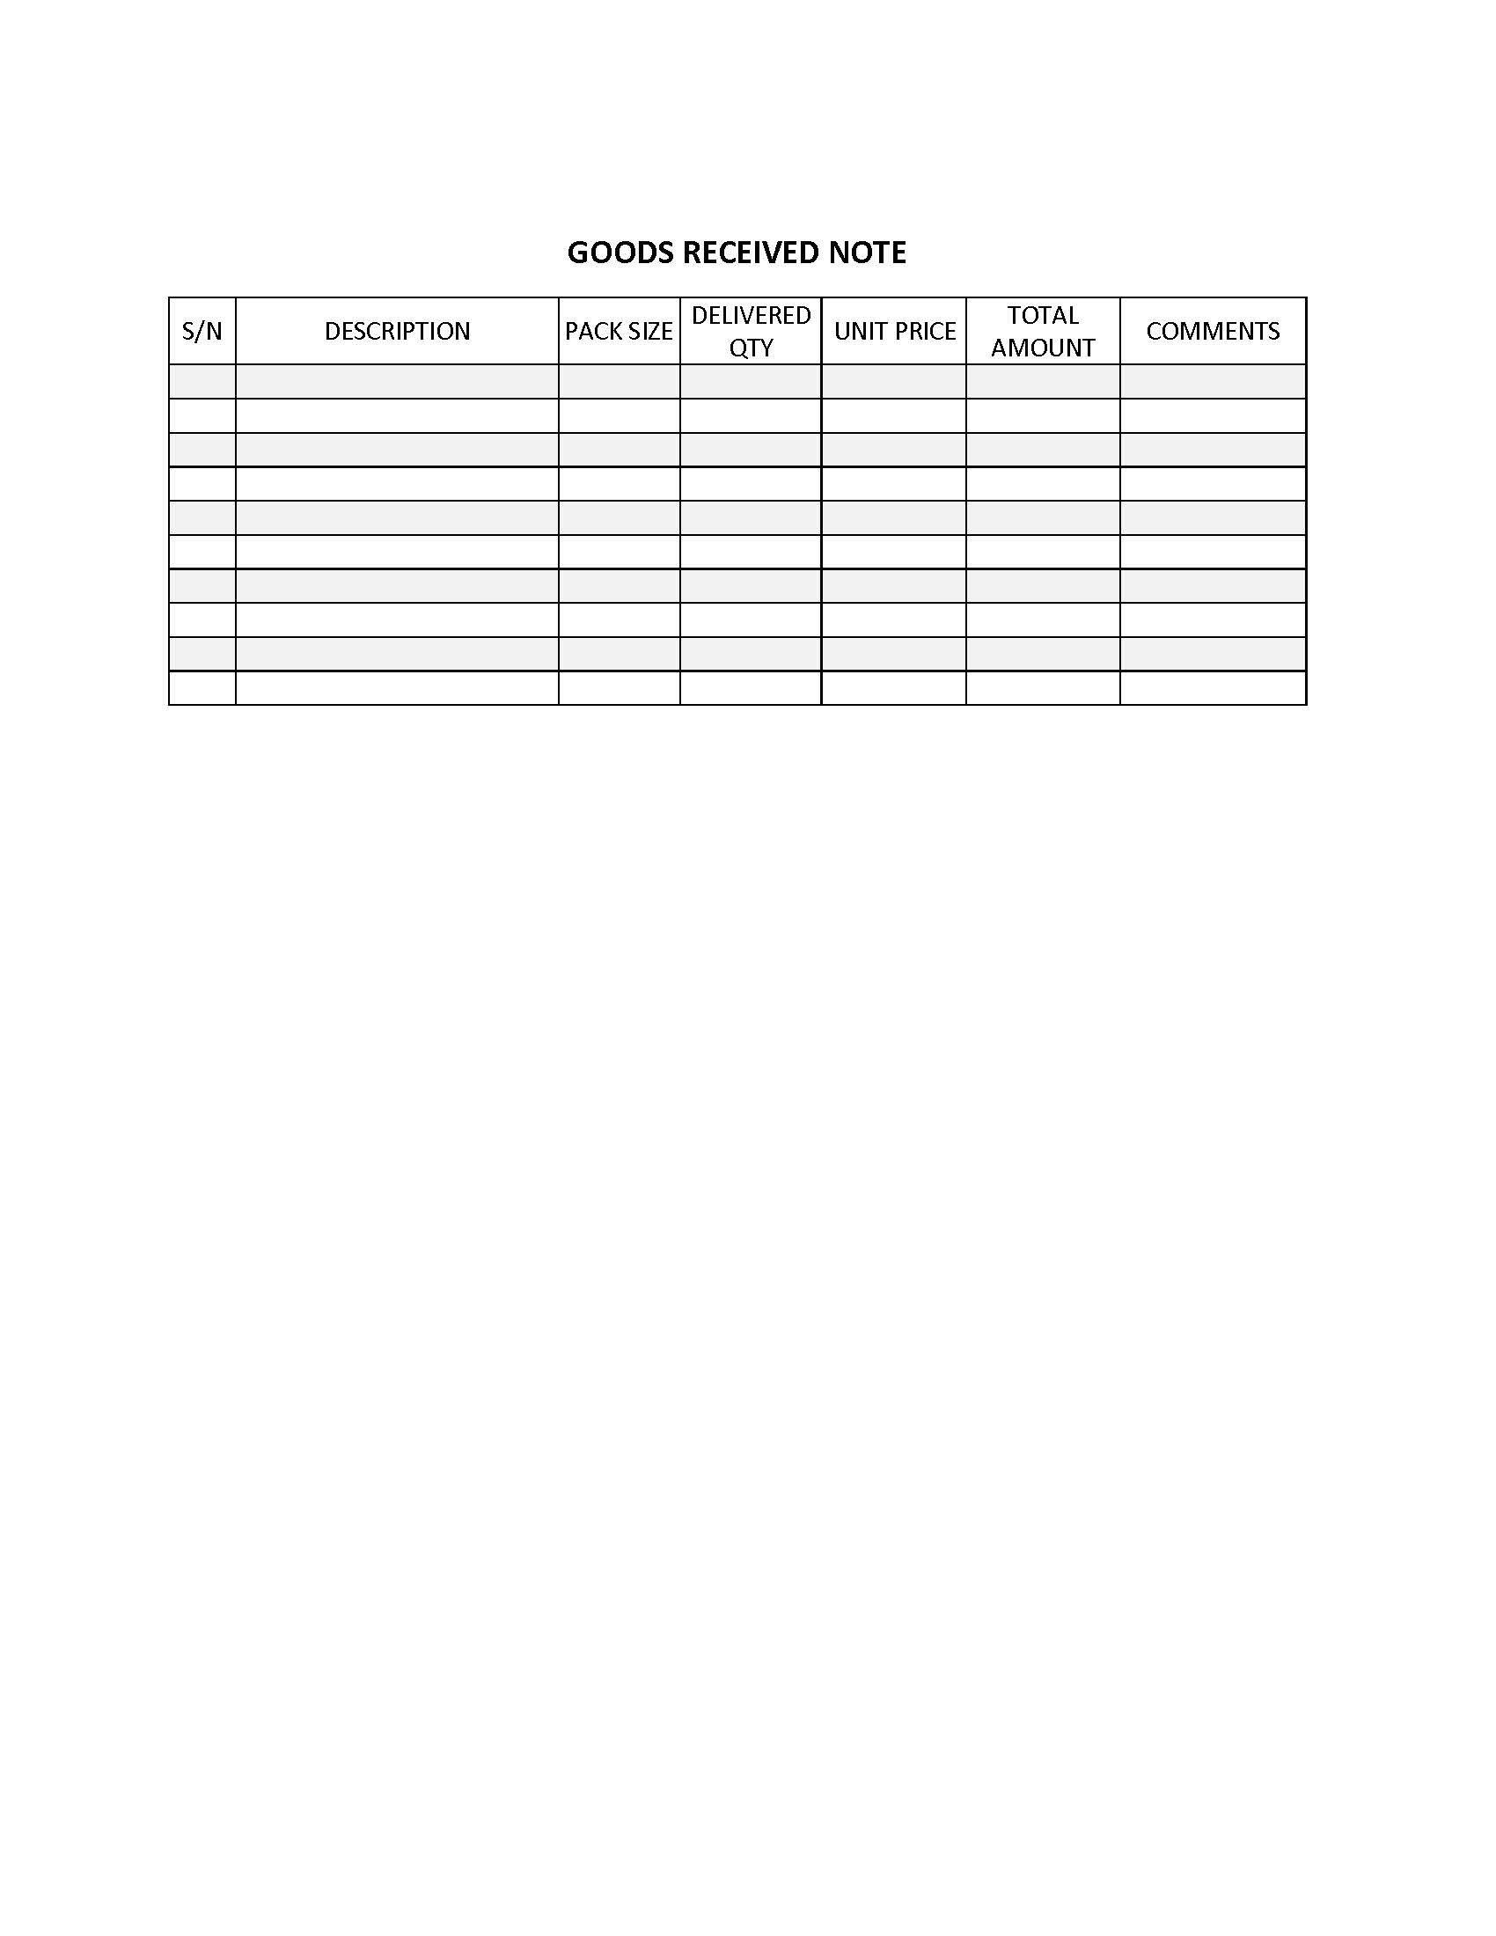
Goods Received Note

Slide 82
2. Maintaining stock records
Transfer the information from the Goods Received Note to the Stock Record Card.
Date each item received.
Enter only one transaction per line.

Slide 83
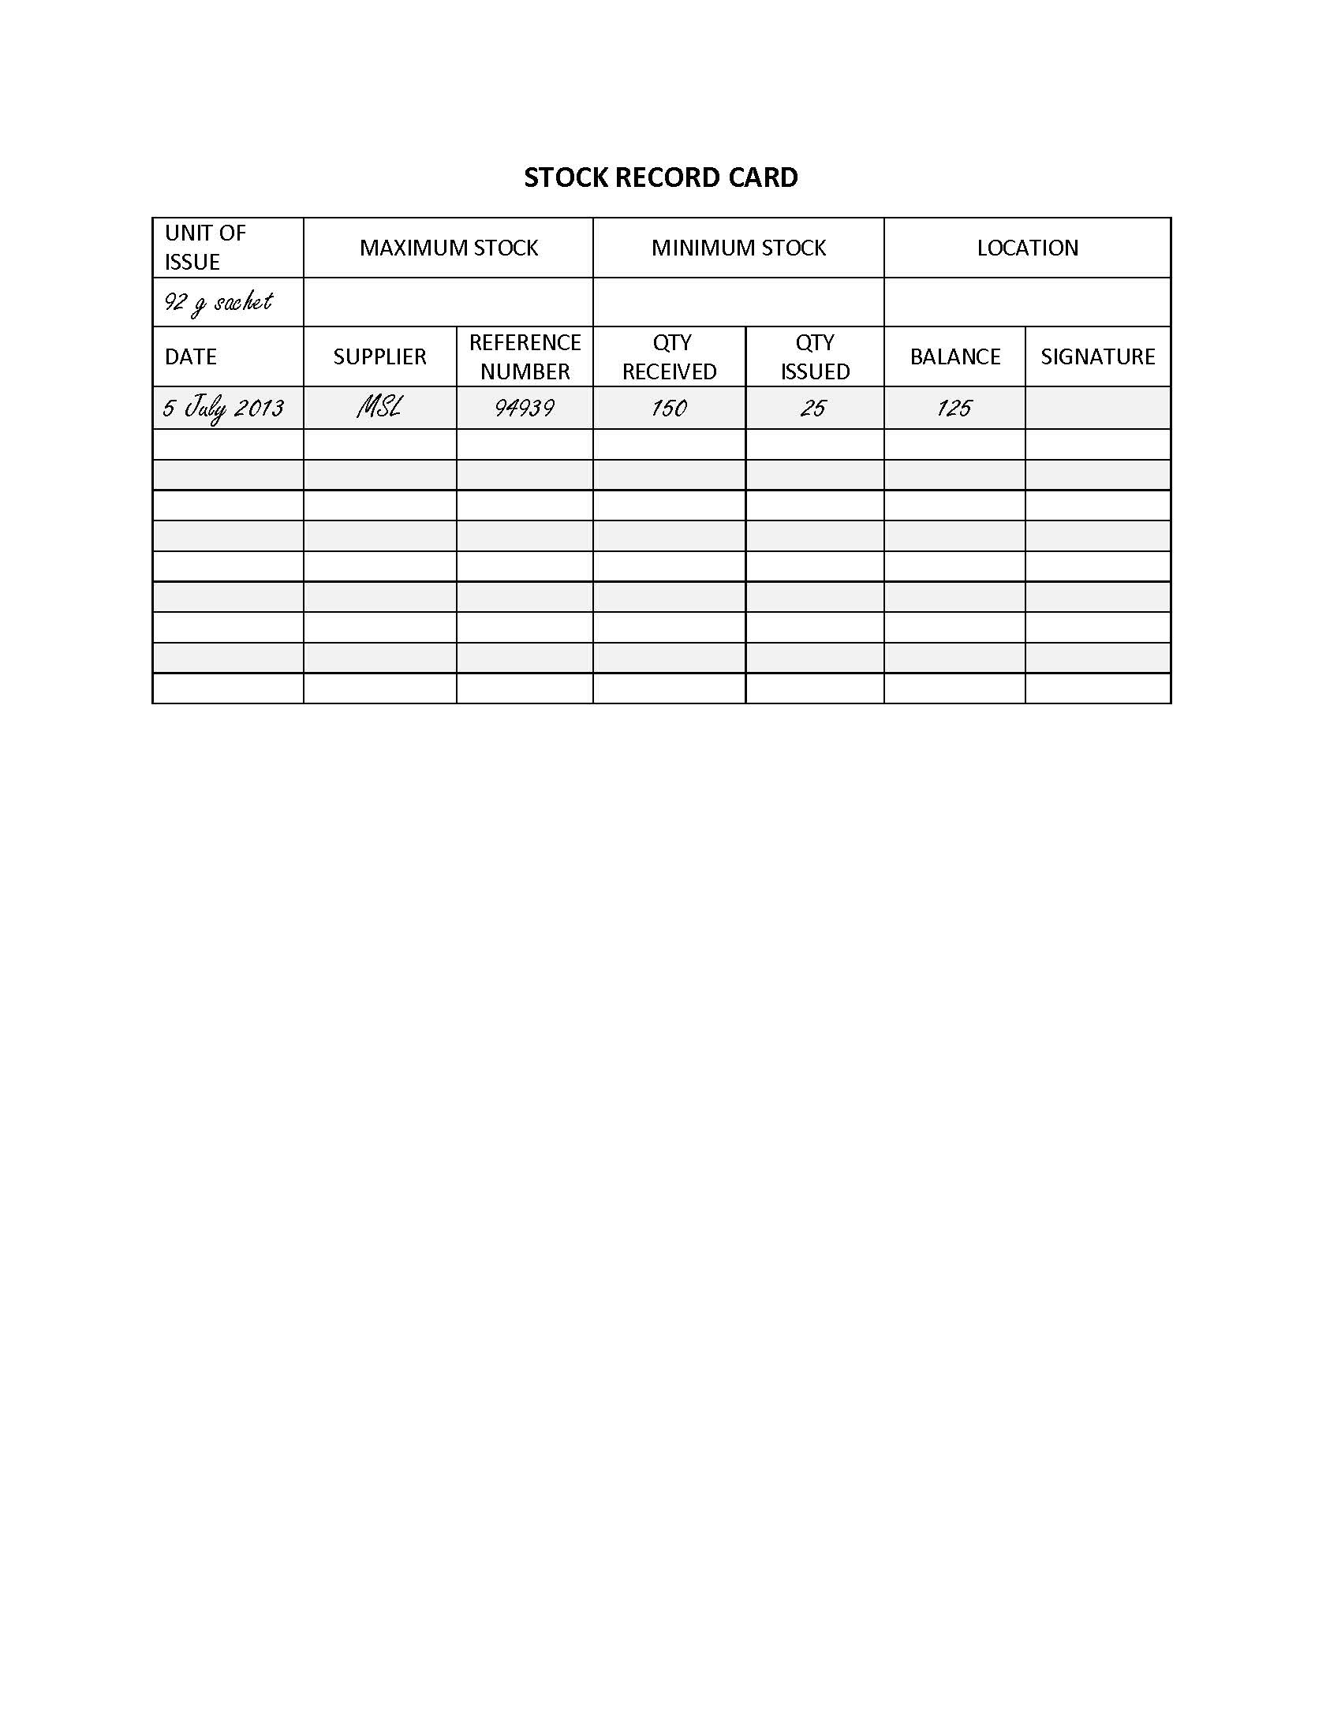
Sample Stock Record Card

Slide 84
3. Storing specialised food products (1)
Store products in a well-lit, ventilated room protected from damp and pests.
Store them away from chemicals, insecticides and other supplies.
Store them away from direct sunlight.
Keep them at least 10 cm off the floor on pallets and at least 30 cm away from the walls.

Slide 85
3. Storing specialised food products (2)
Store packets with arrows pointing up and expiry date and product name clearly visible.
Limit access to authorized people.
Use FIFO (first in/expired, first out): Put new stock behind existing stock and never use expired products.
Separate damaged/expired items for disposal.

Slide 86
4. Prescribing and dispensing specialised food products (1)
Give each malnourished client a Ration Card.
On each visit, record the kind and amount of specialised food products prescribed and dispensed on the card.
Ask the client or caregiver to bring the card back on each visit to collect the next ration.
On discharge, attach the card to the client’s file.

Slide 87
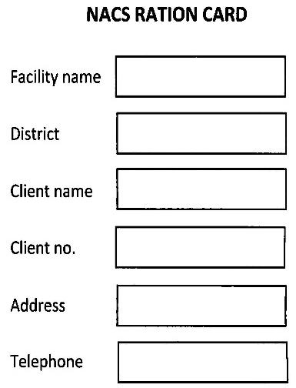
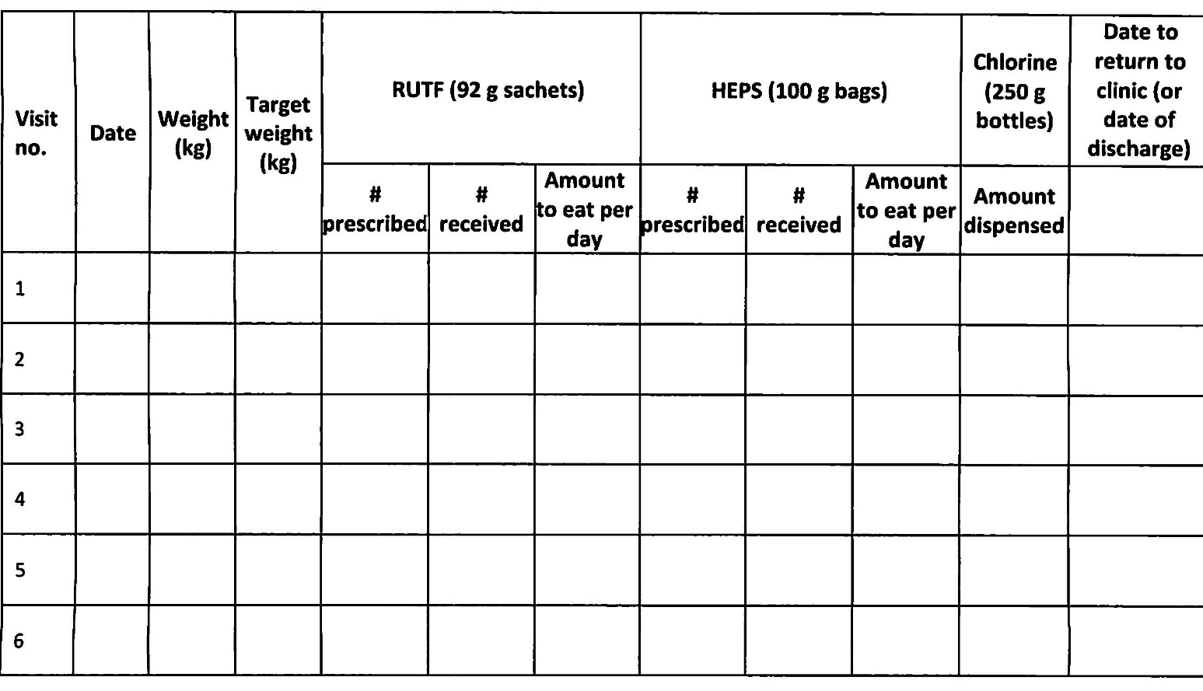
Sample Ration Card

Slide 88
4. Prescribing and dispensing specialised food products (2)
Record the amount prescribed and dispensed in the Master Beneficiary Register.

Slide 89
5. Reordering (1)
Use the Internal Requisition or Supply Voucher to order supplies.
Have it signed by the in-charge and counter-signed by the District Nutritionist.

Slide 90
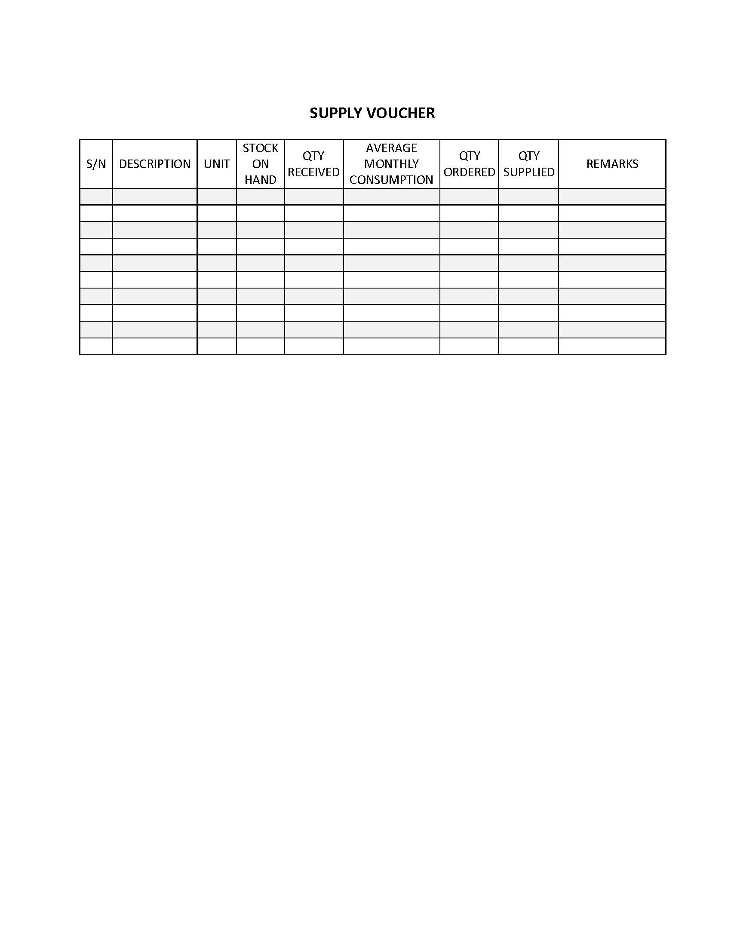
Supply Voucher

Slide 91
6. Disposing of specialised food products
Ask clients to take the empty packets back to the facility for disposal.
Inform the Environmental Health Team or District Council if any HEPS or RUTF is damaged or expired so they can dispose of it safely.

Slide 92
Session 10. Visit
to a Health Care Facility

Slide 93
Session objectives
By the end of this session, participants will have:
Assessed the quality and delivery of NACS services offered at the health facility visited
Discussed how to apply the knowledge and skills learned in this course in your workplaces

Slide 94
Purpose of health facility visits
To practice skills learned in this course in an actual clinic setting
To assess opportunities to implement/integrate nutrition interventions into broader health facility services

Slide 95
Instructions for health facility visits (1)
Observe the delivery and quality of NACS services in the health facility you visit.
What department did you observe?
What NACS services were provided?
Who does nutrition assessment in the health facility?
Who does nutrition counselling?
How is nutrition integrated into different services?

Slide 96
Instructions for health facility visits (2)
What nutrition messages, if any, did you hear health care providers give to clients? Were the messages correct?
What NACS data does the health facility collect?
What forms or registers does the facility use to collect NACS data?
Take anthropometric measurements of at least three clients. Record their weight; height; and either WHZ, BMI, BMI-for-age or MUAC.

Slide 97
Instructions for health facility visits (2)
Provide basic counselling based on the results and record the messages you gave.
What challenges did you find in doing nutrition assessment and counselling in the facility?
What challenges does the facility face in providing NACS services?
How does the facility address the challenges?
How do you think the facility could improve the quality of NACS services? (e.g., equipment, supplies, client flow, client follow-up, NACS record keeping and reporting …)

Slide 98
Group reports on health facility visits
  Challenges in applying NACS skills learned in training
  Challenges to integrating NACS into facility services (unique or similar to your workplaces?)
  Opportunities for improvement
  Changes needed to improve nutrition service delivery (e.g., client flow, client follow-up, NACS record keeping and reporting)
  Ways to address similar challenges in your workplaces

Slide 99
Session 11. Household
Food Security and Nutrition

Slide 100
Session objectives
By the end of this session, you should be able to:
Describe how HIV can affect household food security.
Describe how food insecurity can affect people with HIV.
Discuss how to help HIV-affected households improve food security.

Slide 101
What is food security?
All people at all times have sufficient, safe and nutritious food that meets their needs for an active and healthy life.
Availability–Enough nutritious food at all times
Access–Enough money to buy nutritious food
Utilisation–Ability to use nutrients properly
Stability–Bad weather, political instability, unemployment and rising food prices do not threaten the other three components

Slide 102
How food insecurity
affects nutrition (1)
People who don’t have enough money to buy or cannot grow nutritious food can become malnourished.
Food-insecure people may use risky behavior (e.g., selling sex or migrant work) that make them more vulnerable to HIV and wasting.
Widows and orphans may be forced from their homes or land.

Slide 103
How food insecurity
affects nutrition (2)
People who have been treated for malnutrition may become malnourished again.
Worry increases stress, affecting the immune system.
People may have to choose between spending money on food or on health care.

Slide 104
Ways to improve food security
Support for agriculture or small enterprises
Support for vegetable gardening and orchards
Promotion of chicken or rabbit rearing
Labour-saving technologies such as efficient cooking stoves
Teaching people how to preserve and store food (e.g., dried pumpkin leaves, dried mangos) for future use
Community savings and loan groups

Slide 105
Session 12.
Health Facility-Community Linkages

Slide 106
Session objectives
By the end of this session, you should be able to:
Explain why it is important to follow up malnourished clients to ensure they recover from malnutrition and are not lost to follow-up.
Refer clients to medical or community support services.
Receive clients needing medical care referred from the community.

Slide 107
Group activity
      What systems do your health facilities have to facilitate links with catchment communities?
      What support services do you refer clients to?
      What challenges do you face in linking clients to community support services?
      How could you address those challenges?

Slide 108
Ways to increase
NACS access and uptake
Health education on the importance of nutrition and signs and consequences of malnutrition
Home visits, counselling, food demonstrations
Improved integration of NACS into key health service delivery points
Nutrition information provided to local leaders and media
Community outreach

Slide 109
Aims of community outreach
Increase understanding of NACS services in communities.
Strengthen case-finding and referral of malnourished people.
Increase coverage and strengthen follow-up of defaulters.
Link prevention and treatment of malnutrition.

Slide 110

What is continuum of care?
Comprehensive care from the health facility to the home to link:
Prevention
Treatment
Follow-up

Slide 111
What is community or home-based care?
Care and support outside health facilities for people with prolonged illness and their families

Slide 112
Community nutrition actions
Measure MUAC, check growth cards and assess for bilateral pitting oedema.
Demonstrate how to make nutritious meals and make food and water safe.
Demonstrate how to use specialised food products.
Counsel on dietary management of symptoms and medication side effects.
Counsel on infant and young child feeding and eating a mixed diet.
Refer clients to health facilities or to economic strengthening and food security support.

Slide 113
Client follow-up
When does client follow-up begin?
When the client and health care provider agree on a return date
When does client follow-up end?
When the client recovers, moves or dies
What should be done on a follow-up visit?
Assess the client’s nutritional status
Agree on a goal to work toward before the next visit.

Slide 114
What is client referral?
Sending or directing a client to services or care not provided at the current contact point

Slide 115
Conditions that require referral
Severe acute malnutrition with complications
Medical conditions such as severe vomiting, dehydration, anaemia, high fever, convulsions, hypothermia or opportunistic infections
Psychiatric conditions (depression, stress)
Food insecurity
Lack of knowledge of HIV status
HIV-positive pregnancy

Slide 116
Session 13. NACS Data Collection and Reporting

Slide 117
Session objectives
By the end of this session, you should be able to:
Explain the purpose of collecting NACS data.
Understand NACS indicators.
Describe NACS monitoring and reporting requirements.
Complete data collection and reporting forms accurately.
Interpret nutrition data.

Slide 118
Purpose of NACS data collection
To assess client eligibility for specialised food products
To evaluate client progress
To report on work done
To monitor stocks and resources
To inform other services of client needs
To evaluate the impact of policies and services
To improve services

Slide 119
NACS indicators
# of clients who received nutrition assessment
# of clients who were assessed and received nutrition counselling
# of malnourished clients
# of malnourished clients who received specialised food products

Slide 120
Session 14. NACS Action Plans

Slide 121
Session objective
By the end of this session, you should be able to:
Describe MOH and MOCD expectations regarding NACS implementation and reporting.
Make an action plan to integrate NACS into or strengthen NACS in routine health services.

Slide 122
Instructions
Drawing from what you have learned in this training, decide what you can do to integrate or strengthen NACS services in your workplace.
Develop an action plan for what you will do:
  Immediately
  In the next 6 months
Present your plan in plenary.

Slide 123
Session 15. Post-test
and Course Evaluation

Slide 124
Objectives
By the end of this session, participants will:
Compare expectations to the course objectives.
Complete a post-course assessment
Evaluate the course.

Slide 125
Course objectives
Give participants the knowledge and skills to:
Advocate for and discuss the role of nutrition in care and treatment of people with HIV.
Assess clients’ nutritional status.
Counsel clients on prevention and management of malnutrition.
Prescribe specialised food products and provide other support to malnourished clients.
Monitor and report on NACS services.

