Slide 1
Malnutrition: Uganda Is Paying Too High a Price
Uganda PROFILES Part C
Notes:
Even though we have made some progress over the years, malnutrition in Uganda remains high. Malnutrition affects millions. It kills women, babies, and children. It affects education achievements. It costs the government and families enormous amounts of money to treat related illnesses and significantly affects the economic productivity of this nation. Its price is just too high for us to neglect.

Slide 2
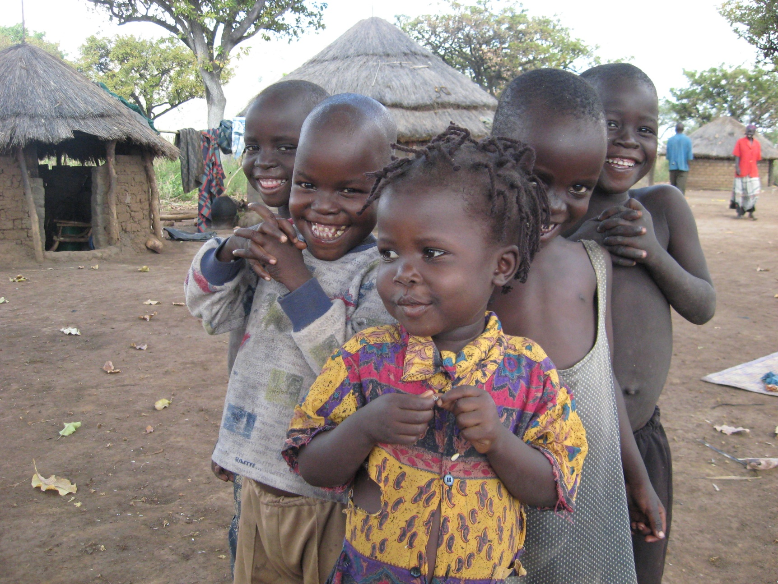
We Can Change the Situation!
Alex Mokori/ RCQHC
Notes:
I want to say that we can change the situation!!! We have made significant strides and we can accelerate the achievements in order to draw the benefits of good nutrition. We are accountable on behalf of many children that experience disease and suffering and that die every day in Uganda due to easily preventable malnutrition. We are accountable for the lost productivity and the high costs we incur every day due to malnutrition. We are accountable for the mental retardation and reduced learning capability of our children associated with malnutrition.
We need to prevent early childhood malnutrition. We need to increase our commitment to preventing all forms of malnutrition in this country. We have done well in reducing poverty, in reducing HIV, in genderizing our development agenda. We can. How?

Slide 3
Benefits to the Poor
AND to the Nation
$
Savings from treating malnutrition-related illnesses
Economic value of increased productivity
$
Notes:
By investing in nutrition programming, about US$7 per child per year, Uganda will save money by treating ailments associated with malnutrition, but will also harvest sustainable economic benefits in terms of increased productivity.

Slide 4
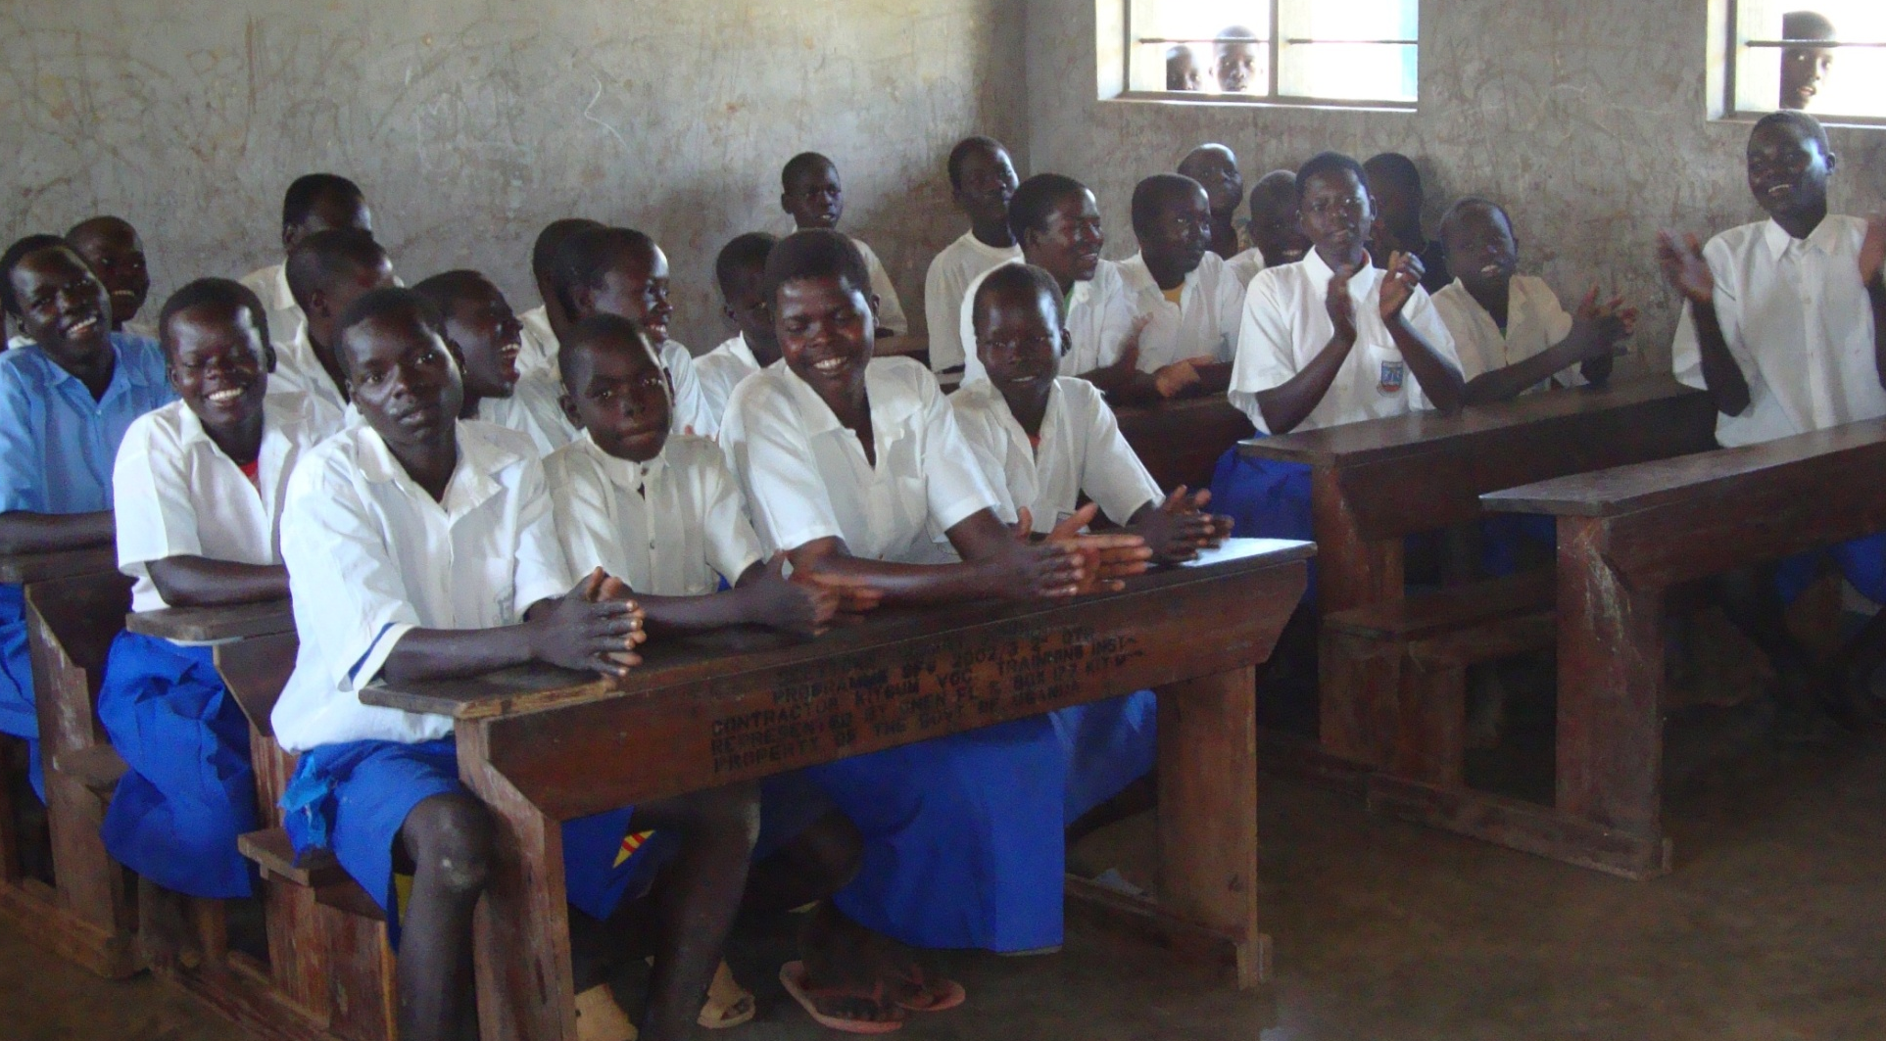
Improved Ability to
Compete in the World
Richard/UHCA
Notes:
Every child availed of their intellectual potential will receive a gift as they are sent off into the world to successfully compete and be proud to be Ugandans.

Slide 5
Fewer Child and Maternal Deaths among the POOR
Deaths
Prevented
R.I.P
Notes:
Every death averted is a benefit to that family, that community, and to this nation.

Slide 6
A Price Too High to Ignore!
UNICEF/Pirozzi
Notes:
Not acting now is a message to the children and women of this country that we are willing to pay the high price of malnutrition. We cannot neglect this message. ‘Malnutrition in Uganda is a price too high to neglect’.
Thank you for your time, ladies and gentlemen.

Slide 7
This training presentation is made possible by the generous support of the American people through the support of the Office of Health, Infectious Diseases, and Nutrition, Bureau for Global Health, U.S. Agency for International Development (USAID) and USAID/Uganda, under terms of Cooperative Agreement No. AID-OAA-A-11-00014, through the FANTA-2 Bridge, managed by FHI 360. The contents are the responsibility of FHI 360 and do not necessarily reflect the views of USAID or the United States Government. March 2012

