Slide 1
Malnutrition: Uganda Is Paying Too High a Price
Uganda PROFILES Part B
UGANDA PROFILES 2012
Notes:
Ladies and gentlemen, thank you for the opportunity to share our thoughts about the consequences of malnutrition in Uganda. We have made progress in reducing poverty and other fronts over the years, but malnutrition still ravages our country, affecting millions of Ugandans. It especially kills women, babies, and children. It impairs educational achievement and economic productivity. It costs the government and families enormous amounts of money to treat related illnesses. The price of malnutrition is just too high to ignore.

Slide 2
Impact of Malnutrition on the National Development Plan (NDP)
Malnutrition in Uganda affects:
Agricultural productivity and value addition
Disease and survival
Human capacity development
Notes:
To help us look at how these high levels of malnutrition may affect the National Development Plan, or NDP, we used a computer program called PROFILES. We used Uganda’s national nutrition data and population patterns to estimate the impact of malnutrition on the three pillars of the NDP:
Agricultural productivity and value addition
Disease and survival
Human capacity development

Slide 3
Impact on Agricultural Productivity
Alex Mokori/RCQHC
Notes:
The agriculture sector employs 85 percent of Uganda’s labour force. About 75 percent of the agriculture labour is provided by women on smallholder farms, where, according to the Agriculture Development Investment Plan, productivity is still a major challenge.
Physical productivity is critical to agricultural productivity, but it is weakened by malnutrition, especially iron deficiency anaemia in adulthood and stunting in early childhood.

Slide 4
Iron Deficiency Anaemia and Agriculture
Iron deficiency anaemia costs Uganda US$34 million worth of productivity each year, or 0.4% of the GDP.
Alex Mokori/RCQHC
Notes:
Uganda lost about US$34 million worth of productivity in 2009 because of iron deficiency anaemia among adults. Women of reproductive age with anaemia accounted for 75 percent, or US$25 million, of that loss. The total loss was estimated at about 0.4 percent of the gross domestic product, or GDP.

Slide 5
Childhood Stunting and Agriculture
Uganda loses US$210 million worth of productivity each year because of childhood stunting.
Alex Mokori/RCQHC
Notes:
Stunting in early childhood affects productivity in adulthood. For every 1 percent that the height of a child under 2 years of age is below the norm, the child’s productivity from manual labour as an adult declines by 1.4 percent. In 2009, Uganda lost about US$210 million in future productivity from childhood stunting.
These two conditions alone (iron deficiency anaemia and stunting) are associated with productivity loss of about US$290 million per year. When low birth weight and iodine deficiency disorders are included, the loss grows to US$310 million, or 4.1 percent of the GDP. And this does not even include the productivity lost when agriculture workers take time off to deal with malnutrition-related illnesses or deaths in their families. Clearly, the costs of malnutrition are just too high for the agriculture sector to ignore.

Slide 6
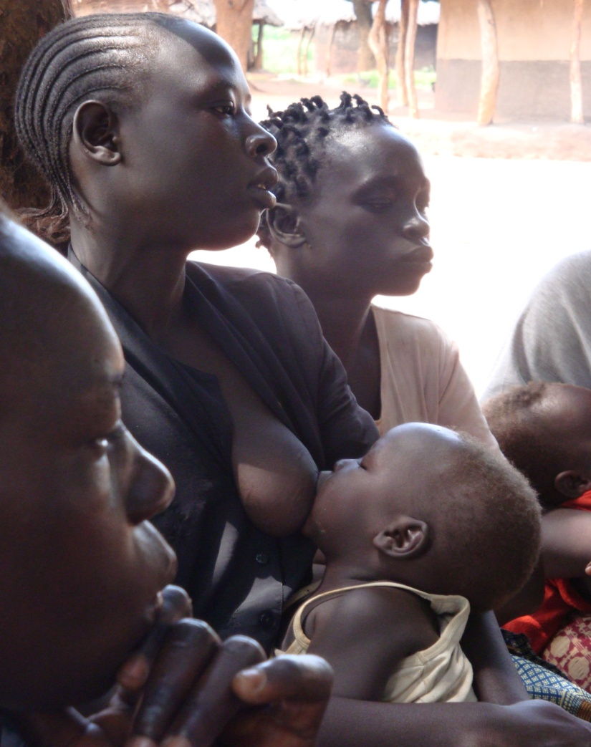
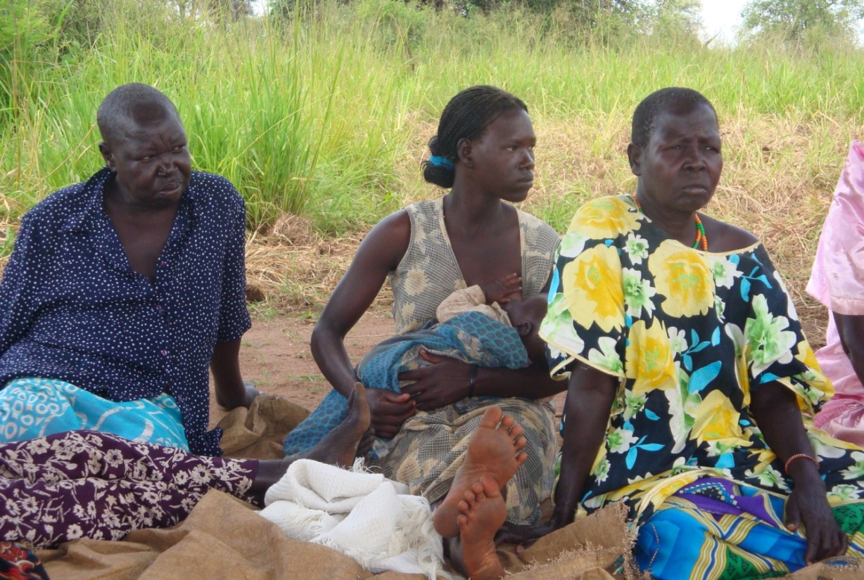
Impact on Disease and Survival
Brenda S. Namugumya/RCQHC
Notes:
Malnutrition kills, causes disease, and makes disease even more severe. The high levels of malnutrition in Uganda cost the government and families millions of dollars per year to treat diseases that are preventable.
Let’s look at how specific types of malnutrition—low birth weight and iron deficiency anaemia—affect the health and survival of Uganda’s children and mothers. We will also examine the health and economic benefits of breastfeeding.

Slide 7
Impact of Low Birth Weight (LBW)
More than 170,000 children weighed less than 2.5 kg at birth (LBW) .
16,000 children died due to LBW.
LBW costs the government and families about US$5.8 million for specialised health care.
Brenda S. Namugumya/RCQHC
Brenda /RCQHC
Notes:
Malnutrition in Uganda starts in the mother’s womb. In 2009, more than 170,000 babies were born with low birth weight, meaning they weighed less than 2.5 kg. This puts them at higher risk of malnutrition, disease, and death. Children with low birth weight are four times more likely to die in the first month of life than other children.
Had all these children been born in government facilities, it would have cost the government and families about US$5.8 million to keep them alive. Unfortunately, most children are not born in health facilities and therefore do not receive specialised, life-saving care.
About 16,000 children with low birth weight died in Uganda in 2009. Most of these children were born to teenage mothers or mothers that have births too close together. Most of these mothers were malnourished or sickly during pregnancy.

Slide 8
Impact of Vitamin A Deficiency
Children with vitamin A deficiency face a higher risk of dying from childhood illnesses.
Brenda S. Namugumya/RCQHC
Notes:
Vitamin A deficiency, which affects mainly women and children in Uganda, increases the risk of blindness and the risk and severity of disease, mainly diarrhoea and acute respiratory infections in children. Children with vitamin A deficiency are 1.4 times more likely to die of these and other childhood illnesses than ones that are not deficient. In 2009, 15,800 children died because of vitamin A deficiency.

Slide 9
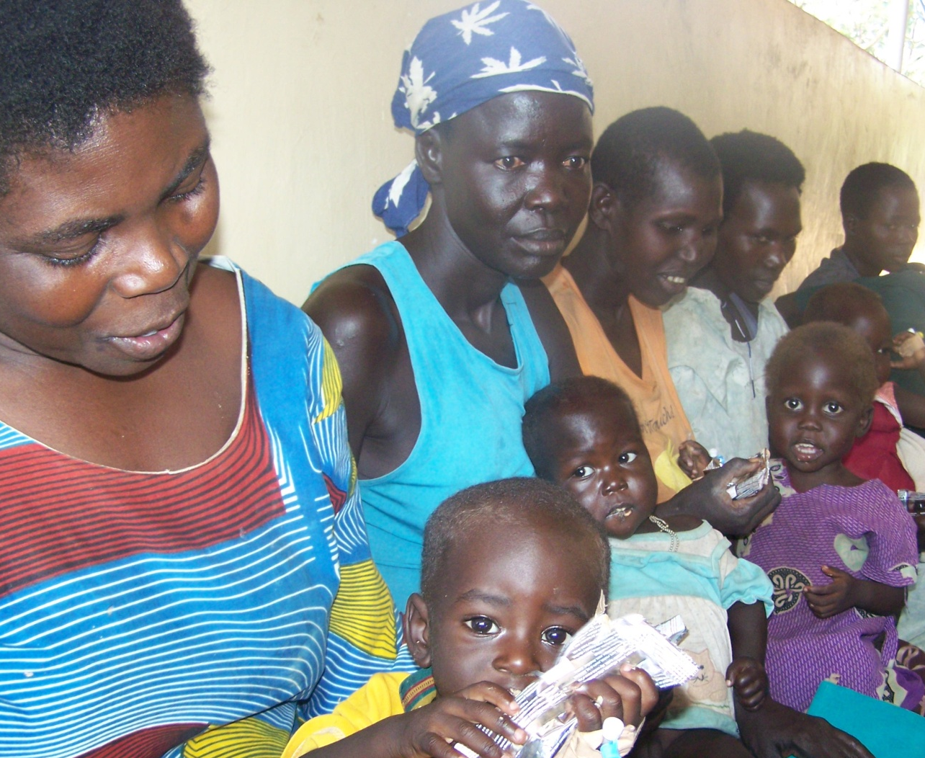
Impact of Childhood Underweight
Linked to 43% of deaths in children under 5
51,300 children died due to underweight in 2009
Vicky Wandawa/NewVision
Notes:
In Uganda, underweight contributes to 43 percent of the deaths of children under 5. In 2009, 51,300 children died because of underweight, about 140 deaths each day.

Slide 10
Malnutrition’s Tragic Toll: 83,300 Children Dead in 2009
R.I.P.
R.I.P
15,800 deaths due to vitamin A deficiency
16,200 deaths due to LBW
51,300 deaths due to underweight
R.I.P
Notes:
Malnutrition in all its forms is linked to 60 percent of child deaths in Uganda. Every day, some 230 families lose a child because of low birth weight, vitamin A deficiency, or underweight.

Slide 11
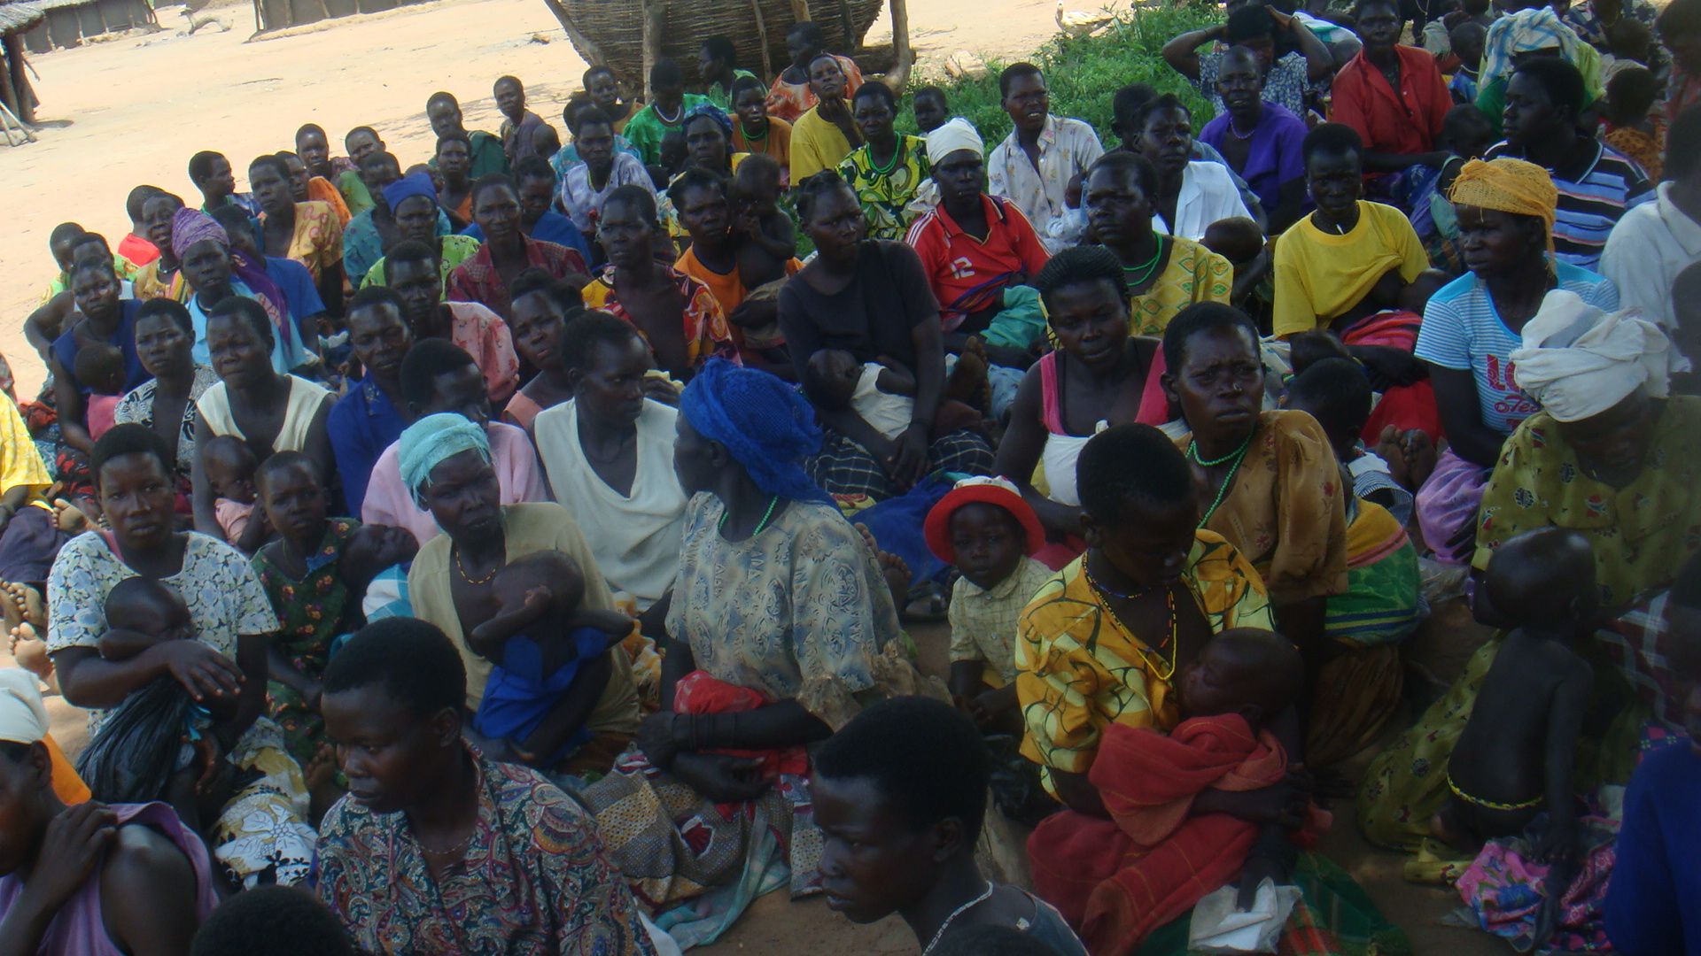
Malnutrition’s Toll on Mothers (2006–2015)
15,000 Maternal Deaths Due to Anaemia!
Alex Mokori/RCQHC
Notes:
The women of Uganda contribute significantly to the economic and social well-being of our country. But women are also very vulnerable to malnutrition. Nearly 12 percent of women were underweight in 2006. Mothers in particular are highly vulnerable. 17 mothers die every day in Uganda, and four of these deaths are associated with iron deficiency anaemia. And, between 2006 and 2015, iron deficiency anaemia will kill about 15,000 mothers, many of whom will leave behind orphaned children that are vulnerable to death and disease.

Slide 12
Economic Benefits of Breastfeeding
Breastfeeding children from birth through 24 months of age saves Uganda US$1.1 billion every year.
Brenda S. Namugumya /RCQHC
Notes:
Despite the health benefits of breastfeeding children from birth through 24 months of age, the average duration of breastfeeding in Uganda fell to 19.6 months in 2006 from 22.5 months in 2000 to 2001. This decline indicates that infants and young children are not receiving breast milk as they should and/or that families have to spend scarce resources to buy substitute foods for their children.
Breastfeeding also has economic benefits. Breastfeeding children from birth through 24 months saves Uganda US$1.1 billion every year.

Slide 13
Impact on Human Capacity Development
Alex Mokori/ RCQHC
Notes:
Quality human capacity is essential to economic development in Uganda, and the NDP noted the importance of strengthening the education sector to improve our economic productivity and quality of life. However, malnutrition undermines our efforts to improve education in Uganda, as well as the intellectual potential of our children. For example:
Children that are malnourished from an early age have a slower brain growth, lower IQ, learning difficulties or delays, and less success in school.
Children with growth impairment tend to enrol in school late. They also are more likely to drop out of school and less likely to continue to higher education.
Malnutrition contributes to Uganda’s poor primary school completion rate, which was only 56 percent in 2008.
Iodine deficiency disorder, growth impairment, and iron deficiency anaemia are the main culprits.

Slide 14
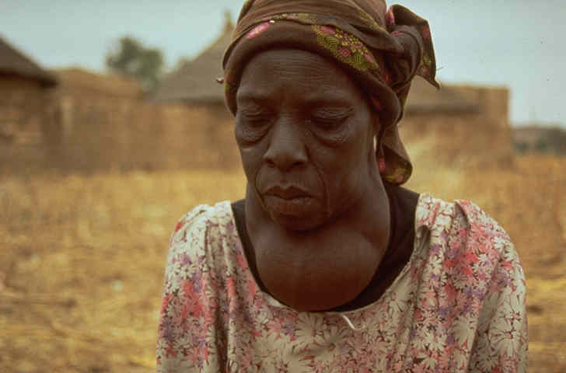
Iodine Deficiency and Education (2009)
2,100 children born as cretins
59,000 born with mental impairment
Permanent!
US$8.6 million worth of productivity lost
UNICEF/95-0065 Shadid
Notes:
Iodine deficiency disorder, or IDD, is the single most common cause of preventable mental impairment, brain damage, and physical disabilities among children in Uganda. Women with IDDs give birth to children with reduced ability to learn, lower school performance, higher rates of school-age repetition, and poor speech and hearing ability. What is especially tragic is that the effects of iodine deficiency are permanent. Because of IDD, in 2009 alone:
2,100 children were born as cretins in Uganda and likely will require 100 percent care their entire lives
59,000 children were born with mild or moderate mental disabilities
Uganda lost US$8.6 million in productivity
In addition, between 2006 and 2015, 19,300 children will be born as cretins and 543,000 will be born with mild to moderate forms of mental impairment. Most of these children are from the mountainous parts of the country. There are many homes in some parts of western Uganda where households do not use iodized salt and instead use local mined salt. More awareness is still needed in these areas.

Slide 15
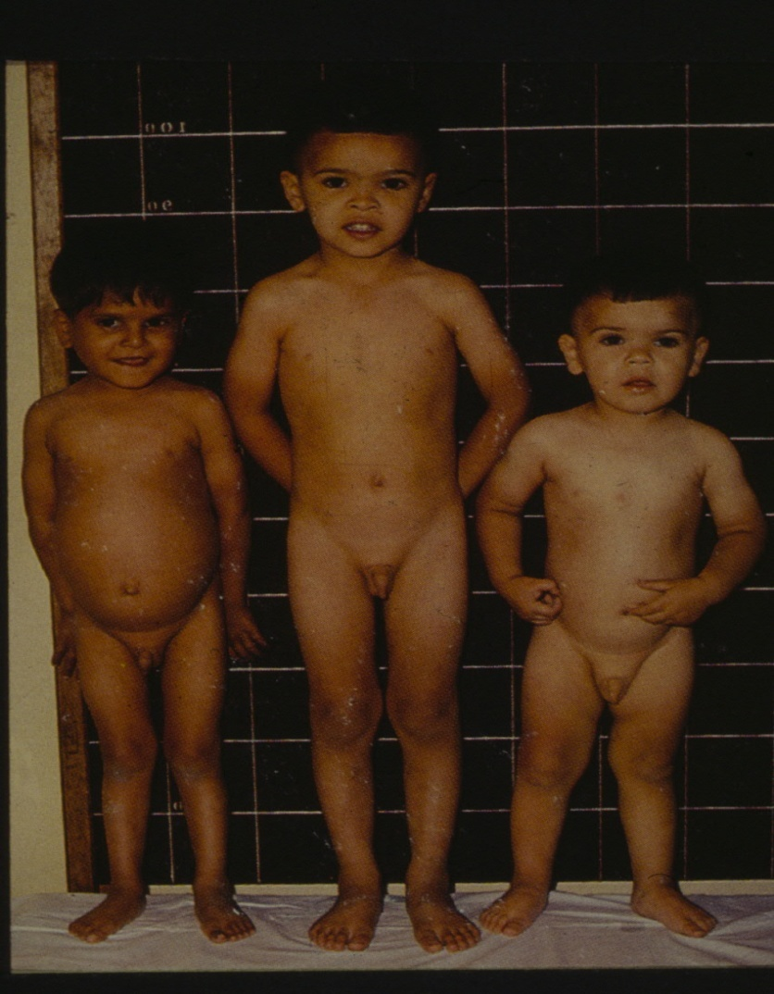
Growth Impairment (Stunting) and Education (2009)
Start school later
Absenteeism is high
School performance is poor
School-year repetition is high
Stunted children tend to start school later, repeat classes, and are less productive in adulthood
Photo: Ricardo Uauy
7 years 7 years 4 years
Notes:
Growth impairment in early childhood, especially stunting, is directly or indirectly associated with lower grade performance and repetition of school years. These effects are over and above those of poverty and lack of food at older ages.
Stunted children are more likely to enter school later than other children because they look too short for their age. Children should start school by age 6, but about 30 percent of them start school late, despite the availability of free primary education through the Universal Primary Education programme.
Stunted children also have higher rates of absenteeism and school-year repetition.

Slide 16
Iron Deficiency Anaemia and Education
Ability to learn
Concentration in school
Retention rates
School performance
Speech and hearing ability
UNICEF/Pirozzi
Notes:
Iron deficiency anaemia during infancy and early childhood impairs the cognitive abilities of about 8.8 million school-age children in Uganda. The number of affected children jumped from 5 million in the past decade due to an increase in anaemia cases in the country. Specifically, anaemia affects:
The ability to learn new concepts
Concentration in school
Retention rates
School performance
Speech and hearing
In addition, other forms of malnutrition, like vitamin A deficiency, worsen school absenteeism by increasing the risk and severity of the infectious diseases that keep children out of the classroom.
Malnutrition and disease reduce the time children are in school and impair their learning when they are in school. This has major implications for Uganda’s education effort and the investments we are making in it.

Slide 17
This training presentation is made possible by the generous support of the American people through the support of the Office of Health, Infectious Diseases, and Nutrition, Bureau for Global Health, U.S. Agency for International Development (USAID) and USAID/Uganda, under terms of Cooperative Agreement No. AID-OAA-A-11-00014, through the FANTA-2 Bridge, managed by FHI 360. The contents are the responsibility of FHI 360 and do not necessarily reflect the views of USAID or the United States Government. March 2012

