Slide 1

Multi-Sectoral Nutrition Coordination
Committee Orientation for
Local Governments
Nutrition Secretariat
Office of the Prime Minister
July 2017

Slide 2
Outline
Opening and Introductions
Orientation Objectives
Unit 1: The Nutrition Situation in Uganda and Policy Environment for Addressing Malnutrition
Unit 2: Roles of and Linkages between Nutrition Coordination Committees, Technical Planning Committees, and Councils
Unit 3: Nutrition Coordination Committee Monitoring and Reporting
Unit 4: Action Plan to Operationalise Nutrition Coordination Committees
Multi-Sectoral Nutrition Coordination Committee Orientation
•
2

Slide 3
Opening and Introductions
Multi-Sectoral Nutrition Coordination Committee Orientation
•
3

Slide 4
Participant Introductions
Please introduce yourself:
Name
Title and District/LLG/Organisation
Explain how nutrition is important to
you and your work
Multi-Sectoral Nutrition Coordination Committee Orientation
•
4

Slide 5
Orientation Objectives
Have an enhanced understanding of the nutrition situation in Uganda
Be able to explain the policy environment for nutrition and the Uganda multi-sectoral nutrition coordination framework
Have improved understanding of the composition, roles and responsibilities of NCCs at local government level
Understand the roles of councils and TPCs in nutrition governance
Understand the linkages between NCCs, TPCs, and councils
Understand the criteria for measuring functionality of NCCs
Understand NCC monitoring and reporting on coordination of multi-sectoral nutrition interventions
Develop an action plan to operationalise NCCs at local government level together with partners
Multi-Sectoral Nutrition Coordination Committee Orientation
•
5

Slide 6
Participant Expectations
On the provided cards, write one expectation you have about the orientation:
Keep in mind the following rules:
One thought per card
Use a marker, not a pen
No more than three lines per card
Print legibly
Multi-Sectoral Nutrition Coordination Committee Orientation
•
6

Slide 7
UNIT 1
The Nutrition Situation in Uganda and Policy Environment for Addressing Malnutrition
Multi-Sectoral Nutrition Coordination Committee Orientation
•
7

Slide 8
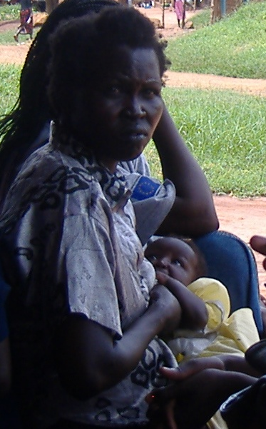
Session 1.1
Nutrition
Situation
in Uganda
Photo: Namugumya, (Regional Center for Quality Health Care (RCQHC)
Multi-Sectoral Nutrition Coordination Committee Orientation
•
8

Slide 9
What Is Malnutrition?
Malnutrition: People are malnourished if their diet is not balanced with their nutritional needs.
Two main categories:
  Undernutrition
    Acute malnutrition (thinness)
    Chronic malnutrition (poor growth)
    Micronutrient deficiency
  Overnutrition
    Overweight
    Obesity
Multi-Sectoral Nutrition Coordination Committee Orientation
•
9

Slide 10
Malnutrition
Undernutrition
Overnutrition
Acute malnutrition
Micronutrient deficiencies
Chronic (stunting)
Moderate acute malnutrition (MAM)
Vitamin A, iron, iodine, zinc
Moderate stunting
Overweight
Severe acute malnutrition (SAM)
Severe stunting
Obesity
Multi-Sectoral Nutrition Coordination Committee Orientation
•
10
Notes:
People are malnourished if their diet is not balanced with their nutritional needs.
Undernutrition: Undernutrition is a consequence of a deficiency in nutrient intake and/or absorption in the body. The different forms of undernutrition, which can appear alone or in combination, are acute malnutrition (bilateral pitting oedema and/or wasting), chronic malnutrition (stunting), underweight (combined form of wasting and stunting), and micronutrient deficiencies.
Overnutrition: Overnutrition happens when a person’s daily energy intake consistently exceeds energy requirements. If this continues over time, a person may become overweight or obese.
Underweight: A composite form of undernutrition that includes elements of stunting and wasting and is defined by a weight-for-age of more than 2 standard deviations below the median WHO Growth Standard. This indicator is commonly used in growth monitoring and promotion (GMP) and child health and nutrition programmes aimed at prevention and treatment of undernutrition.

Slide 11

Examples of Undernutrition: Stunting
Both girls are the same age.
The girl on the left is stunted (short stature for age).
Multi-Sectoral Nutrition Coordination Committee Orientation
•
11
Notes:
Here we show an example of chronic malnutrition or stunting. These girls are the same age, but the girl on the left is stunted due to poor nutrition.
Stunting: Stunting, or chronic malnutrition, occurs when a child fails to grow at a healthy pace and is shorter than expected for a healthy child of the same age. Stunting develops over a long period because of long-term inadequate nutrition (including poor maternal nutrition and poor infant and young child feeding practices) and/or repeated illness or infection. Stunted children have a higher risk of death from diarrhoea, pneumonia, and measles. Stunting is associated with poor cognitive and motor development and lower school achievement. It is defined by a height-for-age of more than 2 standard deviations below the median WHO Growth Standard.

Slide 12
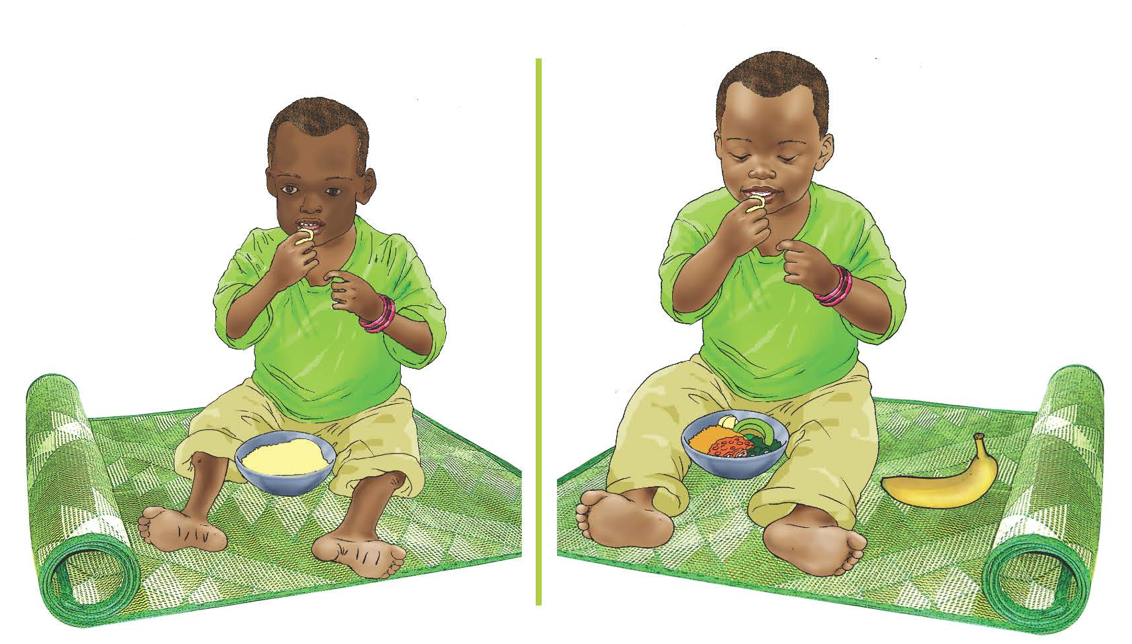
Examples of Undernutrition: Wasting
The child on the left is undernourished (wasting).
Multi-Sectoral Nutrition Coordination Committee Orientation
•
12
Notes:
Here we show images of some examples of undernutrition. You see an example of acute malnutrition in the form of wasting. Acute malnutrition has two categories: severe acute malnutrition (SAM), which can be treated either through inpatient care or outpatient care, depending on the severity and the presence of other medical complications – and moderate acute malnutrition (MAM), which can be treated through outpatient care and/or supplementary feeding programs (SFP).
Wasting: This occurs when an individual is very thin for his or her height. It happens when a person loses weight rapidly or a growing child does not gain adequate weight relative to their growth in height. Wasting may be caused by inadequate food intake, such as a drop in food consumption or sub-optimal infant and young child feeding practices; by disease or infection, including HIV or tuberculosis; or a combination. It is defined as weight-for-height of more than 2 standard deviations below the median WHO standards or MUAC under 125 mm. Wasting is one form of acute malnutrition.

Slide 13
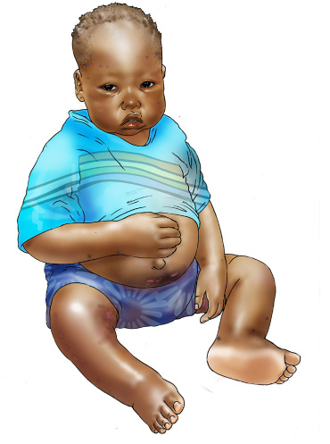
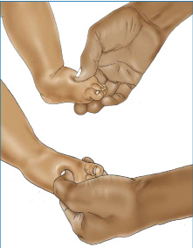
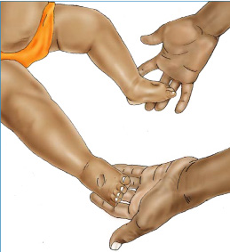
Examples of Undernutrition:
Bilateral Pitting Oedema
Previously called kwashiorkor
Characterized by body swelling that starts from the feet/hands
Form of severe acute malnutrition due to illness or insufficient food intake or both
Multi-Sectoral Nutrition Coordination Committee Orientation
•
13
Notes:
Here we show another example of undernutrition. You see an example of acute malnutrition in the form of oedema.
Oedema (Bilateral pitting oedema): An excess accumulation of fluid that starts in both feet and can progress to other parts of the body. Also known as nutritional oedema or oedematous malnutrition, bilateral pitting oedema is a sign of severe acute malnutrition. It is verified when thumb pressure applied on the tops of both feet for 3 seconds leaves an indentation after the thumb is lifted.

Slide 14
Distribution of Stunting, Wasting, &
Underweight in Children Under 5
(UDHS 1989-2016)
Multi-Sectoral Nutrition Coordination Committee Orientation
•
14
Notes:
Between 1988 and 2016, stunting (low height-for-age, also known as chronic undernutrition) decreased from 48% to 29%, while wasting (a measure of acute undernutrition) decreased from 7% to 4% between 1995 and 2016. While progress has been made, these figures, particularly the 29% stunting level, are still unacceptable. (UDHS 2016).

Slide 15
Regional Distribution of Prevalence of Severe and Moderate Stunting
(UDHS 2016)
Multi-Sectoral Nutrition Coordination Committee Orientation
•
15
Notes:
Vulnerability to malnutrition varies from one region to another. For example, the prevalence of stunting among children under 5 ranges from 14.3% in Teso sub region to 40.6% in Toro sub region. There has been a shift in regional variations from 2011- 2016. In 2011, Karamoja and South western regions registered the highest levels of stunting 45% and 42% respectively (UDHS 2011). In 2016, Toro (40.6%), Bunyoro (34.5%) and Bugisu (35.9%) sub regions were found to have the highest levels of stunting (UDHS 2016).

Slide 16
Regional Distribution of Severe and
Moderate Wasting Among Children
Under 5 (UDHS 2016)
Multi-Sectoral Nutrition Coordination Committee Orientation
•
16
Notes:
Regional differences can also be seen in prevalence of wasting.

Slide 17
Regional Distribution of Severe and
Moderate Underweight Among Children
Under 5 (UDHS 2016)
Multi-Sectoral Nutrition Coordination Committee Orientation
•
17
Notes:
Regional differences can also be seen in prevalence of underweight.

Slide 18


Examples of Overnutrition
Overweight
Obesity
Multi-Sectoral Nutrition Coordination Committee Orientation
•
18
Notes:
Overweight: Overweight is a range of weight that exceeds what is generally considered healthy for a given height. For adults, overweight is BMI from 25 to 29.9.
Obesity: Obesity is a range of weight that is much greater than what is generally considered healthy for a given height. For adults, obesity is having a body mass index (BMI) of 30 or higher.
Overweight among children under five is 4%, an increase of 1% from 2011 (UDHS 2016). Overweight among women of reproductive age has remained high at 19%, while amongst men at 5% (UDHS 2011).

Slide 19
Micronutrient Deficiency
Vitamin A Iron
Iodine
Zinc
Multi-Sectoral Nutrition Coordination Committee Orientation
•
19
Notes:
Micronutrient deficiency: Inadequate intake of micronutrients (vitamins or minerals) for the body’s needs. The most common micronutrient deficiencies are: vitamin A deficiency, Iron deficiency anaemia, iodine deficiency, and zinc deficiency. This is also known as ‘hidden hunger’.

Slide 20
Percent Distribution of Micronutrient
Malnutrition in WRA and Children Under 5
(UDHS 2011)
Women 15-49 years
Children Under 5
Multi-Sectoral Nutrition Coordination Committee Orientation
•
20
Notes:
These graphs show trends in micronutrient deficiencies (anaemia, vitamin A, and iodine).

Slide 21
Anaemia Regional Distribution in Children
Under 5 (UDHS 2016)
Multi-Sectoral Nutrition Coordination Committee Orientation
•
21
Notes:
Like other forms of undernutrition, anaemia deficiencies vary in prevalence by region.
Anaemia in children (hemoglobin levels below 11.0g/dl) increased from 49% in 2011 to 53% in 2016. Children in rural areas are more likely to be anaemic than those in urban areas (54% and 48% respectively). Vulnerability to anaemia in children varies from region to region. For example, prevalence of anaemia among children is lowest in Ankole sub region at 31%, and highest in Acholi sub region at 71%. (UDHS 2016).

Slide 22
Anaemia Regional Distribution in Women of
Reproductive Age (UDHS 2016)
Multi-Sectoral Nutrition Coordination Committee Orientation
•
22
Notes:
Anaemia in women of reproductive age (defined as having a hemoglobin level below 12.0g/dl) increased from 26% in 2011 to 32% in 2016. The proportion of women with anaemia is higher in rural areas than in urban areas (33% and 27% respectively). Regional prevalence of anaemia among women ranges from 17% in Kigezi sub region to 47% in Acholi sub region. In Uganda, anaemia is currently a moderate public health problem for women of reproductive age and a severe public health problem for children under five years.
Uganda Bureau of Statistics (UBOS): Uganda Demographic and Health Survey Report, 2016

Slide 23
Distribution of Stunting and Anaemia in
Children Under Age 5 by Wealth Quintile
(UDHS 2016)
Multi-Sectoral Nutrition Coordination Committee Orientation
•
23
Notes:
However, malnutrition is not only a problem of low income households. The figure shows stunting and anaemia rates by wealth quintile. As you can see, rates even in the two highest wealth quintiles are still quite high. 32% of children in the lowest wealth quintile were stunted compared to 17% in the highest wealth quintile (UDHS 2016). Similarly, anaemia prevalence generally decreases with increased levels of wealth, from 66% among children from lowest wealth quintile to 45% among children in the highest wealth quintile (UDHS 2016). This suggests that more income at the household level does not always lead to better diet and health practices. Therefore, when planning nutrition interventions these groups and interventions targeting them should also be considered. Similarly, the prevalence of stunting decreases as mothers’ education levels increase. Four in every 10 children born to mothers with no education are stunted compared with 1 in every 10 children born from educated mothers.

Slide 24
Exclusive Breastfeeding among
Children under 6 Months
Multi-Sectoral Nutrition Coordination Committee Orientation
•
24
Notes:
According to the UDHS 2016, 66% of infants under age 6 months are exclusively breastfed. Contrary to the recommendation that children under age 6 months be exclusively breastfed, 7% of infants consume plain water, 6% consume non-milk liquids, 8% consume other milk, and 11% consume complementary foods in addition to breast milk before they reach 6 months of age. In addition, 2% of infants under age 6 months are not breastfed at all. The percentage of children exclusively breastfed decreases sharply with age from 83% of infants age 0-1 month being exclusively breastfed to 69% of infants age 2-3 months and, further, to 43% of infants age 4-5 months. 11% of infants under age 6 months are fed using a bottle with a nipple, a practice that is discouraged because of the risk of illness to the child. Breastfeeding a child until age 2, with proper complementary feeding practices beginning after the age of 6 months, is recommended.
Uganda Bureau of Statistics (UBOS): Uganda Demographic and Health Survey Report, 2016

Slide 25
Minimal Acceptable Diet
Multi-Sectoral Nutrition Coordination Committee Orientation
•
25
Notes:
The minimum standards with respect to infant and young child feeding (IYCF) practices among children aged 6-23 months are measured through the Minimum Acceptable Diet (MAD) indicator. The UDHS 2016 indicates that 14% of children aged 6-23 months meet the criteria for MAD. The percentage of children meeting MAD requirements varies by age group: 6-8 months (15%), 9-11 months (13%), 12-17 months (15%) and 18-23 months (13%).

Slide 26
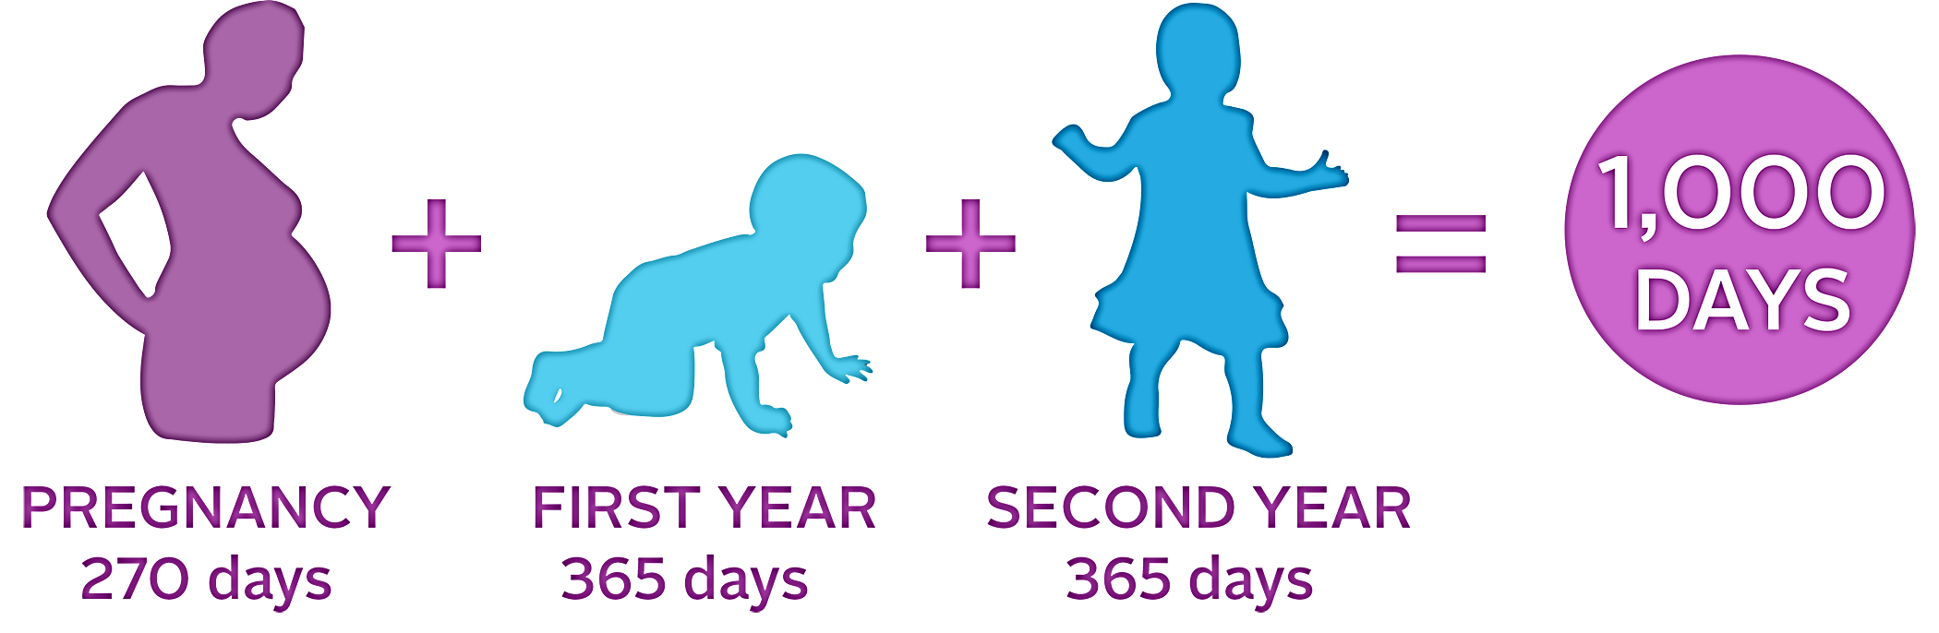

‘1,000 Days’ Window of Opportunity
+
+
=
Multi-Sectoral Nutrition Coordination Committee Orientation
•
26
Notes:
There is a period known as the ‘1,000 days’ window of opportunity during which major gains in malnutrition prevention can be made. Here you see two of the previously mentioned target groups (pregnant women and children under 5, specifically those up to 2 years) are highlighted. This is because good nutrition in children under 5 begins with the nutritional status of the mother, as good growth and development begins during pregnancy. If a mother is malnourished, the baby growing inside will experience poor growth and development, leading to low birth weight and poor development. The period of growth up to 2 years has been identified as a key period for growth and development, particularly as it relates to stunting – as catch up growth has been shown to be much more difficult to achieve after the age of 2.
However, achieving the benefits of the 1,000 days does not begin with pregnancy. Adolescent girls and women of reproductive age are also critical target groups as it is important for women to have a good nutritional status before becoming pregnant and to then maintain good nutrition throughout pregnancy.

Slide 27
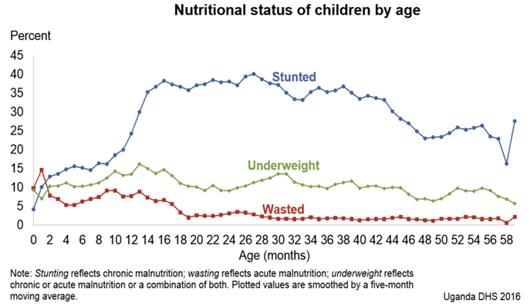
Window of Opportunity to Address
Malnutrition in Uganda (DHS 2011)
Multi-Sectoral Nutrition Coordination Committee Orientation
•
27

Slide 28
Group Work: Nutrition Situation Within
the District/LLG
In small groups, brainstorm and discuss the nutrition situation within the district/LLG:
  What LLGs and/or communities are most affected by malnutrition?
  Which sub-counties/divisions/parishes/ wards would you prioritise for support and why?
Prepare a short presentation to share with the group
Multi-Sectoral Nutrition Coordination Committee Orientation
•
28

Slide 29
Group Work: Causes of Malnutrition
Brainstorm and discuss the causes of malnutrition within the district/LLG
  Be sure to discuss the challenges in each department (e.g., education, health, agriculture, planning, water, social development, trade and industry, and administration) that could contribute to malnutrition.
Write each challenge on a card and display it at the front of the room
Multi-Sectoral Nutrition Coordination Committee Orientation
•
29

Slide 30
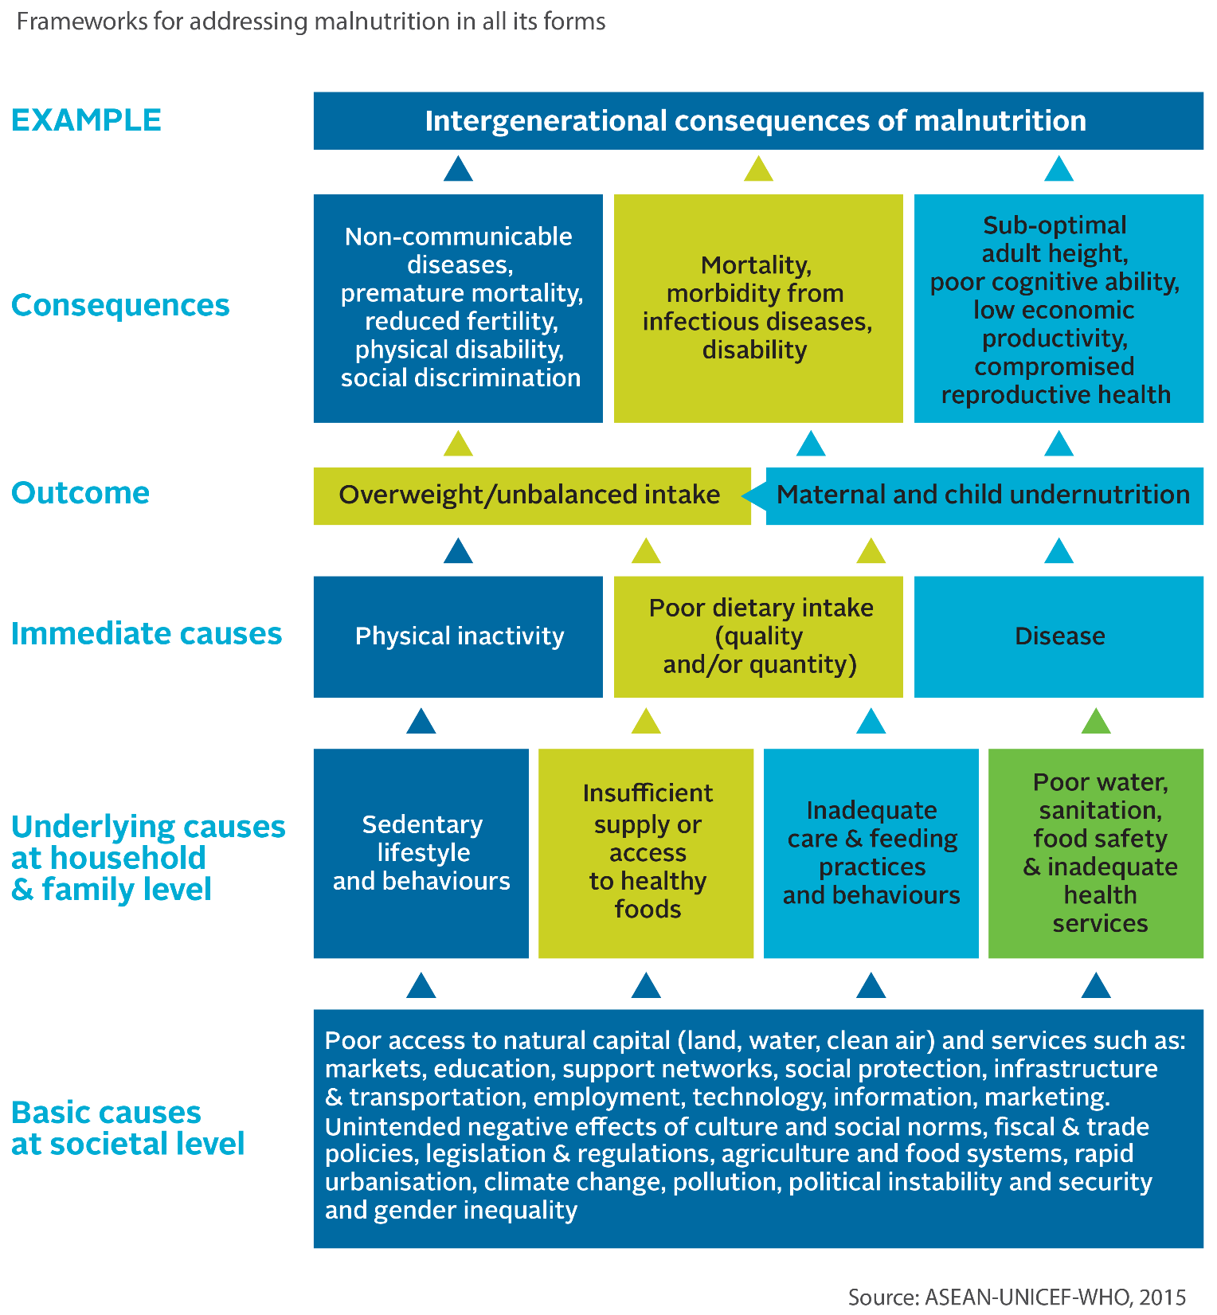
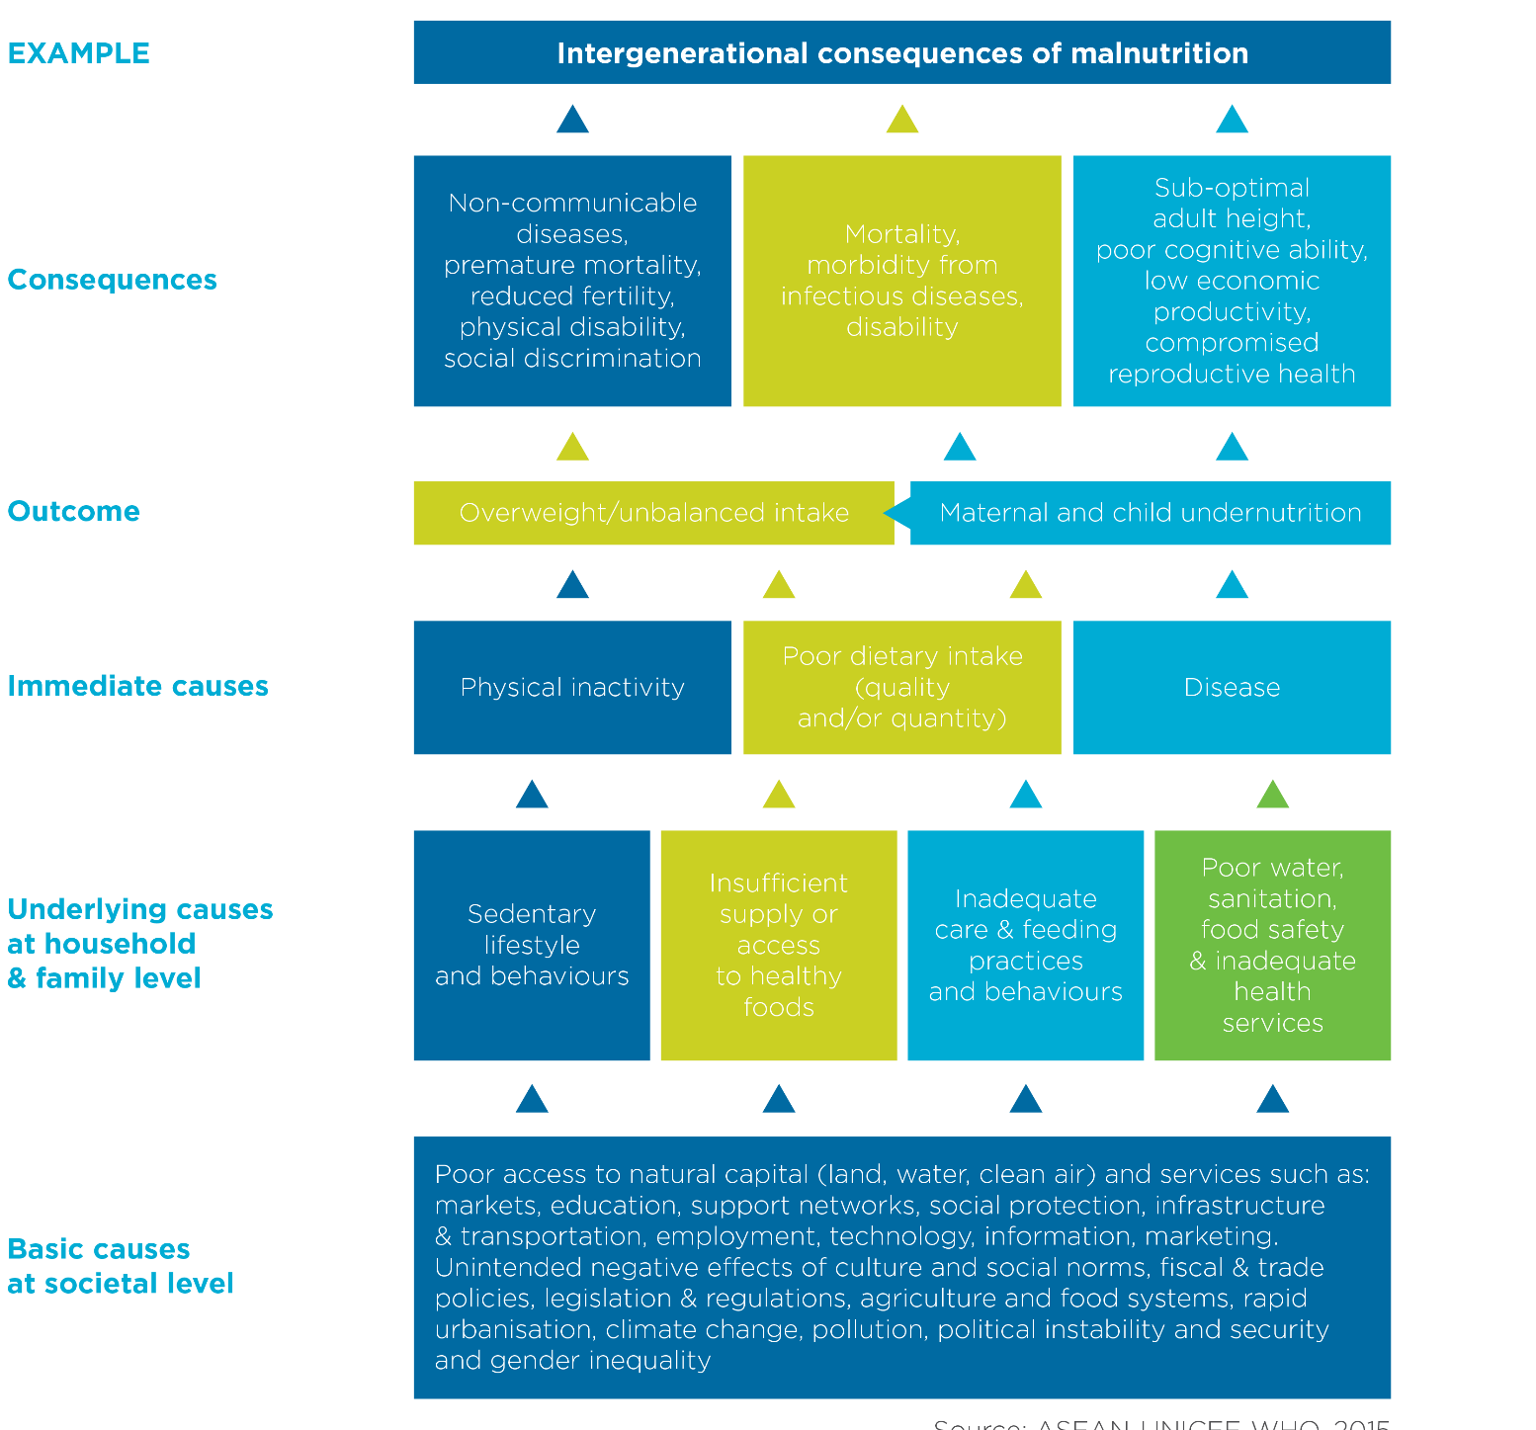
Causes
of
Malnutrition
Scaling Up Nutrition. (2016) Checklist on the Criteria and Characteristics of “Good” National Nutrition Plans.
Multi-Sectoral Nutrition Coordination Committee Orientation
•
30
Notes:
To achieve improvement in nutrition outcomes, the various causes of malnutrition must be tackled. There are three levels of causes of malnutrition: basic causes at the societal level, underlying causes at the household and family level, and immediate causes at the individual level.
Immediate causes can lead directly to malnutrition. The most obvious immediate cause is poor dietary intake. A person may not be getting enough required daily calories, or they may be consuming food that does not have the necessary micronutrients, which can lead to chronic malnutrition (stunting) and acute malnutrition (wasting) in children or specific micronutrient deficiency such as iron deficiency which contributes to anaemia in women and children. Extended and frequent illness/disease also can have an impact on the body’s ability to absorb required nutrients. An example of this is a young child who has frequent diarrhoea, which can result in acute malnutrition due to poor nutrient absorption. In addition, consumption of unhealthy foods (e.g., fatty or high calorie and nutrient poor food) and physical inactivity can also lead to malnutrition in the form of overweight or obesity, which can lead to diet-related non-communicable diseases such as diabetes and heart disease.
Immediate causes are exacerbated or caused by underlying causes of malnutrition. Inadequate dietary intake could be due to household food insecurity or poor child feeding practices, such as inadequate dietary diversity or early cessation of breastfeeding. Other inadequate care practices, such as failing to provide stimulation and other good early child development practices, can have negative impacts on cognitive development, which are further compounded by poor diet. Poor nutrition results in reduced immunity to infection, while infection results in the loss of appetite and reduces nutrient absorption, which can produce further weight loss and continued or increased levels of malnutrition. As this cycle repeats itself in a child, growth is compromised, the nutritional status worsens, and the risk of mortality continues to rise. Diseases can also be caused by poor food hygiene, (e.g., diarrhoea is often caused by exposure to faeces through poor handwashing practices). This, in turn, is linked to the environment, including issues of access to water and sanitation infrastructure. Poor water and sanitation infrastructure can contaminate food, leading to an increase in disease. Lack of access to health services, such as vaccinations, also contributes to disease. Lifestyle choices, such as sedentary behaviour, can lead to overweight and obesity, particularly if there is an imbalance in the number of calories consumed versus used. An appropriate diet based on one’s level of activity is recommended.
Finally, basic causes influence the underlying causes, and so can lead to malnutrition. At this level, all sectors are involved. Household food insecurity can be due to a lack of income, which can be the result of low levels of education, which restrict job opportunities and other income-generating opportunities. Educational disparity can lead to increases in gender-based violence, which can have an impact on a mother’s ability to properly care for her children; this may result in inadequate feeding practices or the inability to take children for health services. Educational disparity and available household resources also contribute to individuals making poor dietary choices--consuming a diet that is low in diversity, high in fat and sugar, and low in micronutrient content (e.g., soda, chips, biscuits). Political will can have an impact on the availability of services, including health, education, community development, and agricultural extension, to name a few. It also has an impact on the enabling environment for pro-nutrition policies, which can help expand service coverage and provide funding for necessary services.
As you unpack this framework, it becomes apparent that every sector has a role to play in improving nutrition.

Slide 31
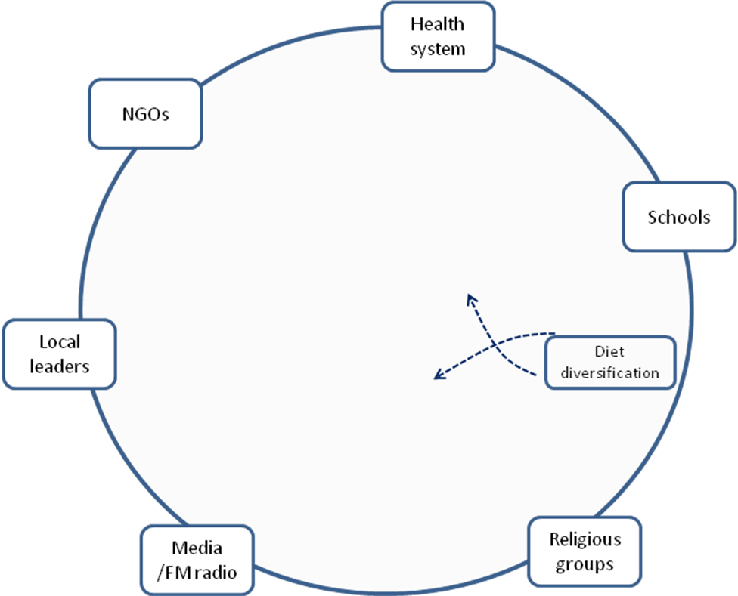
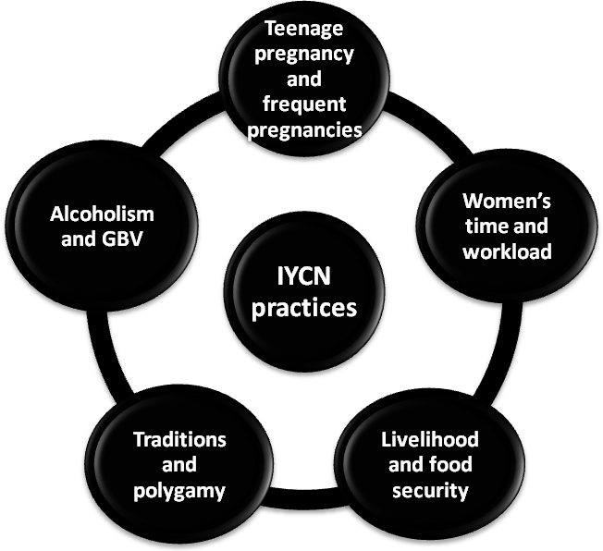
Multifaceted Factors Influencing
Infant Feeding Practices
Source: Namugumya, B.S.; Ruzaaza, G.; Mwadime, R.; Sethuraman, K.; Okello, E. 2010. Opportunities for Addressing Malnutrition in Kitgum and Pader Districts in Northern Uganda. Washington, DC: FHI 360/FANTA-2.,
Multi-Sectoral Nutrition Coordination Committee Orientation
•
31
Notes:
The causes of malnutrition within the household can be further explained using the factors identified as influencing infant and young child nutrition (IYCN) practices in Northern Uganda. These include women’s workload and time, teenage pregnancies and frequent pregnancies, alcoholism and gender-based violence, traditions and polygamy, the lack of livelihoods, and food insecurity. These require concerted efforts from various groups within the communities to improve nutrition outcomes.

Slide 32
Group Work: Consequences of Malnutrition
Brainstorm the effects of malnutrition on individuals, households, and the community, with reference to health, education, productivity, and economic development
Write your consequences on cards and display them at the front of the room
After group work is completed, results will be discussed in plenary
Multi-Sectoral Nutrition Coordination Committee Orientation
•
32

Slide 33
Consequences of Malnutrition
if Not Addressed
lives of children under 5 will be lost related to stunting
mothers’ lives will be lost related to maternal anaemia
equivalent school years of learning will be lost related to stunting
lives of children under 5 will be lost related to wasting
lives of children under 5 will be lost related to vitamin A deficiency
lives of children under 2 will be lost related poor breastfeeding practices
Stunting alone will result in
UGX 19 trillion in economic productivity losses if these problems are not addressed by 2025.
Children will be born with irreversible brain damage with a decrease in IQ related to maternal iodine deficiency
Multi-Sectoral Nutrition Coordination Committee Orientation
•
33
Notes:
If nothing changes by 2025, the following consequences will be realized.
Malnutrition contributes to death and illness of many Ugandans each year. It also significantly reduces agricultural productivity because of productive time lost due to illnesses associated with malnutrition and time spent dealing with family illnesses or deaths associated with malnutrition. As discussed in previous sessions, it also has a disproportionate effect on children under 2, during which their cognitive development can be harmed, leading to lower levels of educational achievement.
Anaemia has negative effects on productivity and the social and economic development of a nation. Women of reproductive age who are anaemic are at more risk of maternal death, having premature births, and giving birth to babies with low birth weight (< 2.5 kg). In turn babies who are premature or born with low birth weight are at high risk of death before their first birthday.
Children who suffer from underweight and/or wasting are at increased risk of mortality from illnesses such as diarrhoea and pneumonia,. The effects of undernutrition on the immune system are wide ranging, and tend to be more frequent and severe in wasted children. Stunting in childhood has short-term and long-term consequences that affect health and human capital development. In addition to poor physical growth, stunting increases childhood risk of infection and mortality, and affects development, learning capacity, and school performance. Later it affects productivity, wages, and reproductive health.

Slide 34
Consequences of Overnutrition
Obesity
Heart Disease
Cancers
High Blood Pressure
Sleep Apnea
High Cholesterol
Hypertension
Respiratory Problems
Quality of Life
Arthritis
Diabetes
Multi-Sectoral Nutrition Coordination Committee Orientation
•
34
Notes:
Stunting can also lead to excessive weight gain later in life, which contributes to higher levels of overweight and obesity. These conditions lead to increased risk of nutrition-related chronic diseases such as diabetes and heart disease. Overweight and obese children are likely to stay obese into adulthood and are more likely to develop non-communicable diseases like diabetes and cardiovascular diseases at a younger age. Prevention of childhood obesity, therefore, needs to be a high priority to support improvement in adult nutrition outcomes as well.

Slide 35
Discussion
What are the changes needed at the district/LLG level to improve the nutrition situation?
Multi-Sectoral Nutrition Coordination Committee Orientation
•
35

Slide 36
Session 1.2
Policy Environment for Nutrition
Photo: Namugumya, (Regional Center for Quality Health Care (RCQHC)
Multi-Sectoral Nutrition Coordination Committee Orientation
•
36

Slide 37


















Sustainable Development Goals
Multi-Sectoral Nutrition Coordination Committee Orientation
•
37
Notes:
The Sustainable Development Goals (SDGs) have set the global development agenda for the next 15 years. SDG 2 aims to end hunger, achieve food security and improved nutrition, and promote sustainable agriculture. This includes eliminating all forms of malnutrition.

Slide 38
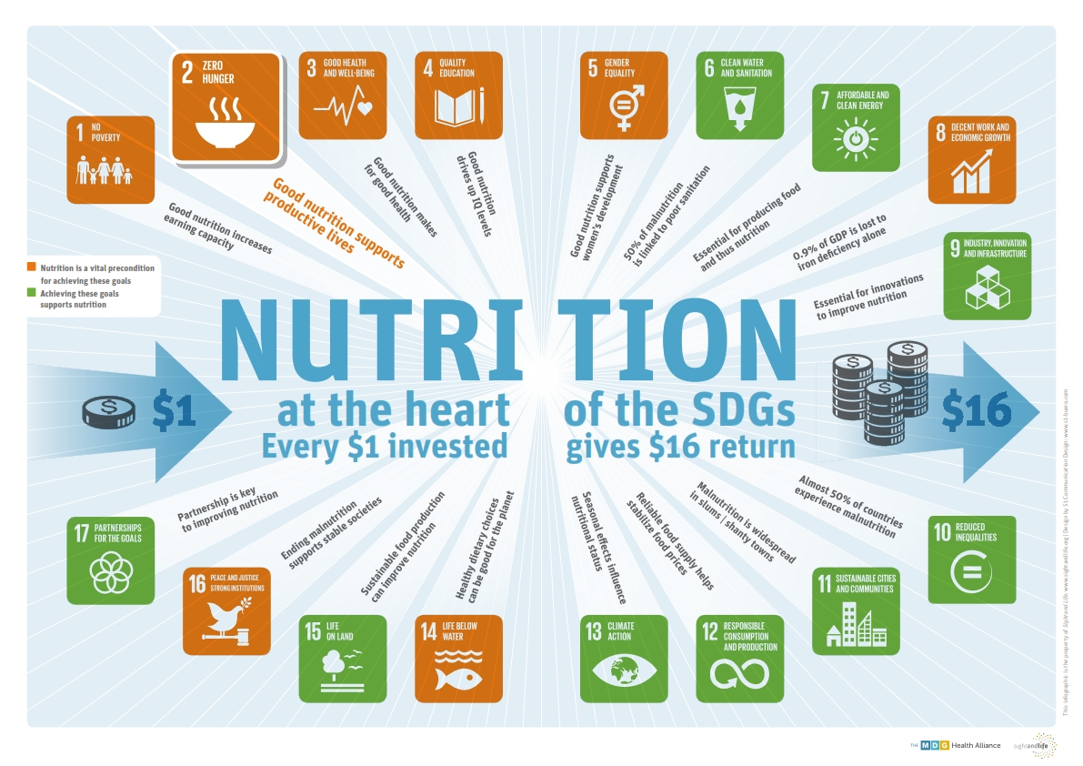
All SDGs Contribute to Improved Nutrition
Multi-Sectoral Nutrition Coordination Committee Orientation
•
38
Notes:
At least 12 of the 17 Goals contain indicators that are highly relevant to nutrition. Without adequate and sustained investments in good nutrition, the SDGs will not be realised. This image is included in your participant’s handbook. You will see that the orange SDGs require good nutrition to be achieved. The achievement of the SDGs in green support nutrition.

Slide 39

Scaling Up Nutrition Movement
Uganda joined the SUN Movement in 2011
The SUN Movement Strategy and Roadmap (2016– 2020) envisions a world free from malnutrition in all its forms by 2030
Multi-Sectoral Nutrition Coordination Committee Orientation
•
39

Slide 40
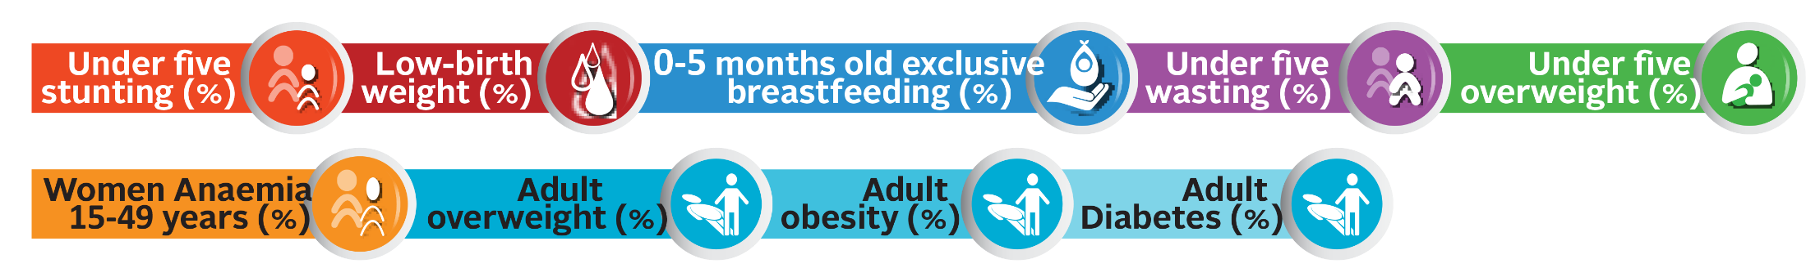
Global Nutrition Targets and Diet-Related Global NCD Targets 2025
The Global Nutrition Targets and the Global NCD Targets 2025 were endorsed by the World Health Assembly in 2012 and 2013
SUN Countries are contributing to meeting these targets
Multi-Sectoral Nutrition Coordination Committee Orientation
•
40

Slide 41
Six Pillars for Nutrition Action
Sustainable food systems for healthy diets
Aligned health systems providing universal coverage of essential nutrition actions
Review, strengthen, and promote nutrition governance and accountability
Improved Nutrition for All
Social protection and nutrition education
Enabling food and breastfeeding environments
Trade and investment for improved nutrition
Multi-Sectoral Nutrition Coordination Committee Orientation
•
41
Notes:
The UN Decade of Action on Nutrition has six pillars for nutrition action.
The six pillars are:
Sustainable food systems for healthy diets
Aligned health systems providing universal coverage of essential nutrition actions
Social protection and nutrition education
Trade and investment for improved nutrition
Enabling food and breastfeeding environments
Review, strengthen and promote nutrition governance and accountability

Slide 42
Regional Frameworks
African Union’s Agenda 2063
African Union 2003 Maputo Declaration on Agriculture and Food Security
African Union 2014 Malabo Declaration on Accelerated Agricultural Growth and Transformation for Shared Prosperity and Improved Livelihoods
East African Community Agriculture and Rural Development Strategy (EAC-ARDS) 2005-2030
Multi-Sectoral Nutrition Coordination Committee Orientation
•
42

Slide 43
Turning Global Strategies into Local Actions
Multi-Sectoral Nutrition Coordination Committee Orientation
•
43
Notes:
Nutrition, especially that of young children and women of reproductive age, is a priority in the Uganda Vision 2040 and is identified as a key contributor to social transformation. The Government of Uganda recognizes malnutrition’s complexity and the Second National Development Plan 2015/16 – 2019/20 (NDP II) and the Uganda Nutrition Action Plan 2011-2016 (UNAP) provide a multi-sectoral framework to improve the nutrition situation in Uganda. Nutrition must be included and planned for as a cross-cutting issue, as mandated in the NDP II, the Local Government Development Planning Guidelines 2014, and the Sector Development Planning Guidelines 2015. These policy documents also emphasize the need to plan and coordinate nutrition programming at national, district, and community levels.
Uganda has aligned its policy frameworks and strategies to the existing global strategies such as the Millennium Development Goals, the Scaling Up Nutrition Movement, the Sustainable Development Goals (SDGs). In this way, Uganda’s national and local level objectives will make direct contributions to global nutrition goals.
This purpose of this presentation is to familiarize you with the key national level polices that provide the mandate for nutrition planning and implementation at all levels of local government, from districts to communities. It will also introduce you to the Uganda national nutrition coordination framework and your role in the district/LLG nutrition planning process.

Slide 44
1995 Constitution of the Republic of Uganda
Section XXII: Food security and nutrition
The State shall:
a) Take appropriate steps to encourage people to grow and store adequate food.
b) Establish national food reserves; and
c) Encourage and promote proper nutrition through mass education and other appropriate means in order to build a healthy state.
Multi-Sectoral Nutrition Coordination Committee Orientation
•
44

Slide 45
Uganda Vision 2040
Vision statement:
A Transformed Ugandan Society from a Peasant to a Modern and Prosperous Country within 30 years
Nutrition target:
  To reduce stunting among children under 5 from 33% in 2010 to 0% by 2040
Multi-Sectoral Nutrition Coordination Committee Orientation
•
45
Notes:
The goal of the Uganda Vision 2040 is to achieve “A Transformed Ugandan Society from a Peasant to a Modern and Prosperous Country within 30 years”. This calls for investment in human capital development. Reducing childhood stunting is one of the Vision 2040 targets, specifically to eliminate stunting among children under 5 from 33% in 2010 to 0 by 2040. This is because, as we learned in the presentation in Session 1.1, addressing malnutrition provides a strong return on public investment – for every 1,000 shillings invested, an estimated 6,000 shillings worth of increased productivity will result from reduced child stunting, improved maternal health, enhanced micronutrient intake, and improved nutritional care.

Slide 46
Second National Development Plan (NDP II)
2015/2016-2018/2019
Nutrition falls under NDP II Objective 3:
  Enhance human capital development
Nutrition-specific target:
  Reduce child stunting in children under
  5 from 33% to 25% by 2021
Multi-Sectoral Nutrition Coordination Committee Orientation
•
46
Notes:
Nutrition in the NDP II is aligned to the Sustainable Development goal 2 on End hunger, achieve food security and improved nutrition, and promote sustainable agriculture. Nutrition targets fall under NDP II Objective 3: Enhance human capital development. This includes a target on reduction in stunting, which will improve educational attainment. General improvements in nutrition status will also help to achieve NDP Objective 3 targets of reducing, maternal, infant, and child mortality rates, and improvements in secondary education completion and total average years of schooling. Additionally, achievements in improved safe water coverage, also an Objective 3 target, will have positive feedback effects on nutrition outcomes as well.
Nutrition is also highlighted as an important cross-cutting issue, which will be discussed more later on.

Slide 47
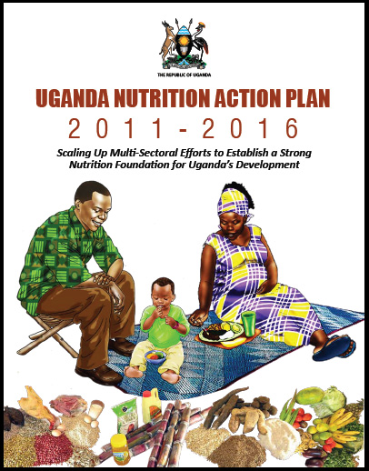
Uganda Nutrition Action Plan
(2011-2016)
Objectives:
  Improve access and utilisation of MIYCN health related services
  Enhance consumption of diverse diets
  Protect households from the impact of shocks & other vulnerabilities that affect nutritional status
  Strengthen the policy, institutional framework & capacity to effectively plan, implement & monitor nutrition
  Create awareness, maintain interest & commitment to improve support for nutrition
Multi-Sectoral Nutrition Coordination Committee Orientation
•
47
Notes:
The Uganda Nutrition Action Plan is the national agenda providing multi-sectoral guidance on improving the nutrition outcomes within the first 1,000 days. The goal of the UNAP is to reduce malnutrition levels among women of reproductive age, infants, and young children from 2011 through 2016 and beyond.
It has five objectives:
Improve access and utilization of Maternal, Infant and Young Child Nutrition health related services;
Enhance consumption of diverse diets;
Protect households from the impact of shocks & other vulnerabilities that affect nutritional status;
Strengthen the policy, institutional framework & capacity to effectively plan, implement & monitor nutrition; and
Create awareness, maintain interest & commitment to improve support for nutrition.

Slide 48
Local Government Development
Planning Guidelines 2014
Integrate key cross-cutting issues into government programmes and projects
Key cross-cutting issues:
  Gender
  HIV/AIDS
  Environment
  Nutrition
  Climate change
  Human rights
  Social protection
  Child welfare
Multi-Sectoral Nutrition Coordination Committee Orientation
•
48
Notes:
Nutrition is a key cross cutting issue highlighted in the local development planning guidelines to be integrated into the planning frameworks in all sectors and government programs. This means nutrition should be included in the district development plans, sectoral work plans and budgets.

Slide 49
National Nutrition Planning Guidelines 2015
Support identification, analysis, integration, monitoring, and evaluation of nutrition issues in national, sector, and local government development plans
Guidance aligned to the local government planning process
Mandates that local governments include nutrition in their district development plans and develop nutrition action plans
Multi-Sectoral Nutrition Coordination Committee Orientation
•
49
Notes:
Because nutrition is mandated as a cross-cutting issue in the NDP II, it needs to be integrated into national, sector, and local government level plans. This is reiterated in the local government planning guidelines. The National Nutrition Planning Guidelines 2015 provide a standard process for integration of nutrition into plans at all levels. It emphasizes the requirements at local government level to include nutrition in their 5-year district development plans and to develop 5 year MSNAPs. This training will familiarize you with the requirements laid out in the National Nutrition Planning Guidelines as you go through the process of developing your MSNAPs.

Slide 50
What Needs to Be Done
Strong leadership and ‘champions’ for nutrition at district, LLG, and community levels
Integrate nutrition into development programmes and projects within the district/LLG
Mobilise resources for nutrition at district, LLG, and community level
Multi-Sectoral Nutrition Coordination Committee Orientation
•
50
Notes:
With this conducive policy environment for implementation of nutrition interventions, there is urgent need to invest in action at local government level and put in place sustainable systems for programming.

Slide 51
Group Work: Nutrition in
District/LLG Plans
What are the nutrition interventions included in the 5-year district/LLG development plan?
What are the nutrition interventions included in the department annual work plans?
What nutrition interventions are included in the Multi-Sectoral Nutrition Action Plan (MSNAP)?
Multi-Sectoral Nutrition Coordination Committee Orientation
•
51

Slide 52
Session 1.3
Overview of the Uganda Nutrition Action Plan (UNAP)
Photo: Namugumya, (Regional Center for Quality Health Care (RCQHC)
Multi-Sectoral Nutrition Coordination Committee Orientation
•
52

Slide 53
The Uganda Nutrition Action Plan (UNAP)
2011-2016
Goal: Reduce malnutrition levels among women of reproductive age, infants, and young children from 2011 through 2016 and beyond.
Focus: National efforts and public resources to improve infant and maternal nutrition outcomes through scaling up of proven interventions
Target: Young children and women of reproductive age
Background: Operationalise nutrition in Constitution, National Development Plan, and Uganda Food and Nutrition Policy
The UNAP has been extended to 31 December 2017 to allow finalisation of the Multi-Sectoral Nutrition Policy and development of the Second Multi-Sectoral Nutrition Action Plan.
Multi-Sectoral Nutrition Coordination Committee Orientation
•
53
Notes:
The Uganda Nutrition Action Plan 2011-2016 (UNAP) is the Government of Uganda’s strategic multi-sectoral framework for scaling-up nutrition under the coordination of the Office of the Prime Minister. The UNAP has been extended to 31 December 2017 to allow finalization of the Multi-sectoral Nutrition Policy and development of the Second Multi-sectoral Nutrition Action Plan.
The goal of the UNAP is to reduce malnutrition levels among women of reproductive age, infants, and young children from 2011 through 2016 and beyond.

Slide 54
UNAP Objectives and Strategies
Objective 1: Improve access to and utilisation of services related to maternal, infant and young child nutrition
  Promote access to and utilisation of nutrition and health related services by target beneficiary
  Address gender and socio-cultural issues that affect maternal, infant, and young child nutrition
Multi-Sectoral Nutrition Coordination Committee Orientation
•
54

Slide 55
UNAP Objectives and Strategies
Objective 2: Enhance consumption of diverse diets
  Increase access and use of diverse nutritious foods at the household level
  Enhance post-harvest handling, storage, and utilisation of nutritious foods at the household and farm level
  Promote the consumption of nutrient-enhanced foods
(Continued)
Multi-Sectoral Nutrition Coordination Committee Orientation
•
55

Slide 56
UNAP Objectives and Strategies
Objective 3: Protect households from the impact of shocks and other vulnerabilities that affect their nutritional status
Develop preparedness plans for shocks
  Promote social protection interventions for improved nutrition
(Continued)
Multi-Sectoral Nutrition Coordination Committee Orientation
•
56

Slide 57
UNAP Objectives and Strategies
Objective 4: Strengthen the policy, legal, institutional frameworks and capacity to effectively plan, implement, and monitor and evaluate nutrition programmes
  Strengthen the policy and legal framework to coordinate, plan and monitor nutrition activities
  Strengthen/harmonise institutional framework for nutrition from local to central government levels
  Strengthen human resource capacity to plan, implement, monitor, and evaluate food and nutrition programmes
  Enhance operational research for nutrition
(Continued)
Multi-Sectoral Nutrition Coordination Committee Orientation
•
57

Slide 58
UNAP Objectives and Strategies
Objective 5: Create awareness of and maintain national interest in and commitment to improve and support nutrition
  Increase levels of awareness of and commitment to address nutrition issues
  Advocate for increased commitment to improve nutrition outcomes
Multi-Sectoral Nutrition Coordination Committee Orientation
•
58

Slide 59
Session 1.4
The Uganda
Multi-Sectoral Nutrition
Coordination Framework
Photo: Namugumya, (Regional Center for Quality Health Care (RCQHC)
Multi-Sectoral Nutrition Coordination Committee Orientation
•
59

Slide 60
Uganda Nutrition Coordination Framework
Policy Coordination Committee
Parliamentary Subcommittee on Nutrition
Policy Coordination
UNAP implementation Steering Committee
Multi-Sectoral Nutrition Technical Committee
Nutrition Secretariat
Office of the Prime Minister
Development Partners Nutrition Coordination Committee
Technical Coordination
Sector Nutrition Coordination Committees
District Nutrition Coordination Committees
Decentralised Coordination
Municipal Nutrition Coordination Committees
Town Council Nutrition Coordination Committees
Sub-County Nutrition Coordination Committees
Division Nutrition Coordination Committees
Multi-Sectoral Nutrition Coordination Committee Orientation
•
60

Slide 61
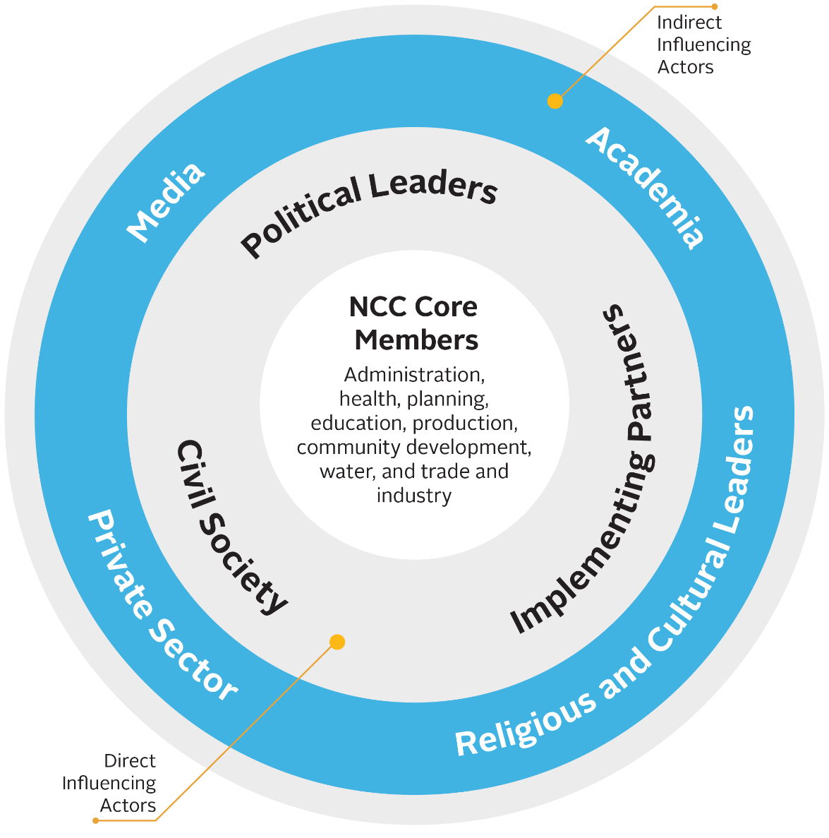
NCC Composition and Influencing Actors
Multi-Sectoral Nutrition Coordination Committee Orientation
•
61
Notes:
NCC core membership should include government representatives from the administration, health, planning, education, production, community development, trade and industry, and water departments
Direct influencing actors include political leaders, civil society, and implementing partners. Because these actors have both financial and technical resources and political influence, they can be effective supporters of NCC operations even though they are not part of the core NCC membership. NCCs should engage with them to advance shared goals that are appropriate for the local context, as these actors are well placed to mobilize nutrition resources and can contribute technical assistance in areas such as data collection.
NCCs should also engage with indirect influencing actors such as academia, religious and cultural leaders, the media, and the private sector. Each of these actors has a sphere of influence in the community and access to platforms through which advocacy and behaviour change communication for nutrition can be done.
During planning and implementation, NCCs should also keep the national context in mind, including both development partners and government sectors. While many such actors do not directly engage with the NCCs on a regular basis, they can influence decisions that impact NCC operations through their work with influencing actors, such as implementing partners, at the district/LLG level.

Slide 62
Session 1.5
Roles and Responsibilities of Nutrition Coordination Committees
Photo: Namugumya, (Regional Center for Quality Health Care (RCQHC)
Multi-Sectoral Nutrition Coordination Committee Orientation
•
62

Slide 63
NCC Mandate
NCCs provide technical advice to technical planning committees and subsequently to the Council. The committees will also monitor and evaluate nutrition activities, carrying out reviews and providing technical advice to districts and lower local government levels. Nutrition focal persons will coordinate nutrition activities within their area of responsibility.
Multi-Sectoral Nutrition Coordination Committee Orientation
•
63

Slide 64
NCC Roles and Responsibilities
Technical guidance
Coordination and partnership with nutrition stakeholders
Monitoring and reporting
Planning, budgeting, and resource mobilisation
Advocacy
Nutrition behaviour change communication and social mobilisation
Multi-Sectoral Nutrition Coordination Committee Orientation
•
64
Notes:
Technical guidance: NCCs provide nutrition technical guidance at all local government levels, including to departments, partners, technical planning committees, and councils to ensure proper nutrition planning and quality of service delivery. This also includes identification of capacity strengthening needs.
Coordination and partnership with nutrition stakeholders: The NCC provides a platform through which nutrition stakeholders from all departments can share information and build consensus on how best to address nutrition problems, use available resources, and harmonise the implementation of nutrition activities in the district/LLG. NCCs also have the responsibility to identify and build partnerships with nutrition stakeholders who can contribute to district/LLG nutrition goals and objectives.
Monitoring and reporting: NCCs conduct joint monitoring and support supervision visits to their lower local government NCCs, departments, and partners to provide oversight to activity implementation. NCCs are also responsible for submitting quarterly reports. Reporting requirements capture progress on nutrition governance activities and on the implementation of activities in the multi-sectoral nutrition action plan.
Planning, budgeting, and resource mobilisation: NCCs ensure integration and alignment of nutrition interventions in all local government development planning frameworks, including Development Plans, the MSNAP, annual work plans, and budgets. NCCs should also mobilise internal and external resources to address resource gaps (e.g., local revenues, partners, and through proposal development).
Advocacy: NCCs should conduct advocacy to raise nutrition awareness among their district/LLG leaders. NCCs should also identify and work with nutrition champions to support advocacy efforts.
Nutrition behaviour change communication (BCC) and social mobilisation: NCCs should utilise available platforms such as the media, community dialogue meetings (barazas), and community outreach to carry out behaviour change communication for nutrition. NCCs should also take the lead in ensuring that nutrition BCC messaging and social mobilisation efforts are harmonised across partners and lower local governments.

Slide 65
Nutrition Focal Point Officer (NFPO) Roles
Act as Secretary to the nutrition coordination committee
Ensure that the MSNAP is prepared and aligned to the development plan
Compile and share district/LLG nutrition coordination reports on a quarterly basis
Function as a link between different nutrition stakeholders in the district/LLG
Multi-Sectoral Nutrition Coordination Committee Orientation
•
65

Slide 66
Nutrition Focal Point Officer (NFPO)
Key considerations
  The NFPO should have strong mobilisation skills
  The NFPO should be a member of the Technical Planning Committee (TPC)
Multi-Sectoral Nutrition Coordination Committee Orientation
•
66

Slide 67
UNIT 2
Roles of and Linkages between Nutrition Coordination Committees, Technical Planning Committees, and Councils
Multi-Sectoral Nutrition Coordination Committee Orientation
•
67

Slide 68
Session 2.1
Roles of Councils and Technical Planning Committees in Nutrition Governance
Photo: Namugumya, (Regional Center for Quality Health Care (RCQHC)
Multi-Sectoral Nutrition Coordination Committee Orientation
•
68

Slide 69
Roles of the Council
Approval of Multi-Sectoral Nutrition Action Plans (MSNAPs) and budgets
Monitor the implementation of nutrition interventions
Multi-Sectoral Nutrition Coordination Committee Orientation
•
69

Slide 70
Roles of Executive Committees
Review district/LLG budgets and work plans and report on progress of implementation of multi-sectoral nutrition interventions
Provide policy direction for implementation of nutrition activities across departments
Monitor the implementation of nutrition interventions across departments
Multi-Sectoral Nutrition Coordination Committee Orientation
•
70

Slide 71
Roles of Sectoral Committees of Council
Scrutinize departmental work plans and budgets to ensure nutrition interventions are planned and budgeted for
Receive reports from departments on nutrition-related issues and ensure alignment/integration with development plans, MSNAPs, annual work plans, and budgets
Monitor the implementation of nutrition interventions across departments
Multi-Sectoral Nutrition Coordination Committee Orientation
•
71

Slide 72
Roles of Technical Planning
Committees
Provide technical assistance to NCCs on nutrition interventions and relevant indicators within the development plans, MSNAPs, annual work plans, and budgets
Develop annual work plans, budgets, and actions plans that support alignment of nutrition interventions across departments
Receive reports from NCCs and departments that implement nutrition interventions
Provide supervisory oversight to all departments
Multi-Sectoral Nutrition Coordination Committee Orientation
•
72

Slide 73
Session 2.2
Linkages between LLG Nutrition Coordination Committees and the District
Photo: Namugumya, (Regional Center for Quality Health Care (RCQHC)
Multi-Sectoral Nutrition Coordination Committee Orientation
•
73

Slide 74
Linkages between LLG Nutrition
Coordination Committees and the District
District Council (DC)
District Technical Planning Committee (DTPC)
District Nutrition Coordination Committee (DNCC)
Municipal Nutrition Coordination Committee (MNCC)
Town Council Nutrition Coordination Committee (TNCC)
Sub-County Nutrition Coordination Committee (SNCC)
Division Nutrition Coordination Committee (DiNCC)
Multi-Sectoral Nutrition Coordination Committee Orientation
•
74
Notes:
While each LLG NCC (MNCCs, TNCCs, DiNCCs, and SNCCs) has the responsibility of planning, implementing, monitoring, and reporting on nutrition activities within their respective LLGs, LLG NCCs all contribute to overall district nutrition plans, objectives, and goals. The DNCC oversees the work of all LLG NCCs within the district. The linkages between the LLG NCCs and the district level structures are illustrated in the graphic.

Slide 75
UNIT 3
Nutrition Coordination Committee Monitoring and Reporting
Multi-Sectoral Nutrition Coordination Committee Orientation
•
75

Slide 76
Session 3.1
Monitoring
Nutrition Coordination Committees
Photo: Namugumya, (Regional Center for Quality Health Care (RCQHC)
Multi-Sectoral Nutrition Coordination Committee Orientation
•
76

Slide 77
Monitoring of NCCs
NCCs are monitored based on the level to which their core roles and responsibilities are being carried out.
Quarterly monitoring and support supervision visits are undertaken by the MSNTC under the leadership of OPM to assess DNCCs.
MNCCs, TNCCs, and SNCCs are monitored quarterly by the DNCCs.
MNCCs are responsible for undertaking quarterly supervision visits to the DiNCCs.
Multi-Sectoral Nutrition Coordination Committee Orientation
•
77

Slide 78
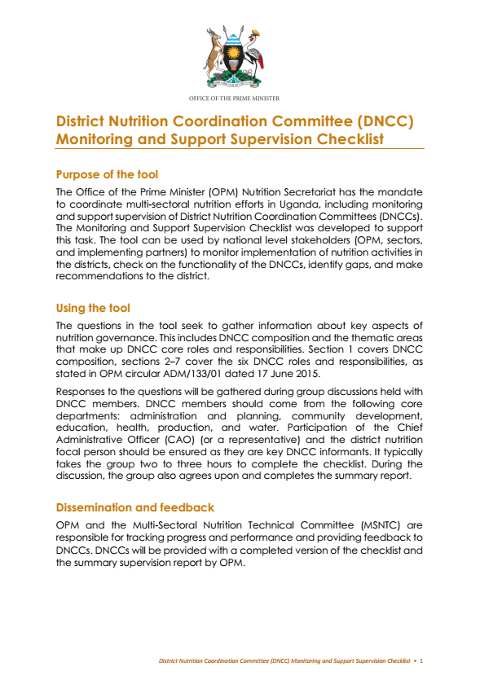
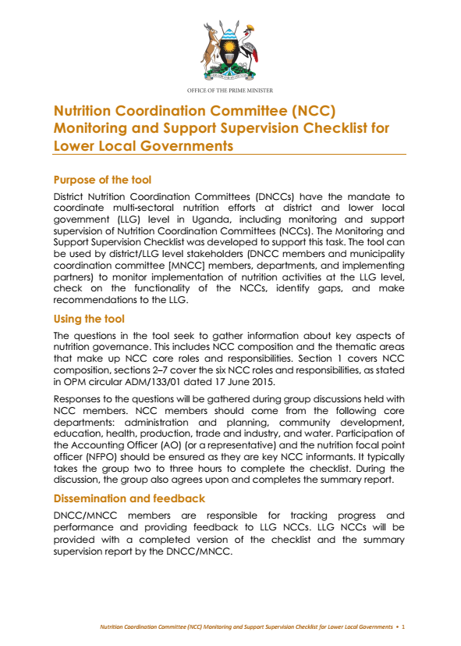
Monitoring and Support Supervision
Checklists
See Annexes 1 and 2 in your Participant Handbook for Checklist details
Multi-Sectoral Nutrition Coordination Committee Orientation
•
78

Slide 79
Session 3.2
Nutrition Coordination Committee Reporting
Photo: Namugumya, (Regional Center for Quality Health Care (RCQHC)
Multi-Sectoral Nutrition Coordination Committee Orientation
•
79

Slide 80
Nutrition Coordination Committee Reporting
  Reporting by NCCs should follow normal government reporting procedures.
  DNCCs consolidate reports from SNCCs and TNCCs into one quarterly district coordination report and submit it to the CAO for submission to OPM, MoFPED, and MoLG
  DiNCCs submit reports quarterly to the MNCC for consolidation of the municipal quarterly nutrition coordination report for submission by the Town Clerk to OPM, MoFPED, and MoLG
  OPM will review DNCC and MNCC quarterly reports and provide feedback and action points to the districts and municipalities during quarterly monitoring and support supervision visits.
  The DNCCs and MNCCs provide feedback and action points to the LLG NCCs during support supervision visits and through the established structures.
Multi-Sectoral Nutrition Coordination Committee Orientation
•
80
Notes:
Reporting by NCCs should follow normal government reporting procedures. SNCCs and TNCCs should forward their reports to the DNCC on a quarterly basis. DNCCs consolidate these reports into a quarterly district nutrition coordination report. This report is submitted by the CAO to the Ministry of Finance, Planning and Economic Development (MoFPED), MoLG, and OPM. Similarly, DiNCCs submit reports quarterly to the MNCC for consolidation of the municipal quarterly nutrition coordination report. The Town Clerk submits the municipal quarterly report to MoFPED, MoLG, and OPM.
OPM will review DNCC and MNCC quarterly reports and provide feedback and action points to the districts and municipalities during quarterly monitoring and support supervision visits. The DNCCs and MNCCs provide feedback and action points to the LLG NCCs during support supervision visits and through the established structures.
Note that copies of the detailed reports for the NCCs should be retained by the DNCCs and MNCCs. Summaries of these reports should also be included in the narrative section of the Output Budgeting Tool (OBT).

Slide 81
NCC Quarterly Reporting Template: Part 1
District/LLG: Reporting period (Quarter, Year): Report compiled by:
Responsibility area | Planned activities for quarter | Activities conducted this quarter | Planned activities for the next quarter
Technical Guidance
Coordination and Partnerships with Nutrition Stakeholders
Planning, Budgeting, and Resource Mobilization
Monitoring and Reporting
Advocacy
Nutrition Behaviour Change Communication and Social Mobilization
Additional comments:
Multi-Sectoral Nutrition Coordination Committee Orientation
•
81
Notes:
This section of the report is a narrative that describes activities undertaken as part of the nutrition coordination work plan. NCCs should provide updates on activities planned for and completed during the quarter and activities anticipated for the upcoming quarter. Examples of the types of activities to be reported on under each section of the report are detailed below.
Technical Guidance: Nutrition guidance provided by the NCC to departments and partners, including capacity strengthening activities; issues presented to the Technical Planning Committee (TPC) during the quarter and the resulting actions.
Coordination and Partnerships with Nutrition Stakeholders: Number of coordination meetings and joint activities conducted with stakeholders, detailing those involved and platforms used; results of stakeholder coordination efforts; and planned next steps.
Planning, Budgeting, and Resource Mobilisation: Efforts made to align department and partner plans with MSNAP activities; challenges implementing plans; budgetary challenges; and resource mobilisation activities.
Monitoring and Reporting: Frequency and types of data provided to the NCC by departments and partners; description of supervision activities undertaken; actions taken as a result of monitoring, supervision, and reporting.
Advocacy: Advocacy efforts undertaken by the NCC during the quarter and actions taken by stakeholders as a result of advocacy efforts. NCCs should also refer to their advocacy implementation plan when completing this section.
Nutrition Behaviour Change Communication (BCC) and Social Mobilisation: Messages shared and platforms used; efforts undertaken or needed to harmonize BCC messaging and social mobilisation activities within the district/LLG.
Additional comments: Describe general NCC achievements; nutrition innovations from community members, partners, or stakeholders; and any upcoming opportunities the NCC hopes to pursue. Detail any support required from the national level to achieve these efforts.

Slide 82
NCC Quarterly Reporting Template: Part 2
Sn | Activities | Indicator | Quarterly Targets |  |  |  | Annual Target | Department/ partner responsible for collection | Quarterly Budget |  |  |  | Cumulative budget
 |  |  | Q1 | Q2 | Q3 | Q4 |  |  | Q1 | Q2 | Q3 | Q4
1.0 | Objective 1
1.2
1.3
2.0 | Objective 2
2.1
2.2
3.0 | Objective 3
2.3
3.1
Multi-Sectoral Nutrition Coordination Committee Orientation
•
82
Notes:
The NCC should refer to the annual Multi-Sectoral Nutrition Implementation Work Plan and Budget and the Multi-Sectoral Nutrition M&E Framework from the MSNAP to report on quarterly progress towards each activity’s annual target. NCCs should call upon partners and sectors to provide updates and data to complete this section of the report.

Slide 83
UNIT 4
Action Plan to Operationalise
the Nutrition Coordination Committees
Multi-Sectoral Nutrition Coordination Committee Orientation
•
83

Slide 84
Session 4.1
Nutrition Coordination Committee Action Planning
Photo: Namugumya, (Regional Center for Quality Health Care (RCQHC)
Multi-Sectoral Nutrition Coordination Committee Orientation
•
84

Slide 85
Group Work: Identifying Start-Up
Activities for the NCC
To kick-start NCC operations develop a short-term action plan. Think about:
  Who needs to know about the nutrition coordination mechanism? And how will we inform them? How will we engage them?
  Who are the stakeholders in nutrition and where do they operate? And how will we involve them?
  What is the plan of action for development of the MSNAP for the district/municipality/sub-county/division/town council?
  NOTE: This start-up action plan IS NOT the MSNAP
Multi-Sectoral Nutrition Coordination Committee Orientation
•
85

Slide 86
Sample of a Start-Up Action Plan for
Nutrition Coordination Committees
Next Steps/Activities | Responsible | Timeline | Approach/ Methodology
1. Send circular to LLGs about formation of SNCCs | CAO | Within 1 week | Mail letters
2. Orient SNCCs | DNCC NFPO | Within 1 month | Use local government orientation materials
3.
4.
Multi-Sectoral Nutrition Coordination Committee Orientation
•
86

Slide 87
Session 4.2
Closing
Photo: Namugumya, (Regional Center for Quality Health Care (RCQHC)
Multi-Sectoral Nutrition Coordination Committee Orientation
•
87

Slide 88
Orientation Guidelines Developed in
Collaboration with the Following Partners
Office of the Prime Minister
USAID Food and Nutrition Technical Assistance III Project (FANTA)
USAID Strengthening Partnerships, Results, and Innovations in Nutrition Globally project (SPRING)
USAID/Uganda Community Connector Project (CC)
USAID/Uganda Communication for Healthy Communities Project (CHC)
Food and Agricultural Organisation of the United Nations
Multi-Sectoral Nutrition Coordination Committee Orientation
•
88

