Slide 1

HEALTH MANAGEMENT INFORMATION FOR NUTRITION 2017
  Session 4.1
  The Health Unit Outpatient Monthly Report (HMIS Form 105) and Nutrition Addendum (HMIS Form 009)
1
1

Slide 2
Objectives
By the end of this session, participants should be able to:
  Explain the data elements in the Health Unit Outpatient Monthly Report
  Describe the data elements in the Nutrition Addendum
2
2

Slide 3
The Health Unit Outpatient
Monthly Report (HMIS 105)
Reports monthly attendance figures: OPD, OPD diagnosis, MCH, HIV/AIDS services, laboratory, stock outs, finance
Due 7th of following month; 3 copies filled
  One stays at the health facility (original copy).
  One goes to the respective district.
  One goes to HSD (HCIVs and below) or MOH/Division of Health Information (hospitals).
Has 10 pages (9 sections). Nutrition data elements are on page 3. Diagnosis:
    Age categories not aligned with quarterly reporting requirements
    BMI-for-age not captured
Responsible: Person in-charge of health facility
Item 95 | SAM (with oedema, without oedema)
Item 96: | MAM
Section 1.3.10 | Body Mass Index (BMI)
3
3

Slide 4
Introduction to the Nutrition Addendum (HMIS 009)
Captures nutrition data missed in HMIS 105, but reported in Health Unit Quarterly report (HMIS 106)
Aligns monthly to quarterly reporting (age, pregnant women)
Due 7th of following reporting month; 2 copies filled
  To the respective district
  To HSD (HCIVs and below) or MOH/Division of Health Information (Hospitals)
  Source registers:
    Integrated, Antenatal, Nutrition
    OPD
    Child
Responsibility: Person in charge of nutrition services
4
4

Slide 5
Data Elements in the
Nutrition Addendum
From Integrated Antenatal Register
  Pregnant women receiving iron/folic acid on 4th visit
  No. of pregnant women with Hb <11 g/dl
From other source registers, disaggregated by gender for age categories (0–6 months, 6–59 months, 5–19yrs)
  Overweight (> +2SD)
  Moderate acute malnutrition (> -3 – < -2 SD)
  Severe acute malnutrition without nutritional oedema ( < -3SD)
  Severe acute malnutrition with nutritional oedema
  Total severe acute malnutrition
5
5

Slide 6
Data Elements in the
Nutrition Addendum
Data on stunting (height-for-age)
  From other source registers, disaggregated by gender for age categories (0–6 months, 6–59 months, 24–59 months)
Stunting: Clients with < -2SD
No stunting: Clients with ≥ -2SD
6
6

Slide 7
End of Session
7
7

Slide 8
HEALTH MANAGEMENT INFORMATION FOR NUTRITION 2017
  Session 4.2
  The Health Unit Nutrition Quarterly Summary
  (HMIS Table 20)
1

Slide 9
Session Objectives
By the end of this session, participants should be able to:
  Describe the data elements in the Health Unit Nutrition Quarterly Summary
  Demonstrate ability to complete the Health Unit Nutrition Quarterly Summary
2

Slide 10
Introduction
The Health Unit Nutrition Quarterly Summary aggregates monthly reporting data based on:
  HMIS 105
  HMIS 009
Due every end of the reporting quarter, on 7th of following reporting quarter
Responsible: Person in charge of nutrition services
Captures data under:
  Age groups (< 6 months, 6–59months, 5–18 years, 18 years and older)
  Pregnant/lactating women
Has 10 data elements
3

Slide 11
Introduction, cont’d.
N1: Number of clients who received nutritional assessment in the quarter using colour-coded MUAC tapes/z-score chart, BMI
  Note: Include clinical assessment (such as oedema)
N2: Clients who received nutritional assessment using Height/Length-for-Age Z-scores (stunted, total)
Only applies to age categories; <6 months, 6–59 months
N3: Number of clients who received nutritional assessment and had malnutrition (MAM, SAM without oedema, SAM with oedema, total)
SAM with oedema should be shaded for pregnant/lactating women.
N4: Number of newly identified malnourished cases in this quarter (HIV positive, total)
4

Slide 12
Introduction, cont’d.
N5: Number of clients who received nutritional supplementary /therapeutic feeds (total, HIV positive)
N6: Number of pregnant and lactating women who received maternal nutrition counseling (total, HIV positive)
N7: Number of pregnant and lactating women who received infant feeding counselling (total, HIV positive)
  For each quarter, the corresponding columns
  (‘18+ years’ and ‘total’) should be shaded (not used) for these data elements.
5

Slide 13
Introduction, cont’d.
N8: Number of HIV-exposed infants who were reported to be exclusively breastfed for the first 6 completed months during the reporting period
N9: Number of HIV-exposed infants who were reported to be breastfed up to 1 year
N10: Number of treated malnourished clients who attained target exit criteria at the end of the quarter (total, HIV positive)
6

Slide 14
End of Session
7

Slide 15
HEALTH MANAGEMENT INFORMATION FOR NUTRITION 2017
  Session 4.3
  The Health Unit Quarterly Report (HMIS form 106a)
1

Slide 16
Session Objectives
By the end of this session, participants should be able to:
  Describe the nutrition data elements in the Health Unit Nutrition Quarterly Report
  Demonstrate ability to complete the Health Unit Nutrition Quarterly Report
2

Slide 17
Introduction
The Health Unit Nutrition Quarterly Report captures quarterly attendance figures for HIV care/ART, nutrition, and TB service.
It is due every 7th of first month in subsequent reporting quarter
3 copies of the report are generated
  One stays at the Health Unit (original copy).
  One goes to the district.
  One goes to HSD (HCIVs and below) or MOH/Division of Health Information (hospitals).
Responsible: Person in charge of Health Unite
Nutrition data elements are in Section 2 (page 4 and 5); Nutrition Quarterly Cross-sectional Report (Recall the 10 data elements)
3

Slide 18
Introduction, cont’d.
Additional nutrition data elements: Section 1A (HIV care/ART quarterly cross-sectional report)
Source register: Pre-ART register
N12: Number active on Pre-ART care assessed for malnutrition at their visit in quarter
N13: Number active on Pre-ART who are malnourished at their last visit in the quarter
Source register: ART register
N29: Number active on ART assessed for malnutrition at their visit in quarter
N30: Number active on ART who are malnourished at their last visit in the quarter
4

Slide 19
End of Session
5

Slide 20
HEALTH MANAGEMENT INFORMATION FOR NUTRITION 2017
  Session 4.4
  Data Extraction and Reporting Practicum
1

Slide 21
Session Objectives
By the end of this session, participants should be able to:
  Identify data quality aspects in the health facility tools
  Describe linkages between the registers and reporting tools
  Demonstrate ability to aggregate facility data using appropriate data tools
2

Slide 22
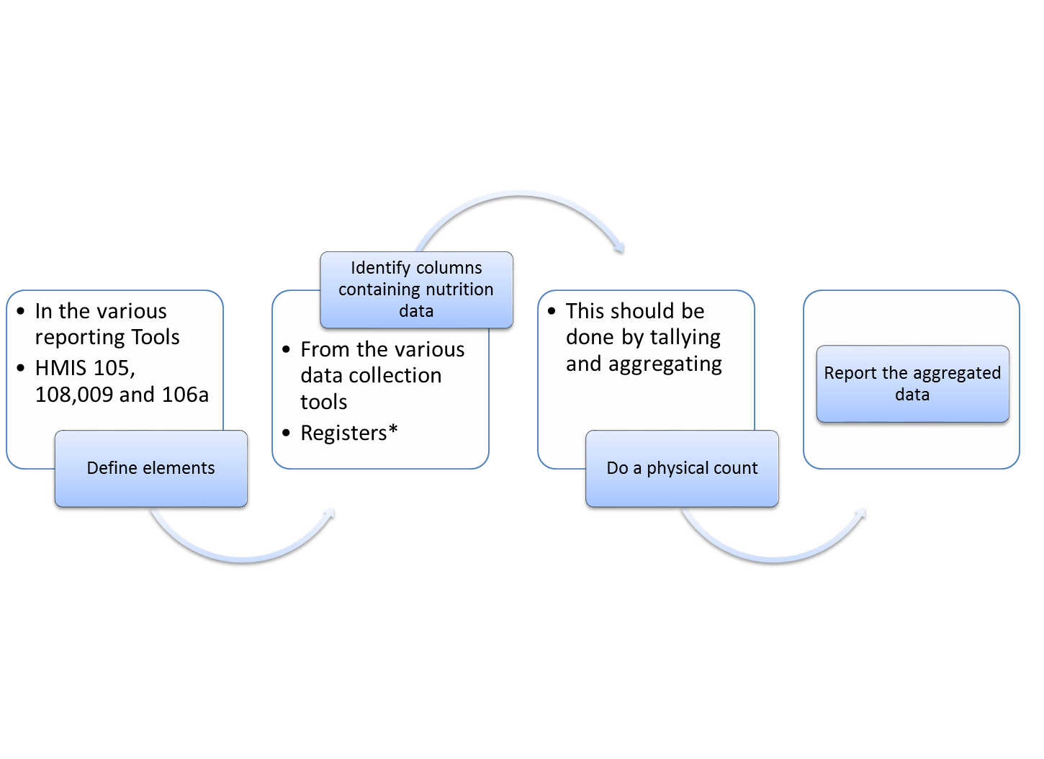
Objectives
3

Slide 23
Group Work
In 4 groups
From the dummy data tools provided:
  Identify the data quality aspects
  Extract data from dummy tools and feed in the quarterly and monthly reports
  Discuss challenges attributed to inequality data
  Suggest possible solutions
4

Slide 24
GROUP PRESENTATIONS
5

Slide 25
End of Session
6

