Slide 1

HEALTH MANAGEMENT INFORMATION FOR NUTRITION 2017
  Session 2.1
  Introduction to the Nutrition Situation in Uganda

Slide 2
Objectives
By the end of this session, participants should be able to:
Explain the extent and trends of malnutrition in Uganda
Describe national-level efforts to reduce malnutrition in Uganda

Slide 3
Trends in Nutritional Status of Children

Slide 4
Stunting by Region
UDHS 2016

Slide 5
Trends in Vitamin A Deficiency
Percent of children under 5 years

Slide 6
Women’s Nutritional Status
Percent distribution of women 15–49 years

Slide 7
Men’s Nutritional Status
Percent distribution of men 15–49 years

Slide 8
Trends in Anaemia in Children
Percent of children age 6–59 months classified as having anaemia

Slide 9
Trends in Anaemia in Women
Percent of women 15–49 classified as having anemia

Slide 10
Brainstorming Session
What are some of the government’s efforts to address malnutrition in Uganda?

Slide 11



















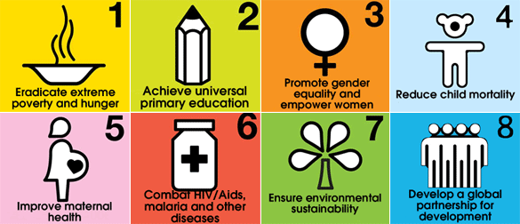
Transforming Global Strategies into National Policy
Government Efforts
Health Sector Strategic and Investment Plans (HSSDP)

Slide 12
National-Level Efforts to Address Malnutrition
Policies and guidelines
  Integrated Management of Acute Malnutrition (2016)
  Nutrition Assessment, Counselling, and Support in Routine Service Delivery training package (2016)
  Maternal Nutrition Guidelines (2010)
Micronutrient initiatives
  Food fortification (e.g., adding vitamin A to vegetable oil)
  Micronutrient supplementation
  Promotion of nutritious foods such as yellow/orange sweet potatoes
Health promotion strategies
  Universal National Expanded Program of Immunization (UNEPI)
  Growth Monitoring and Promotion (GMP)
  Health/nutrition counselling and education
  Water, sanitation, and hygiene (WASH)
Capacity building

Slide 13
Questions/Clarifications

Slide 14
End of Session

Slide 15
HEALTH MANAGEMENT INFORMATION FOR NUTRITION 2017
  Session 2.2
  Basics of Nutrition
1

Slide 16
Objectives
By the end of the session, participants should be able to:
Describe common clinical signs associated with malnutrition
Demonstrate ability to use common anthropometric equipment to take accurate measurements
Use anthropometry to determine nutritional status of individuals
Identify the Nutrition-HMIS counselling terms and codes
2

Slide 17
Brainstorm
What is malnutrition?
What are the categories of malnutrition?
3

Slide 18
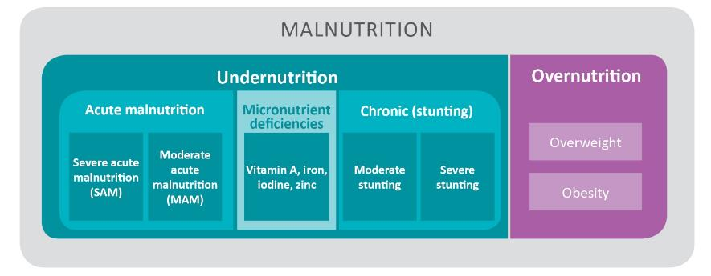
Types of Malnutrition and Categories of Acute Malnutrition
4

Slide 19
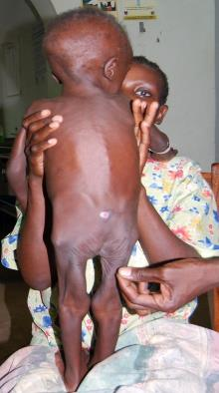
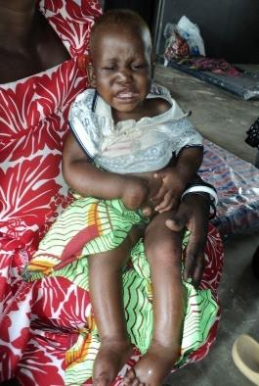
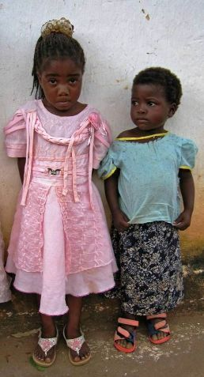
Common Forms of Undernutrition
Girls of the same age
Acute malnutrition
Girls of the same age
5

Slide 20
Plenary
Identify the clinical signs of malnutrition in the following pictures.
6

Slide 21
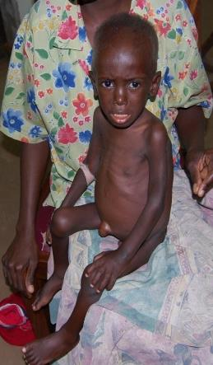
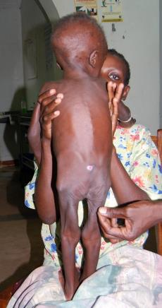
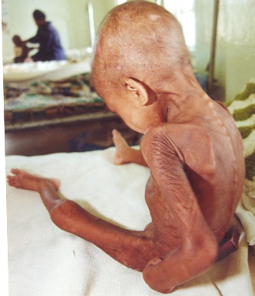
Clinical Signs of Undernutrition
7

Slide 22
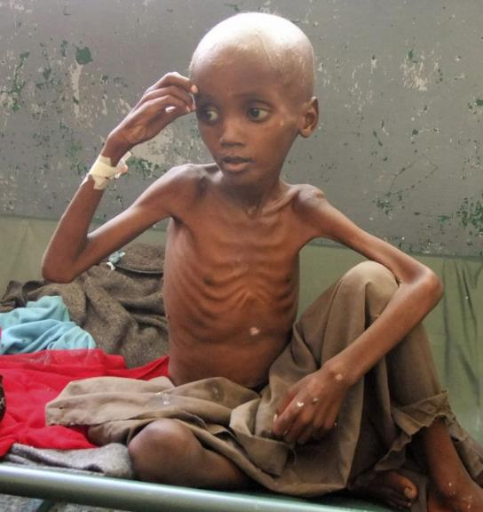
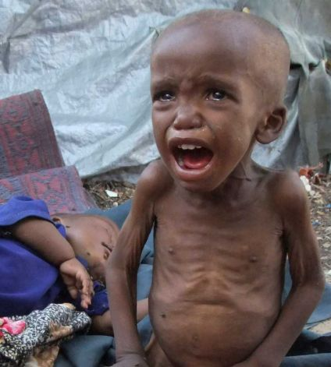
8

Slide 23
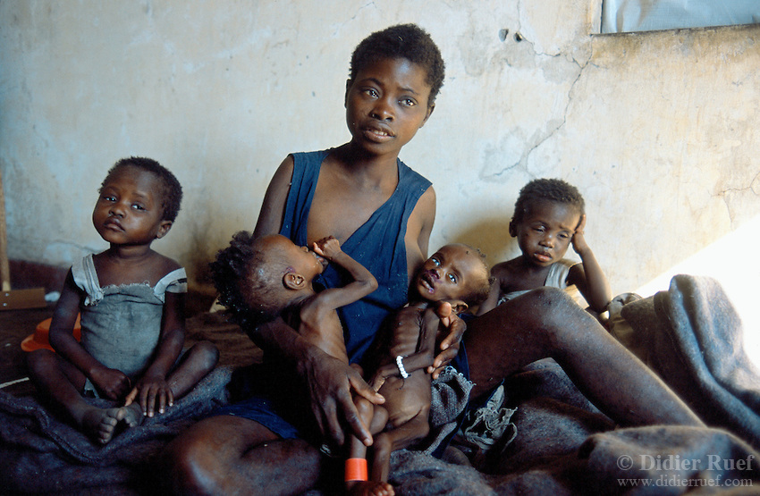
9

Slide 24
10

Slide 25
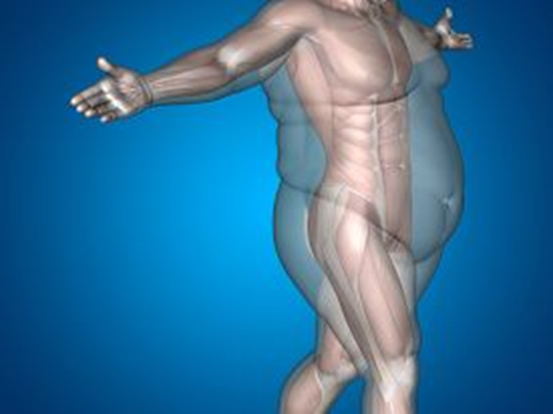
Overnutrition
11

Slide 26
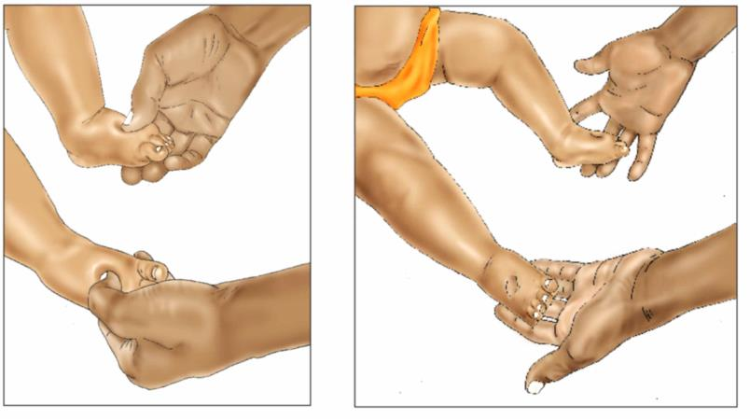
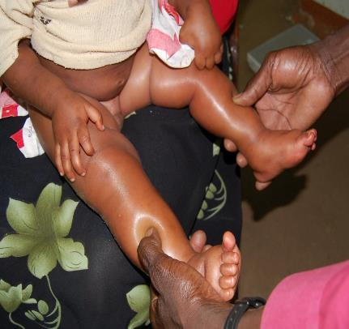
Clinical Signs, cont’d.
(Checking for Bilateral Pitting Oedema)
Once bilateral pitting oedema, no further assessment is required, the client has SAM-O.
12

Slide 27
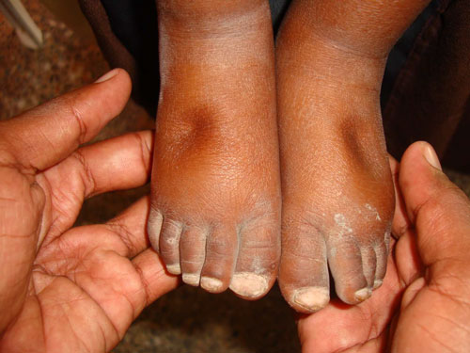
http://motherchildnutrition.org/early-malnutrition-detection/images/edema-step2.jpg
13

Slide 28
Clinical Signs, cont’d.
(Grades of Bilateral Pitting Oedema)
Grade
Absent | No oedema
Grade + | Mild: Both feet (below the ankles)
Grade ++ | Moderate: Both feet and legs (below the knees), hands, or lower arms
Grade +++ | Severe: Generalized bilateral pitting oedema, including both feet, legs, arms, and face
14

Slide 29
Anthropometry
15

Slide 30
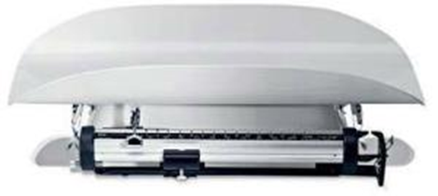
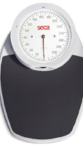
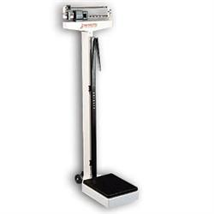
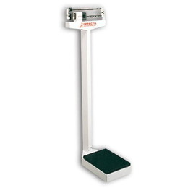
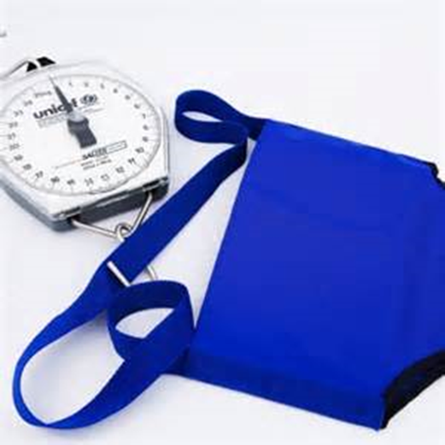
Commonly Used Weighing Scales
16

Slide 31
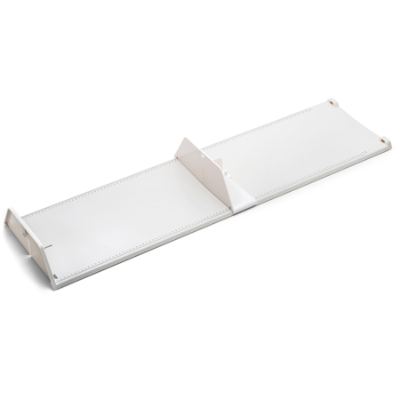

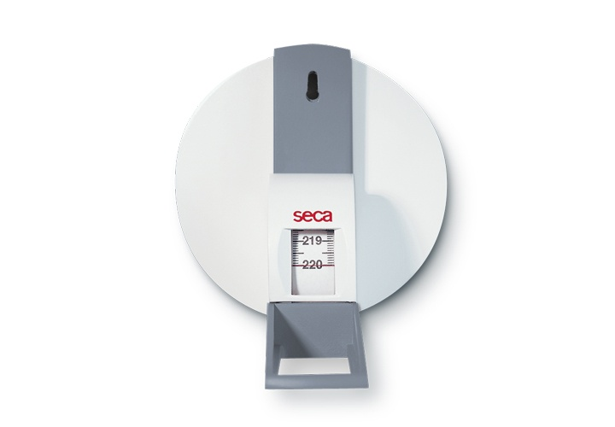
Commonly Used Height/
Length Boards/Tapes
17

Slide 32
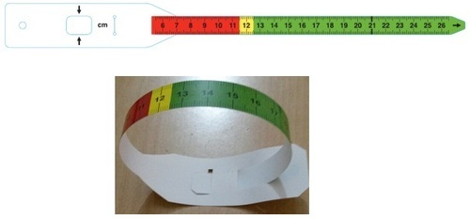
Commonly Used MUAC Tapes
18

Slide 33
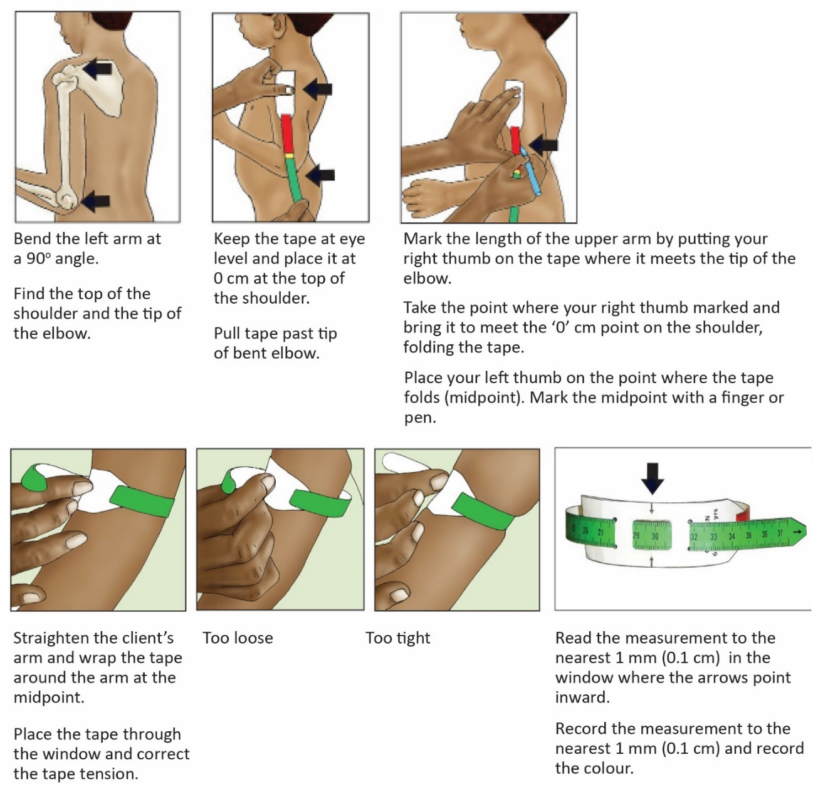
Steps to Accurately Use a MUAC Tape
19

Slide 34
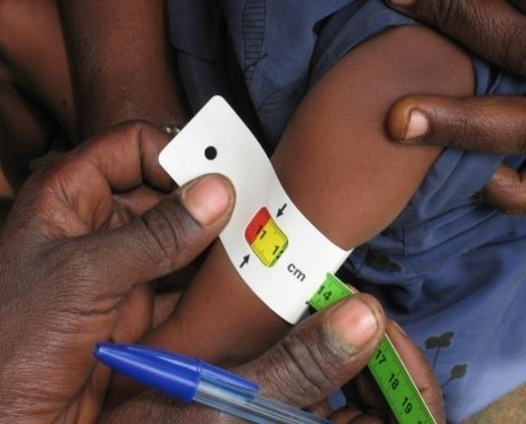
MUAC
20

Slide 35
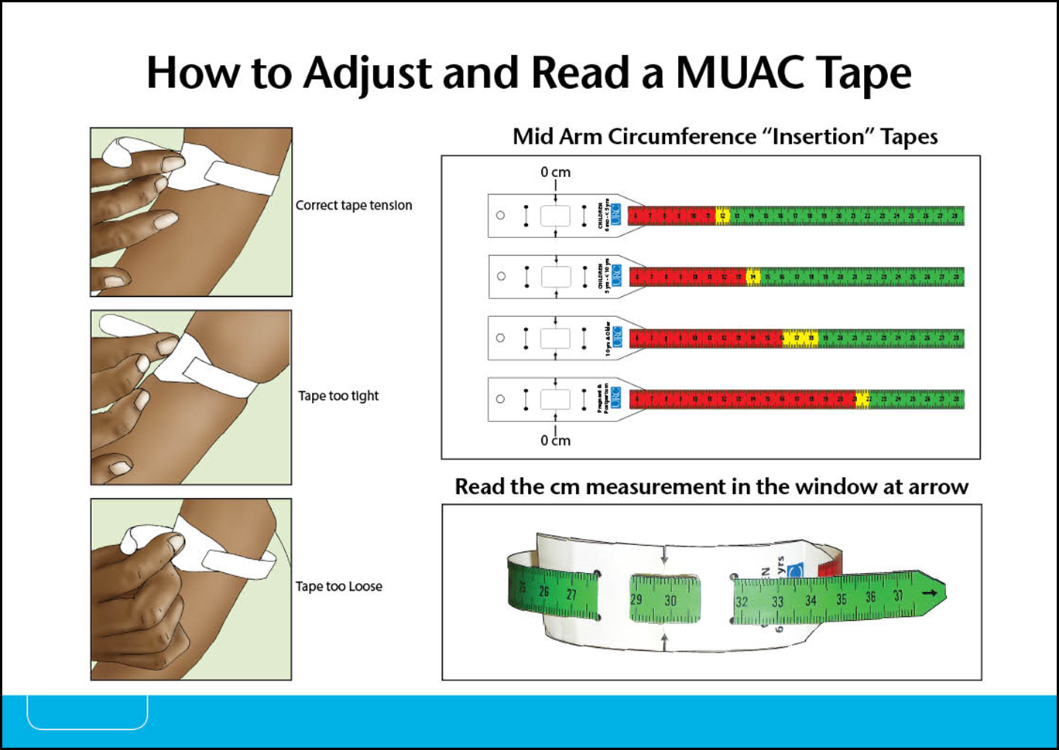
Mid-Upper Arm Circumference
21

Slide 36
Classifying Nutritional Status
Using Cut-offs—MUAC
Group | Severe acute malnutrition (SAM) | Moderate acute malnutrition (MAM) | Normal
Infants and children 6 months to 5 years | < 11.5 cm | ≥ 11.5 to < 12.5 cm | ≥ 12.5 cm
Children 5 - < 10 years | < 13.5 cm | ≥ 13.5 to < 14.5 cm | ≥ 14.5 cm
Children 10 - < 15 years | < 16.0 cm | ≥ 16.0 to < 18.5 cm | ≥ 18.5 cm
Children 15 - < 18 years | < 18.5 cm | ≥ 18.5 to < 21 cm | ≥ 21.0 cm
Adults >18 years and older | < 19.0 cm | ≥ 19.0 to < 22.0 cm | ≥ 22.0 cm
Pregnant women or mothers with infants up to 6 months | < 19.0 cm | ≥ 19.0 to < 22.0 cm | ≥ 22.0 cm
Elderly (60 years+) | < 16.0 cm | ≥ 16.0 to < 18.5 cm | ≥ 18.5 cm
22

Slide 37
Group Work: Nutrition Assessment (20 minutes)
Divide into 5 groups and practice taking anthropometric measurements for all group members.
  MUAC
  Weight
  Height/length
Each group should record all measurements for future reference.
23

Slide 38
Anthropometric Indices
24

Slide 39
Relationship between Anthropometric Indices and Nutritional Status
Children <5 years
Weight
Length
Height
Weight
Weight
Age
Age
Age
Length
Height
Underweight
Stunting
Wasting
( <2 years/ <87 cm)
(≥2 years/ ≥87 cm)
(<2 years/ <87 cm)
(≥2 years/≥87 cm)
Children and adolescents (5–19 years)
Adults (19 years+)
Weight
Weight
Height²
Height²
Age
Body Mass Index
(Adults 19 years+)
BMI-for-Age
25

Slide 40
BMI
Indicator of body fatness or thinness
Measures malnutrition in adults (above 19 years)
DO NOT use to measure nutritional status of:
  Pregnant women
  Lactating women in their first 6 months postpartum
  Adults with oedema
  The elderly, 60 years and older
(Use MUAC instead.)
26

Slide 41
BMI Calculation: Example
BMI = weight in kg/(height in m)²
For example:
Weight = 78 kg
Height = 165 cm (165 cm = 1.65 m)
78
1.65²
78
2.7225
=
=
28.650
=
28.5
27

Slide 42
Exercise: Calculating BMI
Calculate the BMI of the following clients:
Peter weighs 65 kg and is 170 cm tall
Allen: 75 kg and 156 cm tall
Joanne: 45 kg and 164 cm tall
Kim: 30 kg and 123 cm tall
28

Slide 43
Classifying Nutritional Status
Using Cut-offs—BMI
BMI (Adults 19 years and older)
BMI (kg/m²) | Classification
< 16.0 | Severe acute malnutrition
16.0–16.9 | Moderate acute malnutrition
17.0–18.4 | At risk/mild malnutrition
18.5–24.9 | Normal nutritional status
25.0–29.9 | Overweight
≥ 30.0 | Obese
29

Slide 44
Classifying Nutritional
Status Using the BMI Wheel
Use the side of the wheel that reads ‘Instructions’.
The inner/smaller disc shows height; the outer/larger disc shows weight.
Turn the top disc until the height of the client is aligned with the weight of the client.
Read the number the arrow labelled ‘BMI’ is pointing to on the outer disc.
30

Slide 45
Classifying Nutritional
Status Using the BMI Wheel, cont’d.
Look at the box at the bottom of the wheel labelled ‘Nutritional status for adults 19 years and older’.
Find the range that contains the client’s BMI and classify the client’s nutritional status.
On the BMI heel:
  ‘severely underweight’ means SAM
  ‘moderately underweight’ means MAM
  ‘mildly underweight’ means ‘at risk’ of malnutrition
31

Slide 46
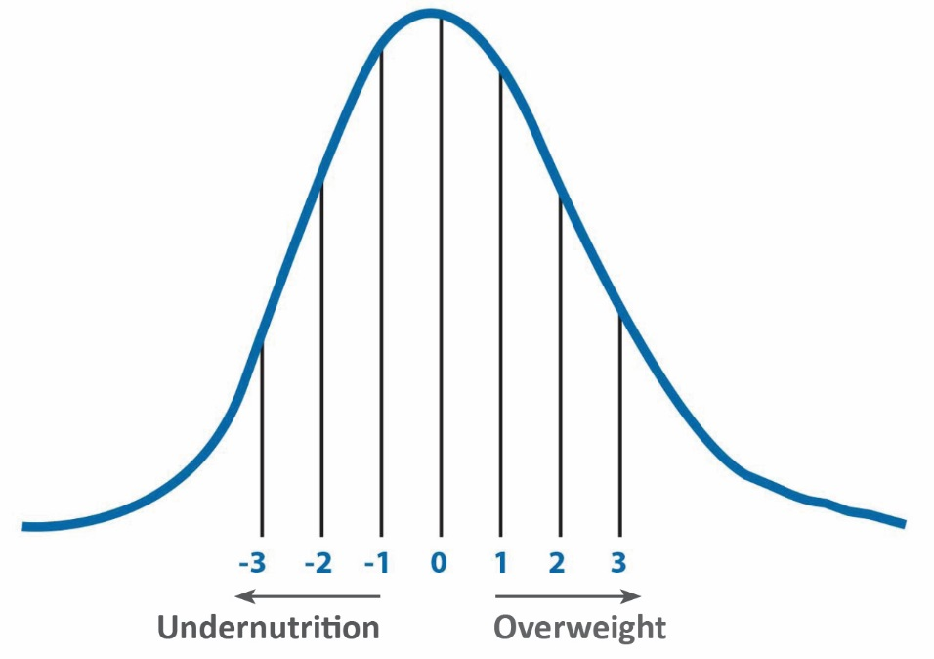
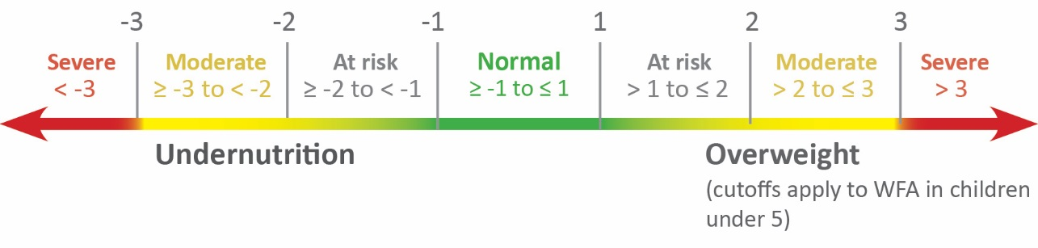
Classification of Nutritional
Status Using Z-Scores
32

Slide 47
Classification of Nutritional
Status Using Z-Scores, cont’d.
WHO growth charts and field tables help determine nutritional status by:
Sex (Blue for boys and Pink for girls)
Age group (birth-2 years, 2-5 years, 5-19 years) for:
  Height/length-for-age z-score
  Weight-for-height z-score
  Weight-for-age z-score
  BMI-for-age z-score
33

Slide 48
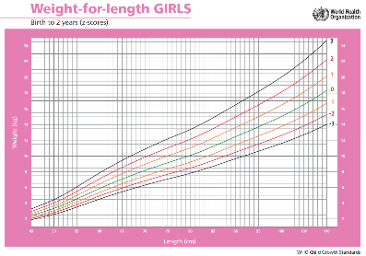
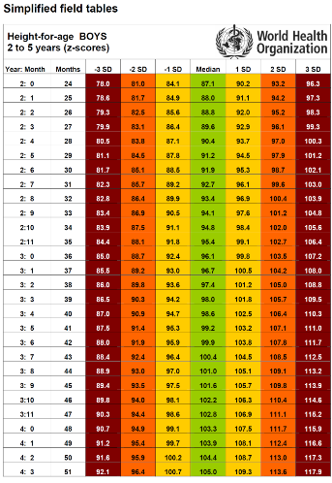
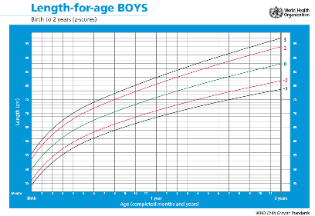
Growth Charts
Field Table
34

Slide 49
Reading the WHO
Chart/Field Tables
Instruction
Find the correct chart for the patient’s age group and sex.
Find the patient’s weight/age on the horizontal axis at the bottom (round to the nearest whole number).
Find the patient’s height/weight on the vertical axis.
Read the number where the two lines meet. These are the patient’s weight-for-height, weight-for-age, and BMI-for-age, respectively.
35

Slide 50
BMI-for-Age (5–19 Years)
Preferred way of classifying nutritional status of children and adolescents 5-19 years.
Reflects variations on body composition by age and gender.
BMI-for-age tables/charts or wheel can be used to classify nutrition of children 5-19 years disaggregated by sex.
(WHO Reference Charts)
36

Slide 51
Finding BMI-for-Age for Children and Adolescents Using BMI Chart/Field Tables
Instructions
Find the client's BMI (as shown previously).
Find the correct BMI-for-age table for the client's sex.
Round the age to the nearest 6 months and find it in the table's middle column.
Find the range within which the client’s BMI lies under the client’s sex.
Example: A boy 5 years and 9 months with a BMI of 12.5 has a z-score between -3 and -2 and is moderately malnourished.
37

Slide 52
Using the BMI Wheel to Classify Nutritional Status for BMI-for-Age
(5–19 years)
BMI-for-Age
Find the patient’s BMI (as shown previously).
Turn the wheel over and point the arrow to the number closest to the patient’s age.
Using the BMI value (above), find the nutritional status by sex.
38

Slide 53
Group Work
Nutritional Assessment and Classification (Exercise 1, 2, 3)
(Reference Manual, Pages 28–29)
39

Slide 54
Summary
Age Group | Measure | SAM | MAM
< 6 months | Weight-for-length | < -3 z-score Other signs (too weak to suckle/feed, body weight < 3 kg) | ≥ -3 to < -2 z-score
6 months to 5 years | Weight-for-length Weight-for-height | < -3 z-score | ≥ -3 to < -2 z-score
 | MUAC | < 11.5 cm | ≥11.5 to < 12.5
All ages | Bilateral pitting oedema | present
40

Slide 55
Summary, cont’d.
Age Group | Measure | SAM | MAM
5 to 19 years | BMI-for-Age | < -3 z-score | ≥ -3 to < -2 z-score
5 to 10 years | MUAC | < 13.5 cm | ≥ 13.5 to < 14.5 cm
10 to 15 years | MUAC | < 16.0 cm | ≥ 16.0 to < 18.5 cm
15 to 18 years | MUAC | < 18.5 cm | ≥ 18.5 to < 21.0 cm
All ages | Bilateral pitting oedema | Present
41

Slide 56
Summary, cont’d.
Age Group | Measure | SAM | MAM
Adults 18 to 59 years | BMI | < 16 | ≥ 16 to < 17
 | MUAC | < 19 cm | ≥ 19 to < 22 cm
Pregnant women or mothers with infants < 6 months | MUAC | < 19 cm | ≥ 19 to < 22 cm
Elderly 60+ | MUAC | < 16.0 cm | ≥ 16.0 to < 18.5 cm
All ages | Bilateral pitting oedema | Present
0–59months | Height-for-age | <-2SD (Stunted) | ≥-2 (Not stunted)
42

Slide 57
Key HMIS-Nutrition Terms
Nutritional Counselling
A form of interpersonal communication through which a person is helped to assess his/ her current Nutritional situation and explore ways to address his/her nutritional problems.
NB: Effective counselling respects the client’s own thoughts, beliefs, and culture.
Infant Feeding Counselling
Counselling on breastfeeding and complementary feeding, including counseling on infant feeding in the context of HIV/AIDS
43

Slide 58
Key HMIS-Nutrition Feeding Practice Terms and Codes
Pre-lacteal feeding
Giving other fluids or foods to a baby before initiation of breast feeding
Exclusive breastfeeding (EBF)
Giving a baby ONLY breast milk; without any other liquids or solids, not even water
*Only prescribed drops or syrups consisting of vitamins and mineral supplements or medicines may be given. Exclusive breastfeeding is recommended until a baby is 6 months of age.
44

Slide 59
Key HMIS-Nutrition Feeding Practice Terms and Codes, cont’d.
Replacement feeding (RF)
Feeding a child who is not receiving any breast milk with a diet that provides all the nutrients the child needs, until the child is fully fed family foods
Mixed feeding
Feeding both breast milk and other foods or liquids to a child under 6 months of age
Complementary feeding (CF)
Giving a baby other foods in addition to breast milk starting at 6 months of age
45

Slide 60
Key HMIS-Nutrition Feeding Practice Terms and Codes, cont’d.
Weaning (W)
Gradually introducing a child to family food and withdrawing breastfeeding/breast milk; recommended after 2 years
Re-lactation
Re-establishing breastfeeding after a mother had stopped, whether in the recent or distant past
No longer breastfeeding (NLB)
  Breastfeeding before and has stopped
Note The code for a mother who is not breastfeeding can be either NLB or RF
46

Slide 61
End of Session
47

