Slide 1

HEALTH MANAGEMENT INFORMATION FOR NUTRITION 2017
  Introductory Session
  Training in the Health Management Information System for Nutrition

Slide 2
Objectives
By end of this session, participants should be able to:
Know each other and complete the daily registration forms
Identify leaders to support the training
Understand course duration, structure, expectations, training methodology
Determine course norms

Slide 3
Introductory Session
Introductions
Course leaders
  Chairperson
  Spiritual leader
  Energizer
  Welfare manager
Notes:
Following introductions, ask participants to change their sitting positions, to minimize side discussions during sessions

Slide 4
Introductory Session, cont’d.
Training expectations
Course norms
Notes:
Following introductions, ask participants to change their sitting positions, to minimize side discussions during sessions

Slide 5
Introductory Session, cont’d.
Aim: Capacity building in nutrition data collection, aggregation, routine reporting, and utilization
Duration: 5 days
Structure: Five modules
      Overview of HMIS
      HMIS for nutrition
      Key nutrition data sources
      Routine nutrition data monitoring and reporting
      Nutrition data quality
Notes:
Following introductions, ask participants to change their sitting positions, to minimize side discussions during sessions

Slide 6
Introductory Session, cont’d.
Training methodology:
  Theory
  Practical
  Brain storming
  Group work
  Exercises/Drills
  Case scenarios
Notes:
Following introductions, ask participants to change their sitting positions, to minimize side discussions during sessions

Slide 7
Introductory Session, cont’d
Key training materials
  Reference manuals
  Anthropometric equipment
  Anthropometric charts/tables
  HMIS data tools (cards, registers, tally sheets, report forms)
  IEC materials

Slide 8
Any Questions?
Let’s get started!

Slide 9
HEALTH MANAGEMENT INFORMATION FOR NUTRITION 2017
  Session 1.1
  The Health Management Information System
1

Slide 10
Objectives
By end of this session, participants should be able to:
Explain the objectives of HMIS, its framework, and reporting structure
Describe HMIS data sources, data flow, routine reports, and timelines of reporting
2

Slide 11
Brainstorming
What is HMIS?
What is the HMIS used for?
3

Slide 12
Introduction
HMIS is an integrated system used by MOH, development partners, and stakeholders to collect relevant and functional information on a routine basis to monitor the Health Sector Strategic and Development Plan (HSSDP) indicators to enable planning, decision making, monitoring, and evaluation of the health care delivery system.
It is designed to assist managers to undertake evidence- based decision making at all levels of the health care service delivery system.
4

Slide 13
Goal of HMIS
To provide quality data that supports evidence-based decision making at all levels of the health care service delivery system in Uganda
5

Slide 14
Objectives of HMIS
Provide quality data to support evidence-based decision making in the health sector
Aid in setting performance targets at all levels of health care service delivery
Assist in assessing performance at all levels of the health sector
Encourage use of health information
6

Slide 15
Attributes of HMIS
Relevant: HMIS is designed to be relevant to the policies and goals of the Government of Uganda.
Functional: The data captured within the HMIS is to be used by management to inform evidence-based decisions aimed at improving the health of the population served.
Integrated: There is one set of forms for collecting administrative data with no duplication of reporting.
Routine: Information is collected on a routine basis from every health unit in all districts of the country.
7

Slide 16
Categories of HMIS Documentation
HMIS manual: This is sub-divided into seven technical modules. The manual consists of all pre-primary and primary data collection tools (patient cards, registers, among others).
HMIS database: This is a document that contains all relevant summary tables for summarizing data from the primary data collection tools.
Indicator booklet: This contains indicator definitions, methods of data collection, frequency, calculation, and interpretation.
8

Slide 17
Uses of HMIS
Planning
Predicting epidemics
Detecting epidemics
Designing disease-specific interventions
Monitoring work plan performance
Allocating resources
9

Slide 18
Group Work/Presentation
In groups of 5–7 participants, answer one of the following:
Identify the various sources of HMIS data.
    OR
Describe the flow of HMIS data in Uganda’s health system.
10

Slide 19
HMIS Data Sources and Flow
Sources of Data
HMIS data are largely captured at health facility/ community levels depending on the point of contact between a health worker/health support and a patient/client.
The data are collected using standardized data collection tools and aggregated at health facility, HSD, district, and finally at national level.
Data at national level are accessed through the electronic system—DHIS2—by stakeholders, depending upon acquisition of user access credentials.
11

Slide 20
Other Sources of Health Data
Administrative: Information on inventories, supervision, management meetings, etc.
Population-based health surveys: Mainly carried out by Uganda Bureau of Statistics (UBOS) and other institutions that generate data relative to populations (population studies) as a whole, e.g., UDHS, UNHS, among others.
Research institutions and academic data: Involves health systems research, clinical trials, and longitudinal community studies.
Sentinel sites.
12

Slide 21
Other Sources of Health Data, cont’d.
  Civil registration and vital statistics system: Essential for providing quality data on births, deaths, and causes of death.
  6. Population and Household Census: Carried out every 10 years and is the primary source of data on size of population(s), geographic distribution, and the social, demographic, and economic characteristics. Annual projections at national and sub-national level are provided by UBOS.
13

Slide 22
Categories of HMIS Data Tools
Pre-primary tools: Contain the first contact information used to identify/locate a patient’s details
Primary tools: Record patient details on a daily basis; basis for evaluating health unit performance
Secondary tools: Reports, summary of performance by programmatic area
Management data: Used to evaluate health unit managerial functions
14

Slide 23
Categories of HMIS Data Collection Tools (Examples)
Pre-primary
Primary
Secondary
Management
Medical form 5
Requests (lab, x-ray)
Treatment sheet
Treatment follow-up form
Patient cards
Referral notes
Registers
Out-patient
Inpatient
Antenatal
INR
Laboratory
Child
Operating theatre
Log books
Daily consumption log
Record books
Cash analysis
Report forms
Notification (HMIS033a)
Weekly (HMIS 033b)
Monthly (HMIS 105)
Nutrition Addendum (HMIS 009)
Quarterly (HMIS 106a)
Annual (HMIS form 107)
Summary tables
Annual
Monthly
Record of management meetings
Record of support supervision
Tool for HMIS support supervision
Inventory tools
Medical and other health supplies
Finance and accounting
15

Slide 24
Data Communication and Feedback
All health service delivery data and information must be routed through the MOH Division of Health Information for validation, analysis, and dissemination.
Feedback mechanisms on reported data flow from top to bottom (Ministry of Health to the community level).
16

Slide 25
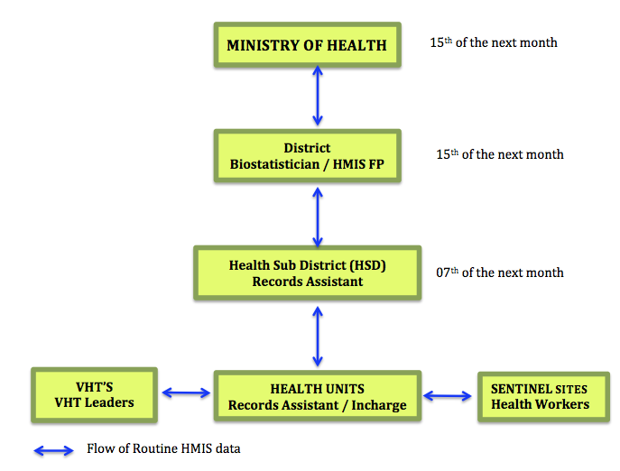
HMIS reporting structure
17

Slide 26
Routine Reports and Their Timeliness
Routine reports (examples) | Timeline of reporting by the HF
Weekly report (HMIS 033b) | Every Monday
Monthly reports (HMIS 105, HMIS 009, HMIS 108) | 7th of the next month
Quarterly report (HMIS 106a) | Due 7th October, 7th January, 7th April, 7th July
Annual report (HMIS 107) | Due 7th August
18

Slide 27
End of Session
19

Slide 28
HEALTH MANAGEMENT INFORMATION FOR NUTRITION 2017
  Session 1.2
  The District Health Information System (DHIS2)
1

Slide 29
Session Objectives
By the end of this session, participants should be able to:
– Describe the evolution of eHMIS
– Discuss the implementation of DHIS2 in Uganda
– Explain the key dimensions of DHIS2
– Navigate the DHIS2 software
2

Slide 30
Evolution of eHMIS
HMIS was introduced in 1985.
With the introduction of the Health Sector Strategic and Development Plan (HSSDP), the HMIS was revised to provide data to monitor the performance of the HSSDP.
In 2005, age and gender disaggregation and Epi-Info-based system was introduced.
In 2007, the District-HIS (DHIS version 1) was introduced.
It was upgraded to web-based HMIS (w-HMIS) in 2008.
In 2011/2012, a National electronic system, DHIS version 2 (DHIS2) was approved in Uganda.
3

Slide 31
DHIS2 Overview
A web-based application used for collection, validation, analysis, and presentation of aggregate statistical data tailored to integrated health information management activities.
Generic in nature, the contents can be customized without programming.
Developed by the Health Information Systems Programme (HISP) project as an open source and globally distributed program.
4

Slide 32
DHIS2 Implementation in Uganda
With support from implementing partners, MOH-Division of Health Information (DHI) rolled out to all districts, Regional Referral Hospitals, and a few Health Sub-districts and Health Units starting in 2011.
5

Slide 33
Accessing DHIS2
DHIS2 is accessible on a standard web browser.
  URL: http://hmis2.health.go.ug/
  MOH website: health.go.ug
  To access the system, type the URL in a web browser and a Login Page will appear.
  Username and Password are required to gain entry to the main features of the system.
  A Standard Operating Procedure (SOP) on getting access to the system is in place at the MOH/DHI or MOH Web Portal.
6

Slide 34
Navigating DHIS2
DHIS2 has two main menu items:
  The Apps Menu (Most features in DHIS2 appear as independent application)
  The Profile Menu (Account settings, Help sub-menu and Log out of the system)
For ease of use, a search box is provided to quickly search for and display a feature of choice.
7

Slide 35
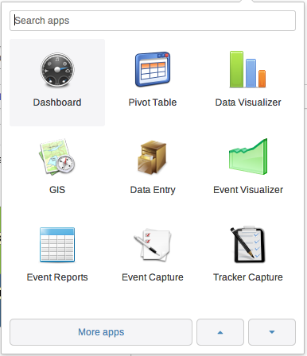
Features of DHIS2—Demonstration
And Many More!
8

Slide 36
Benefits of DHIS2
Designed to facilitate smooth harmonized national reporting.
Facilitates data use and sharing with stakeholders at various levels.
Can be customized to include additional requirements.
Enables data entry and reporting at various levels and for different reporting cycles.
9

Slide 37
Benefits of DHIS2, cont’d.
Provides different applications for data validation for improvement of data quality.
Is a simple, flexible, and open-source information system with easy to use visualization features such as GIS, charts and pivot tables.
10

Slide 38
DHIS2 Terminology
Data elements
Data sets
Indicators
Organisation units (org units)
Reporting periods
11

Slide 39
DHIS2 Terminology, cont’d.
Data element: Unit of data entry
Data set: A set of related data elements that are collected together
  An equivalent of a data entry form
  Not linked directly to the data What?
  Can be modified at any time
  Focus is on the data output, not where it came from
Data elements can be part of many datasets
12

Slide 40
DHIS2 Terminology, cont’d.
Indicators
‘Variables that help to measure changes, directly or indirectly’ (WHO 1981).
A combination of one or more data elements
‘They are tools used to convert raw data into information’.
13

Slide 41
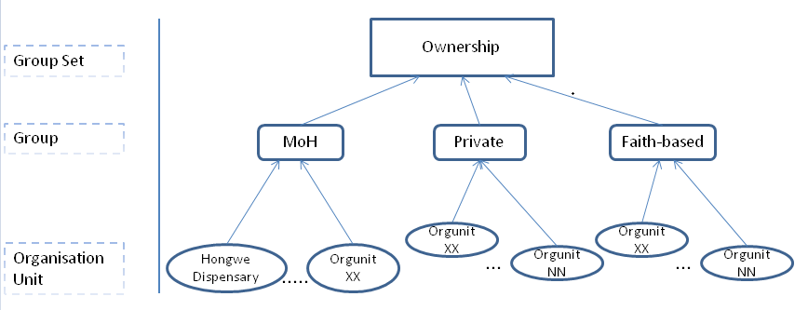
DHIS2 Terminology, cont’d.
Organisation Unit
The location of the data, the geographical context, is represented as organisation units.
Organisation units can be either a health facility or department/sub-unit that provides services or an administrative unit that represents a geographical area (e.g., a district) . Where?
14

Slide 42
DHIS2 Terminology, cont’d.
Reporting period
The frequency of reporting a set of defined indicators/variables through a dataset.
  Daily
  Weekly
  Monthly When?
  Quarterly
  Bi-annual
  Annual (can either be calendar or financial)
15

Slide 43
DHIS2 Core Dimensions
DHIS2 dimensions can be summarized as:
What – data element
Where – organization unit
When – time period
Illustration
WHAT | WHERE | WHEN
Data element | Organisation Unit | Time Period | Value
No. of clients with moderate acute malnutrition | Mukono HCIV | Dec-09 | 22
16

Slide 44
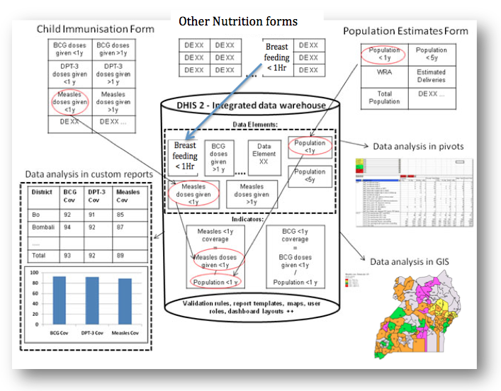
DHIS2 Data Model:
Data input = Data output
Overview
17

Slide 45
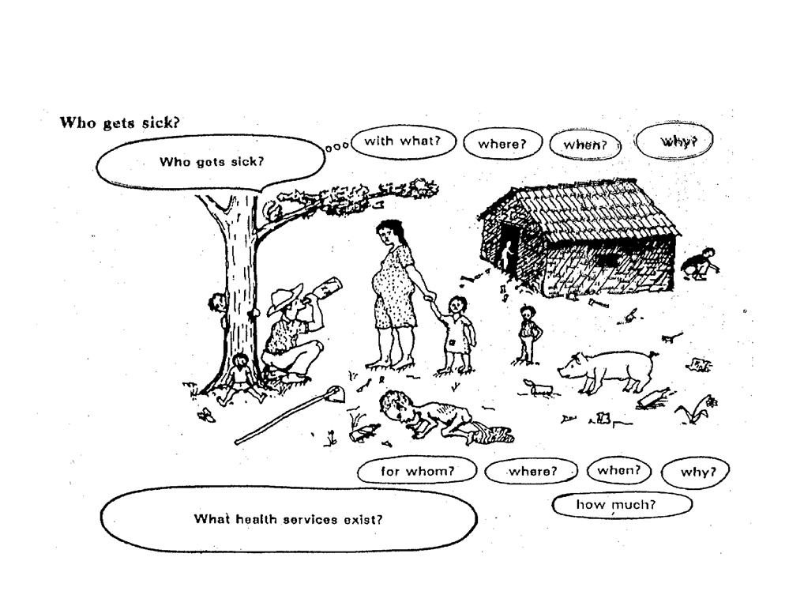
In summary, with DHIS2 we can know…
18

Slide 46
Practical Session
1. Data Entry of HMIS 105, HMIS 106a Nutrition Data
  Divide into groups of 5-6 participants.
  Create a folder on your desktop and name it ‘nutrition training’.
  Use the username and password provided to access (enter) the system (DHIS2)
  On the dashboard, click on the Apps icon and choose the data entry module.
  On the data entry screen, select the dimensions (what, when, where) of interest.
  Using the dummy tools provided, enter the nutrition data elements into the data set provided (either HMIS 105 or HMIS 106a, not both).
19

Slide 47
Practical Session
2. In groups of 5–6 participants, select a district of reference and try out case scenario set 4 (Reference Manual page 74).
Prepare to present in plenary.
20

Slide 48
Group Presentations
Group 1: Report rate summary
Group 2: Pivot table
Group 3: Data Visualizer
Group 4: Dashboard
21

Slide 49
End of Session
22

