Slide 1
District/LLG-Level Nutrition
Advocacy Planning Workshop:
Day 1
[Insert date and location]

Slide 2
Welcoming Remarks

Slide 3
Session 1 Purpose of the Workshop: Why Advocacy and Why Now?

Slide 4
Introductions
Please state your:
Name
Organization
Role
Interest in nutrition advocacy

Slide 5
Discussion Questions
How do you define advocacy?
What are some experiences with nutrition advocacy that you would like to share?
Notes:
Note: Districts/LLGs who have had their MSNAP approved can discuss how they used advocacy to make that happen.

Slide 6
Purpose of the Workshop
Develop district/LLG-level multi-sectoral strategic nutrition advocacy approaches that support implementation of multi-sectoral nutrition action plans (MSNAPs)
Create talking points for each district/LLG that correspond with the advocacy approach
Practice using talking points
Notes:
If all of the districts/LLGs at the workshop have developed MSNAPs, emphasize here that the next step in the process is to get the MSNAPs approved if they haven’t been yet and begin implementation. This workshop is meant to develop an advocacy approach, tailored to each district/LLG and where they are in the process, so that advocacy can be used to either get their MSNAP approved, funded or implemented.

Slide 7
Why Advocacy and Why Now?
We are using the term ‘advocacy’ to describe increasing resources and political/social commitment for nutrition.
Advocacy is a key component that supports all future communication efforts.
Advocacy is essential now to:
Create awareness and understanding of the importance of nutrition among the public and within government
Ensure adequate resources and structures for nutrition services
Increase political action and accountability among government and stakeholders
Notes:
Advocacy is a planned, deliberate, systematic and coordinated process, so stakeholders can speak in one harmonized voice. The aim of this workshop is to create an advocacy approach, and to do this, the work you will do is to:
Prioritize who you want to communicate with (audience) and
What you want to communicate about/on (desired change and intent of advocacy communication)
How you want to communicate (activities and materials)
How you will measure your success (indicators and means of verification)
By when you will complete these activities (timeline)
Who will be responsible (responsible parties)

Slide 8
Expectations
What are your expectations during this workshop?

Slide 9
Review Agenda

Slide 10
Visualization in Participatory Programmes (VIPP)
VIPP allows everyone’s voice to be heard.
Rules:
Include one thought per card
Use a marker, not a pen
Write with broad side of marker
Limit to no more than three lines per card
Print legibly

Slide 11
Session 2 National Nutrition Situation and Policy Environment

Slide 12
Nutrition Situation in [insert country]

Slide 13
Session Outline
Nutrition situation
Consequences of prevailing situation
Government priorities:
Current initiatives
Policy environment
Commitments
28
9
14
Percent of children under 5
*Based on the new WHO Child Growth Standards

Slide 14
Malnutrition Prevalence
Sources:
Notes:
[Content to be added by facilitators]

Slide 15
Nutrition Situation
Underweight
Notes:
[Content to be added by facilitators]

Slide 16
Nutrition Situation
Stunting
Notes:
[Content to be added by facilitators]

Slide 17
Nutrition Situation
Wasting
Notes:
[Content to be added by facilitators]

Slide 18
Nutrition Situation
Iodine deficiency
Notes:
[Content to be added by facilitators]

Slide 19
Nutrition Situation
Iron deficiency
Notes:
[Content to be added by facilitators]

Slide 20
Nutrition Situation
Anaemia
Notes:
[Content to be added by facilitators]

Slide 21
Nutrition Situation
Infant and young child feeding
Notes:
[Content to be added by facilitators]

Slide 22
Consequences of Prevailing Situation
Notes:
[Content to be added by facilitators]

Slide 23
Government Priorities
Notes:
[Content to be added by facilitators]

Slide 24
Current Initiatives
Notes:
[Content to be added by facilitators]

Slide 25
Policy Environment
Notes:
[Content to be added by facilitators]

Slide 26
Commitments

Slide 27
Thank you

Slide 28
Tea Break

Slide 29
Session 3 National Nutrition Advocacy Strategies, Materials, and Resources

Slide 30
Examples from Uganda

Slide 31
Uganda Nutrition Advocacy and Communication Strategy

Slide 32
Four Pillars of the Strategy
NA & C Strategy
Indicators
and Outcomes
Pillar 1: Protecting individuals during the first 1,000 days
Indicators
and Outcomes
Pillar 3: Promoting positive role models
Pillar 2: Promoting healthy Ugandan diets
Indicators
and Outcomes
Indicators
and Outcomes
Pillar 4: Accountability

Slide 33
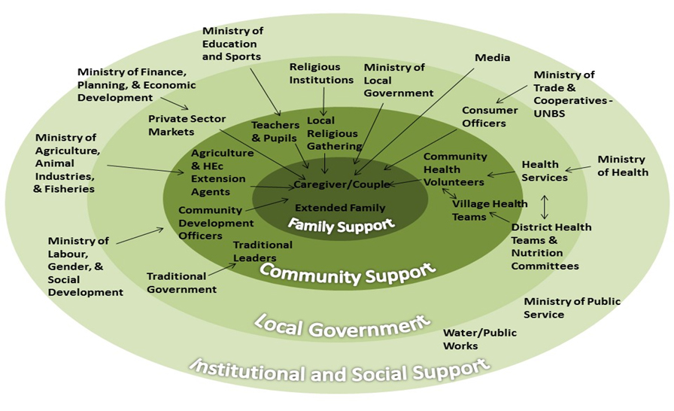
NA&C Pathways of Influence
Notes:
This is critical in helping the participants differentiate between advocacy, behaviour change communication (BCC), and social mobilization. Social mobilization and BCC cover community and family support while advocacy covers the local government and the institutional and social support.

Slide 34
Nutrition Advocacy Package
Materials developed include fact sheets on:
Health and nutrition
Agriculture and nutrition
Economic productivity and nutrition
Education and nutrition
Additional materials targeted:
Media
Civil society organizations
Community-based services officers
Faith leaders
Development partners

Slide 35
Resources Available to Support Nutrition Advocacy: PROFILES

Slide 36
What Is PROFILES?
An evidence-based tool to support nutrition advocacy.
PROFILES uses computer-based models and current country-specific data to estimate the benefits of improved nutrition on health and development outcomes, and the negative consequences if malnutrition continues over a defined time period.
PROFILES estimates are intended to support nutrition advocacy efforts targeting multiple audiences (e.g., communities, local government authorities, parliamentarians).
Notes:
First, let me briefly review what is PROFILES.
PROFILES is a computer-based model that serves as a tool to support nutrition advocacy. It consists of a set of spreadsheet models reflecting current scientific nutrition knowledge and is designed to estimate the functional consequences of malnutrition to support advocacy and communication with policymakers, programme implementers, and other stakeholders.
The basic approach in PROFILES is to provide two scenarios, contrasting a status quo scenario that assumes there will be no change from the current situation throughout the chosen time period (aside from projected changes in population size) with an improved scenario.
The improved scenario—with results estimated for the same time period—assumes that nutrition interventions that are known to be effective are implemented at scale and succeed in reaching the specified targets in terms of reductions in the prevalence of the various nutrition problems. In the status quo scenario, consequences are expressed in terms of lives lost or economic productivity losses, for example. When contrasting the results from the status quo and the improved scenarios, the differences reflect benefits expressed as lives saved or economic productivity gains. Although nutrition interventions are not included in the PROFILES models, the subsequent steps in the nutrition advocacy process can address the need for various nutrition services, interventions, programmes, or issues related to the nutrition policy environment.

Slide 37
General Assumptions of PROFILES
PROFILES requires:
Current prevalence of nutrition indicators
Mortality rates
Projected population estimates
Assumptions about targets for improvement in nutrition
Time period for the estimates
The PROFILES model assumes a steady linear reduction in the prevalence of nutrition problems from the starting point until the end of the specified time period.
Notes:
In order to utilize the PROFILES process, the PROFILES spreadsheet requires information on the current prevalence of various nutrition indicators, mortality rates, and projected population growth, and assumptions are made about what the targets for improvement in nutrition should be.
The other steps in the nutrition advocacy process can address the need for various nutrition services, interventions, and programmes.
The PROFILES model assumes a steady linear reduction in the prevalence of nutrition problems from the starting point until the end of the specified selected time period

Slide 38
Example: The Approach Used in PROFILES to Calculate Estimates
Figure A. Status quo scenario
Figure B. Improved scenario
Figure C. Both scenarios
Notes:
Figures A, B, and C provide an illustrative example of the approach used in PROFILES to calculate estimates of lives saved. (The information shown in these graphs is from a hypothetical example.) The illustrative example presented in Figures A–C is for stunting. The graphs show how the status quo scenario (Figure A), when contrasted against the improved scenario (Figure B), is used to provide estimates of lives saved (or deaths averted) related to stunting among children under 5 during a 10-year period. Figure C indicates that the number of lives saved actually reflects the number of deaths in the status quo scenario minus the number of deaths in the improved scenario. A comparable approach is used in PROFILES to estimate the number of lives saved (or deaths averted) related to other nutrition indicators and to estimate economic productivity gains (or economic productivity losses averted) related to selected nutrition indicators.

Slide 39
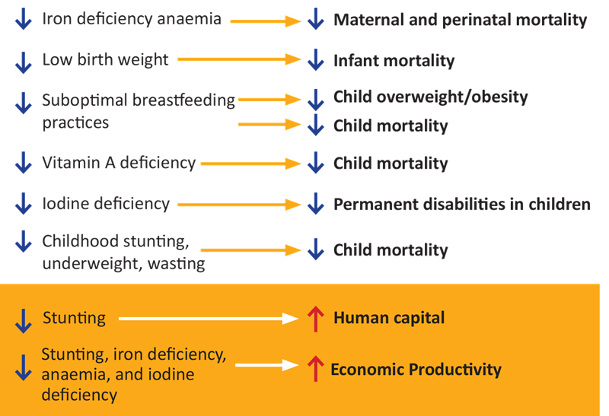
Nutrition Problems Addressed in PROFILES and the Benefits of Their Reduction
Notes:
PROFILES calculates an estimate for a specific outcome. So a reduction in maternal iron deficiency anaemia would result in a reduction in maternal and perinatal mortality – this is what we know from the scientific literature – that if iron status improves, there would be fewer maternal and perinatal deaths as a result.
Similarly, a reduction in low birth weight would reduce infant mortality.
A reduction in vitamin A deficiency in children would reduce child mortality.
A reduction in iodine deficiency during pregnancy would reduce permanent disabilities in children.
A reduction in stunting, underweight, and wasting and sub-optimal breastfeeding practices would reduce child mortality.
A reduction in sub-optimal breastfeeding practices would also decrease child overweight and obesity.
Similarly a reduction in stunting would increase human capital through improved childhood learning.
And lastly a reduction in stunting, low birth weight, iron deficiency anaemia and iodine deficiency would increase economic productivity.

Slide 40
Prevalence, Data Sources,* and Targets
Indicator | 2012 Prevalence | 2025 Target
Moderate and severe underweight (0−59 months) | 13.8 | 8.3
Moderate and severe stunting (24−35 months) | 42.7 | 25.6
Moderate and severe stunting (0−59 months) | 33.4 | 20.0
Moderate and severe wasting (0−59 months) | 4.7 | 3.5
Population 6−59 mos. with vitamin A deficiency | 32.6 | 13.0
Population with goitre | 5.0 | 3.0
Pregnant women with anaemia | 30.6 | 16.8
Nonpregnant women 15−49 years with anaemia | 22.1 | 12.2
Men 15−49 years with anaemia | No data | No data
Low birthweight | 10.2 | 7.1
*The UDHS 2011 was the source of information for all indicators in this table, with the exception of goiter. Because there is no recent information, the goiter prevalence was the same as that used in the Uganda PROFILES 2010.
Notes:
The 2025 targets for reduction in the prevalence of various nutrition indicators were discussed by FANTA HQ/Uganda staff
Setting 2025 as the target date was regarded as a realistic timeframe to see the anticipated changes and also was in line with the targets set by the World Health Assembly.
This slide shows prevalence for nutrition indicators that were used for 2013 and the 2025 targets. The anthropometry indicators in the table provide a summary of some information used by the PROFILES spreadsheet models.
PROFILES also uses additional information including neonatal, infant and under-5 mortality rates and the maternal mortality ratio from the UDHS 2011.

Slide 41
Lack of Change in Stunting Prevalence: Annual Number of Stunting-Related Deaths Will Rise
Due to Children Under-5 Population Increase
Notes:
As you will see in this slide, if stunting levels remain unchanged until 2025, the annual number of under-5 deaths related to stunting in children can be expected to actually increase over time because of an increase in the size of the population of children under 5 due to high fertility in Uganda.
Although Uganda has made progress in reducing stunting, these reductions may not be sustainable, as continued high fertility will put a strain on the country’s resources and ability to meet its food security needs.

Slide 42
Nutrition Improves and Stunting Prevalence Reduced: Annual Number of Under-5 Lives Saved
In the period 2013−2025, ~88,000 deaths related to stunting could be averted
Notes:
However, this slide shows that if high coverage of effective nutrition interventions are implemented and succeed in reducing stunting levels to their assumed targets, in the 2013–2025 time period, assuming a steady decrease in stunting levels, the lives of about 88,000 children under 5 will be saved.

Slide 43
No Change in Wasting Prevalence: Annual Number of Wasting-Related Deaths Will Rise
Due to Children Under-5 Population Increase
Notes:
As you will see in this slide, if wasting levels remain unchanged until 2025, the number of deaths related to wasting in children can be expected to actually increase over time because of an increase in the size of the population of children under 5 due to high fertility in the Uganda.

Slide 44
Nutrition Improves and Wasting Prevalence Is Reduced: Annual Number of Under-5 Lives Saved
In the period 2013−2025, ~31,000 deaths related to wasting could be averted
Notes:
If high coverage of effective nutrition interventions are implemented and succeed in reducing wasting levels to their assumed targets, in the 2013–2025 time period, assuming a steady decrease in wasting levels, the lives of about 31,000 children under 5 will be saved.

Slide 45
Continuation of Current Nutrition Situation: Number of Deaths and Disabilities Status Quo Scenario 2013–2025
Maternal deaths
IDA
Perinatal deaths
IDA
70,900
Infant deaths
196,000
Child deaths
VAD
Permanent disabilities
IDD
1.1 million
221,000
9,800
Child deaths
Stunting
422,000
Child deaths
Wasting
232,000
LBW
Notes:
This slide indicates the number of lives lost that would result if the current nutrition situation in Uganda continues—the status quo scenario.
As you can see, if there is no change in stunting levels over the time period up to 2025, the lives 9,800 women will be lost due to maternal anaemia related to iron deficiency; 70,900 lives will be lost during the perinatal period due to maternal anaemia; the lives of 196,000 infants will be lost due to low birthweight; the lives of 422,000 children under 5 will be lost due to stunting; the lives of 232,000 children under 5 will be lost due to wasting; and 221,000 lives will be lost due to vitamin A deficiency.
Similarly, if maternal iodine deficiency is not reduced by 2025 then over 1.1 million children will suffer from permanent disabilities. Globally, brain damage from intrauterine iodine deficiency is the leading cause of preventable brain damage.

Slide 46
Saving Lives and Preventing Disabilities, 2013−2025
Maternal deaths averted
IDA
Perinatal deaths averted
IDA
19,800
Infant deaths averted
LBW
25,800
Child deaths averted
VAD
Permanent disabilities averted*
IDD
236,500
60,900
4,400
*Cretinism and mild-to-severe permanent brain damage prevented
Notes:
Here you will see that reductions in prevalence of maternal iron deficiency anaemia by 2025 could save about 4,400 women’s lives and avert about 19,800 perinatal deaths over the 2013–2025 time period. Maternal anaemia increases the risk of maternal deaths related to pregnancy and delivery.
In addition, in the 2013−2025 time period, 25,800 infant deaths could be averted by reductions in low birthweight, and 60,900 child deaths could be averted by reductions in vitamin A deficiency.
Similarly, the reduction of maternal iodine deficiency by 2025 could result in preventing permanent brain damage in about 236,500 children over the 2013–2025 time period. Globally, brain damage from intrauterine iodine deficiency is the leading cause of preventable brain damage.

Slide 47
Economic Productivity Losses if the Current Nutrition Situation Continues
Stunting
US$7.7 billion
Iodine deficiency
US$363 million
Anaemia
US$454 million
Notes:
We also examine the economic losses related to various nutrition problems in the status quo scenario, which is if there is no improvement or change in these various nutrition problems (stunting, iron deficiency anaemia, and iodine deficiency). If there is no change, Uganda will suffer US$7.7 billion in economic losses related to stunting, US$445 million in losses related to iron deficiency anemia, and US$363 million in losses related to iodine deficiency.

Slide 48
Economic Productivity Gains by 2025 from Reducing Stunting, Iodine Deficiency, and Anaemia
Stunting
US$1.7 billion
Iodine deficiency
US$75.9 million
Anaemia
US$108.8 million
Notes:
This graph shows the economic productivity gains that could be achieved if the prevalence of stunting, iron deficiency anaemia in adults, and iodine deficiency could be significantly reduced over the 2013–2025 time period.
If the situation regarding stunting levels in Uganda improves, US$1.7 billion could be saved, while US$108.8 million in losses could be averted if iron deficiency anaemia were reduced, and US$75.9 million in losses could be averted if iodine deficiency were reduced.

Slide 49
Conclusion
Nutrition is central to development for Uganda.
Investment in nutrition is needed to achieve further gains in the economic growth and Sustainable Development Goal (SDG)/World Health Assembly goals/targets.
Investing in nutrition is critical because implementation of evidence-based, effective nutrition interventions can result in several improved key development outcomes:
Improved child development, cognitive function, and educational outcomes
Increased economic productivity
Women’s and children’s lives saved
Notes:
In conclusion, nutrition is critical to Uganda’s health, education, and economic productivity outcomes.
Despite Uganda’s achievements in economic growth and Millennium Development Goal (MDG) progress, investment in nutrition is needed to achieve further gains in these areas.
By investing in nutrition, we can:
Increase economic productivity
Improve child development, cognitive function, and educational outcomes
Save women and children’s lives

Slide 50
Session 4 Multi-Sectoral Nutrition Action Plans and Advocacy Needed to Support Those Plans
Notes:
Please refer to each district/LLG’s multi-sectoral nutrition action plans for this session.

Slide 51
Discussion Questions
Are there nutrition advocacy materials currently being used to promote implementation of the nutrition action plans?
Are there advocacy materials on other topics that you like/dislike? Why?
Notes:
Please refer to handouts of nutrition advocacy materials, if available.

Slide 52
Lunch

Slide 53
Session 4 (Continued) Multi-Sectoral Nutrition Action Plans and Advocacy Needed to Support Those Plans
Notes:
Please refer to each district/LLG’s multi-sectoral nutrition action plans for this session.

Slide 54
Session 5 Sample District/LLG-Level Nutrition Advocacy Implementation Plans and Talking Points
Notes:
Please refer to each of the handouts: sample district/LLG-level nutrition advocacy implementation plans and talking points.

Slide 55
Session 6 Audiences, Desired Changes, Barriers, and Motivators

Slide 56
Wrap-Up and Closing of Day 1

Slide 57
District/LLG-Level Nutrition
Advocacy Planning Workshop:
Day 2
[Insert date and location]

Slide 58
Recap of Day 1

Slide 59
Session 1 Audiences, Desired Changes, Barriers, and Motivators (Continued)

Slide 60
Session 2 Revision of Desired Changes, Barriers, and Motivators

Slide 61
Tea Break

Slide 62
Session 3 Intention of Advocacy Communication

Slide 63
Intention of Advocacy Communication
What is an ‘intention of advocacy communication’?
How you plan to address the barriers you identified, so that you can achieve the desired change?
For example: Intention of advocacy communication could involve improving the audience’s understanding of an issue or building their skills.
What is not an ‘intention of advocacy communication’?
It is not a programme objective.
Notes:
It is important to emphasize that the intention of your advocacy communication is NOT your programme objective and it’s also NOT the purpose of your advocacy. You have already addressed that through your desired change. The question here is HOW are you planning on addressing the barriers—using advocacy—to get to your desired change? Do you need to change attitudes? Or build skills? Or both? This is your intention of advocacy communication. It is, quite simply, what you plan to do with your advocacy communication.

Slide 64
Barriers Why Are We Still Dealing with This Problem?
The intention of your communication must address the reasons that people ignore, fear, or resist change.
Barriers
Intention of advocacy communication
Desired change
Notes:
Communication programmes have been working on many of the same problems for decades, because people have reasons for ignoring, fearing, or resisting change. I want to focus on barriers for a moment, because I feel like people talk about barriers a lot, we know we need to address them, but once we start designing our programmes, we have a hard time focusing on them. It’s important that the intentions you set address one or more of the barriers you’ve identified.

Slide 65
Intention of Advocacy Communication
Should be:
Specific
Measurable
Attainable
Realistic
Time-bound

Slide 66
Lunch

Slide 67
Session 4 Revision of Intention of Advocacy Communication

Slide 68
Session 5 Activities, Support Materials, Timeline, and Responsible Person(s)

Slide 69
Communication Channels
Channel | Benefit
Interpersonal: One-on-one meetings, roundtables, etc. | Tailored communication Interactive Good for complex information
Collective: Collective meetings with leaders, etc. | Provides social support Can motivate collective solutions
Mass media: Radio and TV ads and programmes, newspaper articles, posters, brochures, etc. | Extensive reach Efficient and consistent repetition of messages
Notes:
While interpersonal channels are often shown to have the most impact in terms of behaviour change, it’s often the most costly and time- and resource-intensive, so it’s more difficult to reach large audiences.
Community-based meetings provide a forum for collective solutions and ownership of a problem.
Mass media can have extensive reach with repetition of messages, but can never be a replacement for interpersonal communication.
It’s really the range of tools that makes a communication initiative successful.

Slide 70
Factors That Influence the Choice of Channels
Complexity of the issue
Sensitivity of the issue
Desired reach
Cost
Literacy
Audience preference for formats, languages, and media habits
Notes:
There are many factors that influence the choice of communication channels. Issues that are particularly complex and/or sensitive will benefit from using interpersonal channels. While this channel has been shown to be the most effective at behaviour change, it does not have nearly as large of a reach as mass media and is more expensive with regards to how many households are reached, which is why these are done in tandem to complement each other. Literacy levels also play a role in choice of channels. Reaching audiences that have a lower level of literacy, for example, may require the use of mediums such as radio, TV, community theatre, or interpersonal counselling.
It’s important to know your audience and determine before you begin any communication initiative, their preferences about which formats, language, and media habits will be most effective.

Slide 71
Deciding on Activities and Materials
What channels/activities are the best for your audience?
For example: What do they prefer? What has worked in the past?
What language do they prefer?
Does your content suit the channel/activity?
For example: Sensitive or complex content may require interpersonal contact, rather than something printed.
Do you have the resources to support your approach?
How does your approach align with other documents and plans?

Slide 72
Wrap-Up and Closing of Day 2

Slide 73
District/LLG-Level Nutrition
Advocacy Planning Workshop:
Day 3
[Insert date and location]

Slide 74
Recap of Day 2

Slide 75
Session 1 Revision of Advocacy Activities, Support Materials, Timeline, and Responsible Person(s)

Slide 76
Session 2 Indicators and Means of Verification

Slide 77
Discussion Questions
How do we typically judge the success of our efforts?
What means of verification do we use?

Slide 78
Indicators and Means of Verification
Monitoring and evaluation are useful for any advocacy work:
Baseline research
Process evaluation
Output evaluation
Outcome evaluation
Notes:
Monitoring and evaluation are useful at all stages of an advocacy programme. Baseline evaluation occurs at the very beginning of the programme to determine the starting point. Process evaluation occurs throughout implementation. Output and outcome evaluation take place after the activity is finished but must be planned from the beginning. Of course, all evaluation results are used to plan, adapt, and conduct activities again using the lessons learned.

Slide 79
Indicators and Means of Verification
How do we judge the success of our advocacy efforts?
Outcome indicators
Can be used to measure if the desired changes were achieved
Are stated in terms of percentage of target audience reached

Slide 80
Indicators and Means of Verification
How do we judge the success of our advocacy efforts?
Output indicators
Can be used to measure if the intentions of advocacy communication were achieved
Stated in terms of numbers of target audience reached

Slide 81
Indicators and Means of Verification
How do we judge the success of our advocacy efforts?
Process indicators
Can be used to measure if activities were accomplished
Stated in terms of activities held such, as number of meetings, etc.

Slide 82
Indicators and Means of Verification
Means of verification are what you use to monitor and verify the indicator, such as meeting minutes, etc.

Slide 83
Tea Break

Slide 84
Session 3 Indicators and Means of Verification (Continued)

Slide 85
Lunch

Slide 86
Session 4 How to Convey Your Message: Development of Talking Points

Slide 87
Development of Talking Points
Talking points are what you will use to convey your messages to your audience during a meeting.
Talking points are most effective when they:
Convey the information you want to get across simply and succinctly
Are short enough for you to remember them without looking at your notes
Clearly tell your audience what the situation is, why it should matter to them, and what they can do about it
Are something you are passionate about
Typically, talking points are kept to three main messages with no more than three supporting points each.

Slide 88
Example from Uganda

Slide 89
Development of Talking Points
Establish the situation
I. Our district/LLG is responsible for contributing to Uganda reaching its Vision 2040 goals but our progress has slowed, for one main reason: Of every 10 children in our district/LLG, 5 are malnourished. Malnutrition not only impacts our health but also affects education, agriculture, and economic productivity.
Malnourished children are more likely to get sick and die than healthy children. In fact, almost one-half of child deaths in Uganda are because of malnutrition.
Malnutrition slows growth and brain development, lowering intelligence, and making it harder for children to succeed. Because of this, malnourished children become adults who earn less money compared to those who are well-nourished and better-educated as children.
Poor growth in children reduces future labour productivity, which hinders agricultural production and slows development progress. Data show that, if there is no improvement in nutrition, economic productivity losses for the country will be more than 19 trillion Uganda shillings (US$7.7 billion) by 2025, part of which will come from our district/LLG.

Slide 90
Development of Talking Points
Identify the benefit to the audience that will motivate them to make the ‘desired change’.
II. Our district/LLG plays a vital role in improving nutrition. If we can improve nutrition, we can:
Save Ugandan mothers’ and children’s lives
Improve our children’s mental development and prevent permanent brain damage in children, resulting in earlier school enrolment, children staying in school longer, and better performance in school
Reap economic gains through increased productivity exceeding 4.3 trillion Uganda shillings (US$1.7 billion) for the country by 2025

Slide 91
Development of Talking Points
Include a ‘call to action’, which is what you want your audience to do.
III. Improving nutrition starts with us at the district/LLG level. We must:
Include nutrition in this year’s district/LLG-level work plan and allocate funding for those services and activities
Work with each sector to increase coordination on nutrition activities at the district/LLG level

Slide 92
Session 5 Revision of Talking Points and Feedback

Slide 93
Wrap-Up and Closing of Day 3

Slide 94
District/LLG-Level Nutrition
Advocacy Planning Workshop:
Day 4
[Insert date and location]

Slide 95
Session 1 Review of Draft District/LLG-Level Nutrition Advocacy Implementation Plans

Slide 96
Tea Break

Slide 97
Session 2 Revision of Talking Points

Slide 98
Session 3 Practice Sessions with Talking Points

Slide 99
Lunch

Slide 100
Session 3 (Continued) Practice Session with Talking Points

Slide 101
Discussion Questions
What challenges do you anticipate when you go back to your districts/LLGs?
What tips can you offer from your experience?

Slide 102
Session 4 Discussion of Additional Support and Resources Needed to Support District/LLG-Level Nutrition Advocacy

Slide 103
Discussion Question
What additional support and/or resources do you anticipate needing to conduct advocacy after you return to your district/LLG?

Slide 104
Closing and the Way Forward

Slide 105
This presentation is made possible by the generous support of the American people through the support of the Office of Health, Infectious Diseases and Nutrition, Bureau for Global Health, U.S. Agency for International Development (USAID) and USAID/Uganda, under terms of Cooperative Agreement No. AID-OAA-A-12-00005, through the Food and Nutrition Technical Assistance III Project (FANTA), managed by FHI 360. The contents are the responsibility of FHI 360 and do not necessarily reflect the views of USAID or the United States Government.

