Slide 1

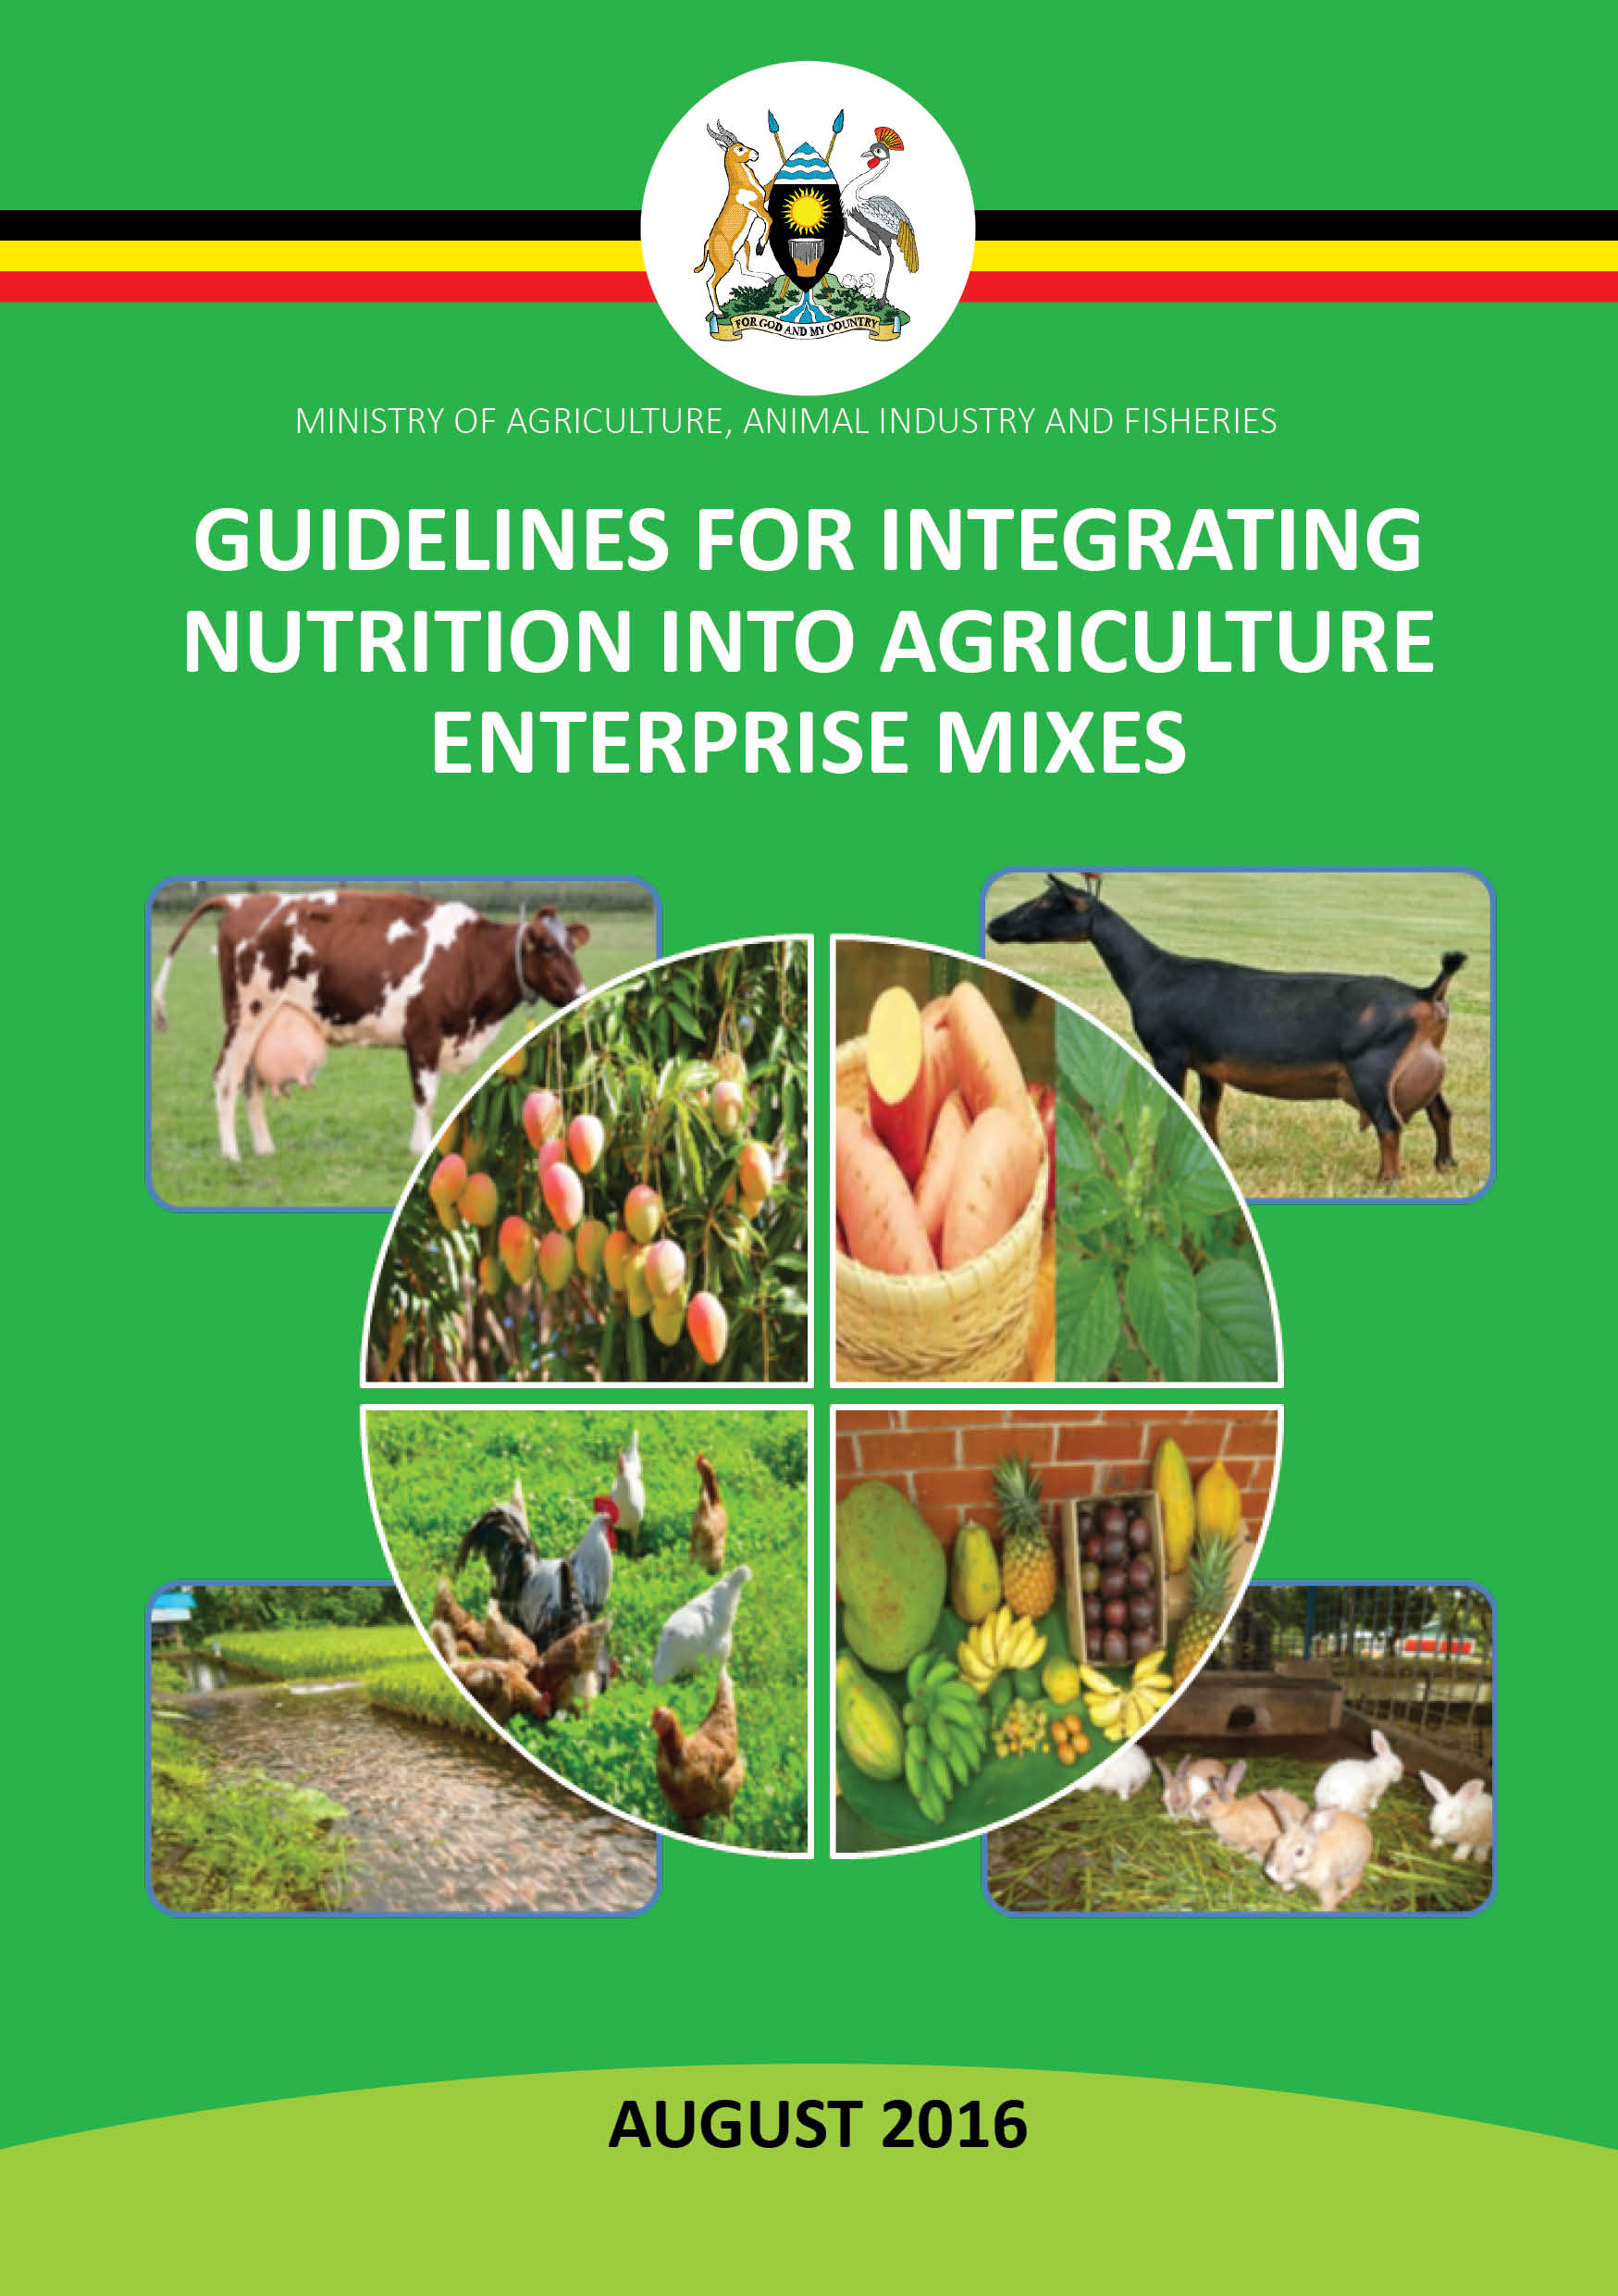
GUIDELINES FOR INTEGRATING NUTRITION INTO AGRICULTURE ENTERPRISE MIXES IN UGANDA
Sensitization/Orientation of District Production Staff
REPUBLIC OF UGANDA
Ministry of Agriculture, Animal Husbandry & Fisheries
Orientation Presentation
July 2017

Slide 2
Outline
Session 1: Course Introduction
Session 2: Introduction to the Guidelines for Integrating Nutrition into Agriculture Enterprise Mixes
Session 3: Food and Nutrition Policy Framework
Session 4: Nutrition Situation in Uganda
Session 5: Agricultural Zoning and Enterprise Mix Approach
Session 6: Criteria/Principles for Integrating Nutrition into Agriculture Enterprise Mixes
Session 7: Community Mobilization for Nutrition

Slide 3
Session 1:
COURSE INTRODUCTION

Slide 4
Climate Setting: Know Your Neighbor
Introduction
  Names
  Designation and organization
Norms
  What is permissible during the workshop/sessions (Dos)
  What is not permissible (Don’ts)
Expectations
  One expectation from the orientation

Slide 5
Objectives of the Orientation Workshop
To disseminate the content of the Guidelines for Integrating Nutrition into Agriculture Enterprise Mixes and enhance participants’ understanding of the:
  Policy frameworks that inform the integration of nutrition and agriculture
  Nutrition situation in Uganda
  Linkages between nutrition and agriculture
  Uganda’s agricultural zoning strategy and selected enterprises for commercial viability, by zone
  Criteria for integrating nutrition into agriculture enterprise mixes

Slide 6
Welcome and Opening Remarks

Slide 7
Session 2:
INTRODUCTION TO THE GUIDELINES FOR INTEGRATING NUTRITION INTO AGRICULTURE ENTERPRISE MIXES

Slide 8
Session 2 Objectives
By the end of the session, participants will be able to:
  Explain the purpose and objectives of the Guidelines
  List the users of the Guidelines
  Justify the need to integrate nutrition into agriculture enterprise mix designs
  Explain the links between agriculture and nutrition

Slide 9
Purpose and Objectives of the Guidelines for Integration of Nutrition into Agriculture Enterprise Mixes
Guide policymakers on the design of nutrition-sensitive policies, strategies, and guidelines
Provide a framework for considering nutrition during the selection of agriculture enterprises, as well as promote nutrition-sensitive programs within the sector
Guide agriculture extension and community development workers and agents in selecting highly profitable and nutrition-sensitive enterprise combinations

Slide 10
Users of the Guidelines
Primary users: agriculture officers, their agents, and community development workers, who play a critical role in guiding the enterprise selection process
Technical officers should refer to the criteria outlined in this guide to:
  Facilitate the selection of a mix of nutrition-sensitive enterprises from those recommended for each agro-ecological zone
  Facilitate discussions on the nutrition sensitivity of enterprises selected by the district, community, or household

Slide 11
Justification for Integrating Nutrition into Agriculture Enterprise Mix Designs
Agriculture contributes more than 25% of Uganda’s GDP and more than 50% of total export earnings
The agriculture sector contributes more than 70% of the labour force in Uganda’s economy.
Most (66%) of Uganda’s working population derive their livelihood from agriculture
A well-nourished, healthy labour force is critical for agricultural production and productivity

Slide 12
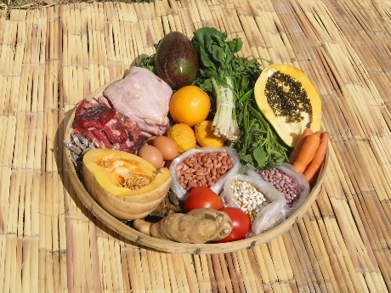
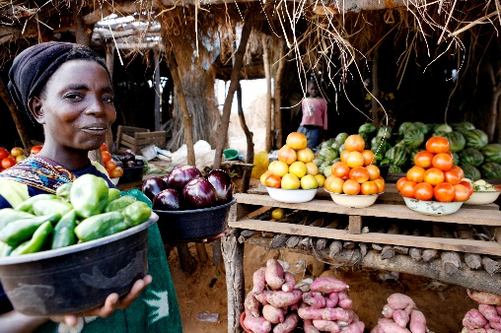
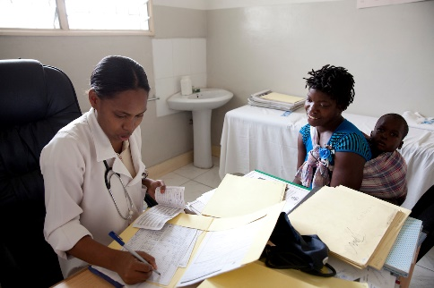
Justification (continued): Agriculture and Nutrition Are Interlinked
Scenario 1
Increased food production increases food consumption
Increased consumption of nutrient-rich food
Improved nutrition
Scenario 2
Increased food production increases income
More nutrient-rich food purchased
Improved nutrient intake in the household
Improved nutrition
Scenario 3
Increased food production increases income
More spending on health care/reduced disease burden
Malnutrition reduced
Iain McLellan, FHI 360/FANTA
Jessica Scranton, FANTA/FHI 360
Jessica Scranton, FANTA/FHI 360
Notes:
Note: These are potential scenarios for how agriculture and nutrition can be linked (p. 5 of Guidelines).
Scenario 1: increased production, including production of nutrient rich foods, leads to increased consumption: assumes that what is produced is consumed.
Scenario 2: assumes part of increased income spent on nutrient rich food from the market & that this nutrient rich food is consumed
Scenario 3: Assumes part of increased income spent on health care, reducing disease burden and associated malnutrition
Note: these linkages need to be reinforced – it cannot be assumed that nutrient rich food produced will be consumed, or that income will be spent on health and nutrition, without some focus on the health and food security considerations.

Slide 13
Justification (continued)
Uganda has invested in agricultural programs to reduce poverty among the country’s citizens
Most of these efforts have focused on farming from a business perspective: profitability, market orientation and income, the country’s zonal/regional enterprise promotion strategy
Household food security and nutrition have been ignored and the integration of nutrition and agriculture has not been well coordinated

Slide 14
More Needs to Be Done
Agriculture and nutrition are interrelated and this mutually beneficial relationship must be strengthened
An enabling environment exists in the form of international, regional, and national frameworks, policies, strategies, and guidelines

Slide 15
BREAK

Slide 16
Session 3:
FOOD AND NUTRITION POLICY FRAMEWORKS

Slide 17
Session 3 Objectives
By the end of this session, participants will be able to discuss:
The global, regional, and national policy frameworks
Implications for food and nutrition security

Slide 18
Food and Nutrition Policy Frameworks
Various national, global and regional policy frameworks have created an enabling environment in Uganda that favours investment in food and nutrition security
Policy frameworks help agriculture program implementers emphasize policies in the design of strategies, projects, and work plans
Policy frameworks emphasize increasing agriculture productivity and ending hunger and all forms of malnutrition

Slide 19


















Policies Related to Agriculture, Food, and Nutrition Security
NATIONAL FRAMEWORKS
GLOBAL & REGIONAL FRAMEWORKS
Agriculture Sector Strategic Plan (ASSP 2015/16 – 2019/20)
National Nutrition Planning Guidelines
Food and Nutrition Handbook for Extension Workers
Sustainable Development Goals (SDGs) 2015
SDG 2: End hunger and achieve food security and improved nutrition
Second National Development Plan (NDP II 2015/16–2019/20)
End hunger and all forms of malnutrition
2003…2010………………………................2016
East Africa Community Food & Nutrition Policy 2014
Achieve food & nutrition security in the region through appropriate policy measures
National Agriculture Policy 2013
Local Government Development Planning Guidelines 2014
Uganda Vision 2040
Uganda Nutrition Action Plan 2011–2016
Improve nutrition status of all Ugandans
New Partnership for Africa’s Development (NEPAD) & Comprehensive Africa Agriculture Development Program (CAADP 2002)
Support measures to increase incomes & end poverty
Agriculture Sector Development Strategy & Investment Plan (ASSIP 2010/11–2015/16)
Millennium Development Goals (MDGs) 2000–2015
Goal 1: Reduce extreme hunger and poverty
Food and Nutrition Policy 2003
Ensure food security & adequate nutrition
Notes:
Uganda has various policy frameworks within which guidance for nutrition sensitive agriculture is provided from both global and national level:
MDGs (2000-2015): Goals 1 was to reduce extreme hunger and poverty
SDGs: Goal 2 aims to end hunger, achieve food security, improve nutrition and promote sustainable agriculture
EAC Food and Nutrition Policy: achieving food and nutrition security in the region through appropriate policy measures
CAADP :Comprehensive Africa Agriculture Development Program. Driven by New Partnership for African Development-NEPAD Pushes for agricultural support to increase incomes and end poverty. Seeks to raise agricultural productivity and contribute towards poverty reduction and elimination of hunger and food insecurity

Slide 20
Uganda Policies Related to Agriculture, Food, and Nutrition Security

Slide 21
Food Security and Nutrition in the National Agriculture Policy 2013
Food and nutrition security are emphasized in Objective 1 of the National Agriculture Policy.
Strategic policy actions:
  Promote agricultural enterprises that enable households to earn daily, periodic, and long-term income to support food purchases
  Promote and facilitate construction of agro-processing and storage infrastructure to improve post-harvest management

Slide 22
Food Security and Nutrition in the National Agriculture Policy 2013 (continued)
Strategic policy actions (continued):
  Develop/improve food handling, marketing, and distribution systems and linkages to domestic, regional, and international markets
  Support establishment of a national strategic food reserve system
  Support development of a well-coordinated system to collect, collate, and disseminate information on agricultural production and food and nutrition security

Slide 23
Food Security and Nutrition in the National Agriculture Policy 2013 (continued)
Strategic policy actions (continued):
  Encourage/support local governments to enact and enforce bylaws and ordinances that promote household food security and nutrition
  Promote production of nutritious foods, including indigenous foods, to meet household needs and for sale
  Promote consumption of diverse nutritious foods, including indigenous foods, at the household and community levels

Slide 24
Food Security and Nutrition in the National Agriculture Policy 2013 (continued)
Strategic policy actions (continued):
  Promote appropriate technologies and practices to minimize post-harvest losses along the commodity value chain
Extension officers should consider expanded production, enhanced storage capacity, increased income to support food purchases, and improved access to key markets and information to increase household food security and nutrition

Slide 25
BREAK

Slide 26
Session 4:
THE NUTRITION SITUATION IN UGANDA

Slide 27
Understanding Malnutrition
Malnutrition: People are malnourished if their diet and nutritional needs are misaligned. Malnutrition includes both undernutrition and overnutrition.
  Undernutrition occurs when there is inadequate nutrient intake and/or absorption in the body. Different forms of undernutrition can appear alone or in combination: acute malnutrition (bilateral pitting oedema and/or wasting), chronic malnutrition (stunting), underweight (combined form of wasting and stunting), and micronutrient deficiencies.
  Overnutrition happens when a person’s daily energy intake consistently exceeds energy requirements. If this continues over time, a person may become overweight or obese.

Slide 28
Session 4 Objectives
By the end of this session, participants will be able to:
Describe the prevalence of malnutrition in different regions of Uganda
Explain the effects of malnutrition on human capital development and productivity

Slide 29
REFLECTION
In groups of 10, discuss:
  How agriculture contributes to and/or influences the nutrition situation in Uganda?
  What are some of the causes of poor nutrition that are attributable to agriculture?
    Immediate causes
    Underlying causes
    Basic causes
Report back in plenary after 15 minutes.
?

Slide 30
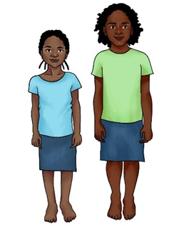
Forms of Malnutrition in Uganda: STUNTING
Almost one in three children is stunted in Uganda!
Too short for age
Due to insufficient nutrient intake and/or infections over the long term
Girls of the same age

Slide 31
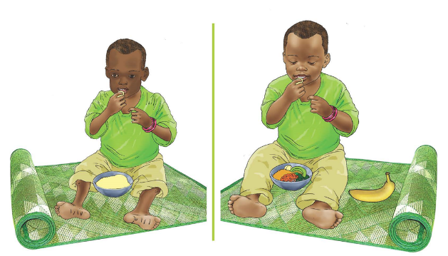
Forms of Malnutrition in Uganda: WASTING
Too thin for height
Caused by acute illness or insufficient food consumption.
A form of acute malnutrition (moderate or severe acute malnutrition)
371,737 Ugandan children under 5 years are wasted (UDHS, 2011)

Slide 32
Forms of Malnutrition in Uganda: OEDEMATOUS MALNUTRITION
A form of severe acute malnutrition
Also called bilateral pitting oedema

Slide 33
Distribution of Stunting, Wasting, &
Underweight in Children Under 5
(UDHS 1989-2016)

Slide 34
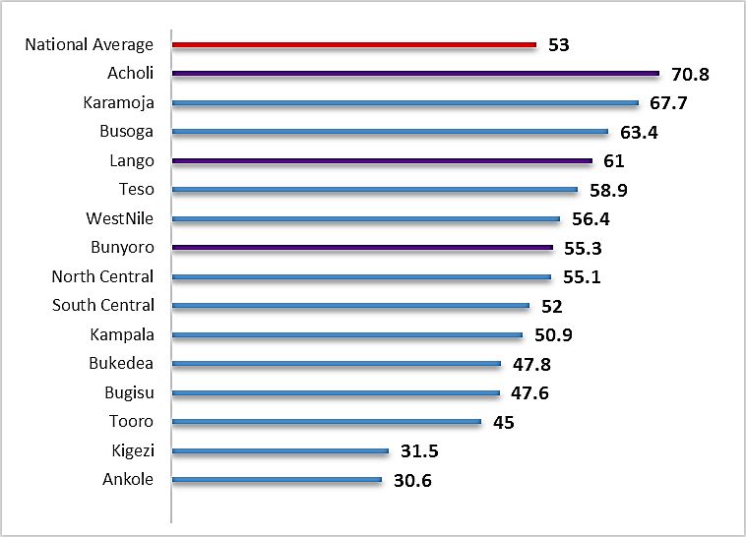
Anemia in Children 6–59 Months
(UDHS 2016)

Slide 35
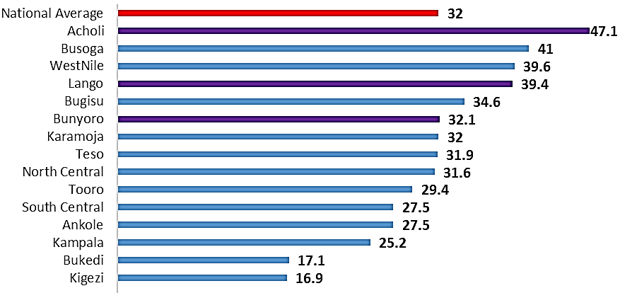
Anemia in Women 15–49 Years
(UDHS 2016)

Slide 36
Cost of Poor Nutrition to Uganda’s Economy
Poor nutrition during the first 1,000 days (pregnancy to a child’s 2nd birthday) causes irreversible cognitive and physical damage, with consequences for individuals, households, communities, and the nation
  Malnutrition is the underlying cause of 45% of childhood deaths in Uganda (COHA, 2015)
  Total losses in productivity attributed to childhood malnutrition were estimated at approximately UGX 1.2 trillion-equivalent to 3.91% of Uganda’s GDP in 2009 (COHA, 2014)
Notes:
COHA, 2015. World Food Program, 2012.Cost of Hunger in Uganda Summary Report. www.costofhungerafrica.com.
GPAFSN, 2016: Global Panel on Agriculture and Food Systems for Nutrition, 2016: The cost of malnutrition: why policy action is urgent. Technical Brief No. 3 | July 2016 | Summary Messages for Decision Makers.

Slide 37
Cost of Poor Nutrition to Uganda’s Economy (continued)
Every one percent (1%) of attainable adult height lost reduces earnings by 2.4% in adulthood (GPAFSN, 2016)
Every dollar invested in reducing childhood stunting and wasting yields a $18 return on investment (GPAFSN, 2016)
Notes:
COHA, 2015. World Food Program, 2012.Cost of Hunger in Uganda Summary Report. www.costofhungerafrica.com.
GPAFSN, 2016: Global Panel on Agriculture and Food Systems for Nutrition, 2016: The cost of malnutrition: why policy action is urgent. Technical Brief No. 3 | July 2016 | Summary Messages for Decision Makers.

Slide 38
BREAK

Slide 39
Session 5:
AGRICULTURE ZONING STRATEGY IN UGANDA AND THE ENTERPRISE MIX APPROACH

Slide 40
Objectives of Session 5
By the end of session 5, participants will be able to:
  Identify the different agro-ecological zones in Uganda
  Explain Uganda’s agricultural zoning strategy and selected enterprises for commercial viability, by zone
  Identify gaps in the current agricultural zoning strategy that hinder food and nutrition security

Slide 41
Agricultural Zoning Strategy and Enterprise Mix Approach in Uganda
Ten agricultural zones, those with similar agro-ecological conditions should produce similar commodities
Criteria for selecting enterprises:
  Soil, temperature, and rainfall patterns
  Land availability
  Farmer knowledge and skills
  Production, processing, and marketing infrastructure
  Availability of inputs and service providers
  Potential for value addition
  Market opportunities
  Public-private partnership opportunities
Notes:
The President’s Office organized zonal poverty alleviation and enterprise selection conferences in 2012, in which political and technical leaders from each region’s districts selected agricultural enterprises based on the following agreed criteria:
Agricultural suitability given soil types, temperature, humidity, and rainfall patterns
Land availability, including size and tenure arrangements
Farmer knowledge and skills
Infrastructure to support production, processing, and marketing
Availability of input suppliers and service providers
Availability of appropriate technology and advice
Potential for agro-processing and other forms of value addition
Potential market opportunities at the local, national, and international (export) levels
Profitability potential
Public/private sector partnership opportunities
The process resulted in prioritized production of food and cash crops and livestock in 18 administrative zones (Tables 2–10). These administrative zones do not necessarily coincide with the geographic areas covered by the agro-ecological zones. The report of the conferences presents a thorough analysis of 46 agricultural enterprise combinations in 18 administrative zones that households can undertake to maximize their net income. These enterprises include all ten of the strategic commodities the MAAIF has prioritized to promote specialization and value addition.

Slide 42
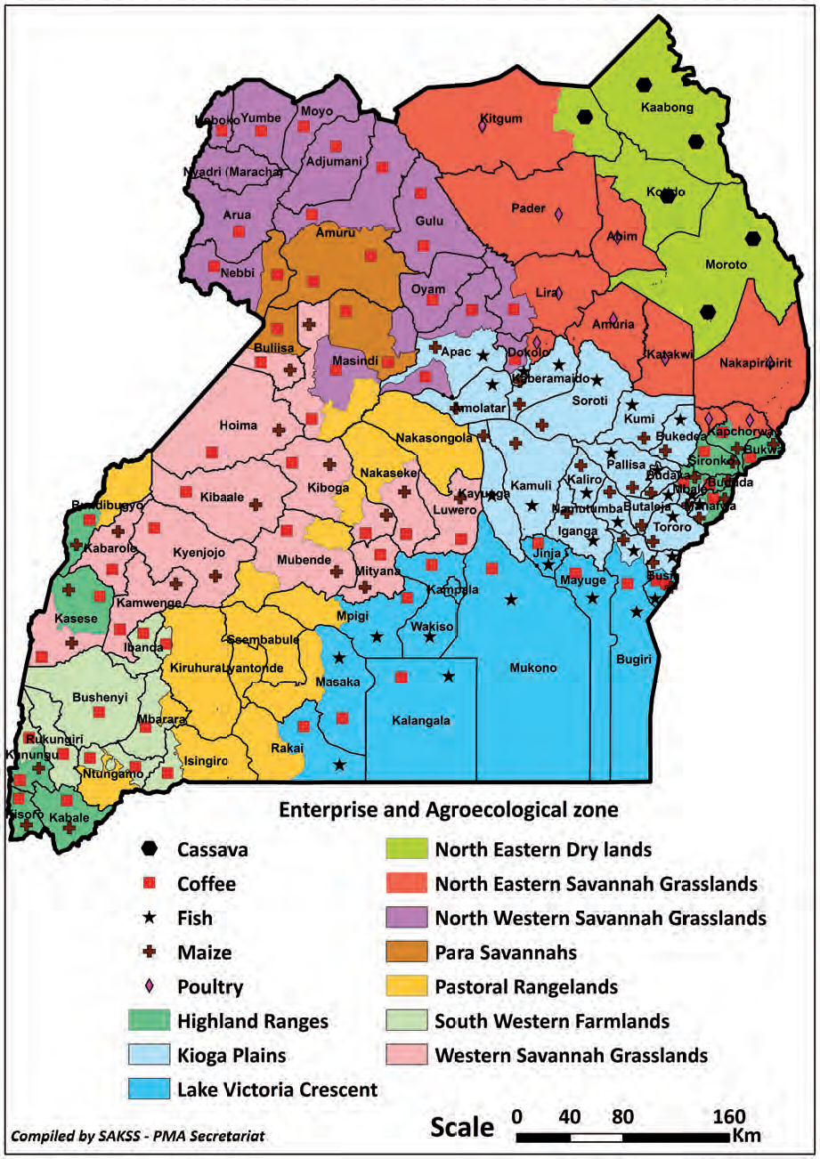

Slide 43
Gaps in Selection of Enterprises
Criteria used to select regional enterprises emphasizes income growth but weak on nutrition
Consequently:
  Enterprises are commercially important but may or may not be nutrition sensitive
  Income growth (including off-farm jobs) does not necessarily lead to improved nutrition
Example: Despite impressive agricultural production, stunting rates in South Western Uganda (42%) are higher than the national average (34%)

Slide 44
Gaps in Enterprise Mix Selection Process
Enterprise mix selection does not use a nutrition-sensitive approach to improve household welfare
Extension workers and agents are not empowered to consider nutrition in addition to income and profitability when guiding the zonal enterprise selection process
Enterprise selection processes are not linked to community education on the consequences of food insecurity and malnutrition or to capacity building

Slide 45
Gaps in Enterprise Mix Selection Process (continued)
Farmers don’t understand the grave consequences of food insecurity and malnutrition or the need for mitigation measures in the enterprise selection process
Agriculture extension workers don’t work with community development workers and other stakeholders closely enough to ensure that opportunities for community mobilization and capacity building are not missed

Slide 46
REFLECTION
In groups of 10, discuss:
  How can selected zonal enterprises become more nutrition sensitive?
  What are some of the challenges in adopting some of the zonal enterprises proposed by farmers/ farmer groups?
?

Slide 47
Session 6:
CRITERIA FOR INTEGRATING NUTRITION INTO AGRICULTURE ENTERPRISE MIXES

Slide 48
Objectives of Session 6
By the end of the session, participants will be able to:
Identify the criteria for integrating nutrition into agriculture enterprise mixes
Explain strategies that can be adopted to achieve nutrition sensitivity for each criterion

Slide 49
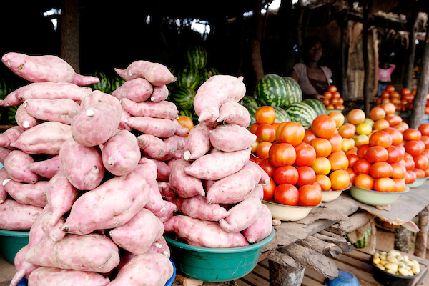
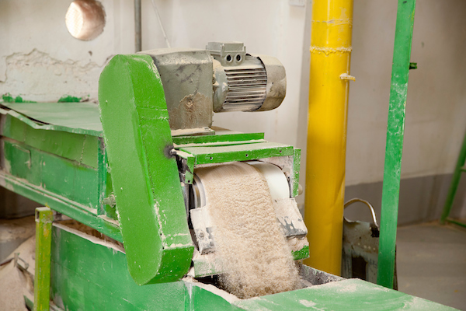
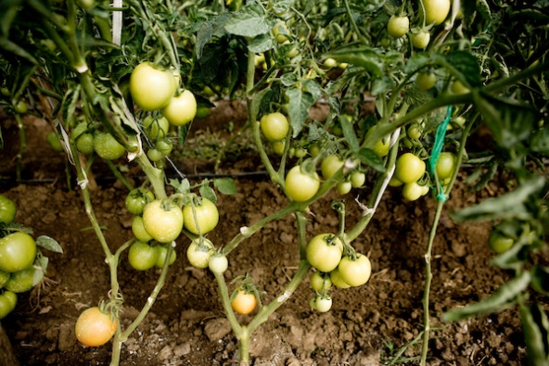
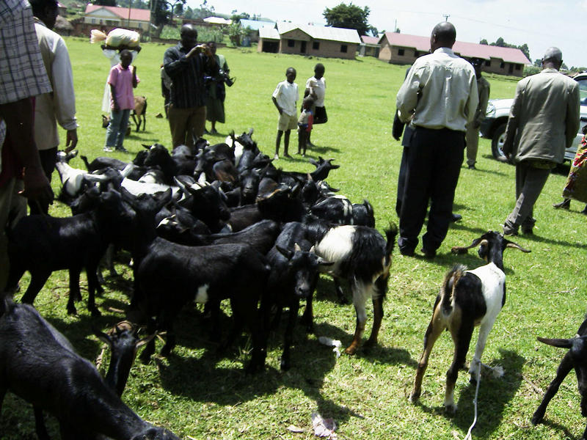
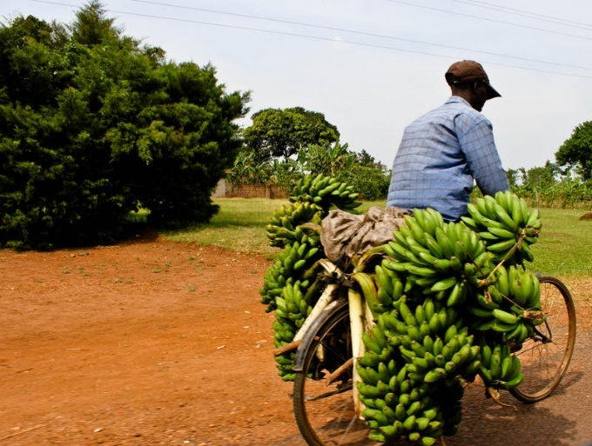
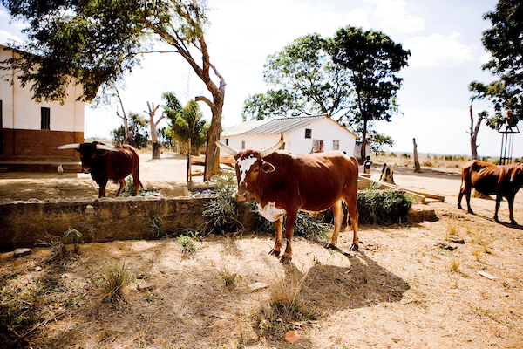
CRITERION 1: Enterprise Mix Design Allows Regular Income Flow
Photo Credits (Clockwise from top left): Jessica Scranton, FHI 360; Jessica Scranton, FHI 360; Jessica Scranton, FHI 360; Jessica Scranton, FHI 360; © 2011 Rachel Steckelberg, Courtesy of Photoshare (Uganda); © 2006 Richard Niyonzima, Courtesy of Photoshare (Uganda); Jessica Scranton, FHI 360

Slide 50
Why Emphasize Regular Income Flow?
Poor households face difficult decisions on how to allocate their spending
  Prioritization of meagre income for health, education, housing, feeding, and fuel
Poor households purchase and consume greater amounts of cheap, energy-dense foods that are filling, but lack nutritional quality, compared to higher income households
High income from agriculture may have relatively little impact on nutrition if income flows are inconsistent

Slide 51
Regular Income Flow and Nutrition
Regular income flow (weekly or monthly) can lead to improved household welfare and better nutrition outcomes if:
  Livestock and crop enterprises favour women and improve their control over household income
  Women use income to purchase nutrient-dense foods
  Households invest income in meeting their nutrition needs

Slide 52
Ensuring Regular Income for Households through Enterprise Design: Livestock Production
Livestock production includes cattle, chicken, fish, poultry, rabbits, pigs, goats, and camels, among others
  Selection of the livestock enterprise depends on resources available to farmers
Households engaged in dairy cow production have a year-round income source from milk
  70% of Uganda’s milk is sold commercially, only 30% is consumed on the farm
  Cross-bred cows can be managed under zero-grazing for small landholdings
  But exotic pure- or cross-bred cows require a relatively large investment and proper animal husbandry practices

Slide 53
Ensuring Regular Income for Households through Enterprise Design: Livestock Production (continued)
Cheaper and easier livestock production options such as fish, poultry, rabbits, pigs, and goats
  Have higher feed conversion rates
  Have shorter production cycles
  Are easier to rear and sell
For example, a poultry enterprise provides
  A continuous supply of eggs, a high quality protein, for household consumption
  An almost daily income flow
  Manure for use as fertilizer
  Low labour input requirements give women time to engage in other household chores

Slide 54
Ensuring Regular Income for Households through Enterprise Design: Livestock Production (continued)
Small livestock are easy for women to own and control because of their limited monetary value
  Women are more likely to make decisions regarding the sale or slaughter of these small livestock

Slide 55
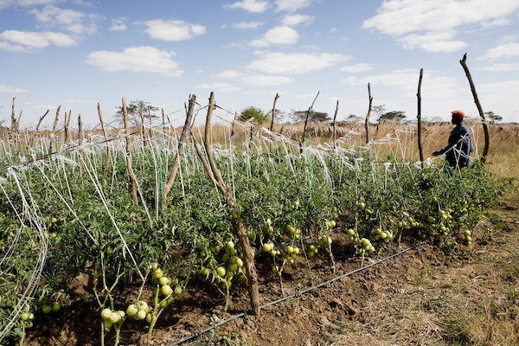
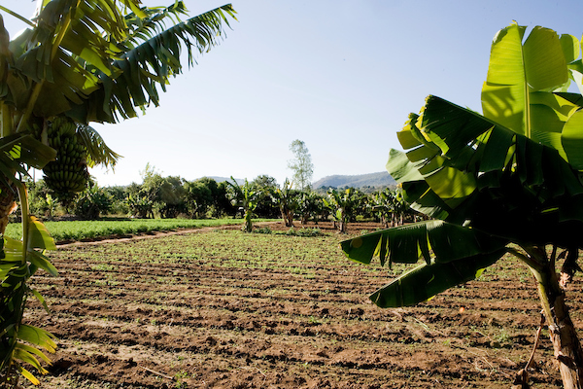
Ensuring Regular Income for Households through Enterprise Design: Crop Enterprises
Most crop enterprises are seasonal. Very few allow regular income flows, unless
  Planting is staggered
  Households have access to off-season production technology (e.g., irrigation)
Examples of crop enterprises with regular cash flow
  Banana production
  Mushroom growing
  Irrigated vegetable production
Photo Credits: Jessica Scranton, FHI 360

Slide 56

Ensuring Regular Income for Households through Enterprise Design: Off-Farm Income
Off-farm income-generating activities are another way to promote regular income flows for farming households
  Provide insurance against food price hikes, hiccups in weather patterns, and poor yields
  Food processing, especially in rural areas, reduces household food and nutrition insecurity

Slide 57
Generating Off-Farm Income through Food Processing and Processing
While crop enterprises are seasonal, safe food processing and preservation
  Allow almost continuous marketing of products
  Provide income flows throughout the year
  Increase total household earnings
Examples of household/cottage-level food processing
  Fruit – juices, jam, dried fruit chips, wines
  Vegetables – salted, pickled, or dried vegetables
  Animal-source foods – yoghurt, dried meat/fish, ghee, cheese, moya
  Plant foods – paste from simsim, groundnuts, maize flour

Slide 58
Generating Off-Farm Income through Food Processing and Preservation
Train and sensitize farmers/cottage-level food processors about good manufacturing and hygiene practices to:
  Maintain physical and nutritional wholesomeness of food products
  Eliminate spoilage by insects and prolong shelf life
  Eliminate pathogenic micro-organisms such as salmonella, E.coli, and aflatoxin-producing mold

Slide 59
Criteria 1: Enterprise Mix Design for Regular Income Flow—Key Messages
Ensure that the enterprise mix design will provide regular income flows (at least weekly or monthly) to the household
Focus on animal and crop enterprise mixes because they can help ensure regular income and provide a more nutrient-dense diet and manure for crop production
Promote household-level food processing, especially in women’s groups, to improve stable access to nutritious food and regular income flows for farming households

Slide 60
REFLECTION
In groups of 10, discuss:
  How do farming households in your district currently ensure regular income flows?
  What challenges do farming households face in regard to ensuring regular income flows? (Give only 4 answers)
  How can these challenges be addressed?
?

Slide 61
BREAK

Slide 62
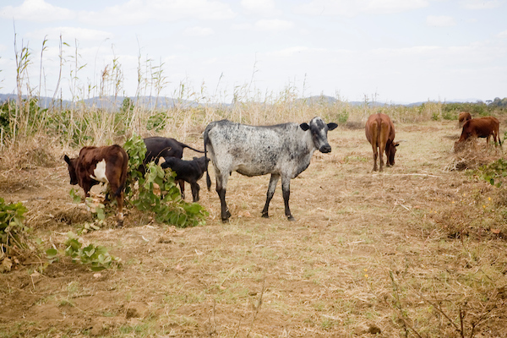
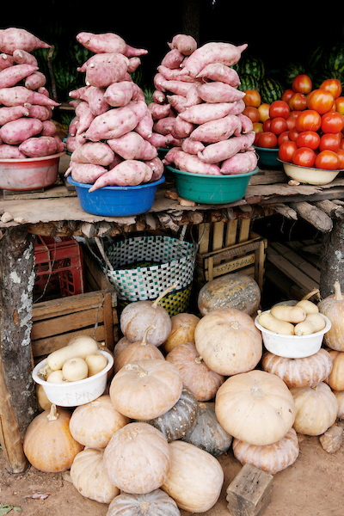
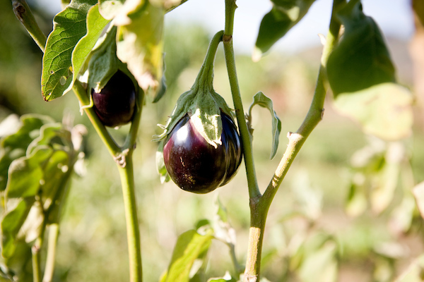
CRITERION 2:
Production of Nutrient-Rich Foods
Photo Credits: Jessica Scranton, FHI 360

Slide 63
Why Emphasize Production and Consumption of Nutrient-Rich Foods
Objective 1 of the National Agriculture Policy (2013) mandates that the Ministry of Agriculture, Animal Industry, and Fisheries (MAAIF) ensure household and national food and nutrition security for all Ugandans through:
  Promoting the production of nutritious foods, including indigenous foods, to meet household needs and for sale (to improve incomes)
  Promoting consumption of diversified nutritious foods, including indigenous foods, at the household and community levels

Slide 64
Why Emphasize Production and Consumption of Nutrient-Rich Foods (continued)
Rural farming households often produce at least some of their food, and depend on the market to buy the remainder
Diets are often monotonous, consisting mainly of nutrient-poor staple foods like cassava, matooke, maize, sweet potato, Irish potatoes, and sorghum
Diversified household production and consumption of highly nutritious foods improves household nutrition by improving food availability and diet diversity and quality

Slide 65
Examples of Nutrient-Rich Foods
For a commodity to be considered nutrient-rich, it must meet be one of the following:
  Bio-fortified
  Derived from a legume, nut, or seed (i.e., sesame seeds, sunflower seeds, pumpkin seeds, wheat germ, sprouted legume seeds)
  An animal-source food, including dairy products (milk, yogurt, cheese), fish, eggs, organ meats, meat, flesh foods, or other miscellaneous small animal protein (e.g., grubs, insects)
  A dark yellow or orange-fleshed root or tuber
  A fruit or vegetable that meets the "high source” threshold for one or more micronutrients (per 100 calories and per 100 grams)

Slide 66
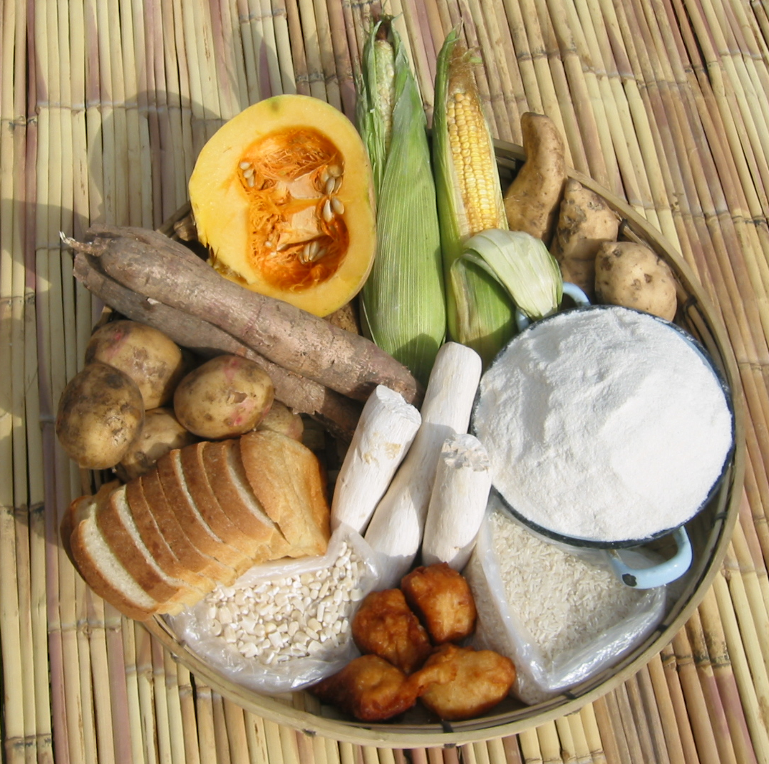
Diverse Diet in Uganda: “GO” Foods
Some of the locally available, energy-giving (“GO”) Foods
Iain Mclellan, FANTA/FHI 360

Slide 67
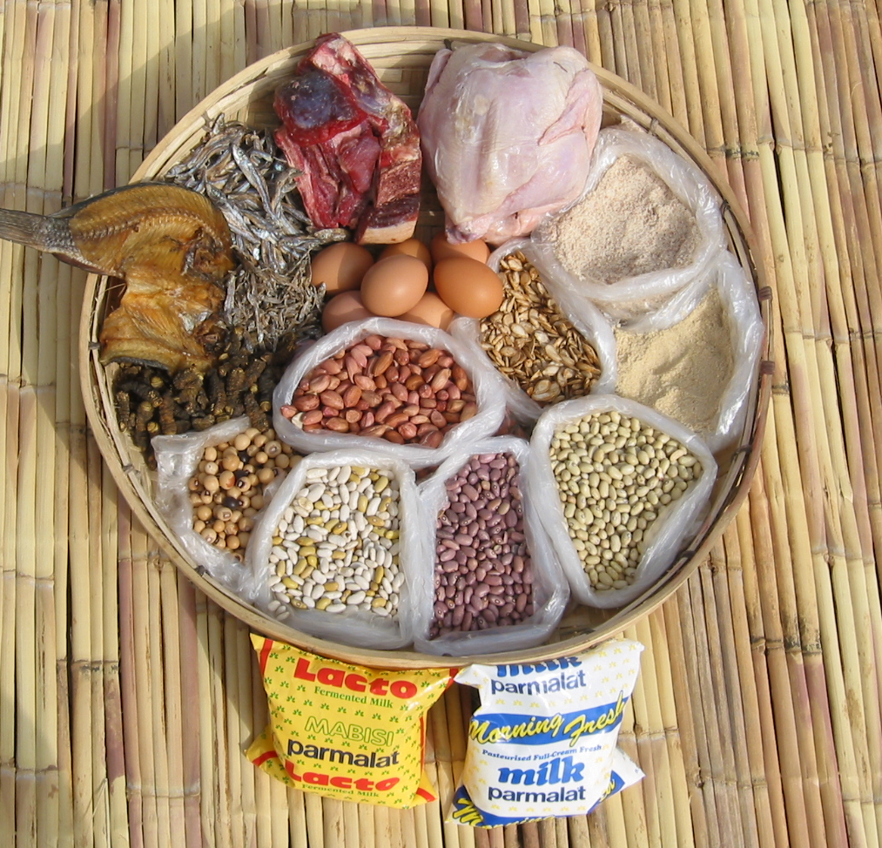
Diverse Diet in Uganda: “GROW” Foods
Some of the locally available, protein (“GROW”) foods
Iain Mclellan, FANTA/FHI 360
Notes:
s)

Slide 68
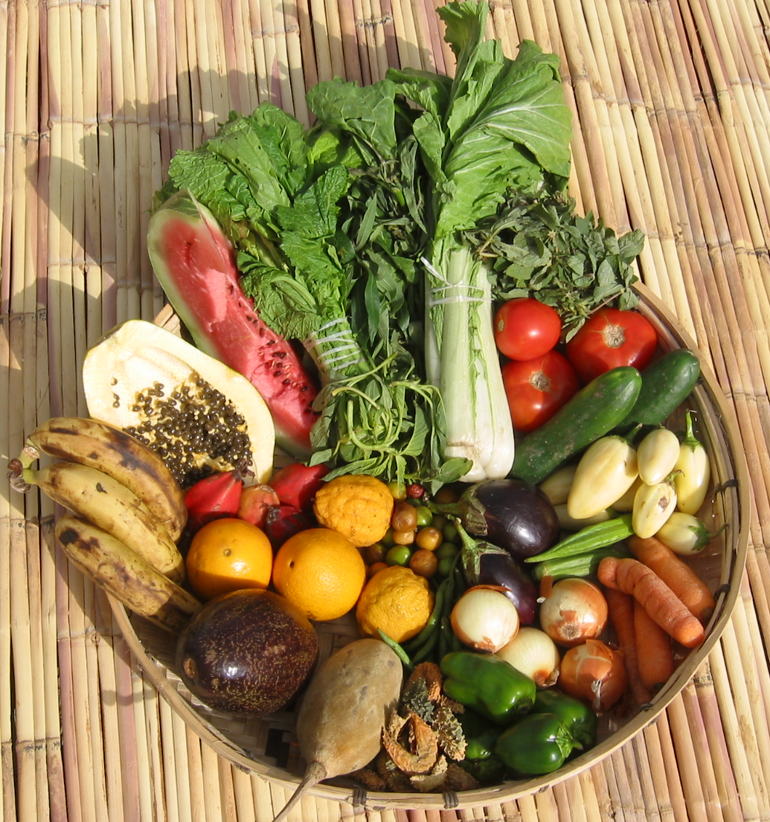
Diverse Diet in Uganda: “GLOW” Foods
Some of the locally available, energy-rich (“GLOW”) foods
vegetables and fruits
rich sources of vitamins and minerals
Iain Mclellan, FANTA/FHI 360

Slide 69
Promote Production of Nutrient-Rich Foods
Extension workers should promote a balanced approach to enterprise mix design by encouraging production of:
  Highly profitable traditional and non-traditional cash crops for income generation
  Legumes
  Bio-fortified foods (e.g., iron-rich beans, high-protein maize, orange-fleshed sweet potatoes)

Slide 70
Promote Production of Nutrient-Rich Foods (continued)
Extension workers should promote a balanced approach to enterprise mix design by encouraging:
  Fruit and vegetable gardens managed by women or the community
  Small animal production, such as poultry, rabbits, fish, pigs, and goats
  Large animal livestock production, especially zero-grazing for dairy cattle, where appropriate
  Consumption of nutritious foods

Slide 71
Interventions that Promote a Balanced Approach
Addition of major micronutrients such as iron and vitamin A
Utilization of techniques that minimize nutrient losses during food processing and preservation
Safe food-handling practices throughout the entire food value chain:
  Production
  Food preparation
  Post-harvest handling and storage (↓the incidence of aflatoxins in groundnuts and maize)
  Integrated pest management to reduce pesticide costs and the potential for excess residues

Slide 72
Criteria 2: Production of Nutrient-Rich Foods Key Message
Consider including both inexpensive livestock (for regular animal food products/by-products) and bio-fortified and indigenous nutrient-rich crop varieties in the enterprise mix design to improve household nutrition

Slide 73
REFLECTION
In groups of 10, discuss:
  How can plantation agriculture (tea, coffee, banana) and mono-cropping systems become more nutrition sensitive?
  What are some of the challenges around making plantation agriculture more nutrition sensitive? (Give only 4 answers)
  What skills and competences do agriculture officers need to ensure nutrition sensitivity?
?

Slide 74
BREAK

Slide 75
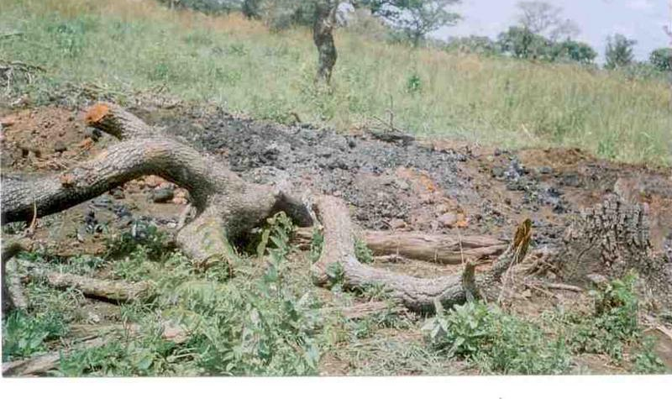
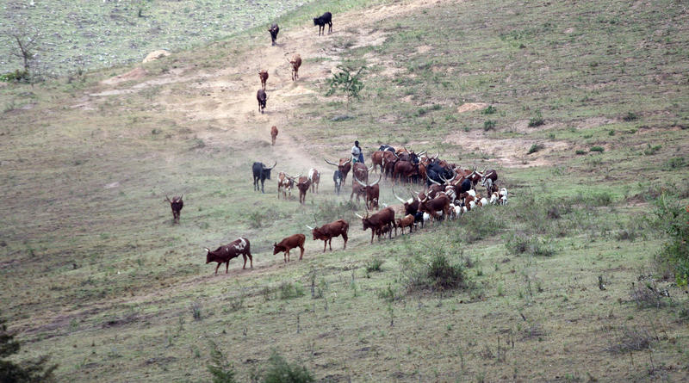
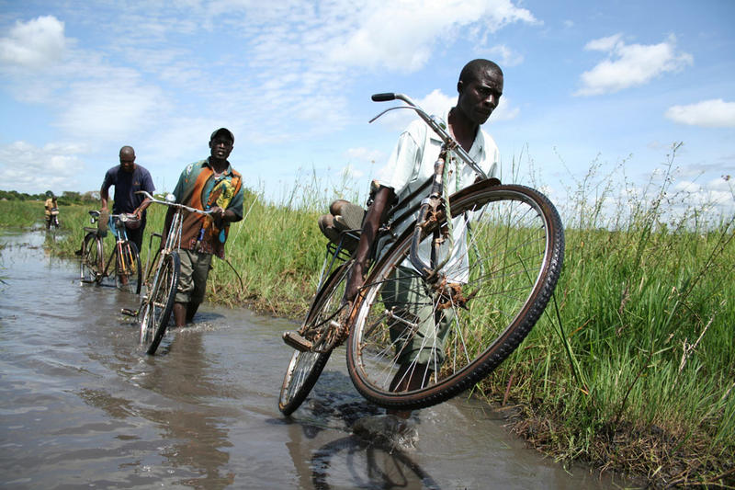
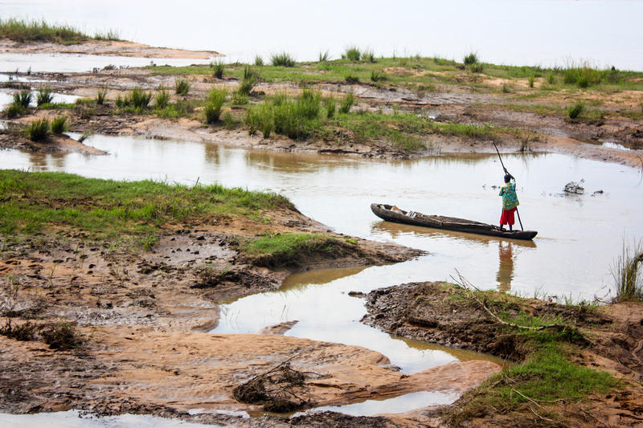
CRITERION 3: Protection of the Environment and Ensuring Household Resilience
Photo Credits (clockwise from top left): © 2011 agam, Courtesy of Photoshare (Uganda); © 2007 Morgan Mbabazi, Courtesy of Photoshare (Uganda); © 2014 Charis McLarty, Courtesy of Photoshare (Chad); © 2006 Felix Masi, Courtesy of Photoshare (Kenya)

Slide 76
Linkages between Climate Change and Food Security and Nutrition
Climate change refers to change in average weather conditions, such as deviations from long-term average weather conditions (i.e., more or fewer extreme weather events) or changes in long-standing weather patterns that have adverse effects
Climate change amplifies damage to the food system by:
  Increasing the severity and scale of natural disasters
  Spreading crop and livestock pests and diseases into new areas
  Increasing food price volatility due to uncertain supply amidst growing demand

Slide 77
Effects of Climate Change in Uganda
Climate change directly affects food security and nutrition in Uganda through:
  Reduced production of major food crops attributable to increased occurrences of drought, floods, landslides, and soil erosion
Prolonged dry spells and high temperatures can reduce productivity, particularly for rain-fed production
Floods can endanger people, livelihoods, and property and cause widespread crop damage

Slide 78
Climate Change Hurts Farming Households
Households with limited savings or other assets are vulnerable to external shocks (climate change and fluctuations in crop prices)
For the poorest households, even small shocks can push them over the edge, requiring them to sell productive assets, forego health care, or reduce food consumption
  Farmers’ exposure to risk and uncertainty is aggravated by lack of information about weather, input choices, farm management practices, and market prices affecting crop production and income

Slide 79
Climate Change Creates Many Challenges
Increasing the production of staple crops is not enough to make agriculture more resilient or to improve diets
  Nutrient-rich foods are particularly susceptible to the effects of climate change, such as drought, spread of pests and diseases, and temperature fluctuations
Smallholders rely upon traditional knowledge and agricultural practices to cope with shocks and stresses
  The effects of climate change erode their coping capacity, leaving smallholders more vulnerable to climatic or economic variations
  Rising levels of carbon dioxide in the atmosphere affect human nutrition by reducing nutrient levels in key food crops

Slide 80
Actions for Community Extension Workers
Learn and promote good environmental management practices and support food and nutrition security through enterprise mix design
Help households improve their capacity to adopt alternative inputs and practices and water management systems by increasing awareness of climate change and resilience strategies
Facilitate the establishment of community-based early warning systems

Slide 81
Actions for Community Level Extension
Improve household access to gender-sensitive information on climate-smart agriculture and promote information and knowledge sharing in the community through public meetings and/or farmer field schools
Promote nutrient-rich crop and livestock enterprises that are drought and/or disease tolerant

Slide 82
Actions for Community Level Extension (continued)
Promote crop enterprises that can benefit from water harvesting
Promote livestock enterprises that minimize the risk of zoonotic diseases
Facilitate the design of area-specific enterprise mixes that diversify income and household food supply and minimize environmental and market risk
  Such mixes should include nutrient-rich perennial crops and animals (e.g., dairy cattle, goats, poultry, chicken, rabbits)

Slide 83
Policy Actions to Promote Resilience
Improve climate-resilient agricultural practices by testing and promoting varieties that are heat and drought tolerant and suitable to particular soils
Increase availability and efficient use of water for smallholder agricultural production by promoting water conservation practices and providing bulk-harvested water for animals and irrigation
Improve access to weather and climate information in communities to increase capacity to manage short- and long-term climate risks and reduce losses from weather-related disasters

Slide 84
Policy Actions to Promote Resilience (continued)
Establish a food security and nutrition information system to gauge vulnerability and follow-up actions to mitigate potentially negative nutrition and food security outcomes
Strengthen national agricultural market information systems to ensure correct and timely tracking of product prices and demand
Develop markets for domestic, regional, and if possible, international enterprises

Slide 85
Policy Actions to Promote Resilience (continued)
Design innovative enterprise mixes with inbuilt resilience to natural and market shocks (e.g., include perennial crops and animal enterprises)
Develop farmer-friendly agriculture insurance and credit facilities

Slide 86
Criteria 3: Protection of the Environment and Ensuring Household Resilience—Key Message
Promote enterprise mixes and practices that can withstand the vagaries of nature, protect against unfavourable market changes, and benefit from low-cost local risk mitigation innovations or solutions

Slide 87
REFLECTION
In groups of 10, discuss:
  What are some of the effects of climate change in your districts?
  How are communities coping and adapting to address climate change and weather challenges?
  How have you as an extension officer addressed the effects of adverse weather in your community?
?

Slide 88
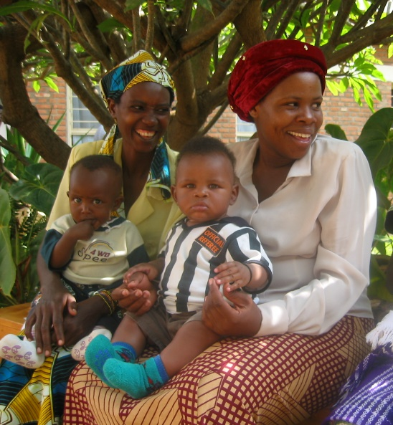
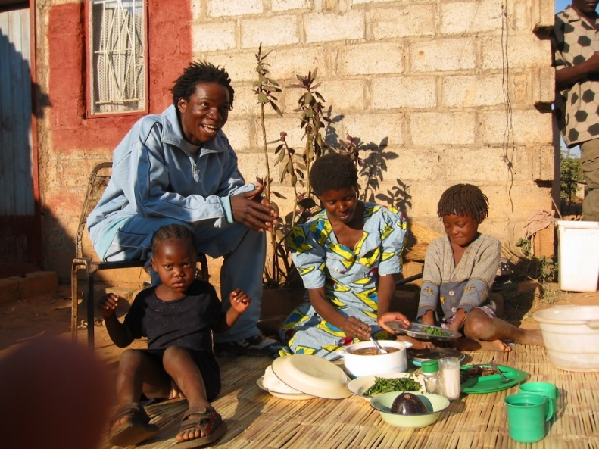
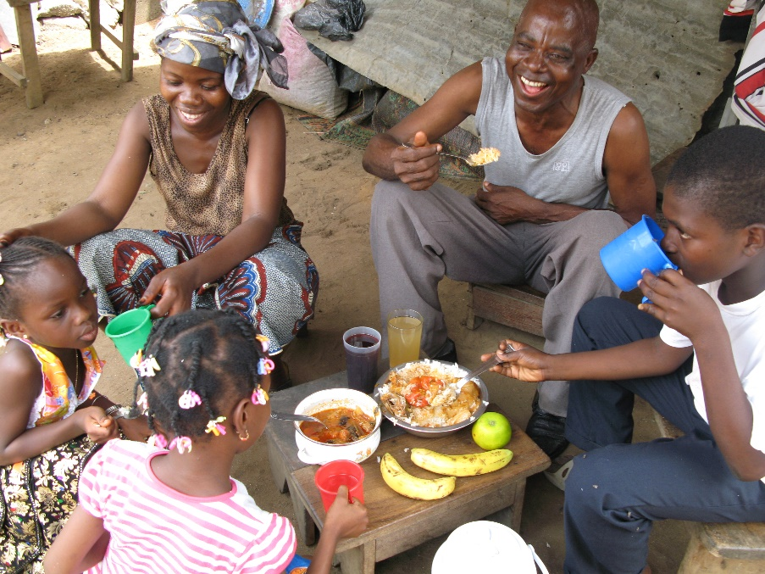
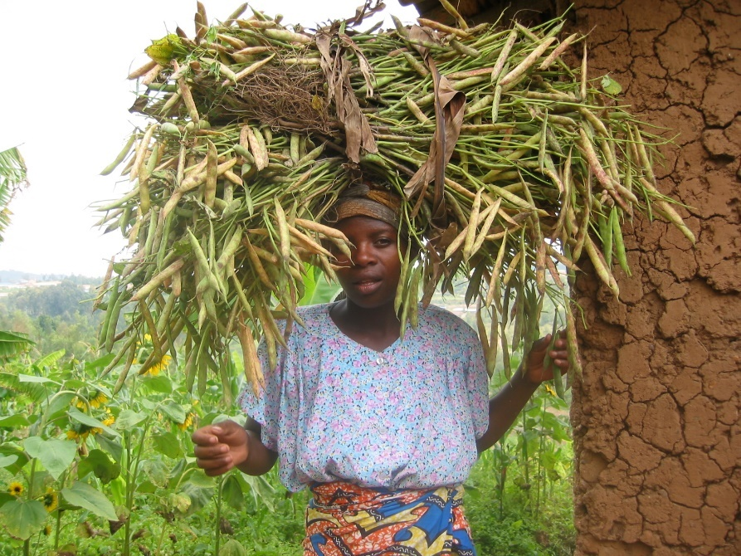
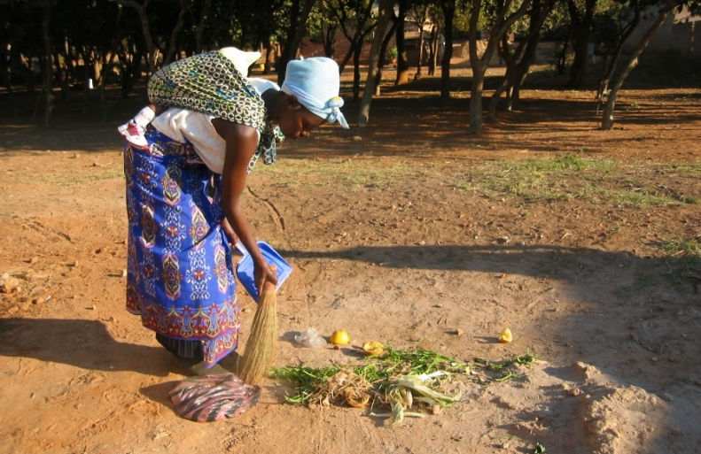
CRITERION 4:
Gender and Family Care Considerations
Photo credits: Iain McLellan FANTA/FHI360

Slide 89
Understanding Gender: Test Your Knowledge
What is the difference between Gender and Sex?
What are some of the roles and expectations assigned to men and women in Uganda (district and tribe)?
Why is it important to use a gender lens in food security and nutrition programs?

Slide 90
Understanding Gender
Gender refers to the socially constructed roles, activities, and responsibilities assigned to women and men in a given culture, location, and time
  These roles and expectations vary among societies and change over time
Social and cultural attitudes and perceptions influence how women and men perceive themselves and their roles in society, which consequently influences agriculture and nutrition outcomes
  Women are responsible for productive and reproductive work
  Men control the assets and the decision to sell
  Access to agriculture financing favours men
  Increasing household food availability and/or income can be time consuming

Slide 91
How Can Extension Agents Create Awareness on Gender and Family Care Issues
Men and women should both be encouraged to participate in all agricultural extension activities
Men and women should both participate in all agriculture technology transfer activities
Communities and households should be encouraged to select enterprises mix designs that address both women’s and men’s needs, thereby limiting conflict
Notes:
Few women determine which enterprises will be undertaken on the land.
Even when the do have a say, they usually are only permitted to decide on food crop enterprises
While men decide on cash crop enterprises.
Food crop enterprises are typically restricted to small plots, leaving the bigger plots for cash crops.
Men are in charge of marketing most of the produce.
Some interventions aimed at increasing household food availability and/or income can end up having a reduced impact on nutrition;
If the activities are so time-consuming that they interfere with caregivers’ ability to adequately care for children.

Slide 92
How Can Extension Agents Create Awareness on Gender and Family Care Issues (continued)
Encourage equal distribution of leadership roles among women and men for representation in decision-making processes at the household/ village level and beyond
  This ensures articulation of issues that promote food security and nutrition
Women should be encouraged to form or join savings and credit associations to improve their access to affordable credit and enable investment in enterprises that promote nutrition
Notes:
Few women determine which enterprises will be undertaken on the land.
Even when the do have a say, they usually are only permitted to decide on food crop enterprises
While men decide on cash crop enterprises.
Food crop enterprises are typically restricted to small plots, leaving the bigger plots for cash crops.
Men are in charge of marketing most of the produce.
Some interventions aimed at increasing household food availability and/or income can end up having a reduced impact on nutrition;
If the activities are so time-consuming that they interfere with caregivers’ ability to adequately care for children.

Slide 93
How Can Extension Agents Create Awareness on Gender and Family Care Issues (continued)
Encourage men and women to engage in discussions of their respective roles in the household division of labour
Discussions should address the proportion of time that men and women in the household spend on:
  Land preparation, planting, weeding, fertilizing, and harvesting
  Food preparation (including fetching water)
  Child care
  Other responsibilities
Notes:
Few women determine which enterprises will be undertaken on the land.
Even when the do have a say, they usually are only permitted to decide on food crop enterprises
While men decide on cash crop enterprises.
Food crop enterprises are typically restricted to small plots, leaving the bigger plots for cash crops.
Men are in charge of marketing most of the produce.
Some interventions aimed at increasing household food availability and/or income can end up having a reduced impact on nutrition;
If the activities are so time-consuming that they interfere with caregivers’ ability to adequately care for children.

Slide 94
How Can Extension Agents Create Awareness on Gender and Family Care Issues (continued)
Sensitize households and communities on the importance of labor-saving technologies and the role that men can play to support women in managing competing priorities
  Child care
  Meal preparation
  Animal care
  Gardening
Technologies/interventions that save time and energy allow women to prepare safe, nutritious baby foods
Notes:
Few women determine which enterprises will be undertaken on the land.
Even when the do have a say, they usually are only permitted to decide on food crop enterprises
While men decide on cash crop enterprises.
Food crop enterprises are typically restricted to small plots, leaving the bigger plots for cash crops.
Men are in charge of marketing most of the produce.
Some interventions aimed at increasing household food availability and/or income can end up having a reduced impact on nutrition;
If the activities are so time-consuming that they interfere with caregivers’ ability to adequately care for children.

Slide 95
Technologies and Actions that Save Time and Energy
Farm technologies that reduce household labour requirements, such as tractors, animal traction, and herbicides to minimize tillage
Planting of wood lots and promotion of agro-forestry activities near homes
  Increase access to biomass energy
  Increase total farm incomes
  Reduce labour costs associated with scavenging for firewood
  Increase the resilience and sustainability of the food production system

Slide 96
Technologies and Actions that Save Time and Energy (continued)
Enterprise mix designs that require relatively little labour or offer flexibility for child care should be selected
  Broiler chickens are less labour-intensive than traditional layers
  Some farming activities can be carried out near home, making it relatively easy for women to care for their children (e.g., household-level food processing and mushroom growing)

Slide 97
Technologies and Actions that Save Time and Energy (continued)
Labour or energy-saving technologies for food preparation
  Low-technology water pumps
  Eco stoves and fuel-efficient stoves
  Low-cost solar driers for fruits and vegetables
  Milling machines and graters
  Rain water harvesting devices

Slide 98
Technologies and Actions that Can Save Time and Energy
Links should be established with other stakeholders to promote community-based childcare centres in farming communities as part of agricultural development programs

Slide 99
Criteria 4: Gender and Family Care Considerations—Key Messages
Agricultural extension workers should work closely with community development workers to:
Promote intensive community mobilization on gender and other social and cultural issues that negatively affect nutrition security
Consider enterprises with suitable energy, time, and labour-saving technologies to reduce women’s workload

Slide 100
REFLECTION
In Groups of 10:
  Develop a convincing argument to pitch to a stakeholder (e.g., CAO, OWC lead, Implementing Partners) on why you should integrate gender into enterprise mix designs (10 minutes)
  Present your argument (3 minutes per group, timed!)
?

Slide 101
Session 7:
COMMUNITY MOBILIZATION

Slide 102
Community Mobilization and Capacity Building for Nutrition
It is important to pay adequate attention to food and nutrition security. This is possible through community mobilization
Agriculture extension and community development offices need to work together so that communities clearly understand food and nutrition security and they take action
The food and nutrition security of the community needs to be analyzed with the community’s participation

Slide 103
Community Mobilization and Capacity Building for Nutrition (continued)
Explain the causes and consequences of food insecurity and malnutrition as part of the community mobilization process to inform required actions
Help the community make an action plan to address causes of food insecurity and malnutrition that are within their means and refer the rest to relevant authorities
Community development and agriculture extension workers and volunteers need to develop their capacity to mobilize the community around food and nutrition security

Slide 104
Why Malnutrition is An Issue of Concern and Why Nutrition Matters
The cost of child undernutrition is estimated at 1.8 trillion UGX
About 33% of Ugandan children under 5 years of age are stunted
14% of children under 5 are underweight
50% of children under 5 are anaemic, as are 24% of women of child-bearing age
Under-nutrition greatly contributes to poor pregnancy outcomes and mortality among mothers and children under 5

Slide 105
Why Malnutrition is An Issue of Concern and Why Nutrition Matters (continued)
Child undernutrition generates health costs equal to 11% of the country's total health budget
54% of the working age population is stunted
Undernutrition contributes to more than 50% of mortality among children under 5
Overnutrition is becoming a problem in Uganda, contributing to the rising incidence of cancer, diabetes, cardiovascular diseases, and dental disease

Slide 106
Causes of Malnutrition
Household food insecurity
Diets poor in quantity, nutrient density, variety, or consumption frequency
Poverty
Inadequate care for mothers and children
Limited understanding of differing nutritional requirements in the household (e.g., among children, pregnant women, the elderly), compounded by low levels of education
Unhygienic living conditions, such as poor water supply and sanitation

Slide 107
Causes of Malnutrition (continued)
Disease
Incongruous traditional beliefs and practices
Inadequate health care services
Improper food preparation, such excess boiling, which reduces nutrient content
Unsafe/unhygienic handling of food during preparation, leading to illness
Improper food handling, such as inappropriate drying and storage practices and untimely harvesting

Slide 108
Community Mobilization Actions that Can Improve Nutrition
Increase production of a variety of nutrient-dense foods rich in micronutrients and protein, such as fruits, vegetables, animal-source foods, legumes, and biofortified crops
Promote community involvement in home gardens by supporting village nurseries
Debunk detrimental food taboos and harmful cultural beliefs/practices
Promote participation of men and women in domestic, agriculture, and livelihood activities
Improve household food safety with good sanitation and food handling practices

Slide 109
Community Mobilization Actions that Can Improve Nutrition (continued)
Explain that different family members have different nutritional requirements and need different levels of care, including feeding
Promote consumption of a healthy diet and locally-available, nutrient-dense foods
Promote practices that reduce post-harvest losses and encourage household-level processing to increase income and access to and consumption of diverse foods
Promote diversification of production throughout the year and improvements in storage and food processing to reduce seasonal food insecurity and ensure regular, adequate income flows

Slide 110
Points to Remember during Community Awareness
During community awareness-raising sessions on gender roles, avoid discussions that portray women as victims of unfair treatment
Emphasis should be on what needs to be done or done better by both men and women to improve nutrition

Slide 111
Thank you!

Slide 112



This presentation is made possible by the generous support of the American people through the support of the Office of Health, Infectious Diseases and Nutrition, Bureau for Global Health, U.S. Agency for International Development (USAID) and USAID/Uganda, under terms of Cooperative Agreement No. AID-OAA-A-12-00005, through the Food and Nutrition Technical Assistance III Project (FANTA), managed by FHI 360. The contents are the responsibility of FHI 360 and do not necessarily reflect the views of USAID or the United States Government.

