Slide 1





United Republic of Tanzania
0.1
Ministry of Health, Community Development, Gender, Elderly and Children
Nutrition Assessment,
Counselling and Support (NACS)
Slides
for Training Health Facility-Based Service Providers
Tanzania Food and Nutrition Centre

Slide 2
0.2
Introductory Session
Nutrition Assessment,
Counselling and Support (NACS)
1

Slide 3
COURSE STRUCTURE
0.3
Module 1. Overview of Nutrition
Module 2. Nutrition Assessment, Classification and Care Plans
Module 3. Nutrition Education, Counselling and Referral
Module 4. Nutrition Support
Module 5. NACS Monitoring and Reporting

Slide 4
TRAINING METHODS
0.4
Brainstorming
Lecture with slides
Discussion
Group work
Written exercises
Site practice visit
Review
Test/evaluation

Slide 5
LEARNING OBJECTIVES
0.5
Discuss expectations and relate them to the objectives of the course.
Take a pre-test.

Slide 6
COURSE OBJECTIVES
0.6
Advocate for and discuss the role of nutrition in care
and treatment.
Assess the nutritional status of clients.
Select appropriate Nutrition Care Plans for clients.
Counsel clients on nutrition.
Communicate the Critical Nutrition Actions (CNAs).
Prescribe and monitor specialised food products for acutely malnourished clients.
Manage NACS services in the workplace.
Collect information to monitor and report on
NACS services.

Slide 7
1.1
Overview of Nutrition
Nutrition Assessment,
Counselling and Support (NACS)
1

Slide 8
LEARNING OBJECTIVES
1.2
Define basic nutrition terms.
Explain the importance of nutrition for good health.
Explain human nutrient needs.
Explain the additional nutritional requirements of people living with HIV.
Describe the interaction between HIV and nutrition.
Describe the interaction between tuberculosis (TB) and HIV.
Describe the causes, features and consequences
of malnutrition.
Describe the Critical Nutrition Actions (CNAs).

Slide 9
DEFINITION OF FOOD
1.3
      Food is anything edible that provides the body
      with nutrients.
      Nutrients are chemical substances in food that are released during digestion and provide energy to maintain, repair or build body tissues. Nutrients include macronutrients and micronutrients.
        Macronutrients include carbohydrates, protein and fat (needed in large amounts).
        Micronutrients include vitamins and minerals (needed only in small amounts).
Notes:
9

Slide 10
DEFINITION OF NUTRITION
1.4
      Nutrition is the intake of food and drink and the chemical and physical processes that break down the food and release nutrients needed for growth, reproduction, immunity, breathing, work and health.

Slide 11
CONDITIONS FOR GOOD NUTRITION
1.5
        Ability to access and eat the right quality and quantity of food to sustain life and health
        Appetite
        Ability to chew and swallow
        Ability to digest and absorb food
        Ability to use nutrients in food for cell development and growth, reproduction, immunity, breathing, work, etc.
        Ability to store different nutrients/energy in relevant parts of the body
        Ability to excrete toxins/waste

Slide 12
DEFINITION OF MALNUTRITION
1.6
Malnutrition occurs when food intake does not match the body’s needs. A malnourished person can have either undernutrition or overnutrition.
Undernutrition is the result of not consuming enough nutrients for healthy growth and development.
Overnutrition is the result of consuming more nutrients than the body needs for healthy growth and development.

Slide 13
TYPES OF MALNUTRITION (1)
1.7
Acute malnutrition is caused by decreased food consumption and/or illness, resulting in wasting. Wasting is defined by low mid-upper arm circumference (MUAC) or low weight-for-height
z-score (WHZ).
Chronic malnutrition is caused by prolonged or repeated episodes of undernutrition, resulting in stunting. Stunting is defined by low height-for-age.

Slide 14
TYPES OF MALNUTRITION (2)
1.8
Micronutrient deficiencies are a result of reduced micronutrient intake and/or absorption. The most common forms of micronutrient deficiencies are related to iron, vitamin A and iodine deficiency.
Overweight
Obesity

Slide 15
IMPORTANCE OF NUTRITION FOR GOOD HEALTH
1.9
Good nutrition
Is essential for human survival, growth, cognitive and physical development and productivity
Strengthens the immune system to reduce morbidity and mortality
Improves medication adherence and effectiveness
Builds a productive society and high quality of life

Slide 16
FOOD GROUPS
1.10
People should eat a variety of foods from all the food groups to get all the nutrients the body needs.
Cereals, green bananas, roots and tubers (carbohydrates for energy)
Pulses, nuts and animal-source food (protein for body building)
Fruits (vitamins and minerals for protection)
Vegetables (vitamins and minerals for protection)
Sugar, honey, fats and oils (extra energy)

Slide 17
DAILY ENERGY REQUIREMENTS
1.11
Group | Kilocalories (kcal)/day
6–11 months | 680
12–23 months | 900
2–5 years | 1,260
6–9 years | 1,650
10–14 years | 2,020
15–17 years | 2,800
≥ 18 years | 2,000–2,580
Pregnant/lactating | 2,460–2,570
Source: WHO, FAO and United Nations University (UNU). 2001. Human Energy Requirements: Report of a Joint WHO/FAO/UNU Expert Consultation, 17–24 October, 2001. Geneva: WHO.
Notes:
17

Slide 18
ENERGY REQUIREMENTS OF PEOPLE LIVING WITH HIV
1.12
HIV-positive adult in early/asymptomatic stage:
10% more energy
HIV-positive adult in late/symptomatic stage:
20% more energy
HIV-positive child
  Asymptomatic: 10% more energy
  Symptomatic: 20–30% more energy
  Losing weight or acutely malnourished:
  50–100% more energy
  Source: WHO. 2003. Nutrient Requirements of People Living with HIV/AIDS: Report of a Technical Consultation, Geneva, 13–15 May 2003. Geneva: WHO.
Notes:
18

Slide 19
DAILY PROTEIN REQUIREMENTS
1.13
Group | Grams (g) per day
0–6 months | 9
7–11 months | 11
1–3 years | 13
4–8 years | 19
9–13 years | 34
14–18 years | 46 (girls), 52 (boys)
19–> 70 years | 46 (females), 56 (males)
Pregnant 14–50 years | 71
Lactating 14–50 years | 105
HIV positive | No additional requirement
Sources: WHO, FAO and United Nations University (UNU). 2001. Human Energy Requirements: Report of a Joint WHO/FAO/UNU Expert Consultation, 17–24 October, 2001. Geneva: WHO. U.S. Department of Agriculture. 2011. Dietary Reference Intakes (DRIs): Recommended Intakes for Individuals. Washington, DC: U.S. Government.
Notes:
19

Slide 20
NUTRIENT REQUIREMENTS
OF PEOPLE LIVING WITH HIV
1.14
Protein: Same as for HIV-negative people (12–15% of energy intake, 50–80 g/day or 1 g/kg of ideal weight)
Fat: Same as for HIV-negative people (no more than 35% of total energy needs), but people on antiretroviral therapy (ART) or with persistent diarrhoea might need to eat less fat
Micronutrients: Same as for HIV-negative people (1 Recommended Daily Allowance [RDA] through diet), but if diet is insufficient, HIV-positive children and pregnant/post-partum women might need multiple micronutrient supplements
  Source: WHO. 2003. Nutrient Requirements of People Living with HIV/AIDS: Report of a Technical Consultation, Geneva, 13–15 May 2003. Geneva: WHO.
Notes:
20

Slide 21
NUTRITION AND TB
1.15
        TB reduces appetite and increases energy expenditure,
        causing wasting.
        Underweight people are at risk of developing active TB.
        Poor nutritional status may speed up progression from TB infection to TB disease.
        Protein loss in TB patients can cause nutrient malabsorption.
        Increased energy expenditure and tissue breakdown increase micronutrient needs in people with TB.
        Poor appetite makes people with TB unable to eat enough to meet their increased micronutrient needs.

Slide 22
HIV-TB CO-INFECTION
1.16
        In southern Africa, people without HIV have a 10% risk of TB over a lifetime. People with HIV have a 10% risk over 1 year.
        People with HIV are more vulnerable to TB, and it is more difficult to treat TB in people with HIV.
        HIV increases the risks of TB infection, latent TB becoming active and relapse after treatment.
        People with HIV are up to 50 times more likely to develop active TB than people without HIV.
        30% of people living with HIV with TB die within 1 year of diagnosis and initial treatment.
        TB speeds HIV progression and increases mortality.

Slide 23
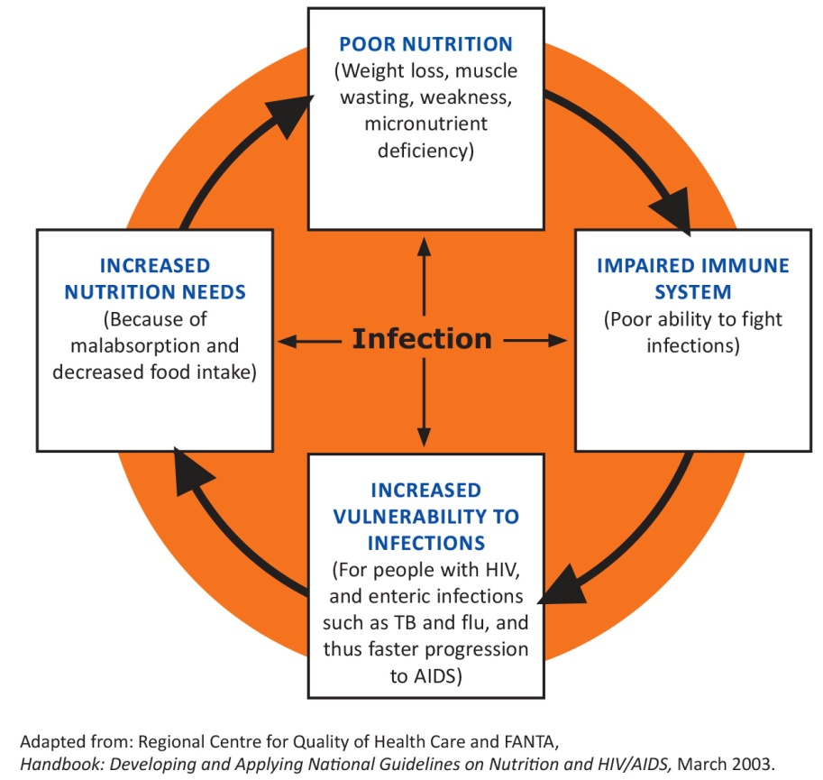
A VICIOUS CYCLE: MALNUTRITION AND INFECTION
1.17
Notes:
23
The link between nutrition and HIV is a vicious cycle that weakens the immune system.
HIV weakens the body’s natural defence against infections.
Frequent infections make the body weaker and lead to faster progression from HIV to AIDS.
HIV and frequent infections increase nutrition needs, but HIV and infections cause loss of appetite and poor absorption and utilisation of food.

Slide 24
NUTRITION INTERVENTIONS
1.18
Good nutritional status
Nutritional needs met
Nutrition
interventions
Stronger
immune system
Reduced vulnerability to infection
Notes:
24

Slide 25
UNICEF CONCEPTUAL FRAMEWORK OF MALNUTRITION
1.19
Malnutrition
Manifestation
Inadequate dietary
intake
Disease
Immediate causes
Inadequate access to food
Inadequate care
for children and women
Insufficient health services & unhealthy environment
Underlying causes
Inadequate education
Human, economic and organizational resources and how they are controlled
Basic causes
Political and ideological factors
Potential resources

Slide 26
CLINICAL FEATURES OF MALNUTRITION (1)
1.20
In adults
        Weight loss
        AIDS wasting
        Anaemia
In pregnant women
        Inadequate weight gain
        Anaemia
        Pre-term delivery
        General
        Reduced lean body mass
        Metabolic disorders
In children
        Growth faltering
        Slower growth rate
        Weight loss
        Stunting
        Underweight
        Wasting
        Hair colour change
        Bilateral pitting oedema
        Anaemia
Notes:
26

Slide 27
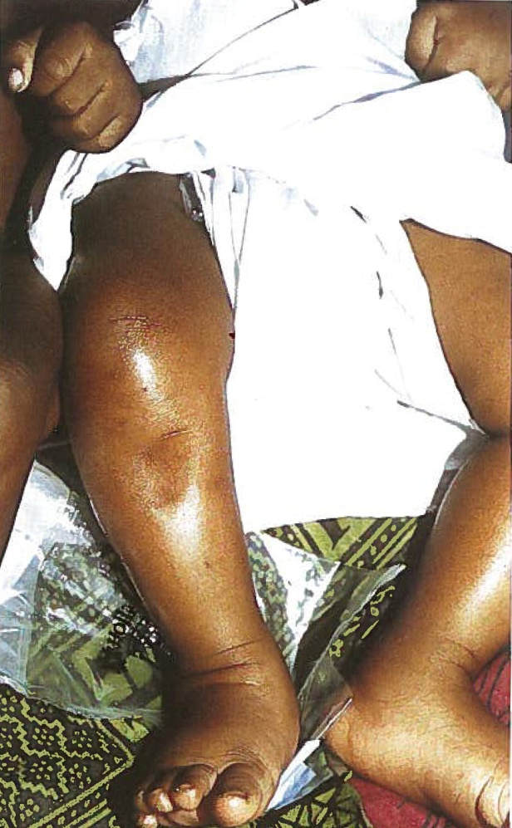
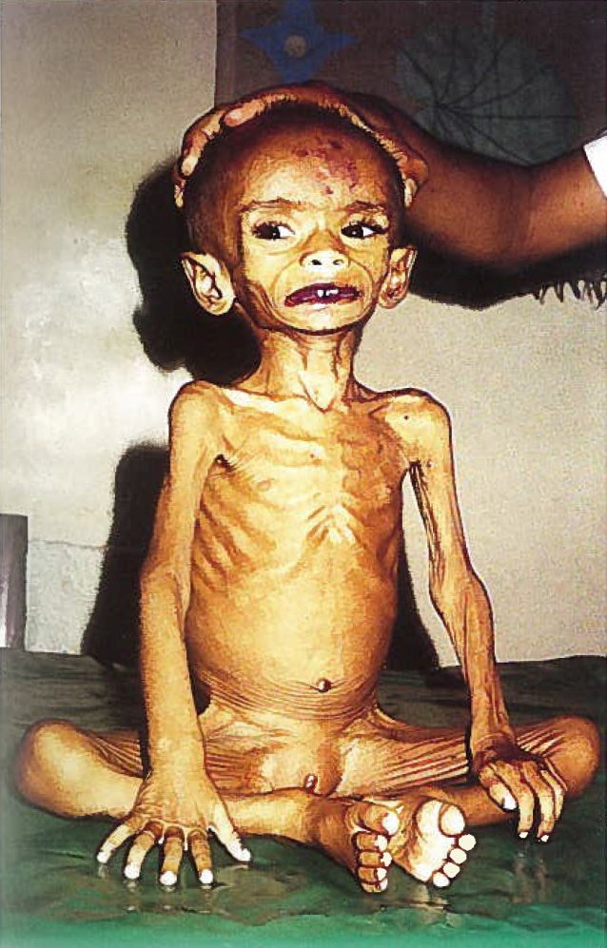
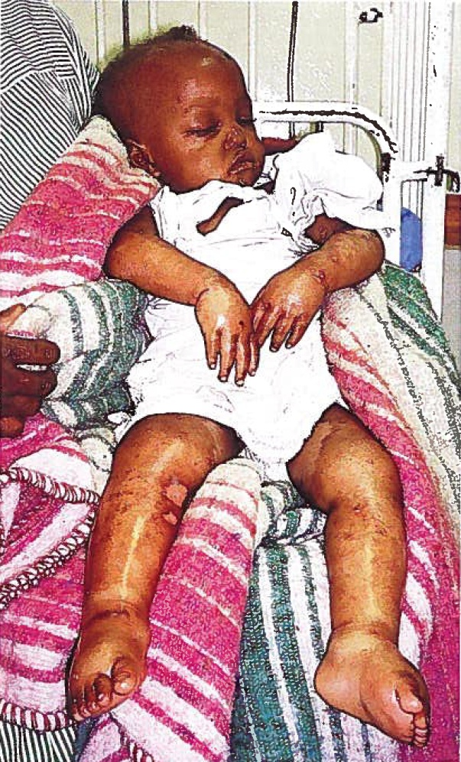
CLINICAL FEATURES OF MALNUTRITION (2)
1.21
Pitting oedema in both legs
Wasting (marasmus)
Oedema and flaking skin (kwashiorkor)
Photos: WHO. 2002. Training course on the management of severe malnutrition. Geneva: WHO.

Slide 28
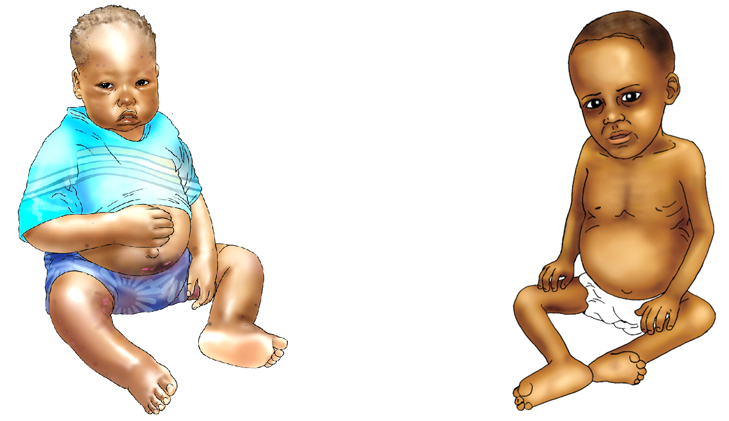
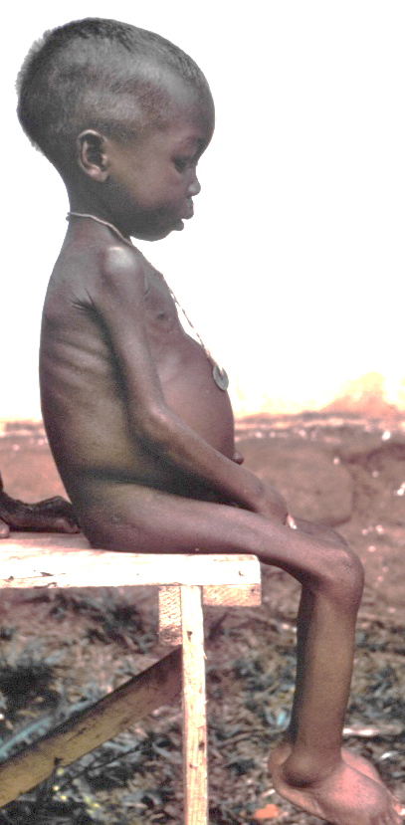
MARASMUS AND KWASHIORKOR
1.22
Kwashiorkor Marasmus Marasmic kwashiorkor
Sources: University Research Co., LLC. 2009. Comprehensive Nutrition Care for People Living with HIV/AIDS: Facility-Based Health Providers Manual. Bethesda, MD: URC; Wikimedia

Slide 29
CONSEQUENCES OF MALNUTRITION
1.23
        Increased risk of infections
        Poor physical growth and brain development
        Weakened immunity, increased morbidity and mortality
        Faster disease progression in people with HIV and TB
        Increased risk of mother-to-child transmission of HIV
        Reduced medication effectiveness and adherence
        Increased poverty and disease
        Lower educational and economic prospects
        Increased health and education costs
        Increased risk of chronic diseases (e.g., diabetes from overnutrition)
Notes:
29

Slide 30
PREVENTING AND MANAGING MALNUTRITION (1)
1.24
Food
        Eating a balanced diet using a variety of local foods
        Optimal feeding of vulnerable groups
        Modifying food (mashing, fermenting, germinating, dehulling, roasting)
        Fortifying food (adding micronutrients to staple foods, sprinkling food with multiple micronutrient powders)
        Improving household food production
        Improving food security through economic strengthening
        Providing food support or food aid
        Improving school feeding
Notes:
30

Slide 31
PREVENTING AND MANAGING MALNUTRITION (2)
1.25
Health services
        Integrating nutrition into routine health services
        Providing micronutrient supplements
        Treating acute malnutrition with specialised food products
        Deworming
        Providing nutrition education and counselling
Behaviour change
        Growth monitoring and promotion
        Nutrition counselling and education
Notes:
31

Slide 32
CRITICAL NUTRITION ACTIONS
1.26
Get weighed regularly and have weight recorded.
Eat a variety of foods and increase intake of nutritious foods.
Drink plenty of boiled or treated water.
Avoid habits that can lead to poor nutrition and poor health.
Maintain good hygiene and sanitation.
Get exercise as often as possible.
Prevent and seek early treatment of infections and advice on managing symptoms through diet.
Manage medication-food interactions and medication side effects through diet.
Notes:
32

Slide 33
NUTRITION SERVICES IN HEALTH FACILITIES
1.27
        Nutrition assessment
        Nutrition counselling and education
        Demonstration of how to prepare nutritious food
        Prescription of specialised food products for acutely malnourished clients
        Micronutrient supplementation
        Deworming
        Referral to community economic strengthening, livelihood and food security services
Notes:
33

Slide 34
Nutrition Assessment,
Classification and Care Plans
2.1
2
2.1

Slide 35
LEARNING OBJECTIVES
2.2
Explain the importance of nutrition assessment.
Take and interpret anthropometric measurements accurately.
Do clinical, biochemical and dietary assessments.
Classify nutritional status correctly based on nutrition assessment.
Select appropriate Nutrition Care Plans based on clients’ nutritional status.
Explain the importance of recording client nutrition information.

Slide 36
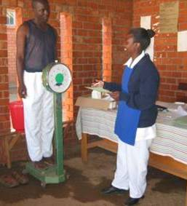
IMPORTANCE OF
NUTRITION ASSESSMENT
2.3
        Identifies people at risk for malnutrition for early intervention or referral before severe malnutrition
        Detects diet habits that increase the risk of disease
        Identifies needs for nutrition education and counselling
        Identifies local food resources
Photo: Wendy Hammond
        Tracks growth and weight trends
        Establishes a framework for a Nutrition Care Plan
Notes:
36

Slide 37
TYPES OF NUTRITION ASSESSMENT
2.4
        Anthropometric
        Biochemical
        Clinical
        Dietary
Notes:
37

Slide 38
CLINICAL NUTRITION ASSESSMENT
2.5
1. Check for medical complications.
        Bilateral pitting oedema
        Wasting
        Anorexia, poor appetite
        Persistent diarrhoea
        Nausea or vomiting
        Severe dehydration
        High fever (≥ 38.5º C)
        Rapid breathing
        Convulsions
        Severe anaemia
        Mouth sores or thrush
        HIV
        Hypothermia
        Hypoglycaemia
        Lethargy or unconsciousness
        Extreme weakness
        Opportunistic infections
        Extensive skin lesions
2. Find out what medications the client is taking.

Slide 39
ANTHROPOMETRY
2.6
Anthropometry is the measurement of the size, weight and proportions of the human body. Anthropometric measurements also can be used to assess the nutritional status of individuals and population groups.

Slide 40
TYPES OF ANTHROPOMETRIC MEASUREMENT
2.7
        Weight
        Height
        Mid-upper arm circumference (MUAC)
Measurements presented as indexes
        Weight-for-age z-score (WAZ)
        Weight-for-height z-score (WHZ)
        Body mass index (BMI)
        BMI-for-age z-score

Slide 41
CLASSIFICATIONS OF
NUTRITIONAL STATUS
2.8
        Severe acute malnutrition (SAM) with no appetite or with medical complications
        SAM with appetite and no medical complications
        Moderate acute malnutrition (MAM)
        Normal nutritional status
        Overweight
        Obesity
Notes:
41

Slide 42
HOW OFTEN SHOULD YOU
WEIGH CLIENTS?
2.9
        Daily in inpatient care
        Generally on each health facility visit
        Children under 5: Follow routine reproductive and child health (RCH) weighing schedule
        Outpatient adults:
  With severe acute malnutrition (SAM): Every 2 weeks
  With moderate acute malnutrition (MAM): Every month
  With normal nutritional status: Every 3 months

Slide 43
BODY MASS INDEX
2.10
        BMI = weight (kg)
        height (m²)
        BMI is a reliable indicator of body fatness and an inexpensive and simple way to measure adult malnutrition.
        BMI cutoffs are not accurate in pregnant women or adults with oedema, whose weight gain is not linked to nutritional status. For these groups, use MUAC.

Slide 44
PHYSICAL SIGNS
OF MALNUTRITION
2.11
        Bilateral pitting oedema
        Dull, dry, thin or discoloured hair
        Dry or flaking skin
        Pallor of the palms, nails or mucous membranes
        Lack of fat under the skin
        Fissures and scars at the corner of the mouth
        Swollen gums
        Goitre
        Bitot’s spots in the eyes

Slide 45
BIOCHEMICAL TESTS USED IN NUTRITION ASSESSMENT
2.12
        Measurement of nutrient concentration in blood
        Measurement of urinary excretion and metabolites
        of nutrients
        Detection of abnormal metabolites in blood from a nutrient deficiency
        Measurement of changes in blood constituents or enzyme activities that depend on nutrient intake
        Measurement of ‘tissue specific’ chemical markers

Slide 46
CRITERIA FOR SAM
2.13
Adolescents and adults
        MUAC < 18.5 cm
        OR BMI < 16.0
        OR weight loss > 10% since the last visit
Women who are pregnant or up to 6 months post-partum
        MUAC < 19.0 cm
Children
        Bilateral pitting oedema
        OR severe visible wasting
        OR MUAC
  6 to 59 months: < 11.5 cm
  5 to 9 years: < 13.5 cm
  10 to 14 years: < 16.0 cm
        OR WHZ OR BMI-for-age z-score < –3

Slide 47
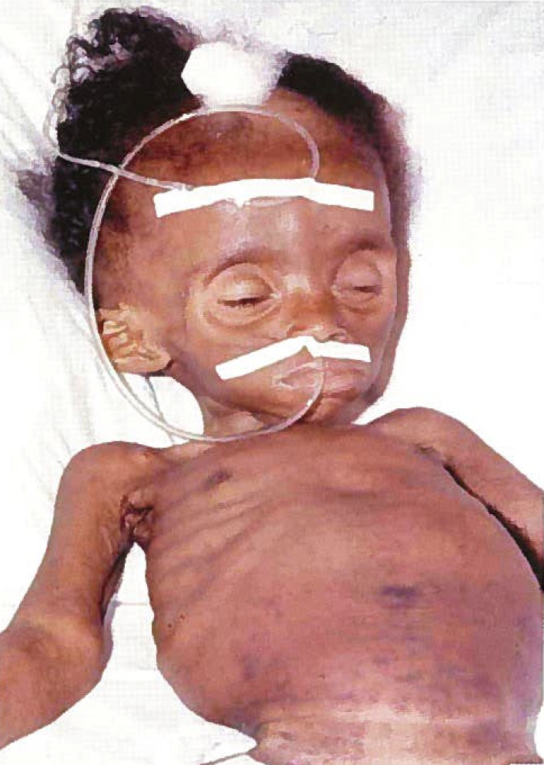
CHILD WITH SAM (1)
2.14
Photo: WHO. 2002. Training Course on the Management of Severe Malnutrition. Geneva: WHO.
Notes:
47

Slide 48
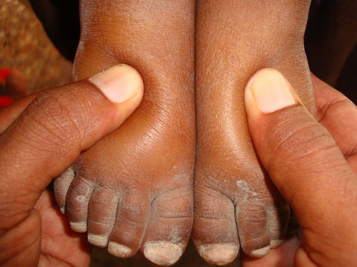
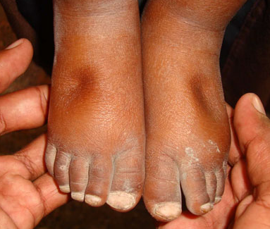
CHILD WITH SAM (2)
2.15
Photos: Geno Teofilo, Oxfam
Notes:
48

Slide 49
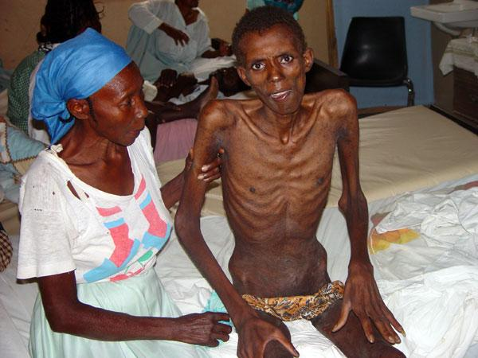
ADULT WITH SAM
2.16
Photo: http://www.redpepper.co.ug/what-to-look-for-14-symptoms-of-hiv/
Notes:
49

Slide 50
NUTRITION CARE FOR
CLIENTS WITH SAM
2.17
        Routine SAM medicines
        Ready-to-use therapeutic food (RUTF)
        High-energy fortified-blended food (FBF) or ready-to-use supplementary food (RUSF)
        HIV testing and PCP prophylaxis if not on ART
        Counselling on the CNAs
        Weekly or bi-weekly monitoring (daily if inpatient)
        Appetite test, oedema assessment, weight monitoring and medical checks on each visit
        Referral to food security and livelihood support, home-based care, psychosocial counselling, etc.
Notes:
50

Slide 51
CRITERIA FOR INPATIENT TREATMENT OF SAM
2.18
        ANY OF THE FOLLOWING:
        No appetite (failed an appetite test)
        Concurrent infections or other medical complications
        In outpatient care for 2 months and no weight gain or weight loss or worsening oedema
        Caregiver unable to provide homecare
        Inability to return in 1 week for follow-up
Notes:
51

Slide 52
CRITERIA FOR OUTPATIENT TREATMENT OF SAM
2.19
ALL OF THE FOLLOWING:
        Appetite (passed an appetite test)
        No concurrent infections or other medical complications
        Caregiver willing and able to provide home care
        Ability to return for follow-up
        Enough RUTF supply in stock
Notes:
52

Slide 53
CRITERIA FOR MAM
2.20
Adolescents and adults
        MUAC ≥ 18.5 to < 22.0 cm
        OR BMI ≥ 16.0 to < 17.0
        OR weight loss > 5% since last visit
Women who are pregnant/ up to 6 months post-partum
        MUAC ≥ 19.0 to < 23.0 cm
Children
        Confirmed weight loss since last visit
        AND MUAC
  6 to 59 months: ≥ 11.5 to
  < 12.5 cm
  5 to 9 years: ≥ 13.5 to
  < 14.5 cm
  10 to 14 years: ≥ 16.0 to
  < 18.5 cm
        OR WHZ OR BMI-for-age ≥ –3 to < –2

Slide 54
NUTRITION CARE FOR CLIENTS WITH MAM
2.21
        Treatment of concurrent illnesses
        FBF or RUSF to provide 40–60% of energy needs (slightly more for children coming from SAM treatment)
        HIV testing (especially children) and PCP prophylaxis if not on ART
        Anaemia assessment (supplementation if necessary)
        Deworming
        Counselling on the CNAs
        Monthly follow-up
        Referral to food security and livelihood support, home-based care, psychosocial counselling, etc.
Notes:
54

Slide 55
CRITERIA FOR NORMAL NUTRITIONAL STATUS
2.22
Adults
        MUAC ≥ 22.0 cm
        OR BMI ≥ 18.5 to < 25.0
Women who are
pregnant or up to 6
months post-partum
        MUAC ≥ 23.0 cm
Children
        MUAC
  6–59 months: ≥ 12.5 cm
  5–9 years: ≥ 14.5 cm
  10–14 years: ≥ 18.5 cm
        OR WHZ ≥ –2 to ≥ +2
        OR BMI-for-age z-score ≥ –2 to ≤ +1
Notes:
55

Slide 56
NUTRITION CARE FOR NORMAL NUTRITIONAL STATUS
2.23
        Counselling to prevent infection and malnutrition
    Critical Nutrition Actions
    Child spacing and reproductive health
    Optimal infant and young child feeding
        Micronutrient supplementation
        Growth monitoring and promotion
        Deworming
        Malaria prevention

Slide 57
CRITERIA FOR OVERWEIGHT
2.24
Adults
        BMI ≥ 25.0 to < 30.0
Children and adolescents 5–17 years
BMI-for-age z-score > +1 to ≤ +2
Children 6–59 months
        MUAC: > 21 cm
        OR WHZ > +2 to ≤ +3
Notes:
57

Slide 58
CRITERIA FOR OBESITY
2.25
Adults (non-pregnant/
post-partum)
        BMI ≥ 30.0
Children and adolescents 5–17 years
BMI-for-age z-score > +2
Children 6–59 months
        WHZ +3
Notes:
58

Slide 59
NUTRITION CARE FOR OVERWEIGHT AND OBESITY
2.26
        Medical assessment to rule out diabetes or high cholesterol
        Counselling to eat more fruits and vegetables, fewer fried and sugary foods and to drink water instead of juice or soda
        Counselling to get at least 1 hour of exercise a day

Slide 60
Nutrition Education, Counselling and Referral
3.1
3

Slide 61
LEARNING OBJECTIVES
3.2
Define counselling.
List the skills needed for effective counselling.
List considerations for planning a counselling session.
Counsel using the GATHER approach.
Recognise challenges in nutrition counselling and how to address them.
Counsel on the Critical Nutrition Actions (CNAs).
Refer clients to other clinical services and
community programmes.

Slide 62
COUNSELLING VS. EDUCATION
AND ADVICE
3.3
        Giving advice is directive.
        Educating is conveying information from an expert to a group of people.
        Counselling is non-directive, non-judgemental, dynamic, empathetic, interpersonal communication to help someone use information to make a choice or solve a problem.

Slide 63
CRITICAL NUTRITION ACTIONS
3.4
Get weighed regularly and have weight recorded.
Eat a variety of foods and increase intake of nutritious foods.
Drink plenty of boiled or treated water.
Avoid habits that can lead to poor nutrition and poor health.
Maintain good hygiene and sanitation.
Get exercise as often as possible.
Prevent and seek early treatment of infections and advice on managing symptoms through diet.
Manage medication-food interactions and medication side effects through diet.
Notes:
63

Slide 64
SKILLS THAT FACILITATE COUNSELLING
3.5
        Using helpful non-verbal communication
        Showing interest
        Showing empathy
        Asking open-ended questions
        Reflecting back what the client says
        Avoiding judgement
        Praising what a client does correctly
        Giving a little relevant information at a time
        Using simple language
        Giving practical suggestions, not commands

Slide 65
GATHER COUNSELLING STEPS
3.6
G – Greet
A – Ask
T – Tell
H – Help
E – Explain
R – Reassure/Return date

Slide 66
CHALLENGES IN COUNSELLING
ON NUTRITION
3.7
Inability to find or buy nutritious foods
Feeling that nutrition is not important compared to other problems
Inexperienced counsellors
Stigma related to HIV
Belief that illness is caused by supernatural forces
Notes:
66

Slide 67
ADDRESSING COUNSELLING CHALLENGES
3.8
Refer clients to food or economic support.
Counsel on the importance of nutrition to prevent and recover from illness, perform better at school and work and help medicines work effectively.
Learn more about nutrition and counselling methods.
Counsel people living with HIV in private and assure them that their information will be kept confidential.
Show evidence of improvement from nutrition interventions.
Notes:
67

Slide 68
THE IMPORTANCE OF SAFE FOOD AND WATER
3.9
        Food- and water-borne illness can decrease appetite and nutrient absorption, lower resistance to infections and increase the body’s need for nutrients to fight infection.
        People living with HIV are at high risk of infection, have more severe symptoms of food- and water-borne illnesses and can have a hard time recovering from diarrhoea.
        Good sanitation and hygiene can prevent infections that cause malnutrition.
Notes:
68

Slide 69
MEDICATION-FOOD INTERACTIONS
3.10
        Medication side effects can reduce appetite, nutrient absorption and medication adherence.
        Some foods can reduce the effectiveness of medications.
        Antiretroviral therapy (ART) can cause changes in body composition (haemoglobin, lipodystrophy, fat redistribution).
        Long-time use of ART can result in diabetes, hypertension, osteoporosis or dental problems.
Notes:
69

Slide 70
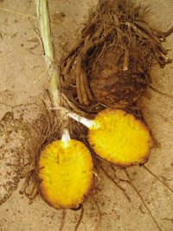


FALSE ADVERTISING OF HIV CURES
3.11
Nutrition supplements sold as HIV treatment
Photo: wb3.indo-work.com
Photo: positivenation.co.uk
False claims that a compound called Rooperol in the African potato can fight HIV
Photo: Avert.org
Notes:
70

Slide 71
AIMS OF COMMUNITY OUTREACH
3.12
        Find malnourished people early and refer them for treatment before they develop serious complications.
        Increase awareness of the importance of nutrition and the causes, signs and treatment of malnutrition.
        Increase awareness of available nutrition services.
        Increase coverage and follow-up of clients.
        Link prevention and treatment of malnutrition.
Notes:
71

Slide 72
CHANNELS OF
COMMUNITY OUTREACH
3.13
        Home-based care (HBC) and most vulnerable children (MVC) services: Measure MUAC to screen for malnutrition, refer malnourished people to health facilities and counsel people on the CNAs.
        Local leaders: Mobilise communities to seek NACS services.
        Networks and support groups for people living with HIV: Encourage members to practice the CNAs, measure MUAC and refer members to NACS services.
        Local media: Inform communities of NACS services and entry and exit criteria.
Notes:
72

Slide 73
COMMUNITY CASE-FINDING OF SAM
3.14
        Growth monitoring and promotion
        MUAC measurement during home visits
        MUAC measurement in meetings with MVC as they come for other services
        MUAC measurement as part of home-based care
        MUAC measurement in support group meetings
Notes:
73

Slide 74
NUTRITION SERVICES IN HOME-BASED CARE AND CARE OF MVC
3.15
        MUAC measurement
        Dietary assessment
        Assessment of food availability and use
        Demonstration to caregivers of how to prepare locally available foods to make nutritious meals
        Demonstration to caregivers of how to prepare and feed specialised food products
        School feeding
        School gardens

Slide 75
Nutrition Support
4.1
4

Slide 76
LEARNING OBJECTIVES
4.2
Explain why it is important to treat acute malnutrition.
Describe the purpose and types of specialised food products.
List entry and exit criteria for treatment with specialised food products.
Correctly complete specialised food product forms and registers.
Manage specialised food products.

Slide 77
COMPONENTS OF NACS
4.3
Nutrition assessment
Nutrition counselling and education
Nutrition Care Plans
Prescription of specialised food products for malnourished clients
Micronutrient supplementation
Referral to other needed clinical and community services support

Slide 78
TARGET GROUPS FOR NACS
4.4
        All malnourished clients in reproductive and child health (RCH) clinics, under 5 clinics, and outpatient care
        For people living with HIV:
  All HIV-positive adults and adolescents in care
  and treatment
  Women who are pregnant or up to 6 months post-partum in prevention of mother-to-child transmission of HIV (PMTCT) programmes
  All HIV-exposed children 0–14 years of age, including children of HIV-positive women

Slide 79
NACS STEPS
4.5
Provide nutrition education in the waiting area.
Assess and classify nutritional status.
Counsel clients and/or caregivers based on the clients’ nutritional status.
Prescribe specialised food products for acutely malnourished clients and counsel on their use.
Continue monitoring clients’ nutritional status and counselling clients on follow-up visits.

Slide 80
SPECIALISED FOOD PRODUCTS
4.6
        Nutritionally dense fortified products used to treat
        acute malnutrition
        Prescribed as medicine in clinic services based on strict criteria for a limited time
        Individual take-home rations to help the malnourished client recover
        Not to be shared with other family members

Slide 81
PURPOSE OF SPECIALISED
FOOD PRODUCTS
4.7
Prevent and treat acute malnutrition.
Improve medication effectiveness and adherence.
Improve the efficacy of ART or TB treatment and help manage side effects.
Improve birth outcomes and promote infant and
child survival.
Provide continuity of care.
Improve functioning and quality of life.

Slide 82
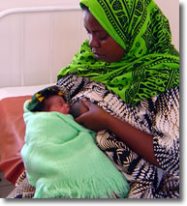
WARNING: SPECIALISED FOOD PRODUCTS AND INFANTS
4.8
        Therapeutic foods (except
        for F-75 and F-100) and supplementary foods are not appropriate or nutritionally adequate for infants under
        6 months of age.
        Children this age should
        receive only breast milk (or replacement milk if it can be provided safely), unless they are in inpatient treatment
        for SAM.
Photo: Quality Assurance Project
Notes:
82

Slide 83
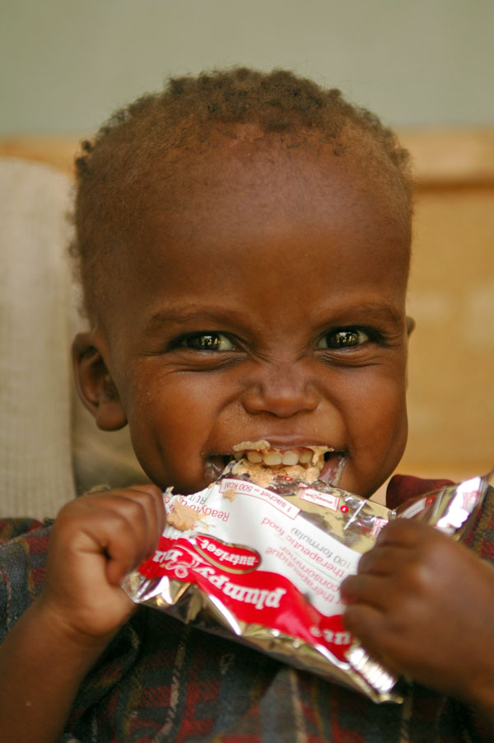

SPECIALISED FOOD PRODUCTS VS. OTHER FOOD SUPPORT
4.9
        Food support aims to increase food security, providing household food rations that often consist of staple foods.
        Specialised food products are prescribed as medicine to treat acute malnutrition or supplement the diets of people with clinical malnutrition identified through nutrition, health or vulnerability assessments.
Photo: WFP
Photo: Julie Pudlowski

Slide 84

TYPES OF SPECIALISED FOOD PRODUCTS
4.10
        Therapeutic food
        F-75 and F-100 therapeutic milks for inpatient treatment of SAM
        Plumpy’nut® in 92 g packets that
        provide 500 kilocalories each (or 543
        kilocalories per 100 g of Plumpy’nut®)
        for inpatient and outpatient treatment of SAM
        Supplementary food
        FBF or RUSF to treat SAM and MAM

Slide 85
PRESCRIBING AND MONITORING SPECIALISED FOOD PRODUCTS
4.11
  Classify nutritional status.
  Do a medical assessment.
  Decide whether to treat the client as an outpatient or refer to inpatient care.
  Prescribe specialised food products as needed.
  Counsel on how to use the specialised food products.
  Record all specialised food products given to the client.
  Exit the client when the target weight, MUAC or BMI is reached.

Slide 86
NACS Monitoring and Reporting
5.1
5

Slide 87
LEARNING OBJECTIVES
5.2
Explain the purpose of collecting NACS data.
Complete NACS data collection forms accurately.
List requirements for quality NACS services.
Assess the quality of NACS services in
the workplace.
Discuss NACS client flow and integration
of services.
Practise nutrition assessment, counselling and NACS data collection in a health facility.

Slide 88
M&E TERMS
5.3
Monitoring: Regularly and systematically collecting information
Evaluation: Systematic and objective evaluation of the relevance, effectiveness, outcomes and impact of activities compared with specified objectives
Indicator: A measurable signal that shows the status of something or a change in something
Numerator: The number above the line in a fraction
Denominator: The number below the line in a fraction

Slide 89
PURPOSE OF RECORDING NACS DATA
5.4
        Client management and follow-up
        Advocacy for support for nutrition services
        Decision making
        Resource allocation
        Stock monitoring
        Evaluation of the impact of services
        Continuous quality improvement of NACS services

Slide 90
NACS INDICATORS
5.5
# and % of clients that received nutrition assessment
# and % of clients that received nutrition counselling
# and % of clients that were identified as malnourished (disaggregated by SAM, MAM or overweight/obese)
# and % of clients > 6−12 months of age with acute malnutrition
# and % of malnourished clients that received specialised food products
# and % of clients that transitioned from SAM to MAM
# and % of clients who graduated from SAM or MAM to normal nutritional status

Slide 91
CHALLENGES IN COLLECTING AND RECORDING DATA
5.6
Collecting data takes a lot of time.
Poor data could be useless for decision making.
Higher levels may not give feedback on reports.
Clients might be registered in more than one facility.
Clients might be lost to follow-up.
Clients might not attend the clinic regularly.

Slide 92
ADDRESSING NACS DATA COLLECTION CHALLENGES
5.7
Fill out forms regularly to become familiar with them.
Collect and record data as accurately as possible.
Ask the site in-charge to coordinate with TFNC for feedback on reports.
Write client identification numbers on all forms.
Ask community health workers to make home visits
to defaulting clients to collect missing information.
Counsel clients on the importance of regular follow-up visits.

