Slide 1

Use of Data in FFP
Data Use Webinar
Arif Rashid, FFP M&E Team Lead

Slide 2
FFP M&E Vision
Using program evidence to tell FFP’s story
Improved effectiveness of FFP programs
Increased use of data in decision making
Improved policy and guidance for FFP and partners
Increased M&E capacity of FFP and partners
Increased integration of learning into planning and management
Improving emergency partners’ program monitoring and reporting | Building FFP M&E capacity with improved guidance & tools | Integrating learning into activity planning & management
Notes:
FFP’s M&E vision is to achieve improved effectiveness of FFP programs and use program evidence to tell FFP’s story. To achieve this vision, FFP’s M&E goal is increased use of data in decision making.
This goal would be achieved through three strategic objectives:
Improved policy and guidance for FFP and partners
Increased M&E capacity of FFP and partners, and
Increased integration of learning into planning and management
To achieve these strategic objectives, the M&E team has identified three broad sets of priority activities in its work plan.
Improving emergency program monitoring and reporting;
Building FFP M&E capacity with improved guidance and tools; and
Integrating learning into activity planning and management
Each one of the three priority activities contributes to several strategic objectives.

Slide 3
Use Of Data For Telling Our Story

Slide 4
International Food Assistance Report (IFAR)
Primary Audience: Congress
https://www.usaid.gov/what-we-do/agriculture-and-food-security/food-assistance/resources/united-states-international-food
Notes:
4
The M&E team is developing an M&E Policy & Guidance document for emergency programs (discussed in the next slide).
M&E team members will contribute to required revisions and updates to the APS for emergency programs.
The M&E specialists in the three Africa Regional FFP Offices are in close communication with WFP Regional M&E Advisors. In addition, the M&E team provided comments and recommendations on WFP’s Strategic and Results Framework. These recommendations related to WFP’s indicators, methods for data collection, and alignment of indicators with results and objectives in the WFP framework.
The M&E team can provide technical input and an M&E perspective on TEC reviews of emergency program applications.
On an as-needed basis, the M&E team can contribute technical expertise, guidance, etc. on emergency needs assessments.
M&E team members can help improve the results of evaluations by providing technical input on the content, design, and review of SOWs for evaluations. There are a number of evaluation study designs that are effective for emergency program evaluations and learning. Guidance and example SOWs will be included as annexes in the forthcoming policy and guidance document.

Slide 5
International Food Assistance Report 2015
Selected Indicators Reported
3.1.9(1): Number of people trained in child health and nutrition through USG-supported programs
3.1.9 (15): Number of children under five reached by USG-supported nutrition programs
3.3.3(15): Number of USG social assistance beneficiaries participating in productive safety nets
4.5.2(2): Number of hectares under improved technologies or management practices as a result of USG assistance
4.5.2(5): Number of farmers and others who have applied new technologies or management practices as a result of USG assistance
4.5.2(7): Number of individuals who have received USG supported short-term agricultural sector productivity or food security training
4.5.2(11): Number of food security private enterprises (for profit), producers organizations, water users associations, women's groups, trade and business associations, and community-based organizations (CBOs) receiving USG assistance
4.5.2(13): Number of rural households benefiting directly from USG interventions
4.5.2(14): Number of vulnerable households benefiting directly from USG assistance
4.5.2(27): Number of members of producer organizations and community based organizations receiving USG assistance
4.5.2(29): Value of Agricultural and Rural Loans
4.5.2(42): Number of food security private enterprises (for profit), producers organizations, water users associations, women's groups, trade and business associations, and community-based organizations (CBOs) that applied improved technologies or management practices as a result of USG assistance
4.5.1(17): Kilometers of roads improved or constructed

Slide 6
Feed the Future Annual Progress Report
Audience: Congress, USG, and other stakeholders
https://www.usaid.gov/news-information/press-releases/oct-13-2016-us-unveils-new-impacts-against-global-poverty-and-malnutrition

Slide 7
Feed the Future Progress Report 2016
Selected Indicators Reported that Include FFP Data
Farmers and others who have applied improved technologies or management practices as a result of U.S. Government assistance
Hectares tended with improved technologies or management practices as a result of U.S. Government assistance
Individuals who have received U.S. Government-supported long-term agriculture sector productivity or food security training
Children under 5 reached by U.S. Government-supported nutrition programs
People trained in child health and nutrition through U.S. Government supported programs
Value of incremental sales (collected at farm level) attributed to Feed the Future (USD)
Food security private enterprises (for-profit), producers organizations, water users associations, women’s groups, trade and business associations and community-based organizations receiving U.S. Government assistance
Number of micro-, small-, and medium-sized enterprises, including farmers, receiving U.S. Government assistance to access loans
Value of agricultural and rural loans (USD)

Slide 8
Department of State and USAID Annual Performance Report also known as Performance Plan and Report (PPR)
Audience – USG and Congress
The Annual Performance Report presents a detailed assessment of Agency performance against annual targets for a representative set of foreign assistance indicators.
https://www.usaid.gov/results-and-data/progress-data/annual-performance-report

Slide 9
Department of State and USAID Annual Performance Report 2016
Selected Indicators Reported that Include FFP Data
Number of farmers and others who have applied new technologies or management practices as a result of U.S. Government assistance
Percentage of operating units using at least one Gender Empowerment and Female Equality indicator in their Foreign Assistance Performance Plan and Report (PPR)
Number of sex-disaggregated indicators where reporting demonstrating improvements toward equality in gender integration for food security programming
Number of people trained in disaster preparedness as a result of U.S. assistance
Number of communities and stakeholders involved in the development of plans, policies, and strategies related to hazard risk reduction
Prevalence of stunted children under five years of age
Number of people gaining access to basic sanitation services as a result of USG assistance
Number of people gaining access to basic drinking water services as a result of USG assistance
Percent of USAID-funded evaluations that are published online
Number of data sets added to USAID.gov/data

Slide 10
FFP Annual Report 2016
Audience: FFP Staff, and other stakeholders
This Year-in-Review Annual Report is a new publication for FFP. It aims to provide the reader with highlights and trends from a number of our development projects and emergency responses, drawing on data reported by FFP partners and analysis.

Slide 11
USAID Blogs

Slide 12
Use Of Data For Program Quality Improvement

Slide 13
ARR Highlights
Audience: FFP
A summary of annual results reports submitted by the development projects

Slide 14
Annual EFSP Progress in West Africa
Audience: FFP West Africa Region
West Africa Regional Office annually produce a report on the performance of EFSP

Slide 15
Mid Term Evaluations
Table 1: Self-Reported Production Data for Selected Crops
Selected crops | Beans | Cassava | Maize | Rice | Vegetables
Area planted (Ha) | 6360 | 4621 | 4720 | 4212 | 712
Production (MT) | 2805.081 | 6760.42 | 2786.2 | 5030.99 | 1891.60
Yield (MT/Hectare) | 0.44 | 1.46 | 0.59 | 1.19 | 2.66
Value (USD) | 641712 | 236103 | 320978 | 1230150 | 143701
Price (USD/MT) | 383.52 | 105.58 | 191.69 | 498.04 | 91.41
Sold (MT) | 1673.22 | 2236.29 | 1674.43 | 2470.00 | 1571.98
Input cost (USD) | 159910 | 77460 | 78577 | 308723 | 15953
Gross income per MT (USD) | 287.95 | 70.94 | 144.77 | 373.05 | 81.27
Gross income per farmer (USD) | 88.67 | 72.11 | 100.48 | 304.58 | 59.33
Number of farmers cultivated | 9109 | 6651 | 4014 | 6162 | 2591
Average area per farmer (Ha) | 0.698 | 0.694 | 1.175 | 0.683 | 0.274
Source: 2016 SAPQ
Annual Monitoring Data are used to inform MTR and to review projects ToC

Slide 16
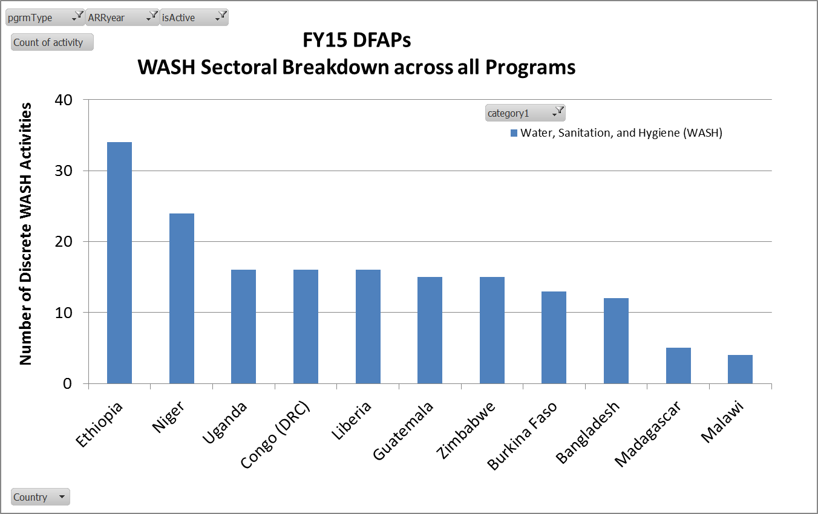
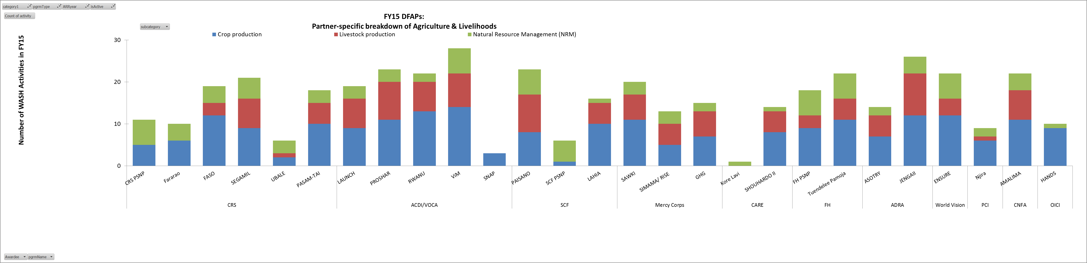
FFP Use of ARR Data
CBOs and the Mission use Annual Monitoring Data to measure activity performance
FFP Technical team uses ARR data to inform their annual TA plan.

Slide 17
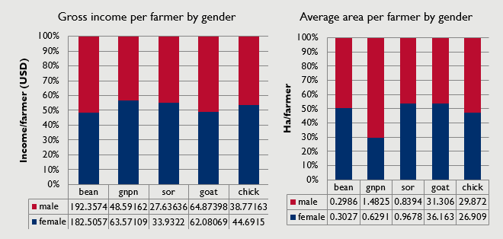
Data Utilization – Example from Zimbabwe - ENSURE
Observations:
Despite having a considerable greater ratio of land to cultivate nuts, men make less profit on average with this crop
Despite receiving relatively more group support, chicken is less profitable relative to other crops on average.
Women make a greater ratio of profit than men on average in all commodities except for beans and goats.

Slide 18
FFP Policy/ Guidance Change Based on Evidence

Slide 19
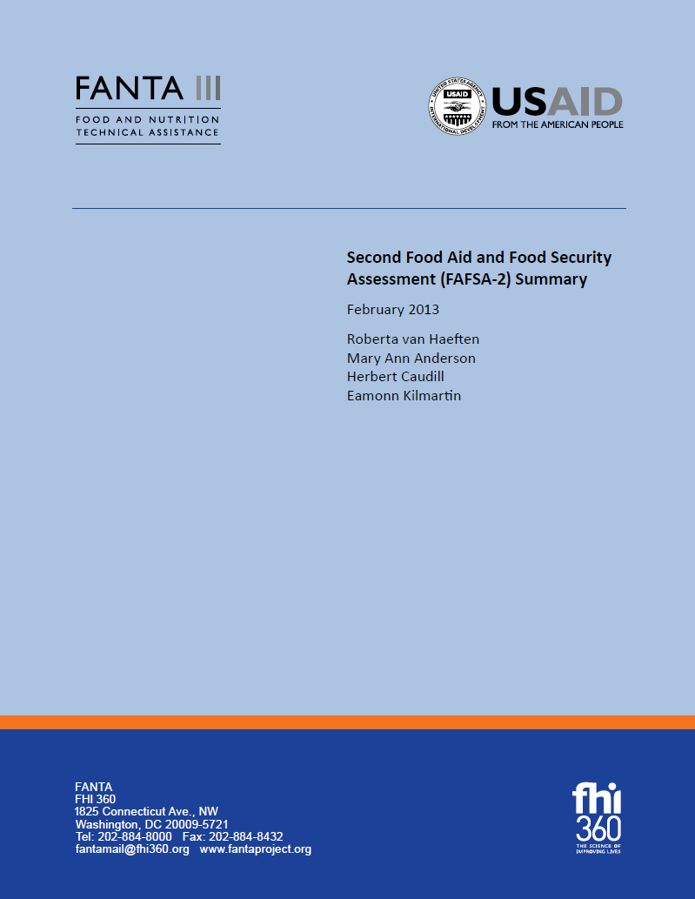
FFP Policy Changes Based on Evidence (FAFSA 2)
USAID/FFP should strengthen monitoring by USAID and Awardees.
USAID/FFP should support experimentation to develop better models for mid-term evaluations.
USAID/FFP should conduct USAID-led program reviews to complement mid-term evaluations done by Awardees. Ensure that the reviews are done by qualified teams.
USAID/FFP should have the baseline and final evaluation surveys and qualitative final evaluations done independently by professional organizations, centrally contracted by USAID/FFP.
USAID/FFP should enforce the requirement that Awardees post project reports and evaluations to the DEC, starting with requesting immediate submission to the DEC of the final evaluations.

Slide 20
FFP Policy Changes Based on the Evidence
FFP Initiated developing the Refine and Implement Approach based on an analysis of 2013 final evaluation reports of its development programs that showed no changes in stunting in 4 out of 5 programs.
FFP added gender integration as an evaluation criteria in FY 2015 based on an assessment carried out by FANTA in 2011.
FFP added a robust sustainability strategy as an evaluation criteria in FY 2016 based on the findings from a number of midterm and final evaluations.
ARR guidance is revised on an annual basis based on the evidence from the previous years.

