Slide 1
USING DATA FOR PROGRAM IMPROVEMENT
[Strengthening Integrated Delivery of HIV/AIDs Services (SIDHAS)]
FFP Data Use Webinar

Slide 2
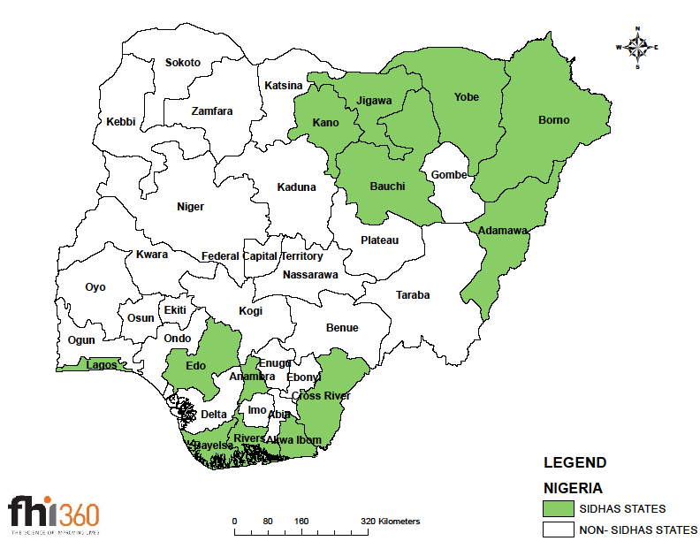
Background
Strengthening Integrated Delivery of HIV/AIDS Services (SIDHAS) is a seven- year PEPFAR funded project designed to build local capacity for the delivery of sustainable, high-quality, integrated comprehensive HIV/AIDS prevention, treatment and care services
SIDHAS is implemented in collaboration with Government of Nigeria (GoN) HIV State Management Teams in 13 states
SIDHAS currently being implemented through 368 Comprehensive ART sites, 381 PMTCT standalone sites and 32 Community Based Organizations

Slide 3
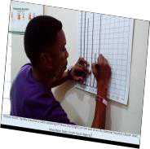
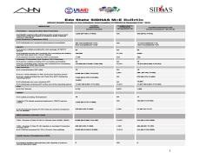

How is data used on the SIDHAS project for program
improvement?
Data Review Meetings, Health Management Team Meetings, Continuous Quality Improvement Runs Charts
HIV Service providers, Medical Records Officers, Facility Management team
Internal Data Review Meetings, Quarterly Programme Review, State HIV Bulletins, Factsheets
Sub-National level
SIDHAS Country Office
Technical Team Meeting, Programme Performance Review Meetings, Inside Nigeria Blog
SIDHAS technical team, Senior Management, State Programme Managers, SIDHAS consortium partners
DHIS, Excel Charts, Power point, Power BI, Inside Nigeria Blog
Weekly, Monthly
Implementing Agency
SIDHAS Implementation Team, Stakeholders at state and local government levels
Excel Charts, PPT, Runs Charts , Cardboards
DHIS, Excel Charts, Power point, bulletins
Monthly
Monthly, Quarterly

Slide 4
DATA USE SCENARIOS

Slide 5
Closing the gap in ARV prophylaxis uptake in Federal
Medical Centre (FMC) Yenagoa
FMC Yenogoa is a Comprehensive ART site in Yenagoa, Bayelsa state
First quarter, FY 13, a significant gap in the uptake of ARV prophylaxis for
PMTCT was observed
<60% of HIV positive pregnant women identified in the quarter were provided with a form of prophylaxis for PMTCT
Presenting the data using standard PMTCT cascade charts to the facility management during the Health Management Team Meeting, resulted in the facility conducting an inquiry and developing strategies to close the gap.
  Increasing CD4 testing days
  Locating an annex of the pharmacy in the O&G unit on ANC days

Slide 6
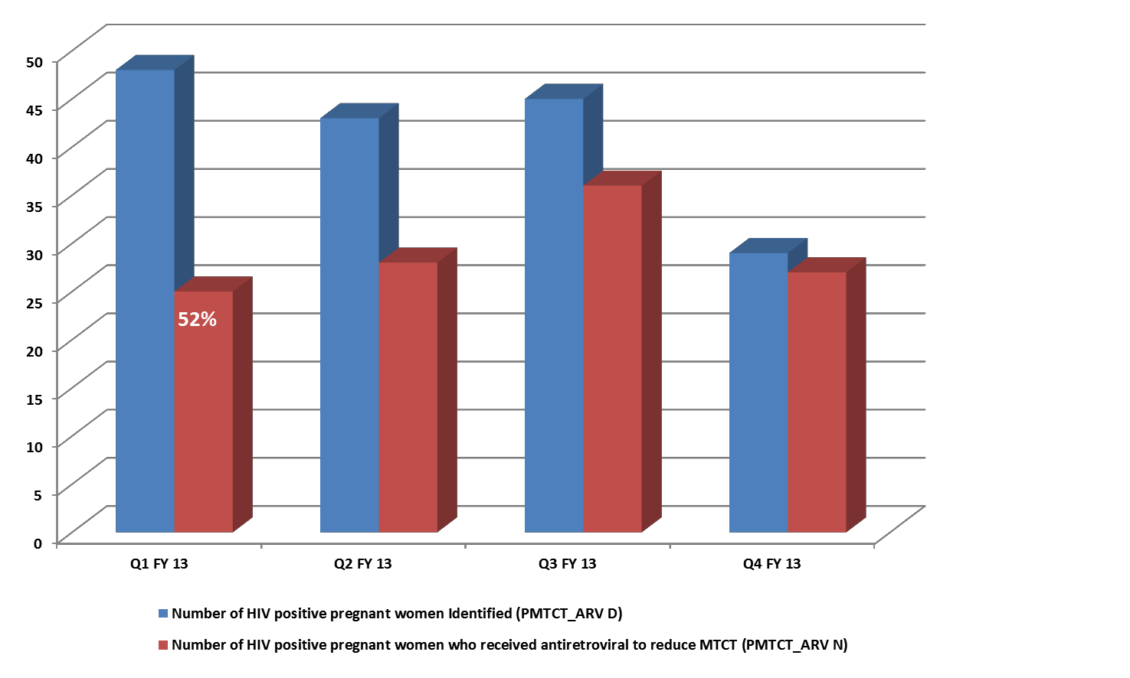
ARV Prophylaxis Uptake in FMC Yenagoa- FY 13
83%
65%
93%

Slide 7
Making the case for the community ART strategy
Excerpts from SIDHAS Weekly Technical Review Meetings
Nigeria has identified 12 states plus the FCT (12+1 priority states) which account for 70% of the HIV/AIDS burden in Nigeria for increased HIV/AIDS focus.
FHI 360 through SIDHAS is lead IP in 8 of these states.
PEPFAR identified 8 states (constituting more than 50% of the National need according to the UN spectrum data) where she will support scale-up of treatment and PMTCT services.
PEPFAR has also adopted a tiered approach to supporting ART & PMTCT services in Nigeria; FHI 360 is supporting PEPFAR plans to increase clients current on treatment by 50% in tier I states and 15% in tier II at the end of FY 15
As a result ambitious for Treatment & PMTCT targets were assigned in FY 15

Slide 8
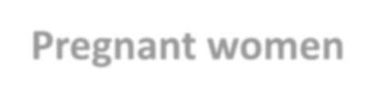
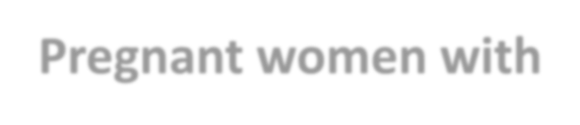





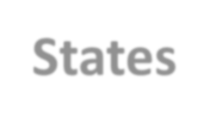
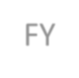
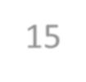
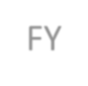
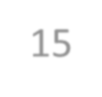
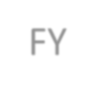
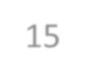
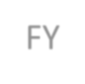
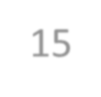

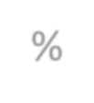
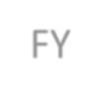
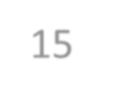

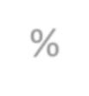
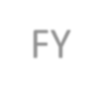
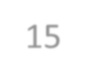

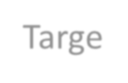
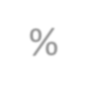


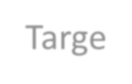


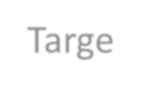






The challenge - SIDHAS performance at Month 5, FY 15
States | Newly started on ART |  |  | Pregnant women with known HIV status |  |  | Pregnant women receiving ARV prophylaxis for PMTCT
 | FY 15 Target | FY 15 Achievem ent to date | % | FY 15 Target | FY 15 Achievem ent to date | % | FY 15 Target | FY 15 Achievem ent to date | %
Akwa Ibom | 14,141 | 2,291 | 16% | 57,615 | 19,244 | 33% | 4,644 | 1,221 | 26%
Cross River | 5,611 | 1,197 | 21% | 100,464 | 18,021 | 18% | 3,676 | 486 | 13%
Lagos | 8,772 | 1,181 | 14% | 102,542 | 30,049 | 29% | 2,571 | 517 | 20%
Rivers | 3,936 | 1,197 | 30% | 109,111 | 14,957 | 14% | 2,834 | 601 | 21%

Slide 9









TX_New Projections- maintaining
current rate
Maintain current rate
Deficits still exist
Rivers
1,197
1,676
3,129
Lagos
1,181
1,653
5,937
Cross River
1,197
1,676
5,752
Akwa Ibom
2,291
3,207
8,643
0% 10% 20% 30% 40%
Achieved in 1st 5 months of FY15
50% 60% 70% 80%
End of FY 15 at current rate
90%
100%
Deficit

Slide 10





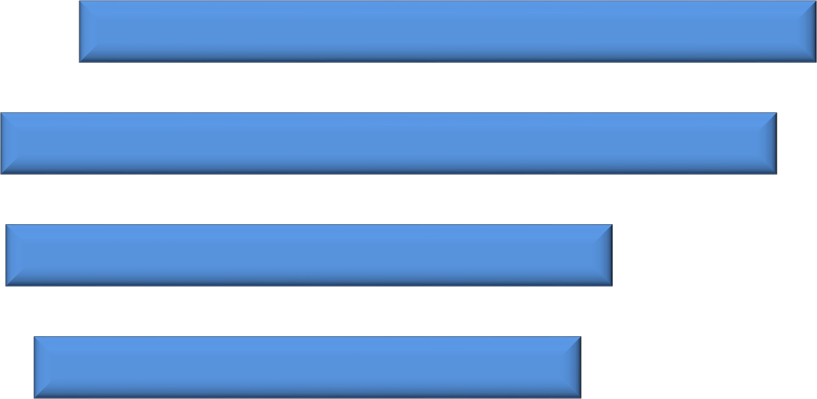

TX_New Projections- optimizing facility level performance
Additional Innovations Needed
Increased Efficiencies
????
Rivers
1,197
3,658
1,147
Lagos
1181
5,626
1,964
Cross River
1197
4,320
3,107
Akwa Ibom
2291
6,391
5,459
0%
20% 40% 60% 80%
At current rate
With additional bump from 80% PITC and demand creation over 5 months Deficit
100%

Slide 11
Proposed strategy
Community
Expanded outreaches to ‘normalize’ HIV testing in
community settings e.g. TBAs, riverine areas
Conduct community HIV testing, CD4 analysis, ART initiation
Transition all initiated clients to the nearest site (Hub/spoke) within 3 months
Facility - Increased Efficiency
Routine testing of all clients
Escort Services to close cascade gap
Scale up Nurse led initiation in high burden sites
Weekly cascade analysis
Target
Met

Slide 12
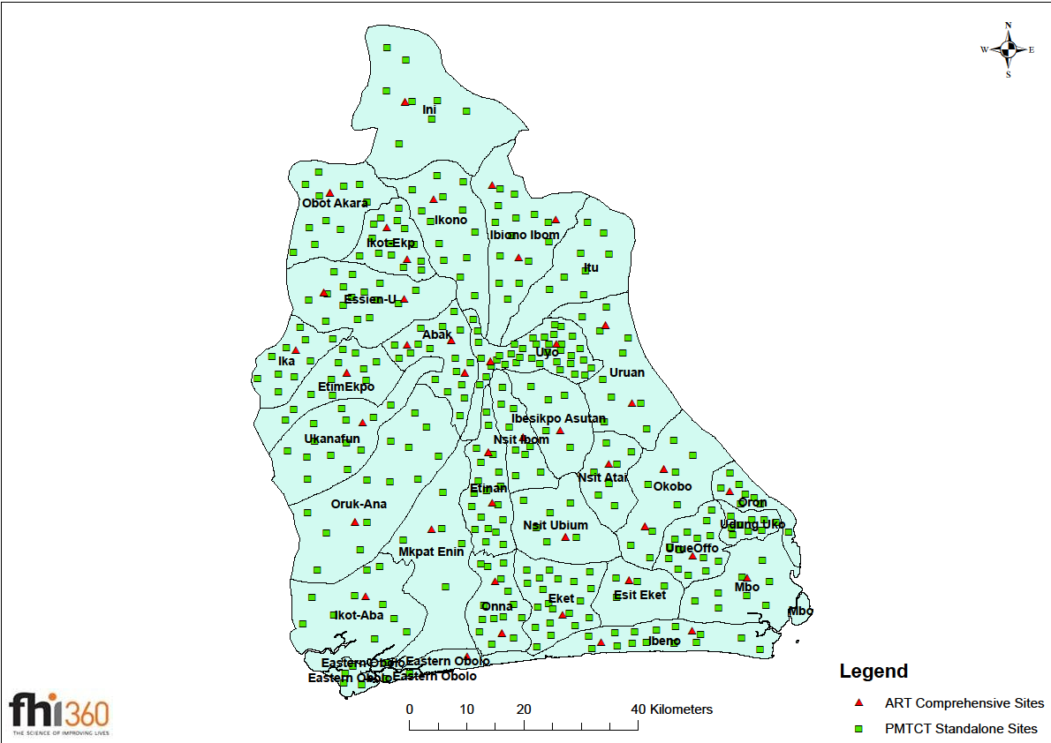
Population based surveys support community strategies
Comprehensive knowledge of HIV is less than
30%
Over 60% of persons never tested for HIV
Only 56% reported home delivery (54.7% of pregnant women would not go to HF due to Poor attitude of health workers (NDHS, 2013)
Poor Knowledge among TBAs on issues relating to reproductive health, STIs and HIV/AIDS
Fear of disclosure, persistent HIV/AIDS related stigma and discrimination (NACA 2010)
Strong misconception –such as witchcraft

Slide 13

Making efficient use of resources
Where do we implement the community ART strategy?
State | Local Government Area | Positivity | Population | HIV Burden | Level of effort
ak Akwa-Ibom State | ak Oron Local Government Area | 18.4 | 87,209 | 16,069 | 5
ak Akwa-Ibom State | ak Esit Eket Local Government Area | 15.7 | 63,358 | 9,930 | 6
ri Rivers State | ri Ahoada East Local Government Area | 12.9 | 166,324 | 21,398 | 8
ri Rivers State | ri Bonny Local Government Area | 12.8 | 214,983 | 27,489 | 8
ak Akwa-Ibom State | ak Ikot Ekpene Local Government Area | 11.9 | 141,408 | 16,797 | 8
ak Akwa-Ibom State | ak Okobo Local Government Area | 11.8 | 102,753 | 12,169 | 8
ri Rivers State | ri Gokana Local Government Area | 11.4 | 233,813 | 26,741 | 9
ak Akwa-Ibom State | ak Mbo Local Government Area | 11.3 | 102,173 | 11,546 | 9
ak Akwa-Ibom State | ak Eastern Obolo Local Government Area | 3.5 | 59,970 | 2,110 | 28
cr Cross River State | cr Ikom Local Government Area | 3.3 | 163,691 | 5,466 | 30
cr Cross River State | cr Akamkpa Local Government Area | 3.3 | 149,705 | 4,906 | 31
cr Cross River State | cr Obudu Local Government Area | 3.2 | 161,457 | 5,171 | 31
ak Akwa-Ibom State | ak Obot Akara Local Government Area | 3.2 | 147,286 | 4,686 | 31
cr Cross River State | cr Akpabuyo Local Government Area | 3.1 | 272,262 | 8,369 | 33
ri Rivers State | ri Andoni Local Government Area | 3.0 | 217,924 | 6,573 | 33
la Lagos State | la Agege Local Government Area | 2.5 | 461,743 | 11,734 | 39
*positivity based on programme data
**level of effort refers to the number of persons to test in order to identify one positive

Slide 14
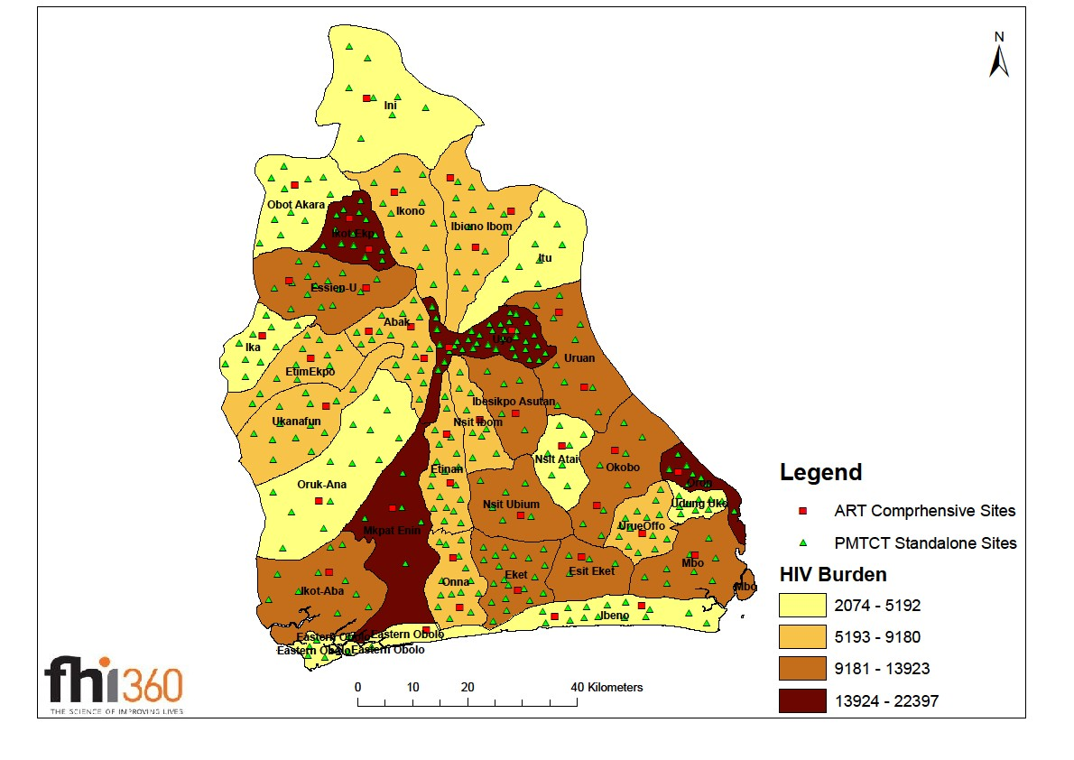
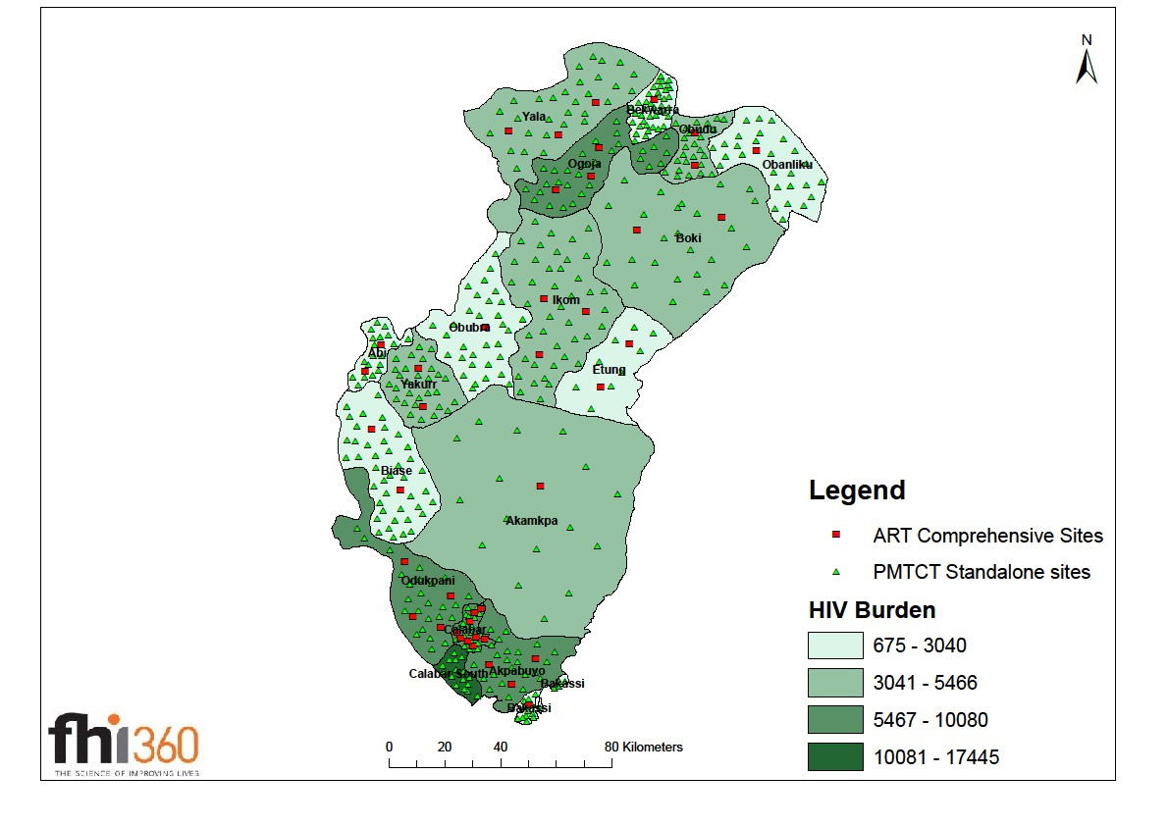
SIDHAS priority states
LGA HIV burden and LGAs for community ART intervention
Akwa-Ibom Cross River

Slide 15
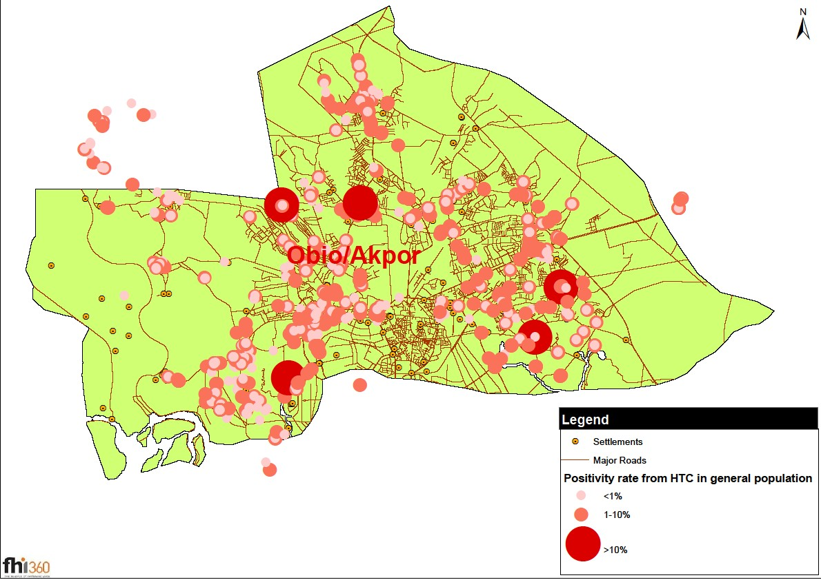
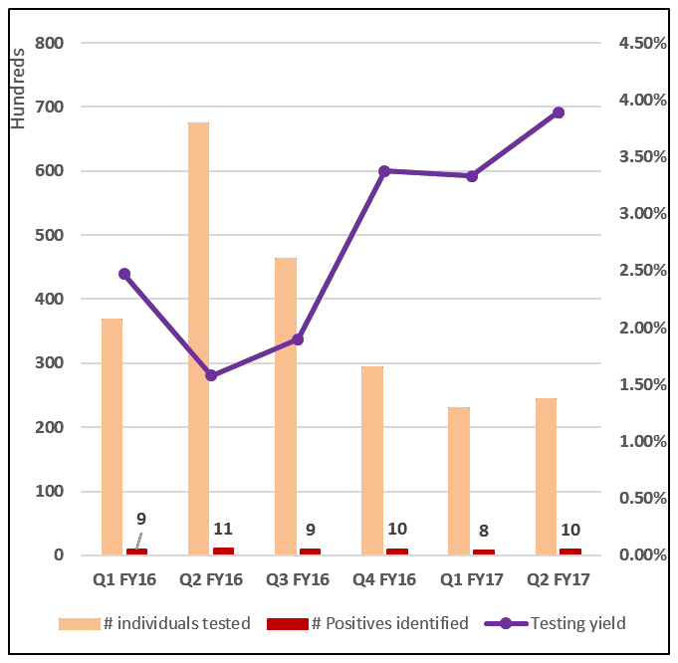
In Scale-up LGAs, where do we concentrate community
outreach activities for greater efficiency?
GIS mapping to identify community hotspots for targeted community testing
Improvements in Testing Efficiency in Obio/Akpor LGA

Slide 16
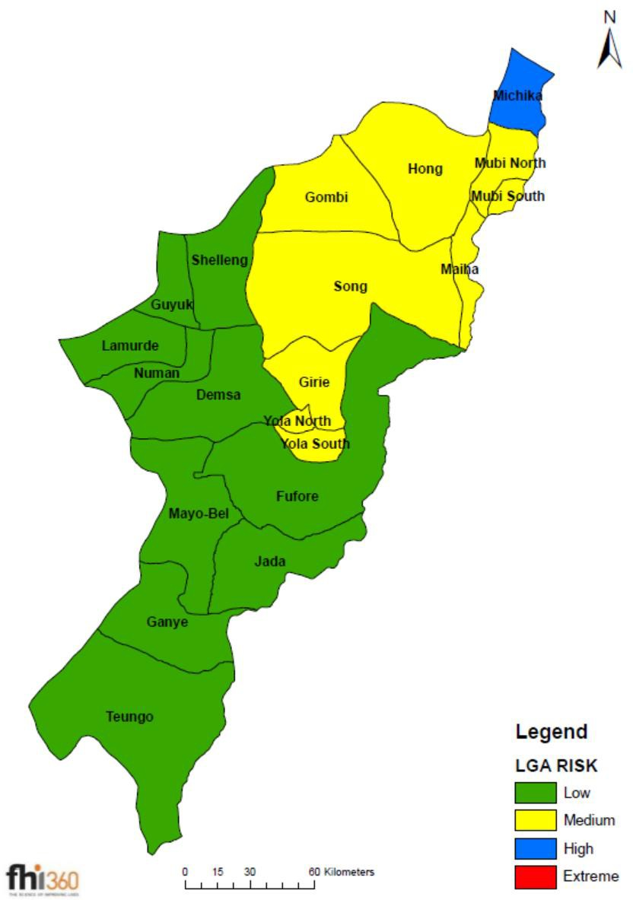
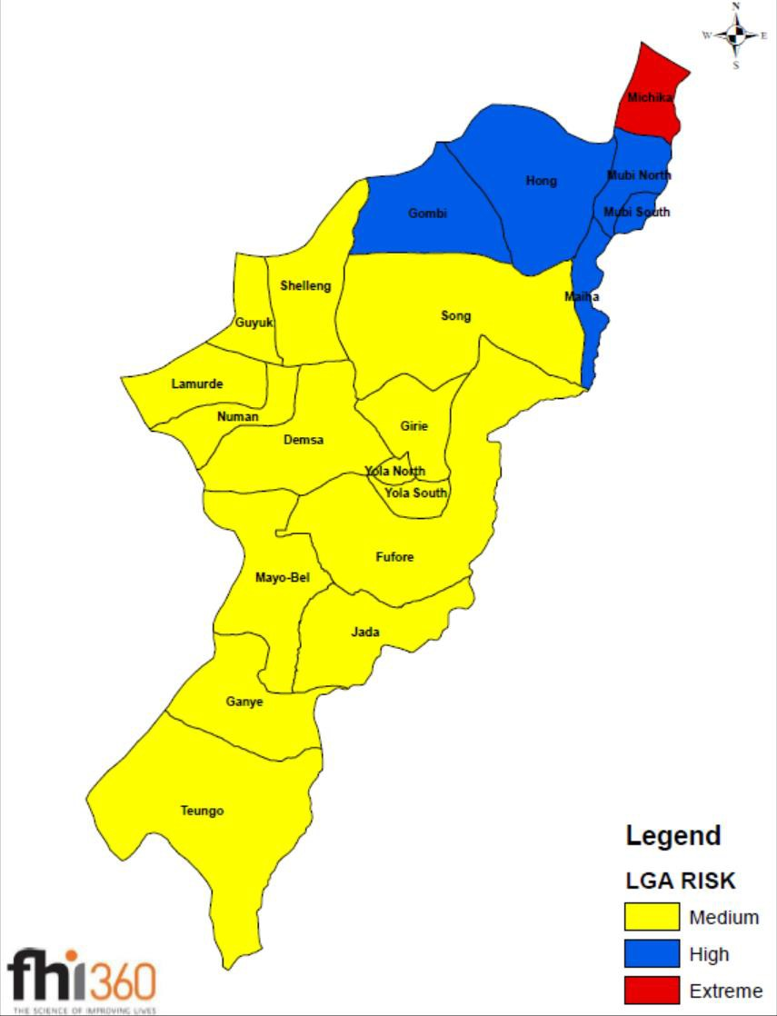
Adamawa security update
May 2015
Feb 2016

Slide 17
What facilitates data use in SIDHAS?
Internal Systems/Processes that demand data, at all levels of the project
  Country Office Senior Management
  Country Office state support team, both technical and programmes
  State Programme Managers
Site owners
Simple, Easy to Use Tools for Data Analysis
  DHIS 2 data visualizer, dashboards
  At Primary Healthcare Centers (PHCs)- using cardboards to display performance charts
Capacity Building for data analysis
  Data analysis module included in the M&E training for site level and sub national level M&E Officers
  Periodic internal capacity building events for internal technical & programme
staff (Supportive Supervisory Visits)

Slide 18
What challenges exist ?
Low Human Resource capacity- particularly at primary health care level
  PHCs constitute 65% of SIDHAS supported sites
  Mostly understaffed, (1-2 Nurse/midwife or Community Health worker
  Lower technical capacity
Differences between the GoN HIV quality indicators and the indicators of interest to the donor
  Introduction of MER indicators- particularly care indicators
  Different data use products for GoN and for the donors
  Facility runs charts only updated with GoN indicators

Slide 19
Thank You

