Slide 1
Using Data Effectively
Challenges and Successes on
Food for Peace Programs

Slide 2
Getting the right data for decisions
Sierra Leone Example

Slide 3
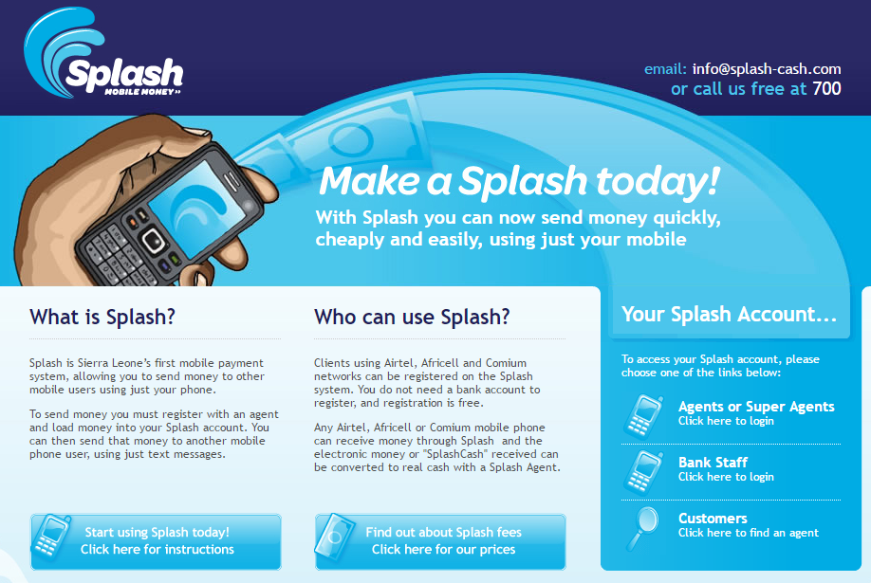
Getting the right data for decisions
Qualitative key informant interviews indicated:
Cell phone coverage of the Kailahun district in Sierra Leone
Access to cell phone credit and mobile providers is available in all chiefdoms in district

Slide 4
Getting the right data for decisions
Quantitative data collected in surveys at registration for validation:
Cash Transfer Mobile Accessibility and Comfort with Mobile Money
 | Total households in census for registration | Households with their own mobile phone |  | Households with phones that have reliable network |  |  | Households with network covered phones who are comfortable with mobile transfers
Geographic Chiefdom | Grand Total | Yes | % | Yes |  | % | Yes | %
Dea | 276 | 13 | 5% | 4 | 31% |  | 1 | 25%
Jaluahun | 1003 | 109 | 11% | 61 | 56% |  | 15 | 25%
Jawei | 975 | 38 | 4% | 10 | 26% |  | 1 | 10%
Kissi Kama | 311 | 5 | 2% | 2 | 40% |  | 2 | 100%
Kissi Teng | 660 | 67 | 10% | 47 | 70% |  | 29 | 62%
Kpeje Bongre | 354 | 15 | 4% | 11 | 73% |  | 4 | 36%
Luawa | 1654 | 87 | 5% | 41 | 47% |  | 17 | 41%
Malema | 635 | 14 | 2% | 3 | 21% |  | 3 | 100%
Upper_bambara | 710 | 21 | 3% | 9 | 43% |  | 5 | 56%
Missing data | 33
Grand Total | 6611 | 369 | 6% | 188 | 51% |  | 77 | 41%

Slide 5
Making evidence based decisions
Guatemala Example

Slide 6
Making evidence based decisions
Prioritizing the activities and populations based on poverty
# | Indicator | Possible Response | Points
1 | How many household members are aged 13 or younger? | Five or more Four Three Two One None | 0 10 12 17 23 33
2 | Did all children ages 7 to 13 enroll for the current school year? | No No children ages 7 to 13 Yes | 0 2 6
3 | Can the female head/spouse read and write? | No Yes No female head/spouse | 0 6 9
4 | Do any household members work mainly as casual laborers or domestic workers? | Yes No | 0 5
5 | What is the main construction material of the residence’s floors? | Earth, sand, wood, or other Mud bricks or cement slab Formed cement bricks Parquet, granite or ceramic | 0 3 9 15
6 | Does the household have a refrigerator? | No Yes | 0 9
7 | Does the household have a gas or electric stove? | No Yes | 0 8
8 | Does the household have a stone mill? | Yes No | 0 3
9 | Does the household have an electric iron? | No Yes | 0 8
10 | If any household member works mainly in agriculture, animal husbandry, hunting, or fishing, does the household have any cows, bulls, calves, pigs, horses, burros, or mules? | No Yes No one works mainly in agriculture | 0 3 4

Slide 7
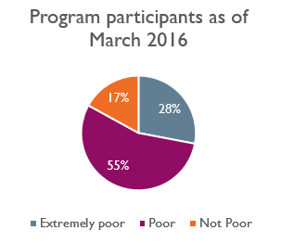
Making evidence based decisions
Prioritizing the activities and populations based on poverty
Classification | Cutoff Points | Probability of being below the poverty lines of Guatemala
Extremely poor | 19 or less | 74.5% | "Extreme" USAID Poverty Line
Poor | 20 to 39 | 70.3% | National Poverty Line
Non-poor | 40 or more
Average PPI scores per region
Quiché: 23.42
Huehuetenango: 30.07
Quetzaltenango: 34.56
Total: 28.05

Slide 8
Making evidence based decisions
Implementation changes
No more enrollment in food or cash transfers with those households with a PPI score of 40 or more. Households could, however, continue to attend growth monitoring and promotion sessions, trainings on disaster risk reduction in their communities, and sustainable livelihood promotion trainings and demonstrations.
In FY2017, differentiated enrollment in PAISANO activities based on PPI scores and livelihood activities were set.
Of 100 new potential beneficiaries identified, who participated in small producer groups, PPI scores revealed the likelihood that 7% were extremely poor, 72% poor and 21% not poor. This stratification helped to determine the different categories and the type of support that each household should receive.
Of 977 new potential beneficiaries identified as pregnant or with infant children, only 6% were classified as Not Poor and were told that they were not eligible to receive cash transfers as an incentive for participation in PAISANO. The cases identified as poor or extremely poor were 75% and 19% respectively.

Slide 9
Data challenges in gauging quality of interventions for expected impacts
Multiple Country Examples

Slide 10
Gauging quality of interventions for expected impacts- “The Missing Middle”
FFP baseline and endline indicators are population based and typically budgeted to be collected at the beginning and end of the program.
If the team is only using FFP annual monitoring indicators to track progress on the Theory of Change, it is possible that they might only capture those trained and adopting practices or changing behaviors.
There is a need to make sure in the Annual Reviews of the Theory of Change, whether the programs have sufficient evidence to assess whether:
Are new practices or behaviors leading to reductions in stunting or improved incomes as expected?
Do we have a real sense of the spillover effects?
Are monitoring and evaluation activities well designed to reflect on the extent the program is moving the needle?
Possible solutions: Performance quality reviews, Annual Surveys, Studies?

