Slide 1
Overview of Community-Based Management of Acute Malnutrition (CMAM)

Slide 2
Module 1. Learning Objectives
Discuss acute malnutrition and the need for a response.
Identify the principles of CMAM.
Describe innovations and evidence making CMAM possible.
Identify the components of CMAM and how they work together.
Explore how CMAM can be implemented in different contexts.
Identify national and global commitments relating to CMAM.

Slide 3
What is Undernutrition?
A consequence of a deficiency in nutrients in the body
Types of undernutrition?
  Acute malnutrition (wasting and bilateral pitting oedema)
  Stunting
  Underweight (combined measurement of stunting and wasting)
  Micronutrient deficiencies
Why focus on acute malnutrition?

Slide 4
What is Undernutrition?
Photo credit: Mike Golden

Slide 5
Undernutrition and Child Mortality
52.5% of child mortality is associated with underweight
Severe wasting is an important cause of these deaths (it is difficult to estimate)
Proportion associated with acute malnutrition often grows dramatically in emergency contexts
Malnutrition
52.5%
Caulfied, LE, M de Onis, M Blossner, and R Black, 2004

Slide 6
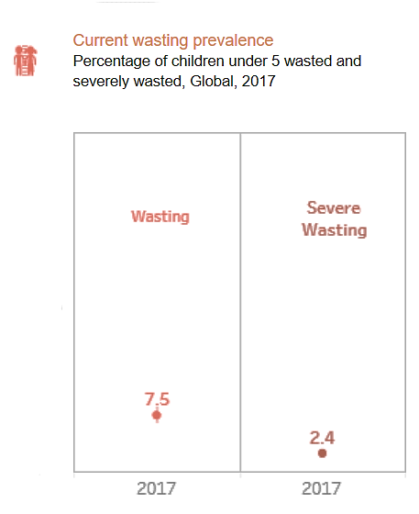
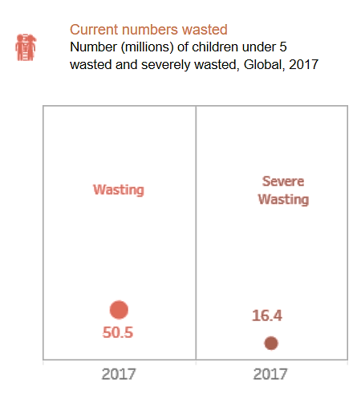
Magnitude of ‘Wasting’ Around the World (2017) – not only in emergencies
Source: UNICEF/WHO/World bank Group. Joint Child Malnutrition Estimate. 2017 http://datatopics.worldbank.org/child-malnutrition/

Slide 7
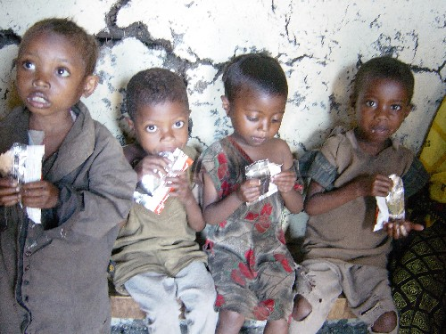
What Is Community-Based Management of Acute Malnutrition (CMAM)?

Slide 8
CMAM
A community-based approach to treating acute malnutrition
  Infants under 6 months and children 6-59 months with without medical complications are treated as outpatients at accessible, decentralised sites
  Infants under 6 months and children 6-59 months with medical complications are treated as inpatients
  Community outreach for community involvement and early detection and referral of cases
Previously known as community-based therapeutic care (CTC)
In some countries referred to as integrated management of acute malnutrition (IMAM)

Slide 9
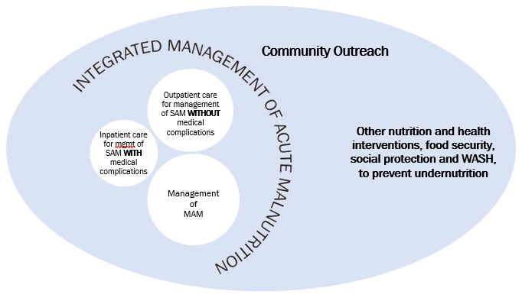
Core Components of CMAM (1)

Slide 10
Core Components of CMAM (2)
1. Community Outreach:
Community assessment
Community mobilisation and involvement
Community outreach workers:
  Early identification and referral of children with SAM before the onset of serious complications
  Follow-up home visits for problem cases
Community outreach to increase access and coverage
Notes:
10

Slide 11
Core Components of CMAM (3)
2. Outpatient care for children 6-59 months with SAM without medical complications at decentralised health facilities and at home
  Initial medical and anthropometry assessment with the start of medical treatment and nutrition rehabilitation with take home ready-to-use therapeutic food (RUTF)
  Weekly or bi-weekly medical and anthropometry assessments monitoring treatment progress
  Continued nutrition rehabilitation with RUTF at home
  ESSENTIAL: A good referral system to inpatient care, based on Action Protocol
Notes:
11

Slide 12
Core Components of CMAM (3)
Infants under 6 months of age who are nutritionally vulnerable without medical complications can also be treated in outpatient care.
  Initial medical, feeding and anthropometry assessment, counselling and feeding support is provided.
  Weekly or bi-weekly medical, feeding and anthropometry assessment and monitoring of treatment progress
  Continued counselling and feeding support
  ESSENTIAL: A good referral system to inpatient care, based on Action Protocol
Notes:
12

Slide 13
Core Components of CMAM (4)
3. Inpatient care for children 6-59 months with SAM with medical complications or no appetite, and nutritionally vulnerable infants under 6 months with medical complications.
  Infant or child is treated in a hospital for stabilisation of the medical complication
  Infant or child resumes outpatient care when complications are resolved
ESSENTIAL: Good referral system to outpatient care

Slide 14
Core Components of CMAM (5)
4. Services or programmes for the management of moderate acute malnutrition (MAM)
Supplementary Feeding

Slide 15
Recent History of CMAM
Response to challenges of centre-based care for the management of SAM
2000: 1st pilot programme in Ethiopia
2002: pilot programme in Malawi
Scale up of programmes in Ethiopia (2003-4 Emergency), Malawi (2005-6 Emergency), Niger (2005-6 Emergency)
2007-2009 many agencies and governments involved in CMAM programming in emergencies and non-emergencies
  E.g., Malawi, Ethiopia, Niger, Democratic Republic of Congo, Sudan, Kenya, Somalia, Sri Lanka
Today CMAM is a globally accepted approach for the management of acute malnutrition and implemented in over 70 countries globally

Slide 16
Principles of CMAM
Maximum access and coverage
Timeliness
Appropriate medical and nutrition care
Care for as long as needed
Following these steps ensure maximum public health impact!

Slide 17
Maximise Impact for Focusing on Public Health
SOCIAL FOCUS
CLINICAL FOCUS
Population
level impact
(coverage)
Individual level impact
(cure rates)
Early presentation
Access to services
Compliance with treatment
Efficient diagnosis
Effective clinical protocols
Effective service delivery

Slide 18
Key Principle of CMAM
Maximum access and coverage
Notes:
18

Slide 19
N Darfur 2001
Karnoi &
Malha
Tina
Um Barow
Kutum
Mellit
Fata Barno
El Sayah
Koma
Serif
Korma
Kebkabiya
El Fasher
Um Keddada
100 kms
Tawila & Dar el Saalam
Hospital with inpatient care
Outpatient care site
Inpatient care site
Taweisha
El Laeit

Slide 20
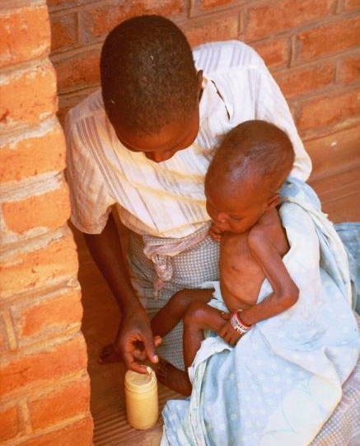
Bringing Treatment into the Local Health Facility and the Home

Slide 21
Key Principle of CMAM
Timeliness
Notes:
21

Slide 22
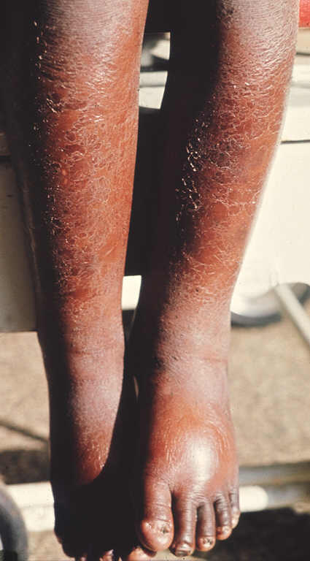
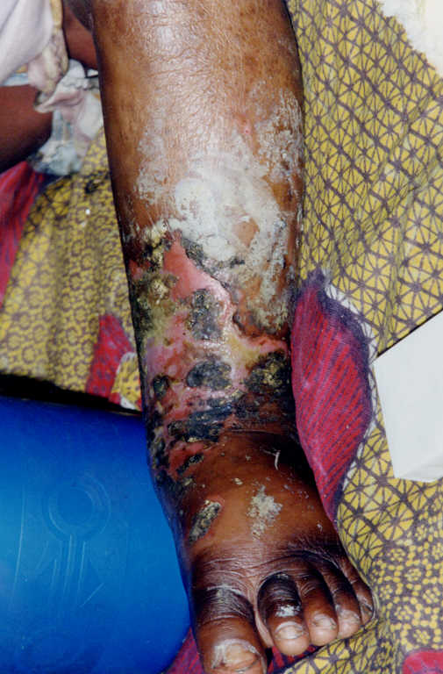
Timeliness: Early Versus Late Presentation

Slide 23
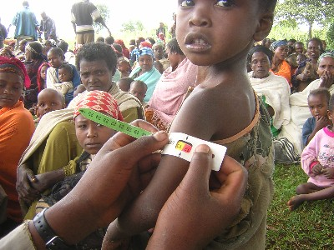
Timeliness (continued)
Find children before SAM and medical complications arise
Good community outreach is essential
Screening and referral by outreach workers (e.g., community health workers [CHWs], volunteers)
Screening and referral by mothers and family members

Slide 24

Catching Acute Malnutrition Early
Inpatient care
Outpatient Care
SFP

Slide 25
Key Principle of CMAM
Appropriate medical and nutrition care
Notes:
25

Slide 26
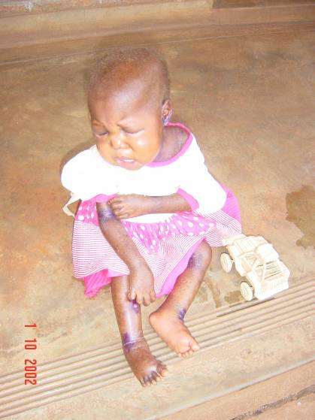
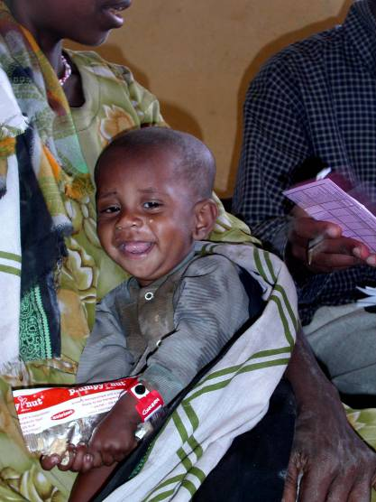
Appropriate Medical Treatment and Nutrition Rehabilitation Based on Need

Slide 27
Key Principle of CMAM
Care for as long as needed
Notes:
27

Slide 28
Care For as Long as Needed
Care for the management of acute malnutrition is provided as long as needed
Services to address acute malnutrition can be integrated into routine health services of health facilities, if supplies are present
Additional support to health facilities can be added during certain seasonal peaks or during a crisis

Slide 29
Innovations Making CMAM Possible
RUTF
Classification of acute malnutrition
Mid-upper arm circumference (MUAC)
  Accepted as independent criteria for admission and discharge of SAM

Slide 30
Ready-to-Use Therapeutic Food (RUTF)
Energy and nutrient dense: 500 kcal/92g
Same formula as F100 (except it contains iron)
No microbial growth even when opened
Safe and easy for home use
Is ingested after breast milk
Safe drinking water should be provided
Well liked by children
Can be produced locally
Is not given to infants under 6 months

Slide 31
RUTF (continued)
Producers of RUTF include:
  Nutriset France produces ‘PlumpyNut®’ and works with partners producing in 10 countries.
  Valid Nutrition (Malawi)
  Project Peanut Butter (Malawi, Sierra Leonne and Ghana)
Ingredients for lipid-based RUTF:
  Peanuts (ground into a paste)
  Vegetable oil
  Powdered sugar
  Powdered milk
  Vitamin and mineral mix (special formula)
Additional formulations of RUTF are being researched

Slide 32
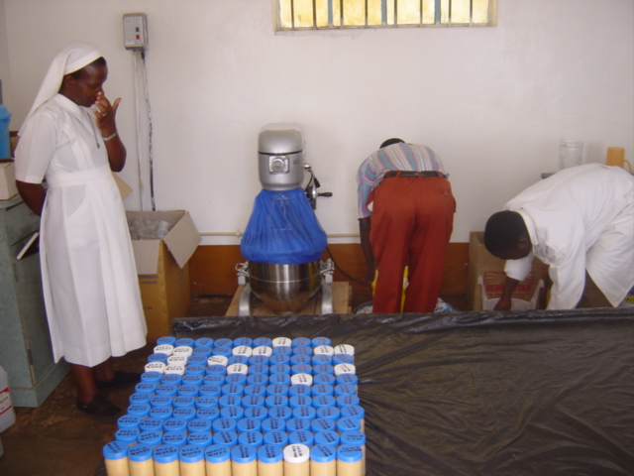
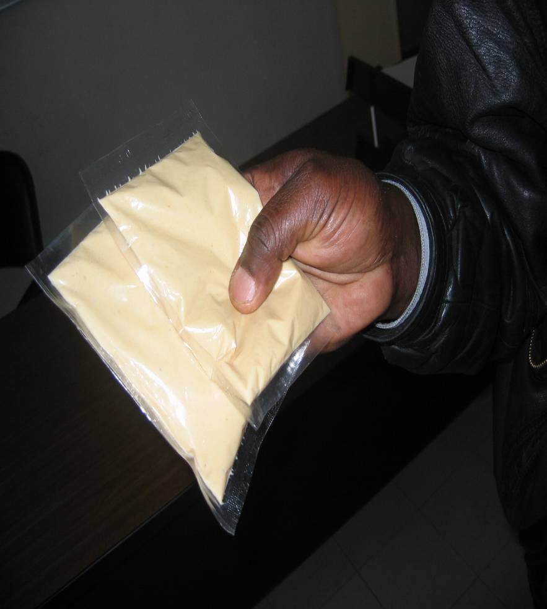
Local Production: RUTF

Slide 33
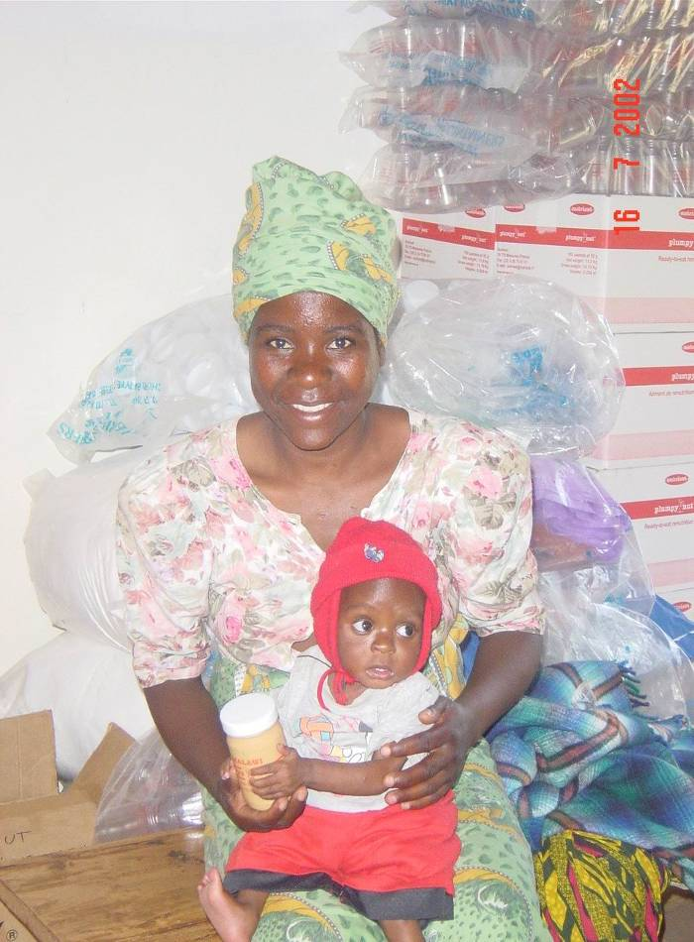
Effectiveness of RUTF
Treatment at home using RUTF resulted in better outcomes than centre-based care in Malawi
(Ciliberto, et al. 2005.)
Locally produced RUTF is nutritionally equivalent to PlumpyNut®
(Sandige et al. 2004.)

Slide 34
Old Classification for the
Treatment of Malnutrition
Acute Malnutrition
Severe Acute Malnutrition
Therapeutic Feeding Centre
Moderate Acute Malnutrition
Supplementary Feeding

Slide 35
Classification for the Community-Based Treatment of Acute Malnutrition
Acute Malnutrition
Severe acute malnutrition
with medical complications*
Inpatient Care
Severe acute malnutrition
without medical complications
Outpatient Care
Moderate acute malnutrition
without medical complications**
Supplementary
Feeding or other programmes for management of MAM
*Complications: anorexia or no appetite, intractable vomiting, convulsions, lethargy or not alert, unconsciousness, lower respiratory tract infection (LRTI), high fever, dehydration, persistent diarhoea, severe anaemia, hypoglycaemia, or hypothermia, eye signs of vitamin A deficiency and skin lesions
**Children with MAM with medical complications are admitted to a programme for management of MAM e.g. supplementary feeding but are referred for treatment of the medical complication as appropriate

Slide 36

Mid-Upper Arm Circumference (MUAC) for Assessment, Admission and Discharge
A transparent and understandable measurement
Can be used by community-based outreach workers (e.g., CHWs, volunteers), mothers and family members for case-finding in the community

Slide 37
Screening, Admission and Discharge Using MUAC
Initially, CMAM used 2 stage screening process:
  MUAC for screening in the community
  Weight-for-height (WFH) for admission at a health facility
  = Time consuming, resource intense, some negative feedback, risk of refusal at admission
MUAC for admission and discharge from CMAM (with presence of bilateral pitting oedema, with WFH optional)
  = Easier, more transparent, child identified with SAM in the community will be admitted, thus fewer children are turned away
Emerging evidence on the use of MUAC in infants under 6 months.
  Classification cutoff has not yet been established.
  Countries and programmes are encouraged to collect MUAC data for infants under 6 months to help build on evidence

Slide 38
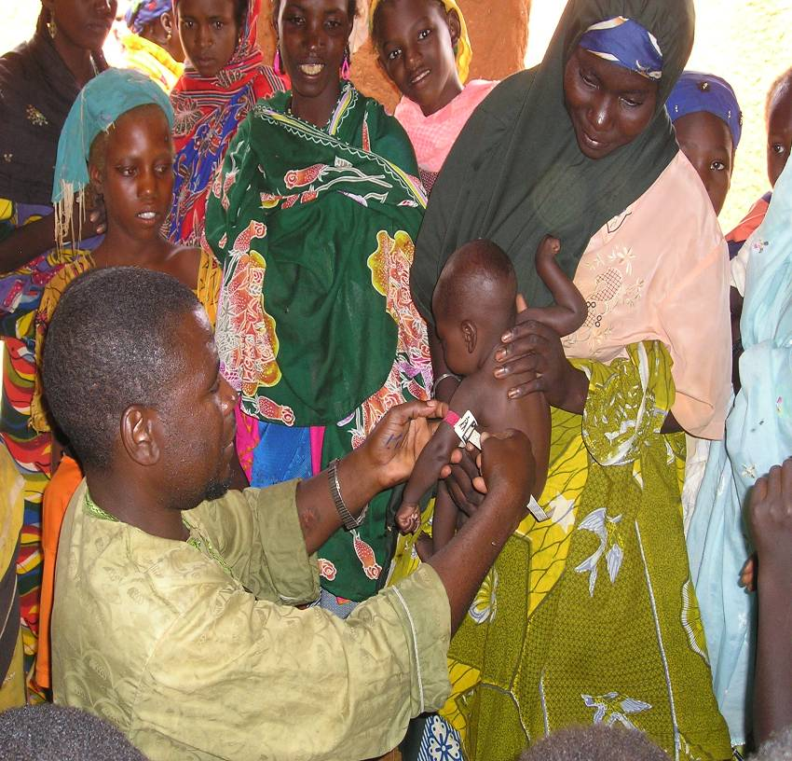
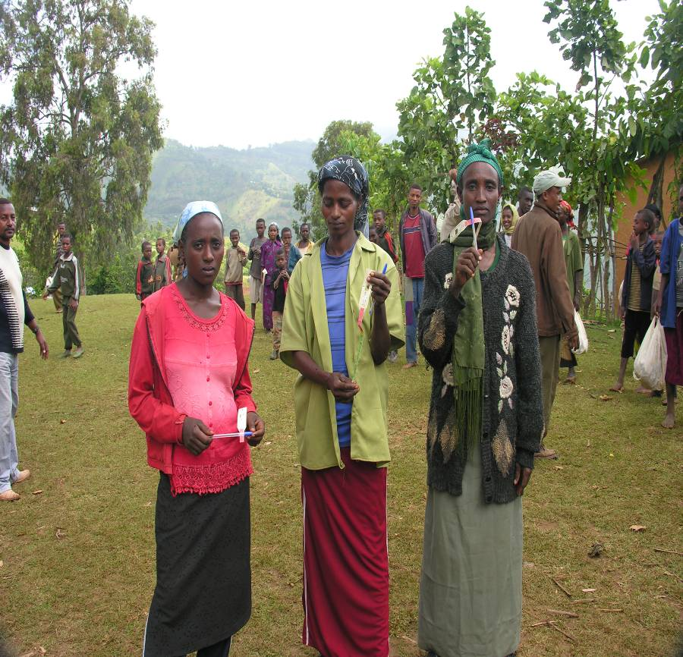
MUAC: Community Referral

Slide 39
Components of CMAM
1. Community outreach
2. Outpatient care for the management of SAM without medical complications
3. Inpatient care for the management of SAM with medical complications
4. Services or programmes for the management of MAM

Slide 40
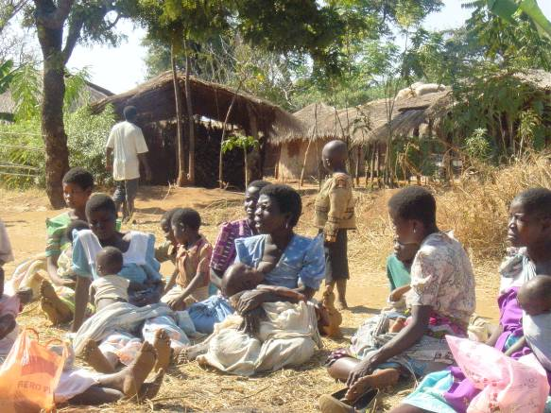
1. Community Outreach
Key individuals in the community:
Sensitize communities on acute malnutrition
Make treatment of acute malnutrition understandable
Understand cultural practices, barriers and systems
Dialogue on barriers to uptake
Promote community case-finding and referral
Conduct follow-up home visits for problem cases

Slide 41
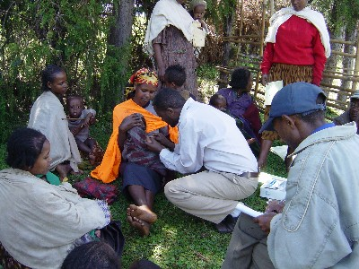
Community Mobilisation and Screening

Slide 42
2. Outpatient Care
Target children 6-59 months with SAM WITHOUT medical complications AND with good appetite
  Activities: weekly outpatient care follow-on visits at the health facility (medical assessment and monitoring, basic medical treatment and nutrition rehabilitation)
Also target infants under 6 months of age who are nutritionally vulnerable WITHOUT medical complication (i.e. moderate nutritional risk).
  Activities: weekly outpatient care follow-on visits at the health facility (feeding assessment, medical assessment and monitoring, counselling and feeding support)

Slide 43
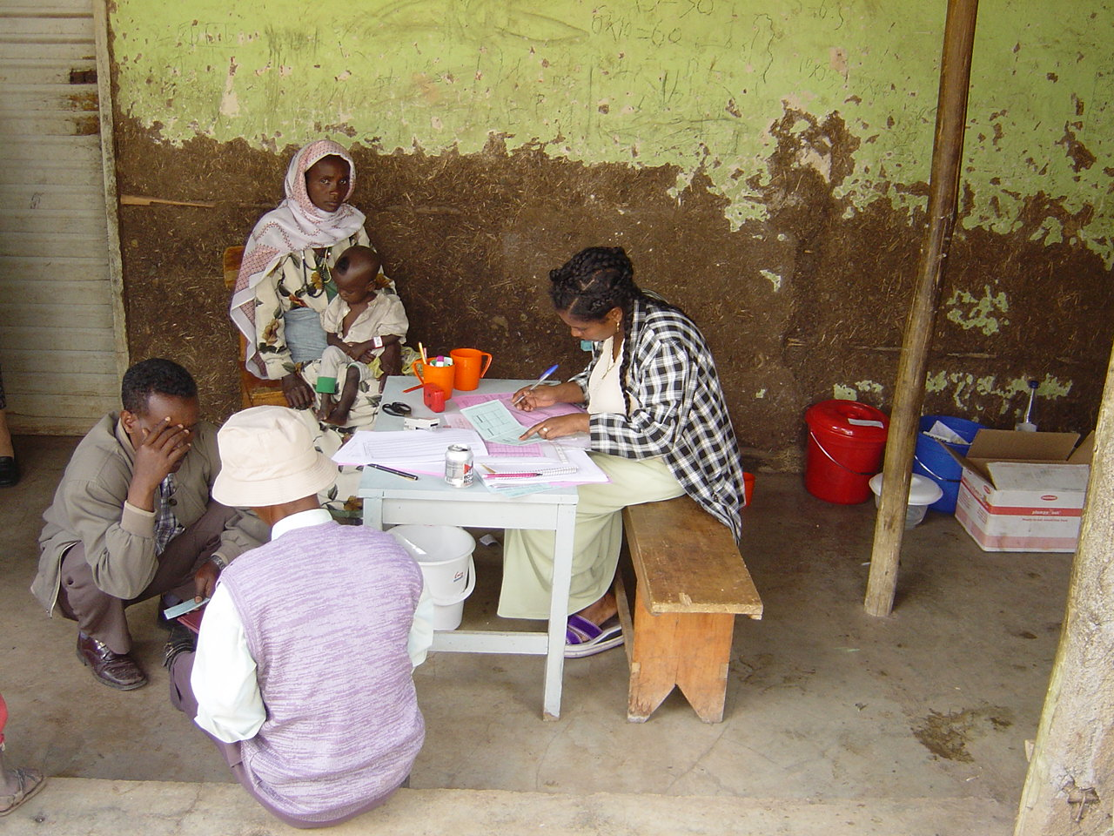
Clinic Admission for Outpatient Care

Slide 44
Outpatient Care: Feeding Assessment for Infant Under 6 months

Slide 45
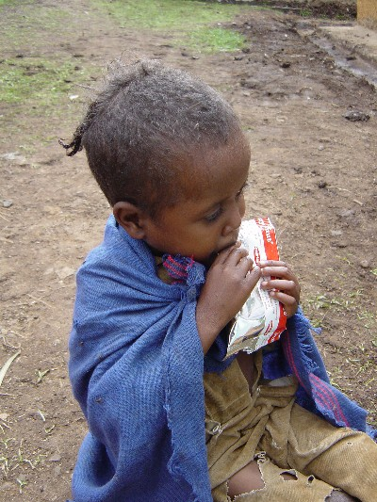
Outpatient Care: Appetite Test for Children 6-59 Months

Slide 46
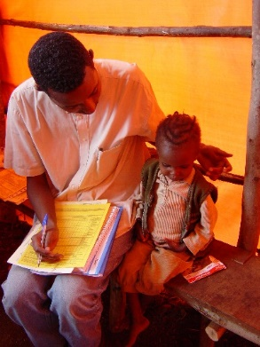
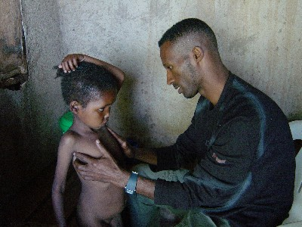
Outpatient Care: Medical Examination

Slide 47
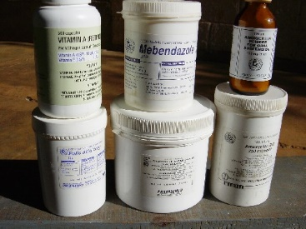
Outpatient Care: Routine Medication
Amoxycillin
Anti-malarials
Anti-helminths
Measles vaccination

Slide 48
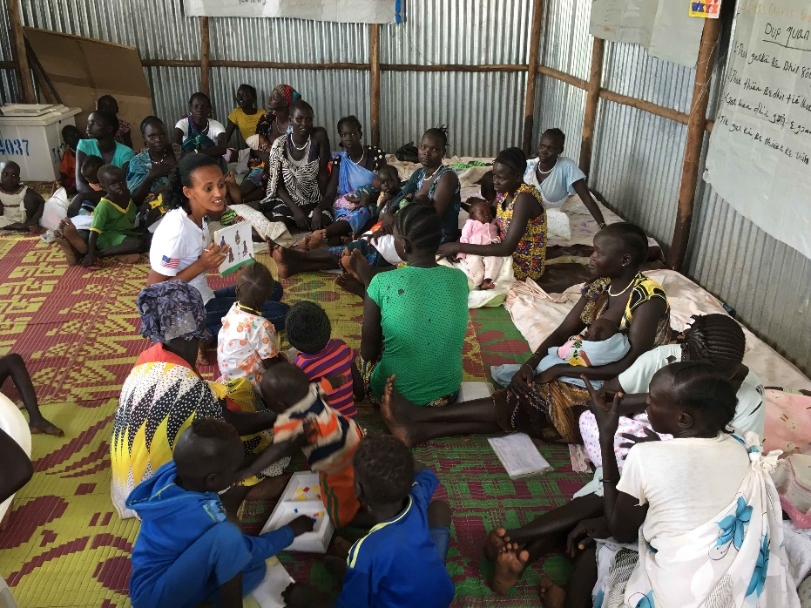
Outpatient Care: Counselling and Feeding Support for At-risk Mothers and Infants Under 6 Months

Slide 49
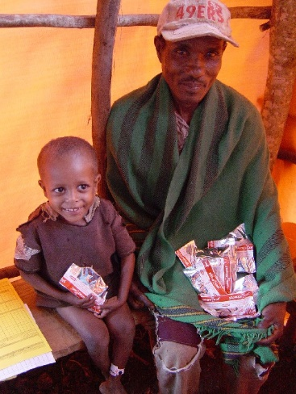
Ensure understanding of RUTF and use of medicines
Provide one week’s supply of RUTF and medicine to take at home
Return every week to outpatient care to monitor progress and assess compliance
RUTF Supply for Children 6-59 Months

Slide 50
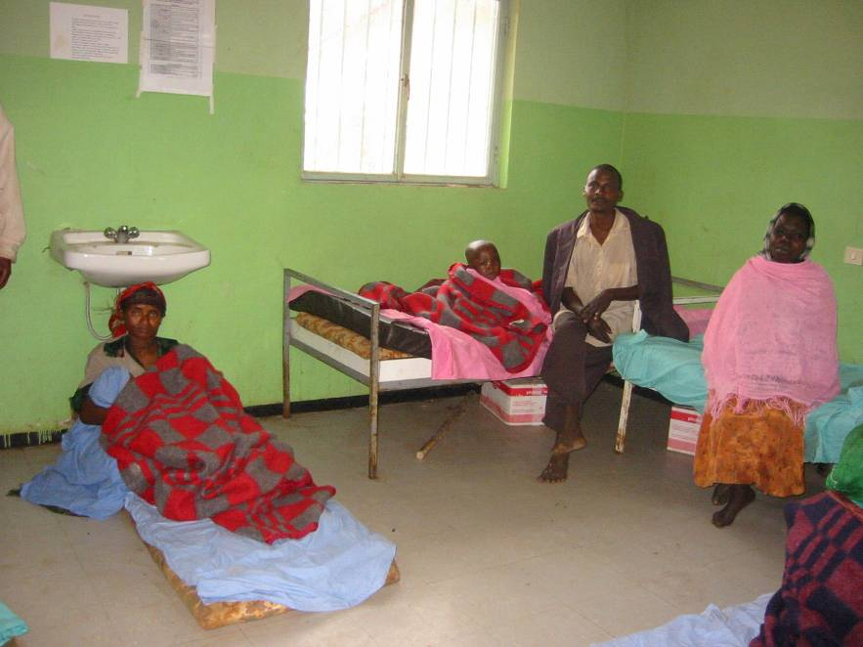
3. Inpatient Care
Child 6-59 months with SAM with medical complications or no appetite
Infants < 6 months who are nutritionally vulnerable with medical complications (i.e., high nutritional risk)
Medical treatment according to WHO and/or national protocols
Infant and child return to outpatient care after complication is resolved, oedema reduced or resolved, appetite regained and feeding well.

Slide 51
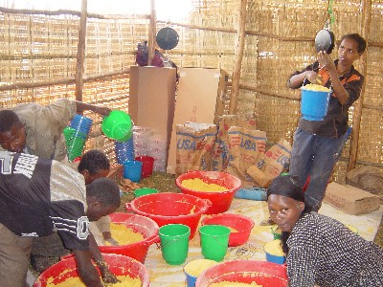
4. Services or Programmes for the Management of MAM
Activities
Routine medication
Take home supplementary ration
Basic preventive health care and immunisation
Health and hygiene education; infant and young child feeding (IYCF) practices and behaviour change communication (BCC)

Slide 52
Components of CMAM

Slide 53
Relationship Between Outpatient Care and Inpatient Care
Complementary
Inpatient care for the management medical complications until the medical condition is stabilised and the complication is resolving
Different priorities
Outpatient care prioritises early access and coverage
Inpatient care prioritises medical care and therapeutic feeding for stabilisation

Slide 54
CMAM in Different Contexts
Extensive emergency experience
  Some transition into longer term programming, as in the cases of Niger, Malawi and Ethiopia
Non-emergency or development contexts
  e.g., Ghana, Kenya, Zambia, Rwanda, Haiti, Nepal
Experience in high HIV prevalent areas
  Links to HIV testing and counselling and antiretroviral therapy (ART)

Slide 55
When Rates of SAM Increase:

Slide 56
Global Commitment for CMAM (1)
United Nations (UN) joint statement on community-based management of severe acute malnutrition (May 2007) – support for national policies, protocols, trainings, and action plans for adopting approach: e.g., Ethiopia, Malawi, Uganda, Sudan, Niger etc..
WHO and UNICEF joint statement on child growth standards and identification of SAM in infants and children (2009) – identification and admission of infants and children with SAM using MUAC and WFH
WHO update on the management of SAM in infants and children (2013) – provides guidance on outpatient and inpatient management of SAM, and use of MUAC for admission and discharge.
New UN (WHO/UNICEF/WFP) joint statement expected to be released in 2018/19, that will reflect on the emerging evidence and global commitments on the management of acute malnutrition.

Slide 57
Global Commitment for CMAM (2)
Collaboration on joint technical support and trainings between UN agencies (WHO, UNICEF, UNHCR, WFP) and donors
Donor support for CMAM development, coordination and training
Several agencies supporting integration of CMAM into national health systems
Several international initiatives on the management and prevention of acute malnutrition with ongoing research and evidence generation.

