Slide 1
Sampling Guide for Beneficiary-based Surveys for Select Feed The Future Agricultural Annual Monitoring Indicators & Sample Size Calculator–May 24, 2016
Presenters: Diana Stukel, FHI 360/FANTA and Anne Swindale, USAID/BFS

Slide 2
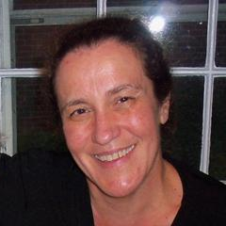
Hosts
Anne Swindale, Ph.D. Senior Program Adviser M&E, USAID/ BFS
Diana Stukel, Ph.D. Scientist, Survey Methods, FHI 360/ FANTA Project
2

Slide 3
Introduction
Feed the Future (including Food for Peace (FFP)) Implementing Partners (IPs) must report annually to USAID on a set of Feed the Future annual monitoring indicators
Data collection options for annual monitoring
Routine monitoring (RM)
Beneficiary-based surveys (BBSs)
3

Slide 4
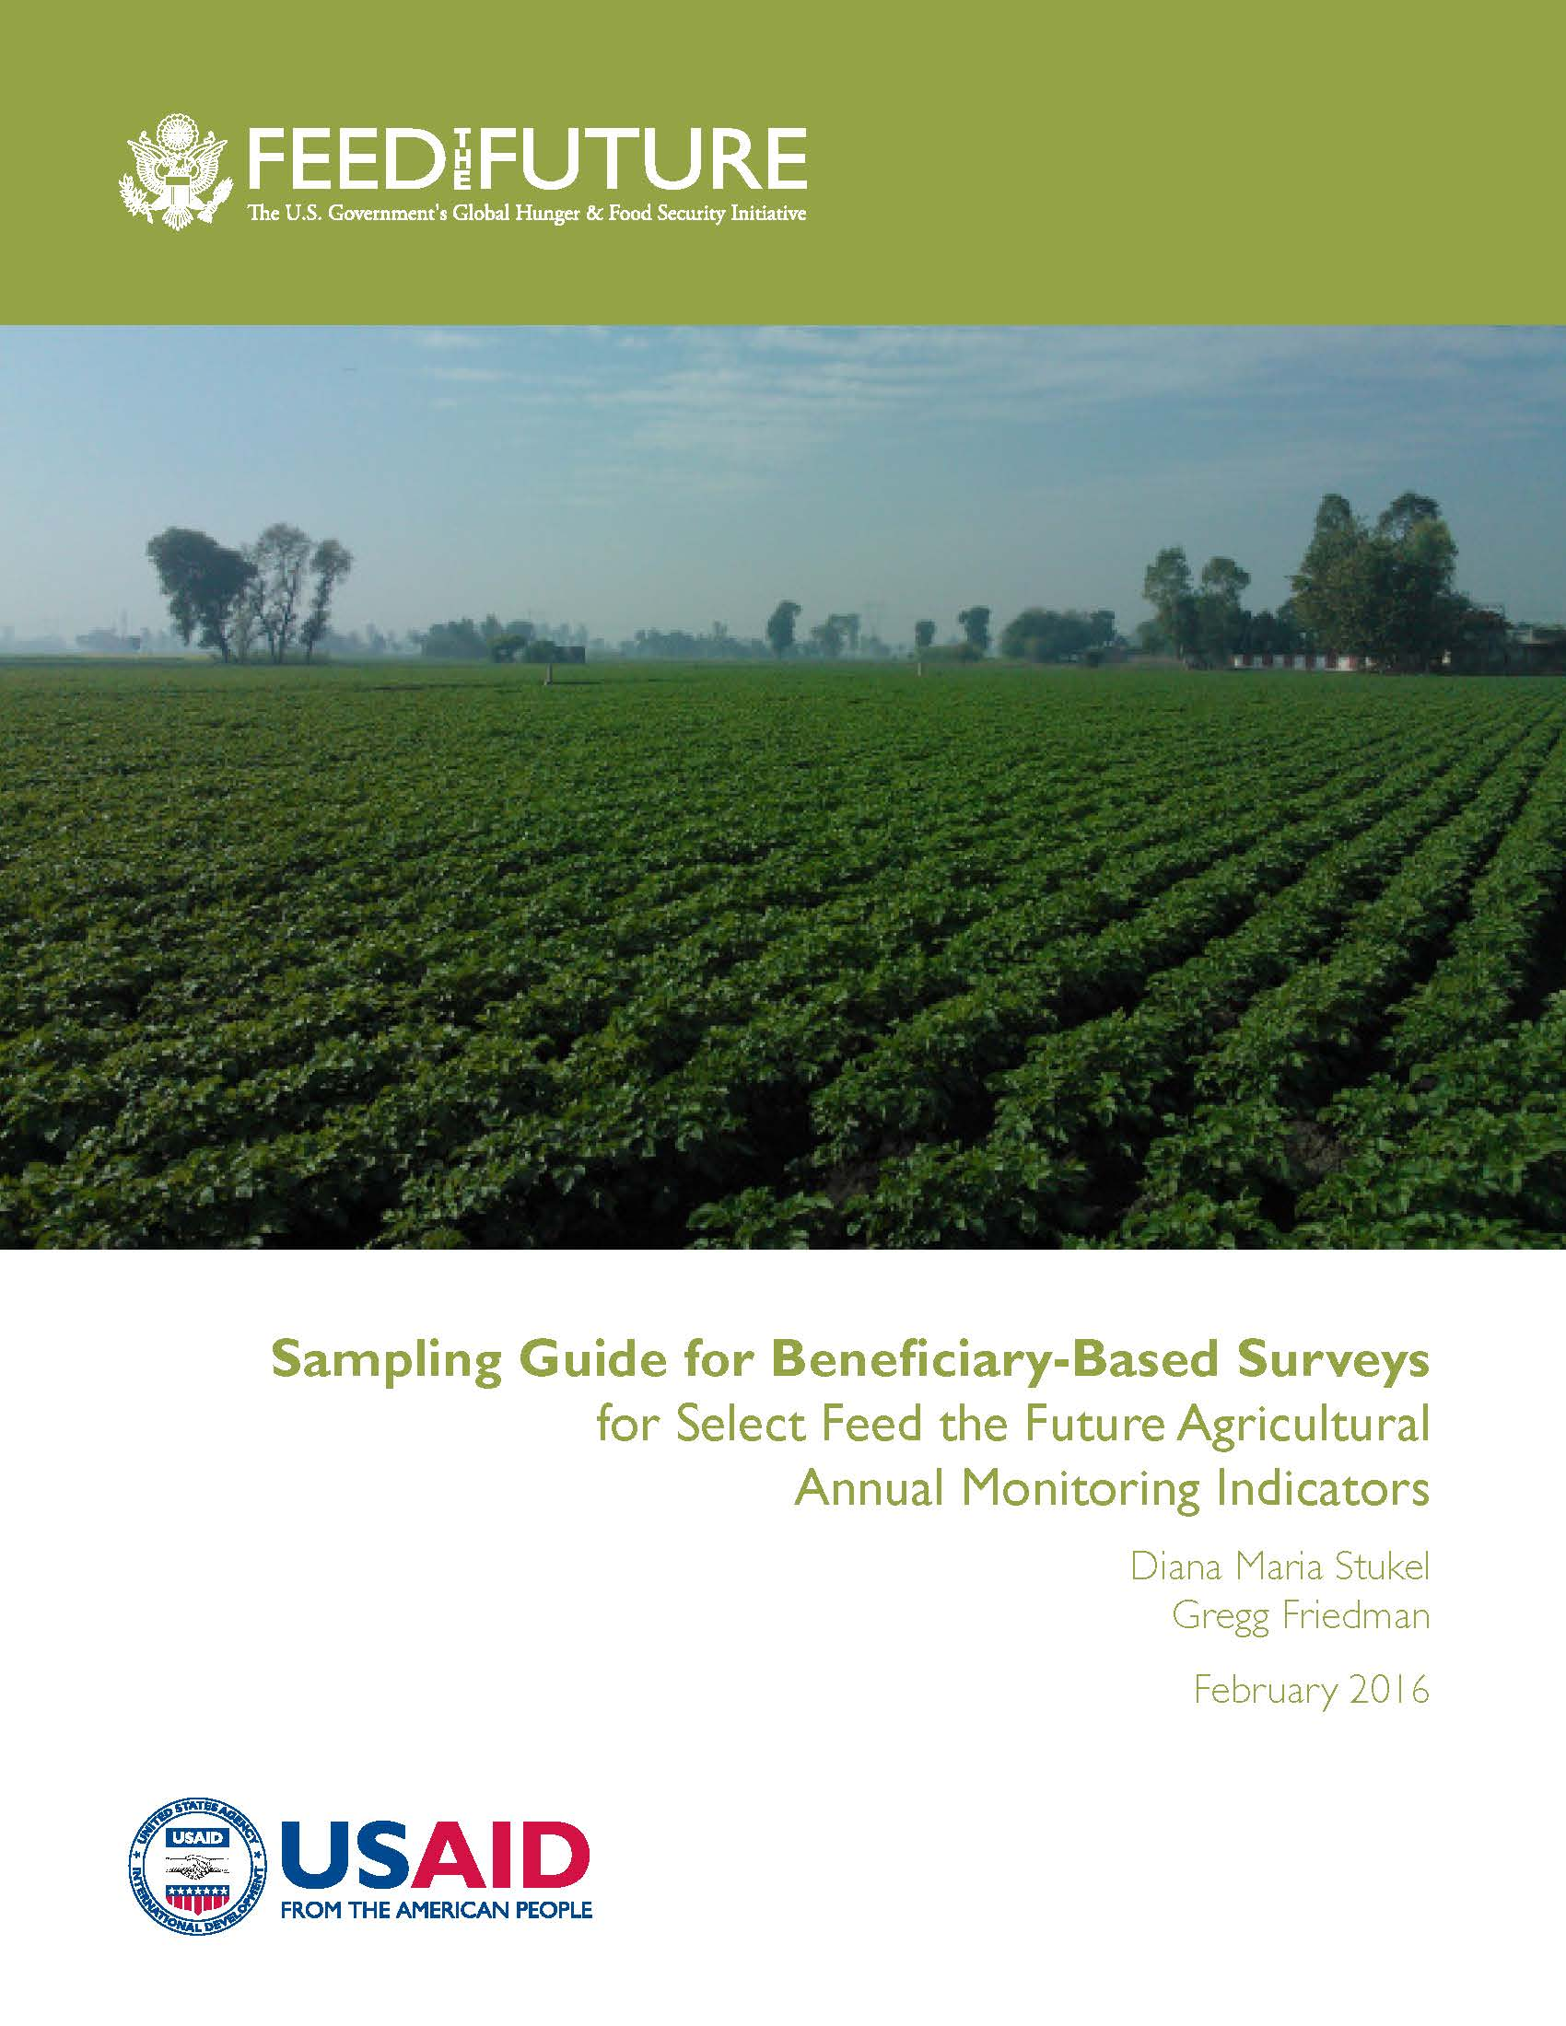
Introduction
FANTA Sampling Guide for Beneficiary-based Surveys and accompanying FANTA Excel-based Sample Size Calculator
4

Slide 5
Introduction
CHAPTERS IN THE FANTA SAMPLING GUIDE FOR BBSs
Chapter 1 - Purpose and background
Chapter 2 - Four selected Feed the Future annual monitoring indicators
Chapter 3 - Comparison of RM and BBSs
Chapter 4 - When are BBSs appropriate?
Chapter 5 - Timing and frequency of BBS data collection
Chapter 6 - Issues to consider when outsourcing work to an external contractor
Chapter 7 - Sampling frame guidance for BBSs
Chapter 8 - Overview of various approaches for collecting annual monitoring data using BBSs
Chapter 9 - The Household Survey Approach (Approach 1)
Chapter 10 - The Farmer Groups Approach (Approach 2)
Chapter 11 - Sample weighting
Chapter 12 - Producing estimates of indicators
Chapter 13 - Producing confidence intervals and standard errors associated with the indicators

Slide 6
Webinar Objectives
Learn under what circumstances BBSs are appropriate
Discuss a few approaches and sample design elements covered in the guide
Understand how to undertake a sample size calculation and observe a demonstration of the on-line Excel-based sample size calculator that accompanies the guide
6

Slide 7
Annual Monitoring Indicators
Annual monitoring indicators reported to Feed the Future span various sectors: Agriculture, Maternal and Child Health and Nutrition (MCHN), Resilience and Gender.
Different data collection mechanisms may be needed to support indicators from different sectors
Most Feed the Future annual monitoring indicators are agriculture-based indicators, so guide focuses on data collection for these
Feed the Future identified 4 agriculture-based annual monitoring indicators for which data collection is deemed particularly challenging
All 4 indicators are either totals or functions of totals – so different considerations needed than for indicators of proportions or means
7

Slide 8
Four Challenging Agriculture-based Annual Monitoring Indicators
Gross Margins
Value of Incremental Sales
Number of Farmers and Others who have Applied Improved Technologies
Number of Hectares of Land under Improved Technologies
8

Slide 9
BBS versus Routine Monitoring?
Routine Monitoring data collection:
IMPLEMENTED BY: Project staff (M&E personnel or agriculture extension workers)
LINKED WITH PROJECT IMPLEMENTATION: Data collection either concurrent with project implementation (e.g., during farmer field school) or at same time as regularly scheduled visits to farmer’s plots coinciding with key points in production cycle
FREQUENCY OF COLLECTION: On a continuous basis throughout the year
TARGET: ALL direct beneficiaries
9

Slide 10
BBS versus Routine Monitoring?
BBS data collection:
IMPLEMENTED BY: Third party firm typically (but can also be implemented by project staff in some cases)
GENERALLY NOT LINKED WITH PROJECT IMPLEMENTATION: Data collection not linked if BBS uses household survey approach, but can be linked if surveying farmer groups
FREQUENCY OF COLLECTION: One or more data collections during year
TARGET: A sample of direct beneficiaries
10

Slide 11
Test Your Knowledge #1
What are the advantages of conducting a BBS over using Routine Monitoring (RM)? (Check all that apply)
Number of beneficiaries on which data collected is smaller through BBSs than through RM
BBSs allow for direct measurement on key data points through visit to farmers’ plots
BBSs do not require specialized skills in survey design and implementation
Data from BBSs can be fed back to project staff more frequently than data from RM
Data collection for BBSs can be integrated into project implementation (e.g., at same time as farmer group meetings)
✓
✓
✓
11

Slide 12
When is it appropriate to conduct a BBS?
Large project and inadequate number of data collection staff
Farmer estimates of key agriculture-related data (such as plot size) considered unreliable and direct measurement through visit to farmer’s plot preferred
Lack of direct contact between project and its beneficiary farmers

Slide 13
What is a Sampling Frame?
Back-bone of BBSs!
Comprises complete lists of units for various stages at which sampling takes place
E.g. Two Stage Cluster Sampling Design
Frame 1: Complete list of clusters (e.g., villages or farmer groups) in project implementation area
Frame 2: Complete list of direct beneficiaries within each cluster
E.g. One Stage Sampling Design
Frame 1: Complete list of direct beneficiaries within project implementation area
13

Slide 14
Characteristics of a High Quality Sampling Frame
Complete (information on all relevant entities; no missing entities; no duplicates)
Comprehensive (extensive information on each entity on frame)
Up-to-date (as current as possible)
Importance of high quality beneficiary registration system!!!

Slide 15
Two Suggested Approaches to BBSs
Approach 1
HOUSEHOLD SURVEY APPROACH
Approach 2
FARMER GROUPS APPROACH

Slide 16
Two Suggested Approaches to BBSs
Approach 1: Household Survey Approach
Resembles traditional household survey but on direct beneficiary population rather than entire population in project implementation area
Various survey design options:
One-stage sampling of direct beneficiaries OR
Two-stage sampling: first stage sampling of clusters (villages or communities) followed by second stage sampling of direct beneficiaries within sampled villages/ communities
Households not directly sampled as in more traditional approaches but beneficiaries interviewed at their households or individual farmer plots
Lot Quality Assurance Sampling (LQAS) not recommended for collecting annual monitoring data
16

Slide 17
Two Suggested Approaches to BBSs
Approach 2: Farmer Groups (FG) Approach
Less traditional approach where interviewing conducted during project implementation (e.g., at a meeting of a FG during farmer field school)
One survey design option (Two-stage sampling):
First stage sampling of FGs (not households!)
Second stage selection of ALL (not subset of!) direct beneficiary farmers within sampled FGs
Farmers interviewed at next meeting of FG
17
Notes:
-

Slide 18
Two Suggested Approaches to BBSs
Approach 2: Farmer Groups Approach
Appropriate:
For projects with large number of beneficiaries and inadequate number of data collection staff
AND
When direct measurement on key indicators (such as plot size) NOT deemed necessary
AND
When project works with farmer groups
18

Slide 19
Two Suggested Approaches to BBSs
Approach 2: Farmer Groups (FG) Approach
Data relating to 4 agriculture indicators are collected with reliance on farmer recall
No direct measurement of data (e.g., plot size) possible since no visit to farmer plot
Data are sample weighted to represent all project beneficiaries receiving agriculture goods, services or training
Less time & resource intensive than Approach 1, (no need to locate, visit and take measurements at households) but may yield less accurate results
19

Slide 20
Two Suggested Approaches to BBSs
Approach 2: Farmer Groups (FG) Approach
Challenges in implementing this approach:
Importance of maintaining frame of FGs and frame of beneficiaries within each FG
Importance of interviewing farmers individually to avoid biased results and to uphold confidentiality protection
Practical issues with interviewing all 15-30 farmers in a sampled FG during one session; need for dedicated meeting and sufficient number of interviewers
Unpredictable sample size since approach reliant on farmers attending next meeting of FG
20

Slide 21
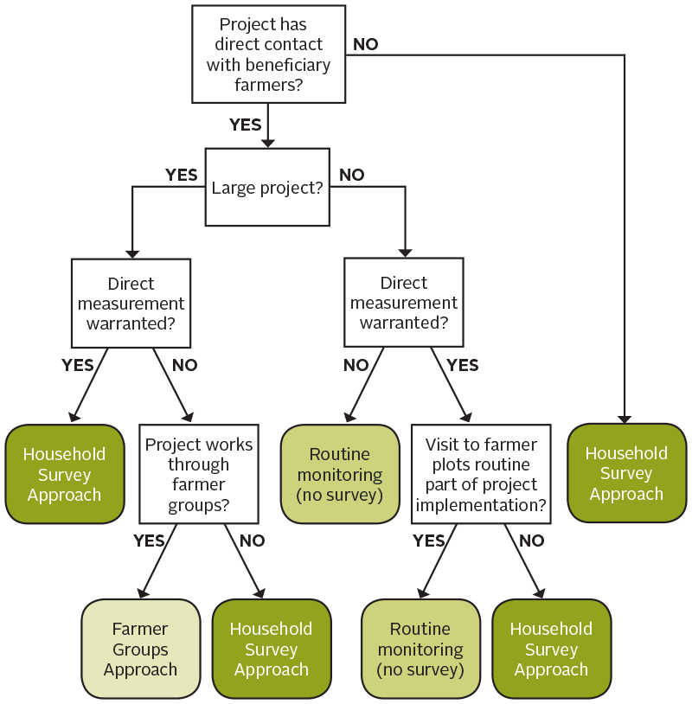
How to Choose the Right Approach?
21

Slide 22
Test Your Knowledge #2
Case Study Example: You are implementing a small project where you work directly with beneficiary farmers on a number of agriculture-based interventions. Experience in other surveys indicates that farmers provide inaccurate estimates of their plot sizes. Project interventions currently do not include periodic visits to farmers’ plots by M&E staff or agriculture extension workers. Using the flow diagram, what would be the best means of collecting annual monitoring data? (Check one only)
BBS using Household Survey Approach
BBS using Farmer Groups Approach
Routine Monitoring (no survey)
✓

Slide 23
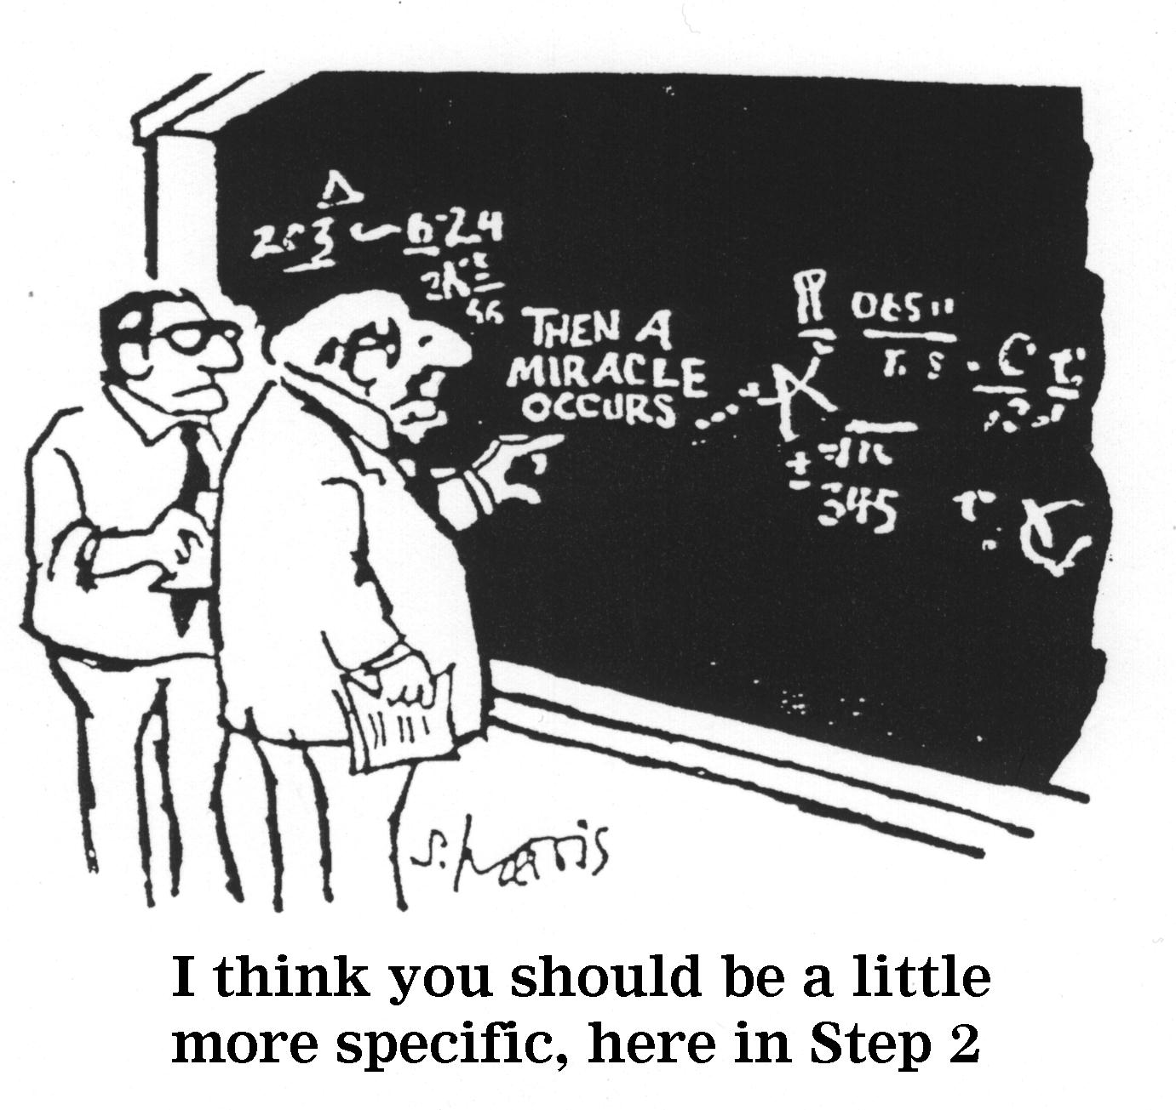
Survey Steps for Approaches 1 & 2
Both the Household Survey Approach and the Farmer Groups Approach entail a number of survey design steps…..
23

Slide 24
Survey Design Steps for Drawing a Sample Using Approaches 1 & 2
Choose a survey design option
Two-stage clustered
design
Calculate the sample size
Choose the number of clusters to select
One-stage design
Select a sample of clusters
Select survey respondents

Slide 25
Survey Step: Calculate the Sample Size
n=∑µα√4

Slide 26
Calculate the Sample Size
BBSs are “descriptive surveys” where the interest is in producing estimates of indicators to provide snapshot of situation at a single point in time
Aim is to achieve estimates with high “precision” (i.e., low standard errors) by controlling the sample size
Specific sample size formula needed for “single point in time” estimates
Most Feed the Future agricultural annual monitoring indicators are totals or functions of totals
Use specific sample size formula for “single point in time” estimates that are totals
26

Slide 27
Test Your Knowledge #3
We do not use sample size formulas to support statistical tests of differences over time for indicators of totals. Why? (Check one only)
A) Testing for statistical differences of indicators of totals does not make sense
B) Testing differences of totals is not the main aim in the context of annual monitoring
✓

Slide 28
Calculate the Sample Size: Four Challenging Agriculture based Annual Monitoring Indicators
Gross Margins (function of totals)
Sample size formula complex, so not recommended to use Gross Margins for sample size computation
Value of Incremental Sales (total – constant)
Number of Farmers and Others who have Applied Improved Technologies (total)
Number of Hectares of Land under Improved Technologies (total)
28

Slide 29
Calculate the Sample Size
Example: Value of Incremental Sales
$VIS= {VS}_{RY }−[\left(\frac{N_{RY}}{N_{BY}}\right){VS}_{BY}]$
where
VS_{RY} = Value of sales for reporting year (value obtained from current BBS)
VS_{BY} = Value of sales for base year (value is known from base year data collection)
N_{RY} = Number of beneficiaries for reporting year (value is known from project records)
N_{BY} = Number of beneficiaries for base year (value is known from base year project records)
At time of BBS, all above values known constants except VS_{RY}
VIS is essential a total minus a constant, i.e., a total
29

Slide 30
Calculate the Sample Size
Sample size formula for a single point-in-time estimator of a total:
$${initial sample size= n}_{initial}=\frac{N^{2}∗z^{2}∗s^{2}}{{MOE}^{2}}$$
where
N = total number of beneficiary farmers
z= critical value of normal distribution (typically use z= 1.96)
s= standard deviation of the distribution of beneficiary data
If no prior value available for s, use estimate:
$$s=\frac{maximum value of indicator for individual beneficiary −minimum value of indicator for individual beneficiary}{6}$$
MOE = margin of error = p* target value of indicator
p=acceptable percentage error; typically 0.05≤p≤0.1
p=0.1 recommended for annual monitoring
30

Slide 31
Case Study Example
You are the M&E specialist for a Feed the Future project in Burundi. You have decided to conduct a beneficiary-based survey (BBS) to collect your agricultural annual monitoring data and you need to calculate the sample size for the survey. You have decided to use a household survey approach using a two-stage clustered design. One of the indicators of interest is the Value of Incremental Sales. Here is some information on your project:
Number of beneficiaries: 60,000 small-holder farmers
Expected maximum value of sales for any individual beneficiary: US$1,200
Target value of sales over all beneficiaries for this year: US$15,000,000 (or US$250 per beneficiary)
31

Slide 32
Calculate the Sample Size
Example: Value of Incremental Sales
N=60,000 small-holder beneficiary farmers
z= 1.96
s: no prior value available so must use estimate
Maximum value of sales for individual beneficiary is US$1,200
Minimum value of sales for individual beneficiary is US$0
s = (US$1,200 – US$0)/ 6 = US$200
32

Slide 33
Calculate the Sample Size
Example: Value of Incremental Sales (continued)
MOE = margin of error = p* target value of indicator
p=0.1 (recommended value)
Target value of indicator is US$250 for each individual beneficiary, or US$15,000,000 for N=60,000 farmers
MOE = 0.1*US$15,000,000 = US$1,500,000
${initial sample size= n}_{initial}=\frac{N^{2}∗z^{2}∗s^{2}}{{MOE}^{2}}=\frac{{60,000}^{2}∗{1.96}^{2}∗{200}^{2}}{{1,500,000}^{2}}=$246
33

Slide 34
Screen shot from accompanying sample size calculator
 | SAMPLE SIZE CALCULATOR FOR BENEFICIARY-BASED SURVEYS IN SUPPORT OF SELECT FEED THE FUTURE AGRICULTURAL ANNUAL MONITORING INDICATORS
Please fill in appropriate values or select choices from the drop-down boxes provided for all cells highlighted in red.
 |  | SURVEY DESIGN OPTION | 1 - Two-stage cluster design with systematic selection of beneficiaries
 |  | INDICATOR | 2 - Value of incremental sales (collected at farm level) attributed to USG implementation
 |  | INITIAL SAMPLE SIZE | N | Population of beneficiaries | 60,000
 |  |  |  | Estimate of standard deviation available? | NO
 |  |  |  | If YES, write estimate here (in units of indicator):

Slide 35
 |  |  | If NO, provide estimates of minimum and maximum:
 |  | max | Estimate of maximum (per beneficiary) | 1,200.00
 |  |  |  | units of currency
 |  | min | Estimate of minimum (per beneficiary) | 0.00
 |  |  |  | units of currency
 |  | s | Standard deviation | 200.00
 |  | p | Acceptable percentage error (Margin of error parameter) | 10.0%
 |  |  | Target value of indicator (Margin of error parameter) | 15,000,000.00
 |  | MOE | Margin of error | 1,500,000
 |  |  | Confidence level | 95%
 |  | z | Critical value from Normal Probability Distribution | 1.96
 |  | n_{initial} | Initial sample size | 246

Slide 36
Calculate the Sample Size
Three adjustments to the initial sample size needed
${final sample size=n}_{final}=n_{initial}∗adj\text{FPC}∗adj\text{DEFF}∗$ $adjNR$
$adj$_{FPC} = Finite Population Correction adjustment
Need for populations that are small relative to initial sample size (i.e., when $n_{initial}$ > $0.05∗N )$
Can reduce sample size somewhat in this case
Most often not needed and if not $adj$_{FPC} =1
$adj$_{DEFF} = Design Effect (DEFF) adjustment
Need for two-stage cluster designs
Need to increase sample size to compensate for intra-cluster correlations
Use value of DEFF for same or similar indicators from prior surveys
In absence of prior information, use $adj$_{DEFF} =2
$adjNR$= Non-response adjustment
Need to increase sample size to compensate for anticipated non-response at beneficiary level
Use values from prior similar surveys in same geographic area
In absence of prior information, assume 5% non-response or $adj$_{NR} = 1/(1-0.05)
36

Slide 37
Calculate the Sample Size
Example: Value of Incremental Sales (continued)
$adj$_{FPC} = Finite Population Correction adjustment
Check: $n_{initial}$ = 246 is not greater than $0.05∗N=0.05 ∗60,000=3,000$
Adjustment not needed so $adj$_{FPC} =1
$adj$_{DEFF} = Design Effect (DEFF) adjustment
Assume absence of prior information, so $adj$_{DEFF} =2
$adjNR$= Non-response adjustment
Assume absence of prior information, so $adj$_{NR} = 1/(1-0.05)
${final sample size=n}_{final}=n_{initial}∗adj\text{FPC}∗adj\text{DEFF}∗$ $adjNR$
$$= 246∗1∗2∗\frac{1}{1−0.05}=518$$
37

Slide 38
Screen shot from accompanying sample size calculator
 | ADJUSTMENT 1 |  | Use adjustment 1? (YES for all survey design options but only if n__{initial} /N is greater than 5%) | NO
 | Finite population correction | n_{initial} / N | Ratio of initial sample size to population size (%) | 0.4%
 |  | n_{adj1} | Adjusted sample size (1) | 246
 | ADJUSTMENT 2 |  | Use adjustment 2? (YES for survey design options 1,2 and 4) | YES
 | Design effect | D | Design effect | Enter value below:
 |  |  |  | 2.00
 |  | n_{adj2} | Adjusted sample size (2) | 492
 | ADJUSTMENT 3 |  | Use adjustment 3? (YES for all survey design options) | YES
 | Non-response |  | Non-response rate | 5.00%
 |  | n_{adj3} | Adjusted sample size (3) | 518
 | FINAL SAMPLE SIZE | n_{final} | Final sample size | 518

Slide 39
DEMONSTRATION OF
EXCEL-BASED SAMPLE SIZE CALCULATOR!!
39

Slide 40
Calculate the Sample Size
Do similar computation for other challenging agriculture indicators (do not use Gross Margins)
Take largest (affordable) sample size among all sample sizes computed
”Number of Farmers and Others who have Applied Improved Technologies” is indicator with greatest sample size requirement, so overall sample size for survey is 809
INDICATOR | FINAL SAMPLE SIZE
Value of Incremental Sales | 518
Number of Farmers and Others who have Applied Improved Technologies | 809
Number of Hectares of Land under Improved Technologies | 360
40

Slide 41
Calculate the Sample Size: Four Challenging Agriculture-based Annual Monitoring Indicators
# Farmers and Others who have Applied Improved Technologies:
Direct beneficiaries throughout the value chain
Others
Producers
# Hectares Under Improved Technologies:
Land-based (crop) technologies only
All direct beneficiary producers
Gross Margins and Incremental Sales:
Crops, animals, fish; direct beneficiaries Smallholder producers only!
Smallholder producers of crops
Smallholder producers of animals, fish
Larger crop producers

Slide 42
Calculate the Sample Size
It is recommended to use a minimum
sample size of 525 beneficiaries (including
inflation for non-response) for any BBS
Why?
To ensure reasonable precision for Feed the Future required disaggregates
To ensure reasonable precision for any district or other sub-project geographic areas for which IPs wish to produce estimates
To compensate for diminished sample size due to screening out of non-small holder farmers for Gross Margins and Value of Incremental Sales indicators
To justify base cost of survey
42

Slide 43
Survey Design Steps for Drawing a Sample Using Approaches 1 & 2
Choose a survey design option
Two-stage clustered
design
Calculate the sample size
Choose the number of clusters to select
One-stage design
Select a sample of clusters
Select survey respondents

Slide 44
After data collection, analysis…
Data entry (if not using a tablet or PDA)
Data cleaning (consistency and logic checks)
Production of sampling weights to take into account:
Probability of selection at each stage of sampling
Non-response at individual beneficiary level
Production of estimates of indicators (using software packages)
Production of associated confidence intervals and standard errors (using software packages)
44

Slide 45
This presentation is made possible by the generous support of the American people through the support of the Office of Health, Infectious Diseases and Nutrition, Bureau for Global Health, United States Agency for International Development (USAID); the Bureau for Food Security; and the Office of Food for Peace, Bureau for Democracy, Conflict and Humanitarian Assistance, under terms of Cooperative Agreement No. AID-OAA-A-12-00005, through FANTA, managed by FHI 360. The contents are the responsibility of FHI 360 and do not necessarily reflect the views of USAID or the United States Government.

