Slide 1
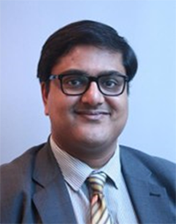
Sumantra (Shumone) Ray
MBBS, DNHE, MPH, MD
Chair and Honorary Professor at the NNEdPro Global Centre for Nutrition and Health in Cambridge
Governing Body Fellow of Wolfson College at the University of Cambridge

Slide 2


UN Decade of Action on Nutrition
The NNEdPro Global Centre for Nutrition and Health: Mobile Teaching Kitchens in Urban Slums of India
Professor Sumantra (Shumone) Ray
Licensed Medical Doctor and Registered Nutritionist (Public Health)
NNEdPro Founding Chair & Executive Director
Governing Body Fellow, Wolfson College Cambridge
Course Director in Applied Human Nutrition, University of Cambridge
Co-Founder, BMJ Nutrition, Prevention and Health
Project Co-Lead (INDIA) & Advisor (LATAM), UKRI Global Challenges (2017-21)
Lead Clinician, UK National Diet & Nutrition Survey (2013-18)
Senior Clinician Scientist, Medical Research Council (2010-18)
Visiting Professor, Imperial College London, UK
Visiting Professor, Ulster University, Northern Ireland
Adjunct Professor, University of Waterloo, Canada
Honorary Professorial Fellow, University of Wollongong, Australia
The Need for Nutrition Education/Innovation Programme (NNEdPro)
Global Centre for
Nutrition and Health
Cambridge
W: www.nnedpro.org.uk Email: sr506@cam.ac.uk
Notes:
The NNEdPro Global Centre for Nutrition and Health in Cambridge is an inter-disciplinary think-tank, training academy & knowledge network, anchored in Cambridge, for individuals or organisations interested in nutrition & health improvement via education, research, evaluation or advocacy.
Our mission is to develop a critical mass of self-sustaining knowledge, skills and capacity in Nutrition and Health, within the global healthcare and public health workforce, resulting in significantly improved health practices and outcomes.
NNEdPro has formal affiliations with six strategic partner organisations.

Slide 3




About us…
An award winning, international and interdisciplinary think-tank, training academy and knowledge network
A strategic partnership between doctors, dietitians, nutritionists, researchers, educators and other professionals
Anchored in Cambridge (UK)
Working without borders!!!
2016 Finalist
2017 MNI AWARD (ESPEN)

Slide 4











NNEdPro Key Strategic Partners
Academic Institutions
Specialist Organisations

Slide 5


Lord Diljit Rana MBE
Honorary Global Patron
Lord Richard Balfe of Dulwich* FRSS
Honorary President
Prof Sumantra Ray*****
NNEdPro Chair/Executive Director [Strategic Development]
Finance, Audit & Risk Committee: Andy Burman (Chair), Andre Laperriere & Suzanne Piscopo
Strategic Advisory Committee: Representatives of Key Strategic Partners
Pauline Douglas**
NNEdPro Vice-Chair/Education Director [Operational Governance]
Global Innovation Panel
Principal Advisor: Prof Martin Kohlmeier***
Lead: Celia Laur*
Deputy Co-Lead: Dr Giuseppe Grosso*
Deputy Co-Lead: Dr Rajna Golubic*
Dr Francesca Ghelfi*
Harrison Carter*
Shivani Bhat
James Bradfield
Dr Sile Griffin*
Eden Barrett**
Dr Minha Rajput-Ray***
NNEdPro Medical Director [Wellbeing & Equity]
Prof Comm Daniele Del Rio****
NNEdPro Scientific Director [Research & Innovation]
* Governing Body Fellow of Wolfson College, University of Cambridge
* Members of Colleges/Departments, University of Cambridge
* Editor-in Chief of BMJ Nutrition, Prevention & Health
* Co-Chair of BMJ Nutrition, Prevention & Health
* Company Directors of ‘NNEdPro-CREATE’ & Co-owners
of BMJ Nutrition, Prevention & Health
* Management Committee, BMJ Nutrition, Prevention & Health
* Defined Specialist Roles
Key Resources Panel
Principal Advisor: Dr Glenys Jones*
Co-Lead: Karen Chamberlain
Co-Lead: Ananya (Ria) Roy
Deputy Co-Lead: Nida Ziauddeen
Deputy Co-Lead: Mhairi Brown
Directors’ Assistant: Rachel Keane
Other Key Members & Specialist Networks >200 Individuals (excluding wider regional networks)
Academy & Alumni Networks
Collaborators & Representatives Network
Regional Network Leadership
Primary University Hubs: Cambridge, Imperial, Ulster, Parma

Slide 6


Our role in Global Challenges…
EVALUATE and ASSESS delivery methods and healthcare impact
ASSESS and IDENTIFY knowledge gaps
DEVELOP and DELIVER education and training interventions
COLLATE and SYNTHESIZE evidence

Slide 7
Our Conceptual Framework → Step-ladder from Food to Health…
HEALTH STATUS
WIDER DETERMINANTS OF DIET, NUTRITION AND HEALTH
NUTRITIONAL STATUS
DIETARY CHOICES
FOOD ENVIRONMENT
NUTRIENT QUALITY
NUTRITIONAL KNOWLEDGE & APPLICATION
FOOD PRODUCTION

Slide 8
I-KANN-25
Knowledge Generating Experts
News & Events
Key Global Research
Legacy Capture
I-KANN-25 (International Knowledge
Application Network in Nutrition 2025)
Open access online portal with bespoke e-learning + collation of openly available knowledge resources with commentary/guidance +
interactive sections for
workforce capacity
Training
i-KANN-25
Testing Methods
Organisations
Discussions
Policy & Law

Slide 9
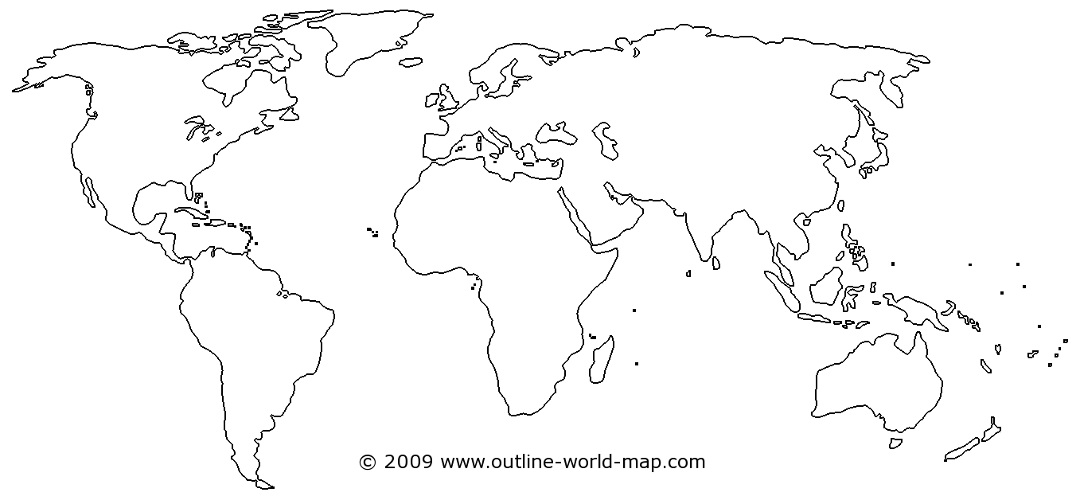
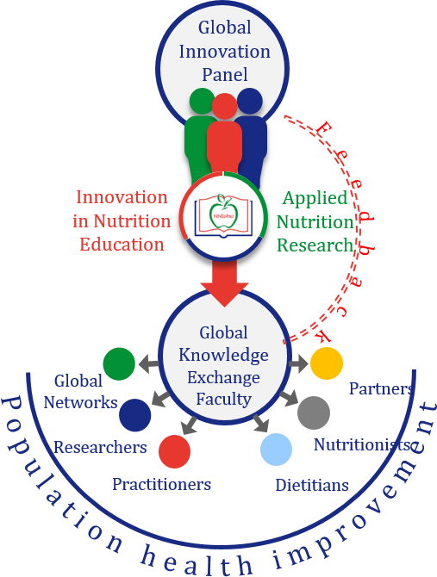
Our Growing Reach → Local to Global…
UK and Ireland
Extended reach via strategic partners:
Cambridge based networks
LGC Network across 21 countries
GODAN 600+ partners worldwide
Canada
Italy & EU
Note: 17 countries represented
at NNEdPro 2017 Summer
School and Summit in
Cambridge
USA
SE Asia
India & S Asia
Morocco & African Region
New Zealand
Australia

Slide 10
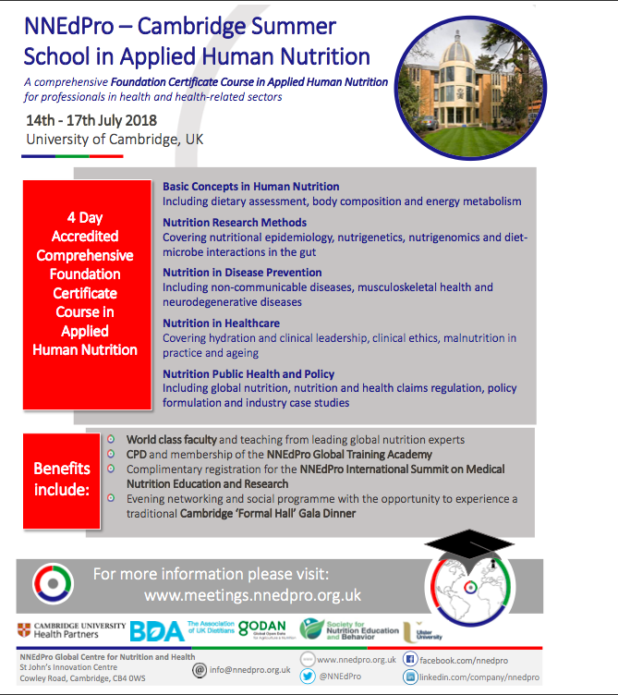

HOPE TO SEE YOU IN CAMBRIDGE THIS SUMMER!

Slide 11
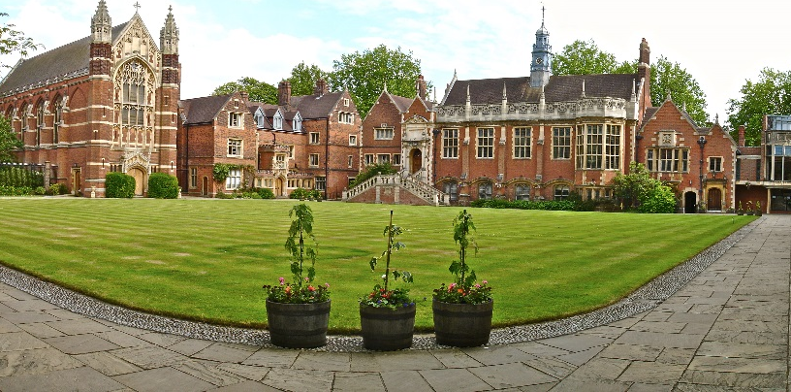
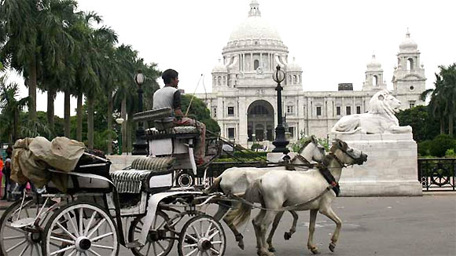
From Cambridge to Capacity Building in the City of Joy…
WHAT WE ARE DOING IN KOLKATA…
NELICO INDIA INITIATIVE = NUTRITION EDUCATION AND LEADERSHIP FOR IMPROVED CLINICAL AND PUBLIC HEALTH OUTCOMES

Slide 12




Feb 2014 → Feb 2015 & the Impact Road to India…

Slide 13

NNEdPro – Indian Strategic Partnerships
Established 2015
UK Partners
University of Cambridge
British Dietetic Association
Medical Research Council
Ulster University
NHS organisations
India Partners
Halo Medical Foundation
Srimanta Sankara Health Sciences University
All India Institute of Hygiene and Public Health
National Institute of Cholera and Enteric Diseases
Indian Institute of Management-C
Indian Dietetic Association
Independent Member(s)
(Strategic and Scientific Advisory Panel to NNEdPro Network in India)
UK NNEdPro Group
NNEdPro Network
in India
Remedy Clinic Study Group
(NNEdPro Agency in India)
(Cambridge Hub)
India Strategic Goals based on Core NNEdPro Themes (1. Medical Education, 2. Research Education and 3.‘NCD’ and Malnutrition Prevention)
Key Project – ‘NELICO India’ (Nutrition Education and Leadership for Improved Clinical/Public Health Outcomes
10 NELICO India ‘Champions’ to conduct 2 projects in Kolkata by Feb 2016 with support from NNEdPro
Theme 1
Theme 2
Theme 3
Advised by the British Deputy High Commission Kolkata
(Knowledge Economy Advisor)

Slide 14
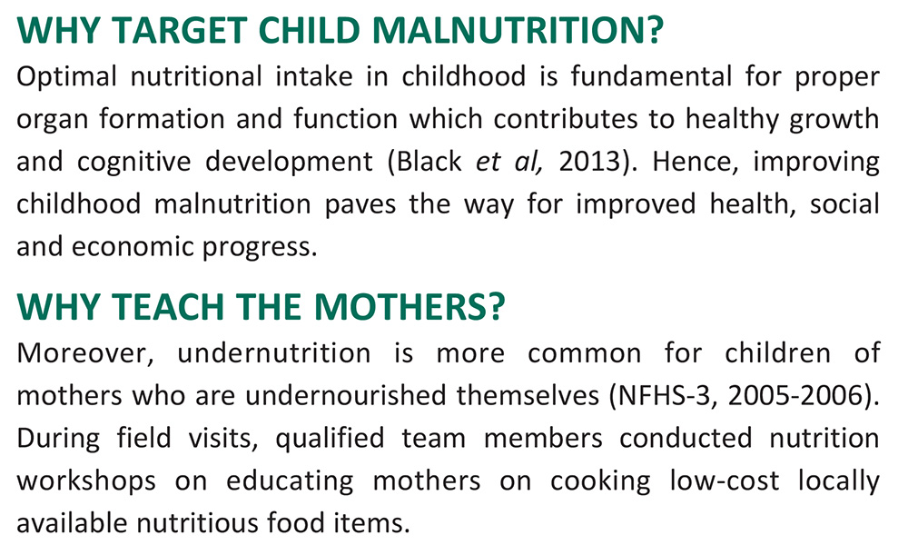
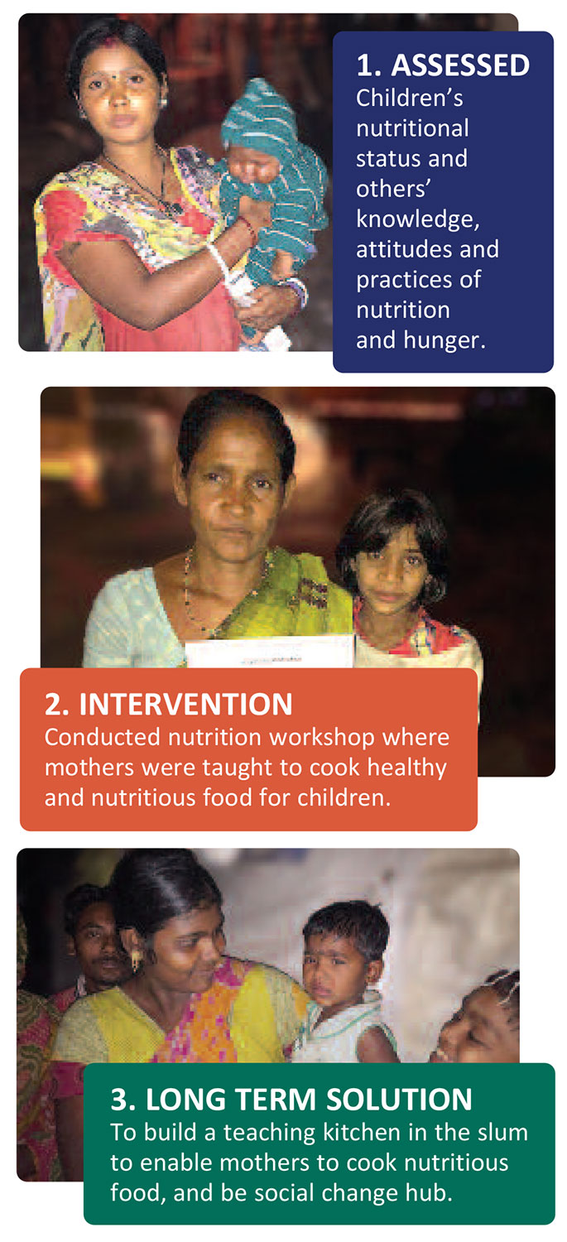
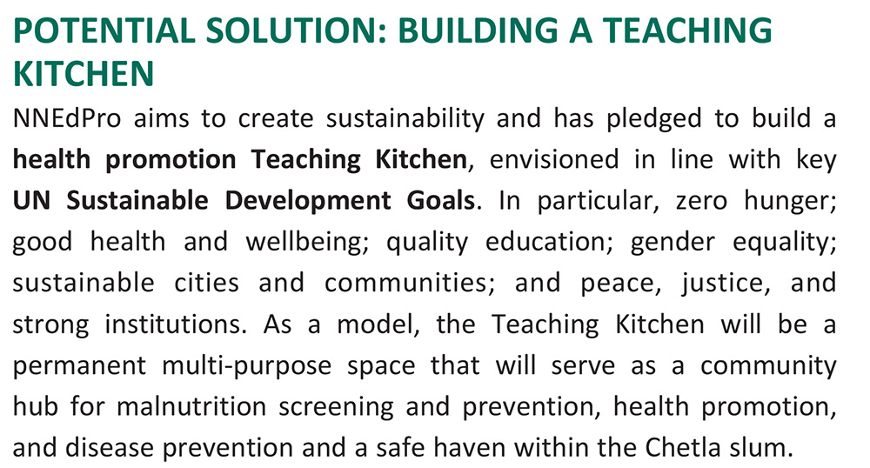
WHAT WAS DONE IN THE URBAN SLUMS?

Slide 15
Objectives
Improve awareness (K-A-P) of diet diversity and disease prevention
Measure indicators of nutritional health
Use cooking skills as a medium for education
Provide resources and signposting for food security
Promote social empowerment and impact preventative health

Slide 16
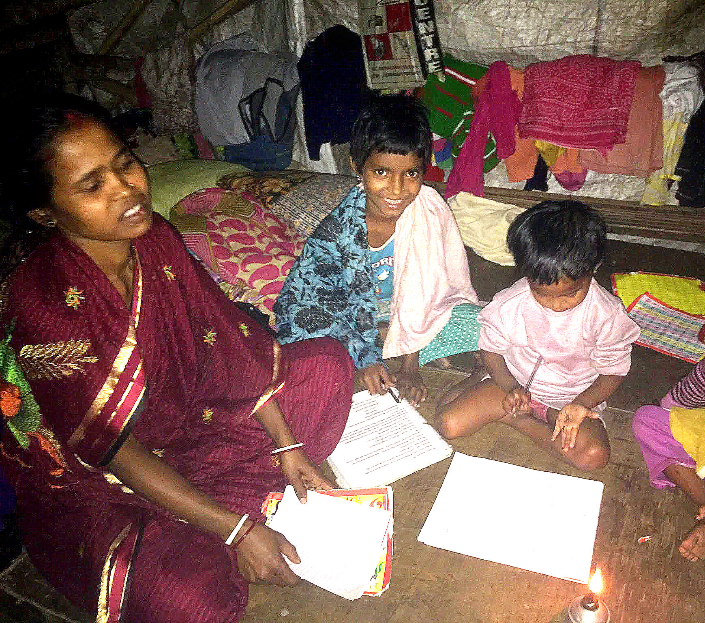
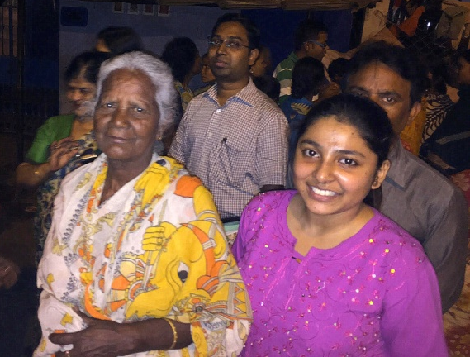
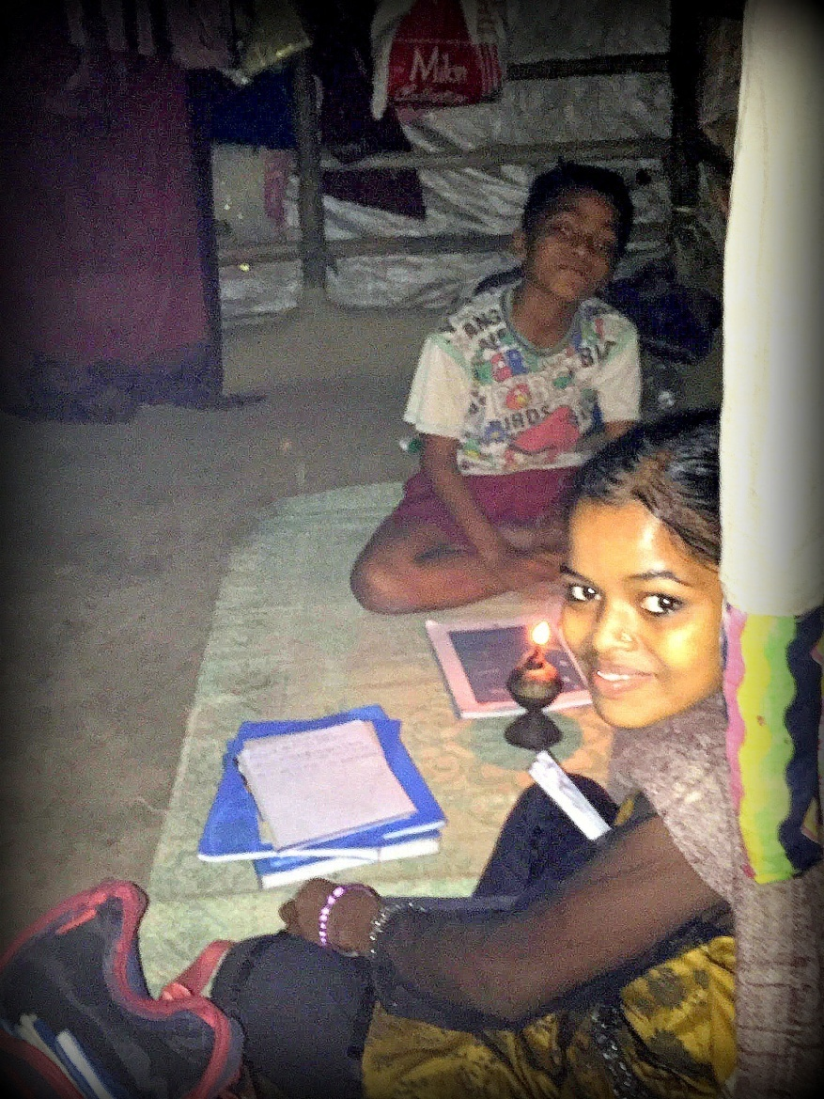

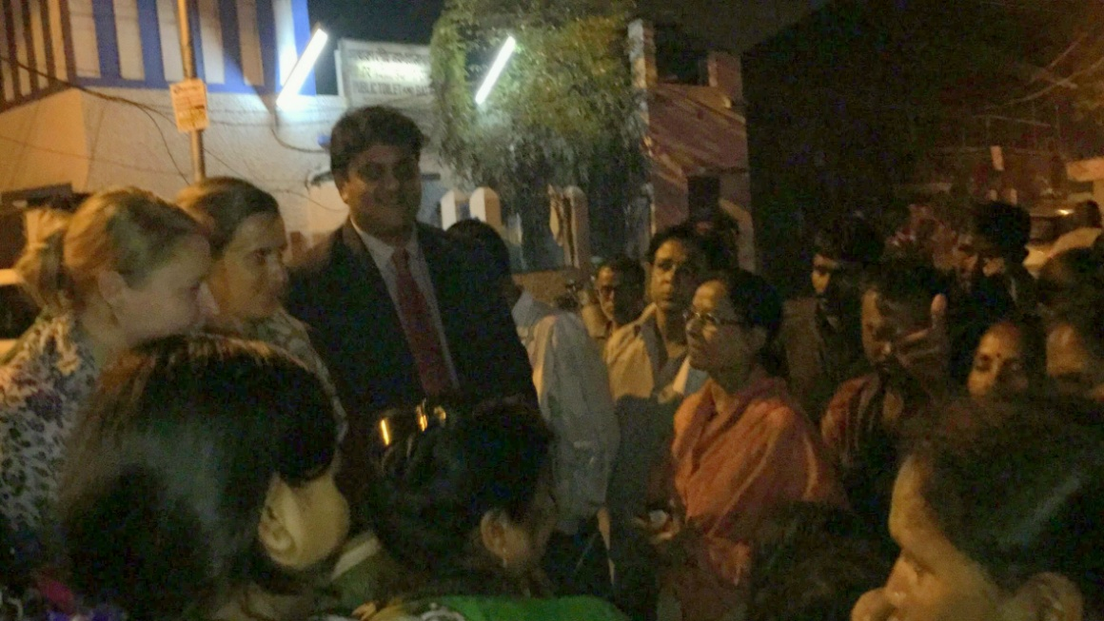
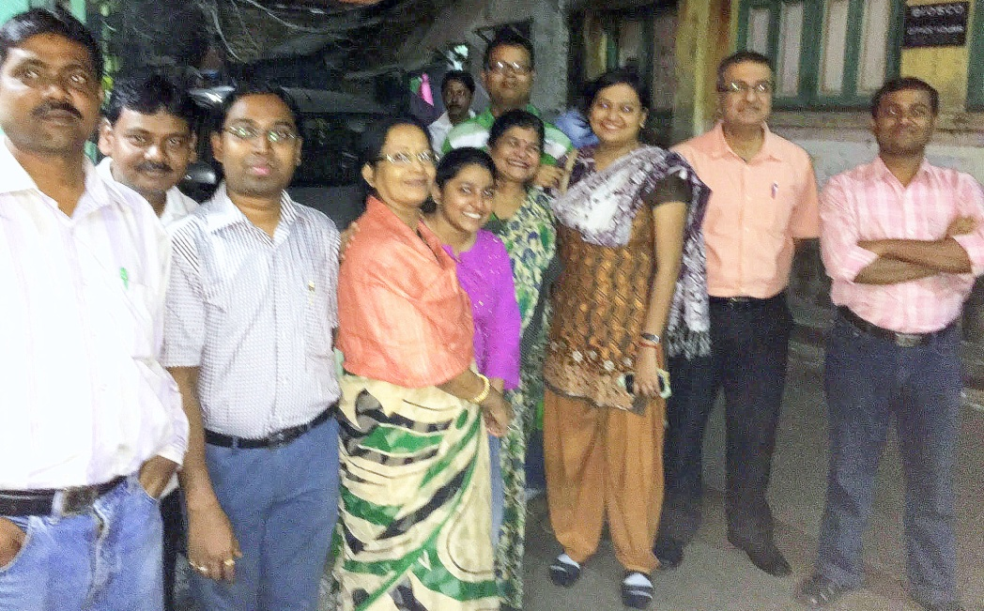
Feb
2016

Slide 17
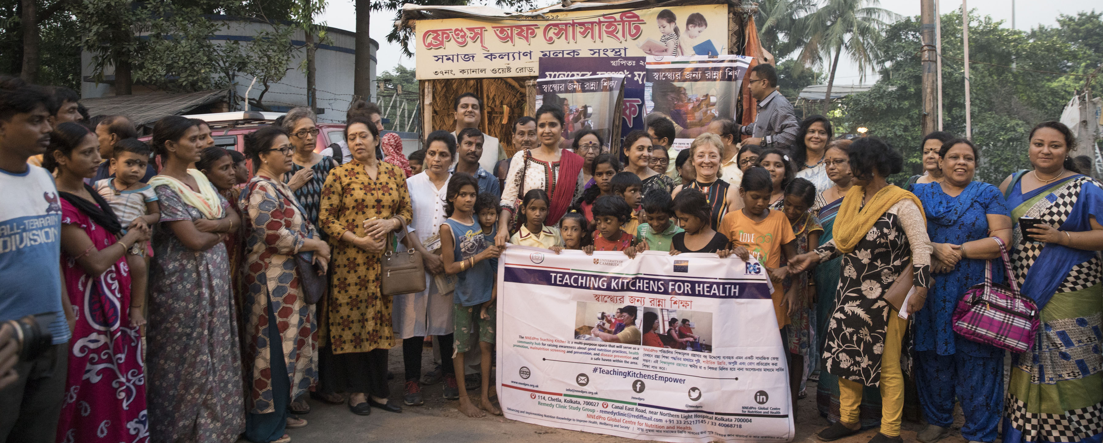
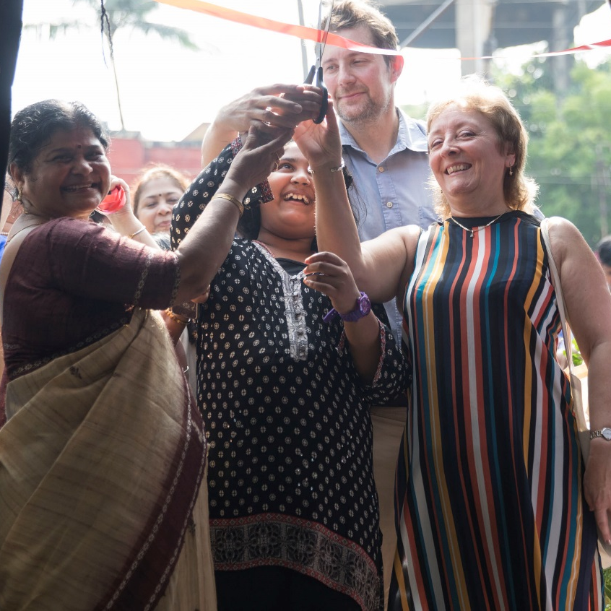
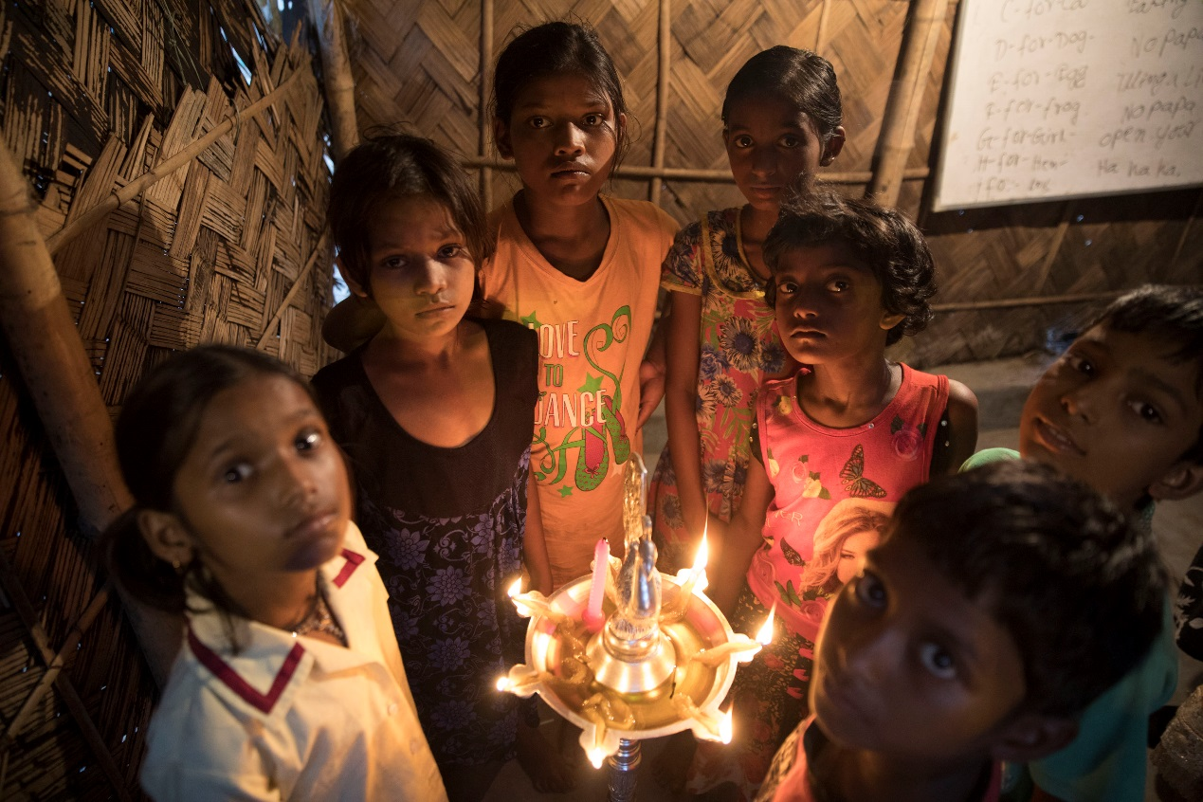
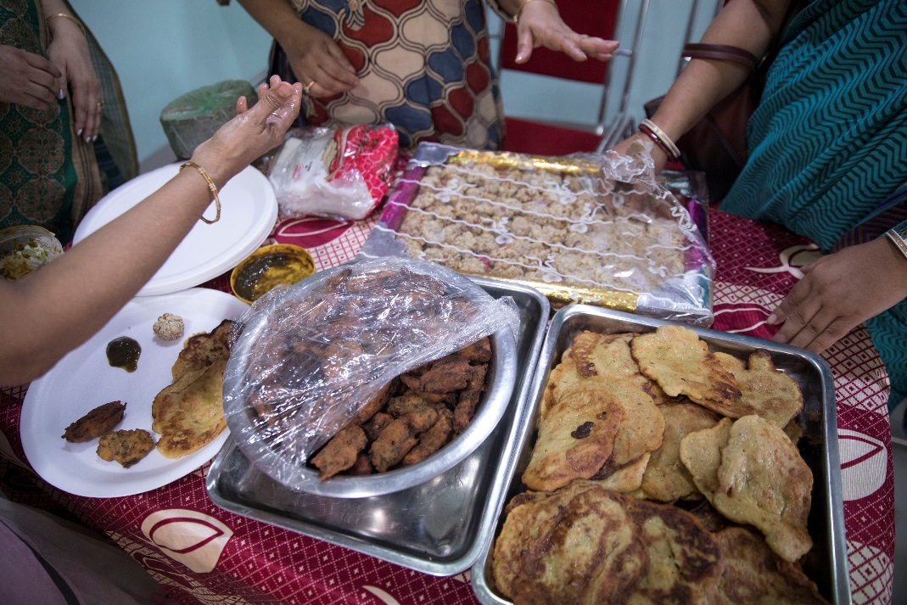
Oct
2017

Slide 18
Partnership Work-in-Progress…
NNEdPro & RCSG – PLANNING & LOGISTICS…
INNER WHEEL & ‘FRIENDS’ – VOLUNTARY INPUTS TO FIELDWORK BY ROTATION…
LUTHERAN TRUST & OTHER STAKEHOLDERS – RESOURCES, SUPPORT & TECHNICAL EXPERTISE…
ESRC IMPACT ACCELERATION WORKSHOPS: OCT 2017 & FEB 2018

Slide 19
STEPS…
Phase 1a TEACHING KITCHEN IN RG KAR CANAL EAST & CHETLA
    FEB 2017 TO FEB 2018 – PLAN | RUN | MONITOR | EVALUATE
    CONTENT: RECOGNISING A TEMPLATE ‘PLATE OF GOOD HEALTH’ (WITH APPROPRIATE FOOD SWAPS) WITH A BALANCE OF MICRO- AND MACRO-NUTRIENTS FROM INEXPENSIVE, LOCALLY SOURCED FOODS PREPARED HYGIENICALLY WITH ATTENTION TO QUALITY & TASTE
Phase 1b ADDING MOBILE TEACHING KITCHEN
    FOCUS INITIALLY ON NUTRITION & HEALTH WITH FURTHER FOOD SWAPS TRAINING
    EXPAND TO OTHER DOMAINS OF PUBLIC HEALTH & EXPLORE MICRO-ENTERPRISE
IMPACT ASSESSMENT | FURTHER PLANNING | Phase-2
    SUSTAINING, ADAPTING/SCALING UP (GCRF) & ADDING FURTHER ACTION-RESEARCH
    SATELLITE PROJECT – ASHWELL SCALE VALIDATION

Slide 21
‘BHAVISHYA SHAKTI’
Empowering the future
Aim
To determine whether ongoing transmission of learning within the community is possible and thus to provide evidence of the ongoing sustainability of this teaching kitchen model.
Objectives
To conduct nutrition and health status measurements for benchmark data collection on consenting participant mothers and children, including anthropometric and clinical assessment information pre-teaching kitchen intervention.
To undertake demographic data collection at baseline of the children and mother participants to also include education, occupation and income information.
To record dietary practice measurements at intermediate and discrete stages throughout the teaching kitchen intervention using a standardised knowledge, attitudes and practice questionnaire.
To conduct post intervention nutrition and health status measurements (with a dual focus on Knowledge—based as well as Health-based outcome measures) as part of the final data collection phase to be able to conduct longitudinal analysis pre and post teaching kitchen intervention.

Slide 22
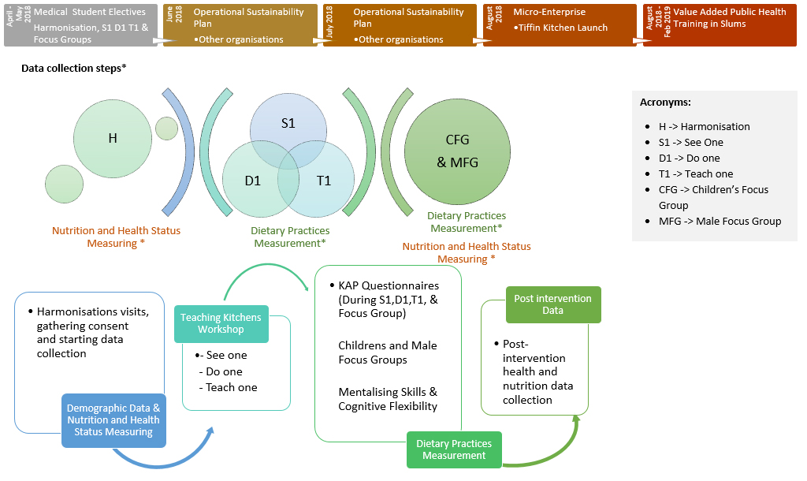
Timeline, Phases & Data Collection Steps to facilitate project planning

Slide 23


Defining Next Steps and Working Together…
MISSING KEY: MEDICAL & HEALTHCARE NUTRITION EDUCATION FOR POLICY & PRACTICE

Slide 24
WITH GRATITUDE TO ALL CONTRIBUTORS!!!
SR506@CAM.AC.UK

