Slide 1





The impact of a food-assisted integrated health and nutrition program in Guatemala on maternal and child nutrition outcomes
Deanna Olney, Jef L Leroy, Lilia Bliznashka, Marie Ruel- IFPRI
October 27, 2016

Slide 2
Research questions
What was the overall impact of PM2A?
What was the optimal size and composition of the food rations?
  Did the size of the household ration affect child growth outcomes?
  Did the type of individual ration affect child growth outcomes?

Slide 3
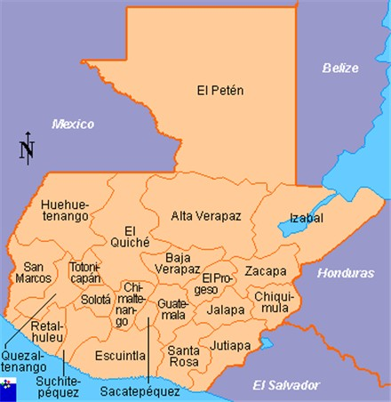
PROCOMIDA – Study area
Program was implemented by Mercy Corps
Undernutrition among children
47% stunted
13% underweight
< 1% wasted
Alta Verapaz

Slide 4
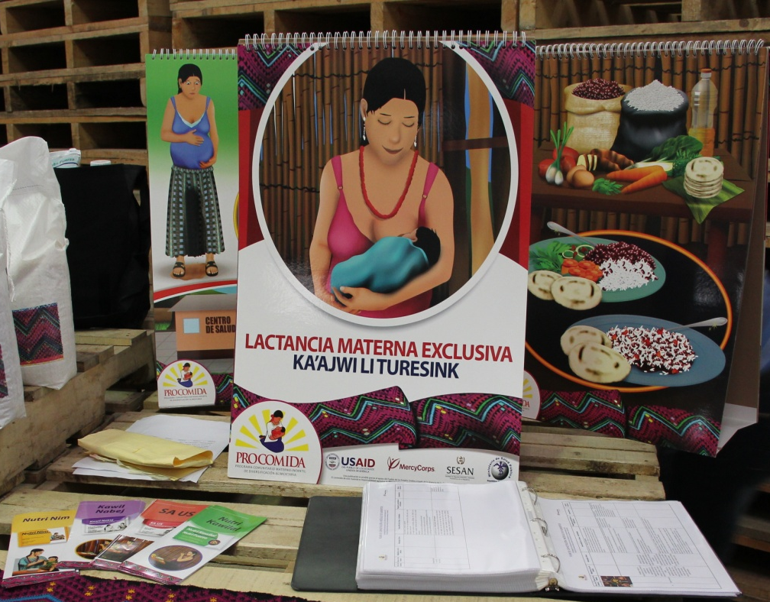
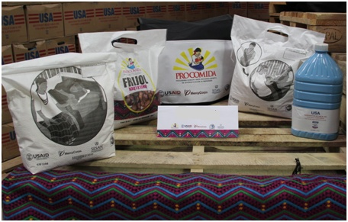
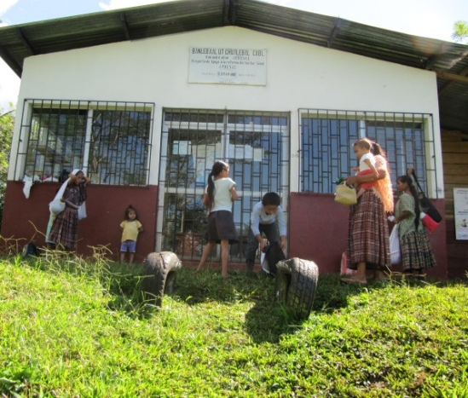
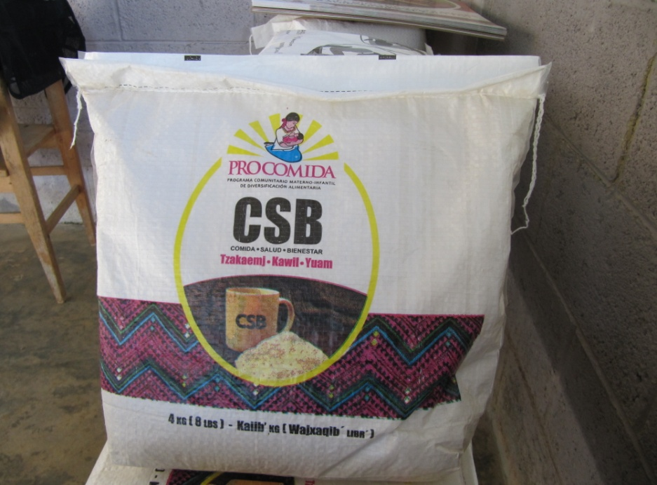
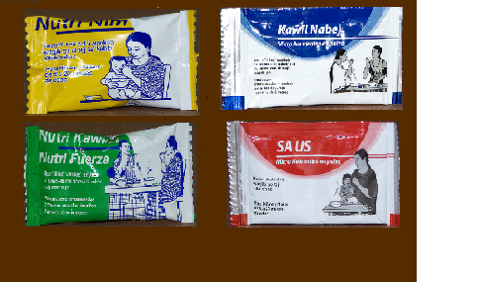
Program components
Food
  Family ration
  Individual ration
BCC
Health Services
6 kg rice
4 kg beans
1.85 kg oil
Notes:
6 kg rice; 4 kg beans; 1.8 kg oil – 4 kg CSB

Slide 5

Comparison groups
(20 clusters and ~750 mother/child pair per group)
Full family ration + CSB | Reduced family ration + CSB | No family ration + CSB | Full family ration + LNS | Full family ration + MNP | Control

Slide 6



Longitudinal design
Each mother/child pair assessed 8 times
Pregnancy
1 m
4 m
6 m
9 m
12 m
18 m
24 m

Slide 7
Data analysis
Les pratiques d'alimentation du nourrisson et du jeune enfant
We used linear mixed effects models to assess impacts.
Models included covariates:
  HH: wealth, education of head, speak Spanish, dependency ratio
  Maternal: education, speaks Spanish, age, height (for child stunting model)
  Child: sex
Standard errors were adjusted for clustering.

Slide 8
Participation in PROCOMIDA
Les pratiques d'alimentation du nourrisson et du jeune enfant
Notes:
Food distribution and BCC participation
Equal and generally high.
Lowest in the no family ration arm.

Slide 9
Did the size of the family ration affect children’s growth outcomes?

Slide 10
Child stunting (LAZ < -2) by child age and family ration size compared to control
**
*
*
* p<0.05 , ** p<0.01 – individual study arm compared to control arm at individual time point

Slide 11
Child stunting (LAZ < -2) by child age and family ration size compared to control
**
-11.2 pp
*
*
-4.6 pp
* p<0.05 , ** p<0.01 – individual study arm compared to control arm at individual time point

Slide 12
Did the type of individual ration affect child growth outcomes?

Slide 13
Child stunting (LAZ < -2) by child age and type of individual ration compared to control
*
**
*
Prevalence of stunting (%)
*
*
*
*
*
* p<0.05 , ** p<0.01 – individual study arm compared to control arm at individual time point

Slide 14
Child stunting (LAZ < -2) by child age and type of individual ration compared to control
*
**
*
Prevalence of stunting (%)
*
*
*
*
-3.9 pp
*
-4.6 pp
* p<0.05 , ** p<0.01 – individual study arm compared to control arm at individual time point

Slide 15
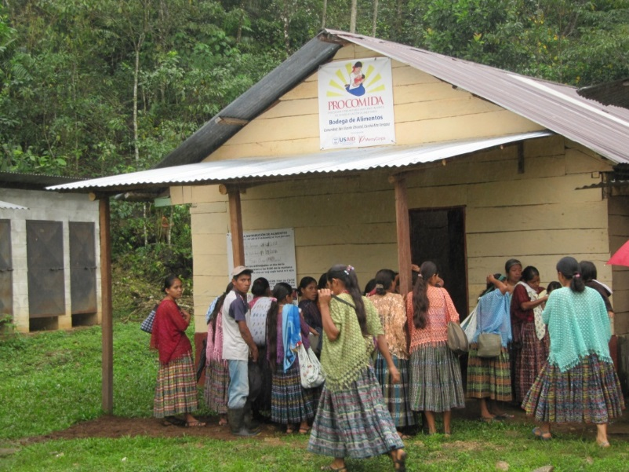
Impact of PROCOMIDA on child wasting and underweight
There were no significant program impacts at 24 months of age on:
  Child underweight
  Child wasting (prevalence was very low)

Slide 16
Pathways of impact on child stunting
 | Family | Full | Reduced | None | Full | Full
 | Individual | CSB | CSB | CSB | LNS | MNP
Early initiation of breastfeeding |  | + | + |  |  | +
Exclusive breastfeeding |  | 2+ | 2+ | 2+ | 2+ | 2+
Child IYCF practices |  | 2+ |  |  | 1+ | 5+
Child hygiene practices |  | + | + |  |  | +
Household hygiene practices |  | 3+ | 2+ |  |  | 2+

Slide 17
Conclusions
PM2A WORKS:
  1st evidence that PM2A (targeting first 1000 days) reduces stunting (using RCT + control group)
FOOD RATIONS:
  Larger family ration led to greater participation and impacts
  With full family ration, CSB or MNP worked to reduce stunting
BCC:
  Worked to improve knowledge and practices for several IYCF, hygiene and health practices but more improvements in this area are needed
Health Services:
  PROCOMIDA increased the frequency of use of health services in both pregnant women and young children
Notes:
Other bottlenecks (such as government funding for health sector, limited capacity of staff, limited access to health centers) are critical for service delivery, but beyond the scope of PM2A programs.

Slide 18
Acknowledgements
The research took place within the USAID FFP-funded PROCOMIDA program, implemented by Mercy Corps. We thank Mercy Corps for overseeing and implementing the program and for their collaboration with the research teams and processes.
Sources of financial support:
  The study was made possible by the generous support of the American people through the support of the Office of Food for Peace, Bureau for Democracy, Conflict, and Humanitarian Assistance, and the Office of Health, Infectious Diseases, and Nutrition, Bureau for Global Health, U.S. Agency for International Development (USAID), under terms of Cooperative Agreement No. AID-OAA-A-12-00005, through the Food and Nutrition Technical Assistance III Project (FANTA), managed by FHI 360.
  This study also received support from the CGIAR Research Program on Agriculture for Nutrition and Health (A4NH), led by IFPRI

Slide 19
Micronutrientes niños | Macrovital | CSB-PROCOMIDA (100g) | MNP-PROCOMIDA | LNS-PROCOMIDA
Iron (mg) | 12.5 | 17.49 | 9 | 9
Zinc (mg) | 5 | 5 | 8 | 8
Vitamin A (μg RE) | 300 | 784 | 400 | 400
Folic acid (μg) | 30 | 300 | 150 | 150
Vitamin C (mg) | 30 | 40 | 30 | 30
Cu (mg) | - | 0.9 | 0.34 | 0.34
Calcium (mg) | - | 831 | 280 | 280
Phosphorous (mg) | - | 206 | 190 | 190
Potassium (mg) | - | 634 | 200 | 200
Magnesium (mg) | - | 173.8 | 40 | 40
Selenium (mg) | - | 6 | 20 | 20
Iodine (μg) | - | 56.9 | 90 | 90
Manganese (mg) | - | 0.7 | 1.2 | 1.2
Sodium (mg) | - | 7.3 | - | -
Vitamin B1 (mg) | - | 0.53 | 0.5 | 0.5
Vitamin B2 (mg) | - | 0.48 | 0.5 | 0.5
Niacin (mg) | - | 6.23 | 6 | 6
Pantothenic acid (mg) | - | 3.4 | 2 | 2
Vitamin B6 (mg) | - | 0.5 | 0.5 | 0.5
Vitamin B12 (μg) | - | 1 | 0.9 | 0.9
Vitamin D (IU) | - | 198 | 200 | 200
Vitamin E (mg) | - | 8.7 | 6 | 6
Vitamin K (μg) | - |  | 30 | 30
Energy (kcal) | - | 375.7 | - | 118
Protein (g) | - | 17.2 | - | 2.6
Fat (g) | - | 6.9 | - | 9.6
Linoleic acid (g) | - |  | - | 4.56
α- Linolenic acid | - |  | - | 0.58
Fluor (mg) | 1.5 |  | - | -

