Slide 1
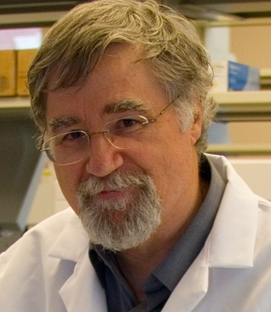
Martin Kohlmeier MD, PhD
Professor of Nutrition at the Medical School and the Gillings School of Global Public Health, University of North Carolina (UNC) at Chapel Hill

Slide 2
Medical Nutrition Education
Path to better global health
Martin Kohlmeier, MD, PhD
University of North Carolina at Chapel Hill
School of Medicine & Gillings School of Global Public Health
and
UNC Nutrition Research Institute, Kannapolis, NC
mkohlmeier@unc.edu
Notes:
I am a nutrition educator and researcher at the school of medicine and the school of public health of the University of North Carolina.

Slide 3
Health care is better with trained providers
Pregnancy complications are fewer and newborn health is better when physicians provide nutrition guidance
Proper nutrition monitoring and timely interventions by their physicians protect development and well-being of children
Resistance against infections and recovery from infectious diseases are much better with optimal nutrition
Hospital stays are shorter and complications less common when physicians ensure nutrition assessment and support
Physicians can improve educational outcomes in children and work performance in adults with targeted nutritional information
Notes:
I am interested in nutrition education because it teaches powerful tools for everyday medical practice. When physicians provide nutrition guidance their patients have fewer pregnancy complications and give birth to healthier children. Hospital stays and outcomes after expensive surgeries and other treatments are getting increasing attention because best nutrition practices actually save money. It often just takes the right words at the right time.

Slide 4
Challenges are similar in US and rest of the world
Most resident physicians (94%) know that they should provide nutrition counseling to their patients, but few (14%) feel adequately trained (Vetter et al., J Am Coll Nutr 2008)
Many internists and pediatricians (48%) feel unable to adequately counsel patients about common nutritional treatment options (Jay et al., J Gen Intern Med 2008)
Most OB/GYN (67%) fail to advise about pregnancy weight gain or (84%) discuss nutritional issues during GYN visit (Landsberger et al., 2013)
Notes:
But physicians are not prepared. Many ignore nutrition altogether because they lack the necessary training.

Slide 5
Cost of inattention to nutrition
More than 600,00 premature deaths in the US are related to nutrition and inactivity
$117 billion for obesity-related costs alone in 2000 (CDC), also in many emerging economies
Malnourished patients have 60% higher rate of complications, longer time in intensive care, more readmissions
Notes:
Nutrition education is so important because it can help to prevent illness in millions of people and premature deaths of hundreds of thousands. And then we have to look at the staggering cost. Obesity-related costs are exploding to the point where they threaten to make the affected countries less competitive. On the other end of the spectrum, avoidable malnutrition of patients also increases costs. All of these points should make it clear that healthcare providers need to know about nutrition.

Slide 6
What physicians need to know about nutrition
1. The Science
They need to know how nutrients and foods work in people.
2. Best Practice
They need to know what clinical signs to look for and what to prescribe.
3. Effective Delivery
They need to know how to guide people through difficult changes.
Notes:
It is clear what physicians need to know about nutrition to serve their patients. First, the science, how foods work in health and disease; then best nutrition practice, recognizing nutrition problems and what to do about them; and finally getting the message across, which often means to help their patients help themselves.

Slide 7
What physicians need to know about nutrition
It takes at least 25-30 hours of instruction
to achieve just basic nutrition competencies
(that is less than 0.5% of total training hours)
Notes:
A standard list of nutrition knowledge and skills was spelled out by a large expert committee of the Nutrition Academic Award Program of the National Institutes of Health. We know that it takes at least 25 to 30 hours of medical school instruction to achieve just basic nutrition competencies.

Slide 8
NIM resources are widely available
Currently over 40 modules of 15-60 min length
Evidence-based instruction of clinical skills
Run on any standard desktop or laptop
Used by students at 149 of 180 US schools
Chosen by medical schools in 23 other countries
Previously funded by NCI, ODS, USDA and others
Notes:
The NIM online materials for evidence-based instruction are used by medical students at most US medical and osteopathic schools.

Slide 9
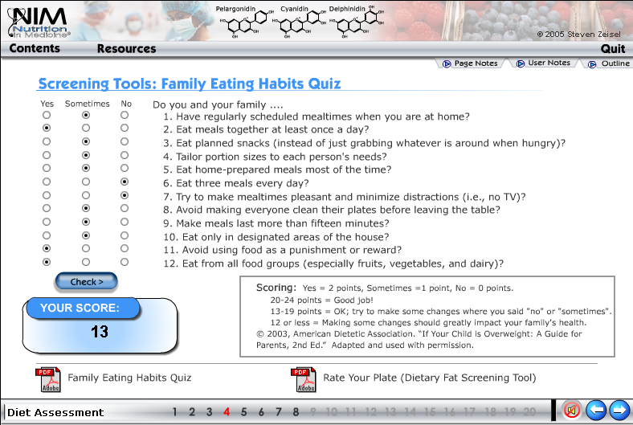
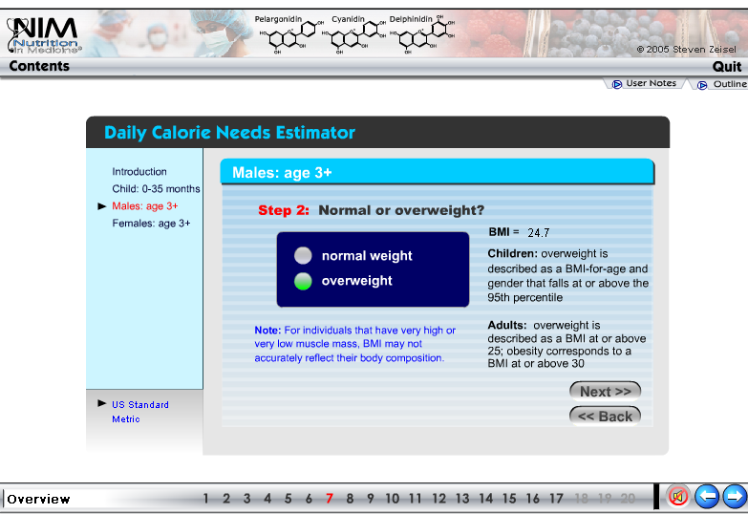
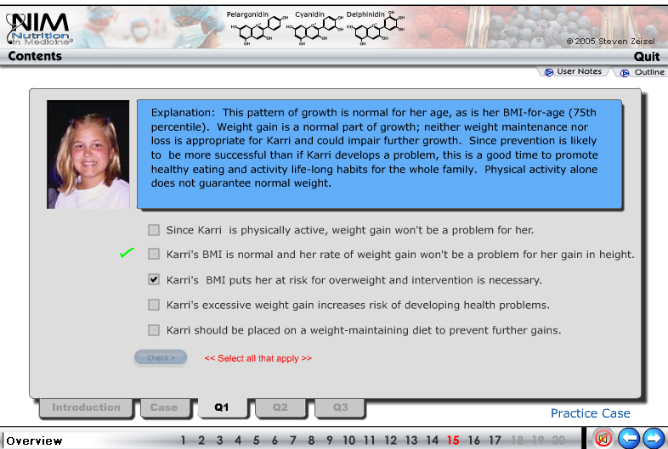
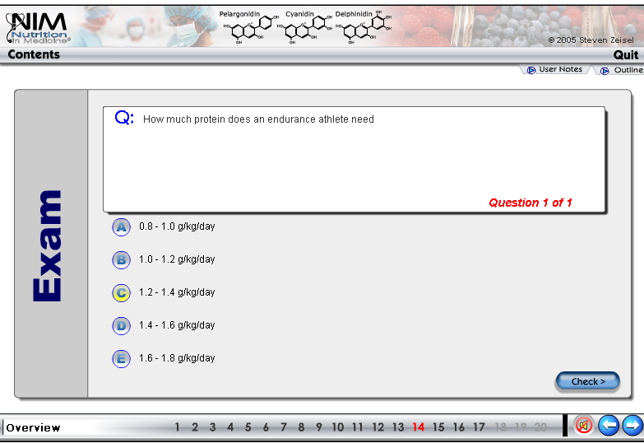
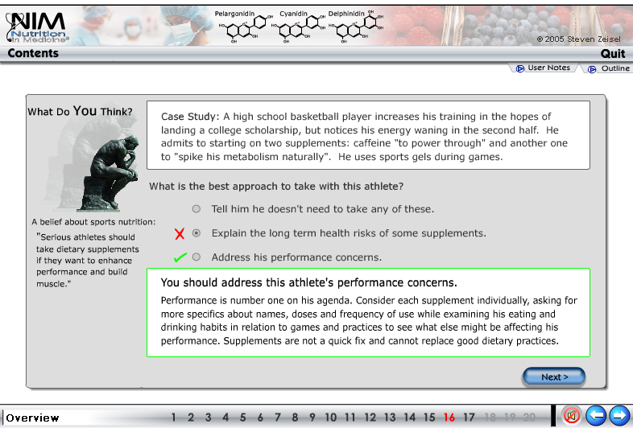
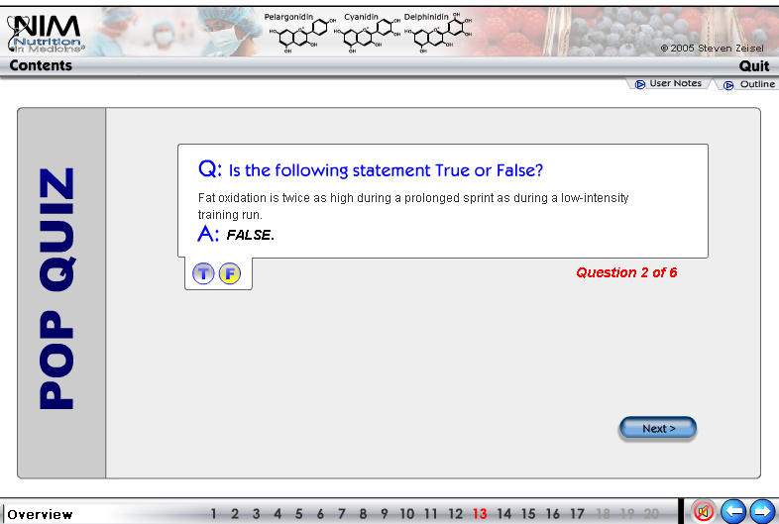
Lessons
Tools
Case studies
Review questions
Notes:
Our online courses cover a full curriculum from basic science to clinical practice, using lessons, interactions and video cases.

Slide 10
3. NIM instructional design
The objective
Notes:
After this presentation you should be able to

Slide 11
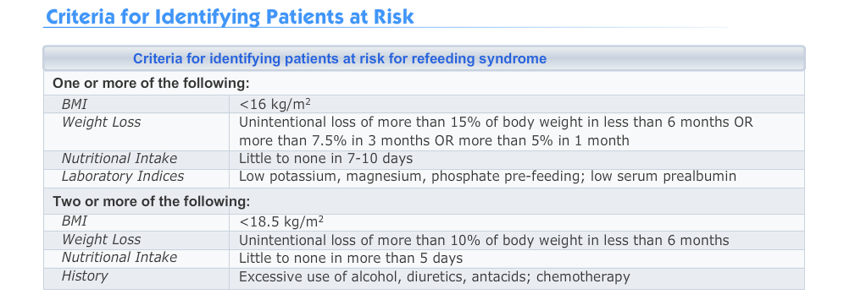
3. NIM instructional design
First pass instruction
Notes:
After this presentation you should be able to

Slide 12
3. NIM instructional design
Reinforcing with an exercise
Notes:
After this presentation you should be able to

Slide 13
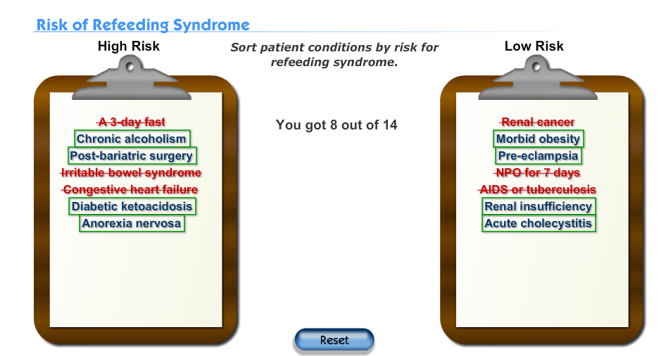
3. NIM instructional design
Reinforcing with an exercise
Notes:
After this presentation you should be able to

Slide 14
3. NIM instructional design
Then another review, if necessary
Notes:
After this presentation you should be able to

Slide 15
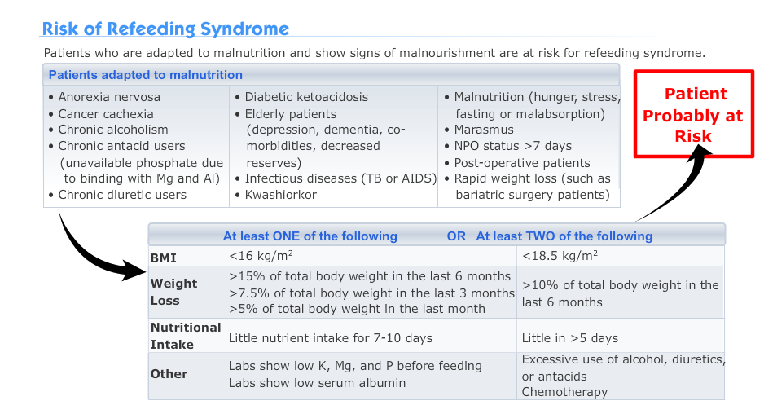
3. NIM instructional design
Then another review, if necessary
Notes:
After this presentation you should be able to

Slide 16
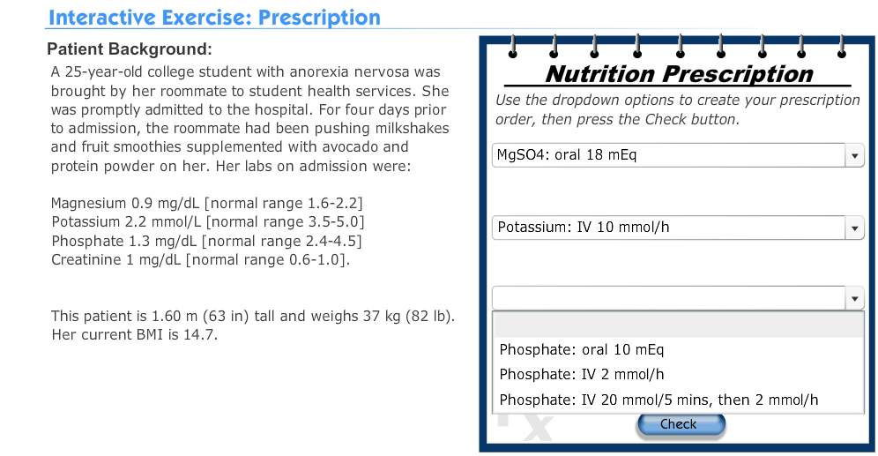
3. NIM instructional design
Integrating and synthesizing
Notes:
After this presentation you should be able to

Slide 17
If they did not get it right
Notes:
After this presentation you should be able to

Slide 18
More prompts
Notes:
After this presentation you should be able to

Slide 19
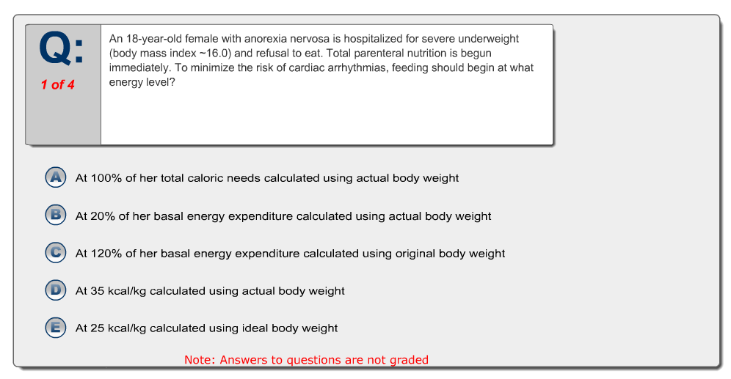
3. NIM instructional design
A final check
Notes:
After this presentation you should be able to

Slide 20
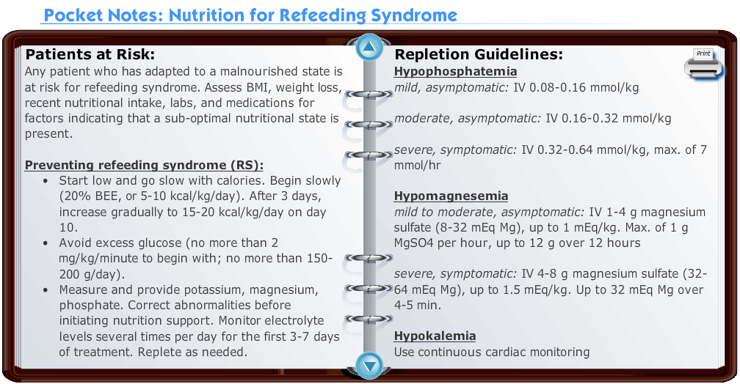
A handy reference
Notes:
After this presentation you should be able to

Slide 21
One hour of instruction for OB/GYN residents
Clinical activity | Baseline | Three months later | Stat.significance
Address nutritional issues at new OB appointment | 57.9% | 64.5% | 0.77
Advise about gestational weight gain | 33.2% | 77.4% | 0.003
Calculate BMI at OB visit | 78.4% | 93.3% | 0.07
Discuss nutritional issues during GYN visit | 16.2% | 43.3% | 0.002
Refer to an RD | 36.8% | 56.7% | 0.03
Kaplan et al., Exp Biol 2013
Notes:
We have found that just one hour of online instruction changes practice patterns. In one study residents learned to use effective assessment and counseling tools with their patients. Before the training session, most of these budding obstetricians rarely or never advised their pregnant patients about proper weight gain, and three months after the one-hour session most of them did so. This is at least a start.

Slide 22
International NIM Use and Collaborations
Trinidad
Kenya
Egypt
Ethiopia
Ghana
Nigeria
Malawi
India
Morocco
Philippines
Notes:
While not the focus of our previous work, the NIM project has a long history of collaborations with educators around the world. The global NNEdPro partnership extends this reach with training projects in high-need countries such as India, Morocco and Kenya.

Slide 23
Operational aspects
We have deep experience with online instructions
NIM materials readily adaptable to regional needs
Modules can be tailored to different skill levels
Delivery of instruction is specific for learners
Collaborations with in-country leaders are sought
Assessment of instructional efficacy is built-in
Includes later competency and practice evaluations
Notes:
The NIM system and materials an be readily adapted to regional needs.

Slide 24
Joe O’Brien
We need support to help educators train health workers
mkohlmeier@unc.edu
Notes:
Something needs to change, and we know how it can be done.

Slide 25
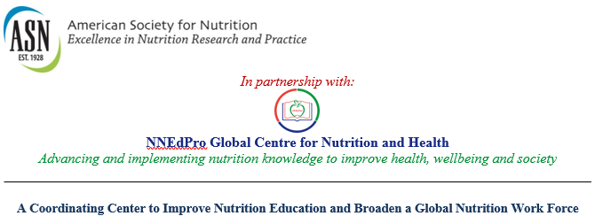
ASN Coordinating Center
GODAN is a key strategic partner
Notes:
The NIM system and materials an be readily adapted to regional needs.

