Slide 1

Alice Nkoroi
BSc, MS
Country Project Manager Food and Nutrition Technical Assistance III Project (FANTA)/ FHI 360, Ghana (2009–2013) and Malawi (2014–2017)

Slide 2




Improving Pre-service Nutrition Education of Frontline Workers: Nurses and Midwives in Ghana and Malawi
Alice Nkoroi, FANTA/FHI 360

Slide 3
Presentation Outline
Context
Approach and Process
Impact
Lessons Learned
Acknowledgments

Slide 4
1. Context
In both Ghana and Malawi, FANTA worked to improve access and quality of nutrition services. This included support to the governments to develop policies, strategies and guidelines; and build competence of health care providers and managers.
Lancet Series (2013) emphasis on capacity development of variety of human resource needed to scale-up priority nutrition interventions.
With the limited number of nutritionist and dieticians working at the forefront, nurses and midwives play a vital role in delivering nutrition services.
WHO and International council of nurses highlight on the need for competence based pre-service nutrition education.

Slide 5
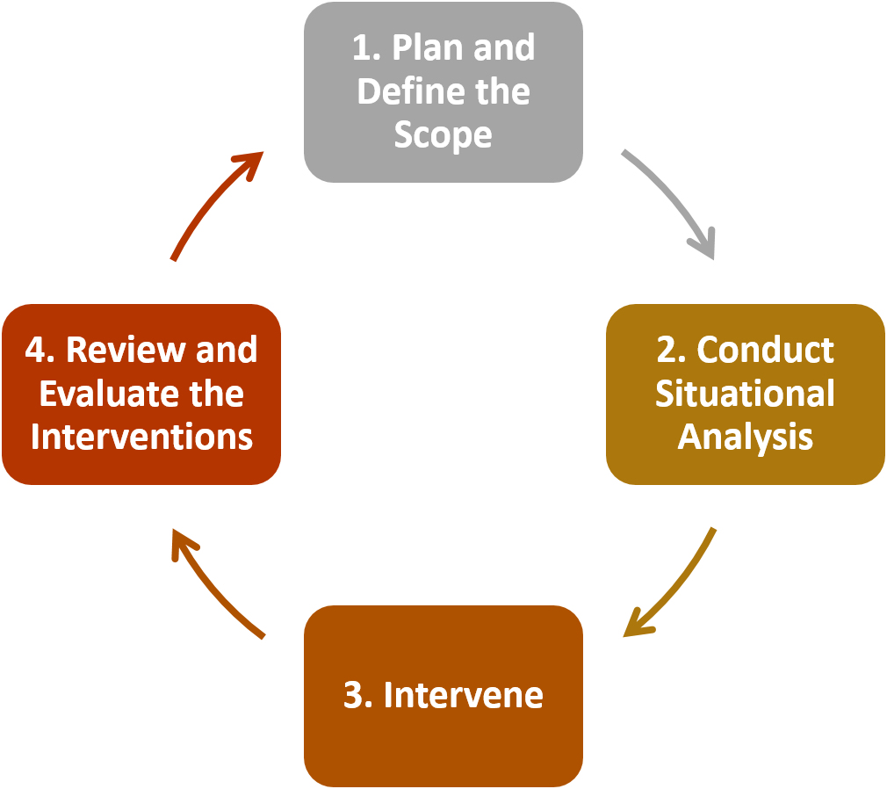
2. Approach and Process
Notes:
In both Ghana and Malawi, FANTA working in collaboration with the MOH, Nurses and Midwives Council and USAID/MCHIP to applied a competence-based approach to improve pre-service nutrition and training of nurses and midwives. The process has four main phased I will discuss in the next slides:
Planning and defining the scope
Conducting a situational analysis to better understand the context and interventions needed
Intervening
Review and evaluation of the interventions

Slide 6
Plan and Define the Scope (2)
Stakeholder Consultation and Consensus
  With the MOH, teaching institutions, regulatory bodies and nutrition partners
National Guidelines and Policy Priorities
  Update and alignment with national context, global guidance and standards
Define the Core Nutrition Competencies
  What should a nurse or midwife know and be able to do in nutrition
Notes:
The first step in planning and defining the scope is to bring together the actors responsible for national policy and guidance development, curricula development, regulation of pre-service training and education, and employment of health care providers.
Next is determining the updated national guidelines and policy priorities. In both countries, the government had updated its national nutrition policies to align with global priorities such as the SUN and SDGs.
The governments had adopted new global policy guidance including approaches for addressing malnutrition. For example: in Malawi, the MOH had re-established the baby friendly hospital initiatives to help improve the breastfeeding rates in the country where as in Ghana, the MOH/GHS had adopted CMAM as an approach for treating severe acute malnutrition. Other guidance such as new breastfeeding recommendations for HIV infected mothers had also been released by WHO.
While the new policy guidance had been adopted at service delivery, it had not been updated in the pre-service training.
New graduates were not aware of the new guidance therefore needed in-service training immediately at deployment.
Finally, defined the core nutrition competencies (knowledge, skills and attitudes) that were aligned with the policy priorities. To do this, we outlined what a nurse (community health, clinical and public health) or midwife is expected to know and do.

Slide 7
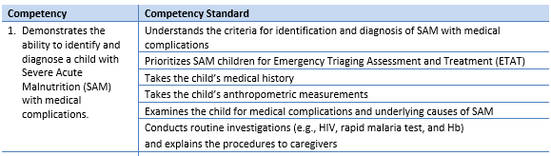
Example of Nutrition Competency (2)

Slide 8
Conduct Situational Analysis (2)
Curricula Review and Mapping
Assessment of Teaching and Resources
What nutrition content is taught?
What is the trainers’ (lecturers/tutors) level of competence on nutrition?
Are the core competencies and national nutrition policy priorities taught?
Do the trainers have access to up-to-date teaching resources?
Do the schools have nutrition equipment and tools?
Notes:
Curricula review and mapping looked at all nursing and midwifery training programs; community health, public health, mental nursing, midwifery, child health nursing etc.. The objective was to compare existing training objectives and competencies against the defined competencies for each training program. We also reviewed the courses for sequencing and how they linked with one another e.g. when the basic nutrition was taught, when nutrition is supposed to be applied during other courses e.g. pediatric nursing, child health nursing, medical nursing etc..
Assessment of pre-service teaching involved:
Measuring the tutors level of competence using Objective Structured Clinical Examination (OSCE)
Reviewing the tutors teaching notes, libraries and demonstration labs to understand if they had the needed materials and resources to teach nutrition to modern standards.
Findings from the situation assessment showed:
Poor performance in knowledge and skills on nutrition
Most of the training curricula were generally not up to date with national nutrition policy priorities
Lack of standardized teaching materials, this varied across the schools, mainly based on geographic location.
Teaching institutions lacked basic nutrition equipment and materials e.g. weighing scales, height measuring devices, MUAC tapes, BMI reference charts or wheels, counselling materials, guidelines and protocols etc..
Limited practice sessions in the training

Slide 9
Example from Ghana: Assessment of Tutors Competence in Nutrition (2)
 | Average Score (%) | Classification
Knowledge of:
Prevention of micronutrient deficiencies | 71% | Good
Nutrition assessment (anthropometry and clinical) | 64% | Average
Complementary feeding | 52% | Average
Basic nutrition | 45% | Average
Breastfeeding and lactation management | 22% | Poor
Maternal nutrition | 11% | Poor
Inpatient care management of severe acute malnutrition with medical complications | 7% | Poor
Outpatient care management of severe acute malnutrition without medical complications | 0% | Poor
Skills in:
Nutrition assessment | 20% | Poor
Nutrition counseling on infant and young child feeding | 3% | Poor
Notes:
Here is an example of tutor’s assessment in Ghana, as you can see performance in the assessed skills was poor.

Slide 10
Intervene (2)
Train the Trainer (i.e., Lecturers/ Tutors)
Standardized Teaching Aids and Resources
Equip Institution to Facilitate Practice
Post-Training Support to the institutions
Update Training Curricula (or document for future updates)
Notes:
Interventions include:
Training of the trainer
Providing standardized teaching aids and resources
Equipping institutions to facilitate practice and demonstrations
Conduct post-training support to the institutions
Update or lobby for update of curricula to include latest content

Slide 11
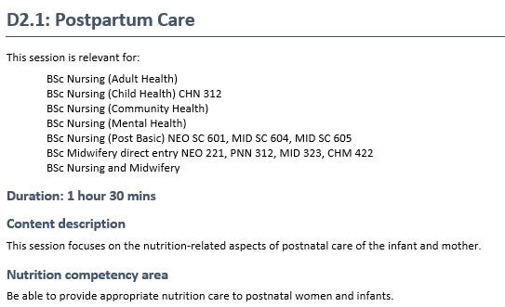
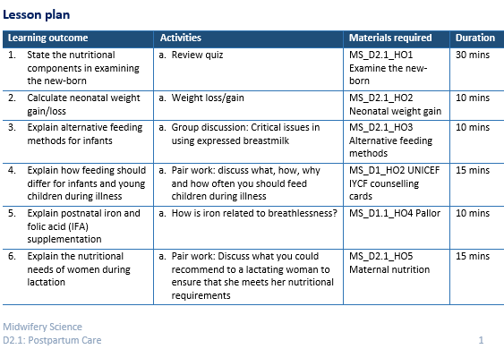
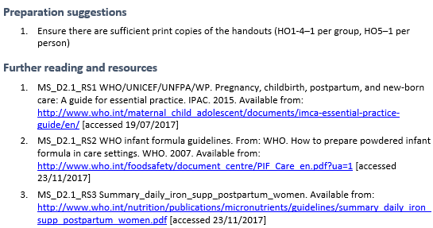
Example from Malawi: Standardized Nutrition Teaching Aids and Resources for Nursing and Midwifery Institutions

Slide 12
Review and Evaluate the Interventions (2)
Post-Intervention Evaluation
  Curricula and resources
  Trainer competence
  Students competence
Refine the Scope based on Evaluation Findings
  Teaching and curricula
  Resources and materials

Slide 13
3. Impact
The core competencies requirements for service delivery were aligned with pre-service training and job descriptions.
Curricula for nurses and midwives included nutrition clinical practice sessions that were previously not covered.
Pre-service training on nutrition was standardized and evidence based.
Tutors had a solid understanding of and skills in teaching nutrition theory and practice.

Slide 14
4. Lessons Learned
Defining core competencies provided scope for including the national policy priorities in the pre-service training curricula.
Updating pre-service training should be continuous process. This should be done alongside continuous professional development while in-service.
For sustainability of interventions, partnerships and collaboration should include the MOH at all levels, teaching institutions and the regulatory bodies.
More online training and resources are needed to help mitigate problems related the teacher-student ratio and time needed to cover the course material.

Slide 15









5. Acknowledgements

Slide 16

This presentation is made possible by the generous support of the American people through the support of the Office of Maternal and Child Health and Nutrition, Bureau for Global Health, U.S. Agency for International Development (USAID), under terms of Cooperative Agreement No. AID-OAA-A-12-00005, through the Food and Nutrition Technical Assistance III Project (FANTA), managed by FHI 360. The contents are the responsibility of FHI 360 and do not necessarily reflect the views of USAID or the United States Government.

