Slide 1
0.1
Nutrition Assessment,
Counseling, and Support (NACS)
Slides
For Training of Facility-Based Service Providers

Slide 2
0.2
Introductory Session
Nutrition Assessment,
Counseling, and Support (NACS)
0

Slide 3
COURSE STRUCTURE
0.3
Module 1. Basic Nutrition
Module 2. Nutrition Assessment and Classification
Module 3. Nutrition Education and Counseling
Module 4. Food and Water Safety and Hygiene
Module 5. Nutrition Care for Pregnant and Postpartum Women
Module 6. Nutrition Care for Infants and Young Children

Slide 4
COURSE STRUCTURE (Cont.)
0.4
Module 7. Nutrition and Antiretroviral Therapy
Module 8. Nutrition Support
Module 9. Health Facility-Community Linkages
Module 10. NACS Monitoring and Reporting
Module 11. Site Practice Visits
Module 12. NACS Action Plan

Slide 5
TRAINING METHODS
0.5
Lecture with slides
Discussion
Group work
Role-play
Demonstration
Written exercises
Site practice visit

Slide 6
LEARNING OBJECTIVES
0.6
Discuss expectations and relate them to the objectives of the course.
Take a pre-test.

Slide 7
COURSE OBJECTIVES
0.7
Advocate for and discuss the role of nutrition in care
and treatment.
Assess the nutritional status of clients.
Select appropriate nutrition care plans for clients.
Counsel clients on nutrition.
Communicate the critical nutrition actions (CNA).
Prescribe and monitor specialized food products for acutely malnourished clients.
Manage NACS services in the workplace.
Collect information to monitor and report on
NACS services.

Slide 8
1.1
Basic Nutrition
Nutrition Assessment,
Counseling, and Support (NACS)
1

Slide 9
LEARNING OBJECTIVES
1.2
Define basic nutrition terms.
Explain why nutrition is important for good health.
Describe the conditions for good nutrition.
Discuss food choices for a balanced diet.
Describe the causes and consequences
of malnutrition.
Describe the interaction between HIV and nutrition.
Explain the additional nutritional requirements of PLHIV.
List the CNA.

Slide 10
DEFINITION OF FOOD
1.3
      Food is anything edible that provides the body
      with nutrients.
      Nutrients are chemical substances in food that are released during digestion and that provide energy to maintain, repair, or build body tissues. Nutrients include macronutrients and micronutrients.
        Macronutrients include carbohydrates, protein, and fat (needed in large amounts).
        Micronutrients include vitamins and minerals (needed only in small amounts).
Notes:
10

Slide 11
DEFINITION OF NUTRITION
1.4
      Nutrition is the intake of food and drink and the chemical and physical processes that break them down and release nutrients needed for growth, reproduction, immunity, breathing, work, and health.

Slide 12
CONDITIONS FOR GOOD NUTRITION
1.5
        Ability to access and eat the right quality and quantity of food to sustain life and health
        Appetite
        Ability to chew and swallow
        Ability to digest and absorb food
        Ability to use the food for cell development and growth, reproduction, immunity, breathing, work, etc.
        Ability to store different nutrients/energy in relevant parts of the body
        Ability to excrete toxins/waste

Slide 13
DEFINITION OF MALNUTRITION
1.6
Malnutrition occurs when food intake doesn’t match the body’s needs. A malnourished person can have either undernutrition or overnutrition.
Undernutrition is the result of lack of nutrients caused by an inadequate diet and/or disease.
Overnutrition is the result of taking in more nutrients than the body needs over time.

Slide 14
TYPES OF MALNUTRITION (1)
1.7
Acute malnutrition is caused by decreased food consumption and/or illness, resulting in wasting and/or bilateral pitting oedema. Wasting is defined by low mid-upper arm circumference (MUAC), body mass index (BMI), or weight-for-height z-score (WHZ).
Chronic malnutrition is caused by prolonged or repeated episodes of undernutrition, resulting in stunting. Stunting is defined by low height-for-age z-score (HAZ).

Slide 15
TYPES OF MALNUTRITION (2)
1.8
Micronutrient deficiencies are a result of reduced micronutrient intake and/or absorption. The most common forms of micronutrient deficiencies are related to iron, vitamin A, iodine, and zinc.

Slide 16
IMPORTANCE OF NUTRITION FOR GOOD HEALTH
1.9
Good nutrition
Is essential for human survival, growth, cognitive and physical development and productivity
Strengthens the immune system to reduce morbidity and mortality
Improves adherence to and effectiveness of some medications
Builds a productive society and improves quality of life

Slide 17
FOOD GROUPS
1.10
People should eat a variety of foods from all the food groups to get all the nutrients the body needs.
Cereals, bread, pasta, roots, and tubers (carbohydrates for energy)
Meat, poultry, fish, beans, nuts, eggs, and milk products (protein for body building)
Fruits (vitamins and minerals for protection)
Vegetables (vitamins and minerals for protection)
Sugar, honey, fats, and oils (for extra energy)

Slide 18
DAILY ENERGY REQUIREMENTS
1.11
Group | Kilocalories (kcal)/day
6–11 months | 680
12–23 months | 900
2–5 years | 1,260
6–9 years | 1,650
10–14 years | 2,020
15–17 years | 2,800
≥ 18 years | 2,000–2,580
Pregnant/lactating | 2,460–2,570
Source: World Health Organization (WHO), Food and Agriculture Organization of the United Nations (FAO), and United Nations University (UNU). 2001. Human Energy Requirements: Report of a Joint WHO/FAO/UNU Expert Consultation, 17–24 October, 2001. Geneva: WHO.
Notes:
18

Slide 19
DAILY PROTEIN REQUIREMENTS
1.12
Group | Grams (g)/day
0–6 months | 9
7–11 months | 11
1–3 years | 13
4–8 years | 19
9–13 years | 34
14–18 years | 46 (girls), 52 (boys)
19–> 70 years | 46 (females), 56 (males)
Pregnant 14–50 years | 71
Lactating 14–50 years | 105
HIV positive | No additional requirement
Sources: WHO, FAO, and UNU. 2001. Human Energy Requirements: Report of a Joint WHO/FAO/UNU Expert Consultation, 17–24 October, 2001. Geneva: WHO; U.S. Department of Agriculture. 2011. Dietary Reference Intakes (DRIs): Recommended Intakes for Individuals. Washington, DC: U.S. Department of Agriculture.
Notes:
19

Slide 20
CONCEPTUAL FRAMEWORK
OF MALNUTRITION
1.13
Malnutrition
Manifestation
Inadequate food
intake
Disease
Immediate causes
Inadequate access to food
Inadequate care of children and women
Inadequate health services, unhealthy environment
Underlying causes
Inadequate education
Human, economic, and organizational resources and how they are controlled
Basic causes
Political and ideological factors
Potential resources

Slide 21
CLINICAL FEATURES OF MALNUTRITION (1)
1.14
In adults
        Weight loss
        AIDS wasting
        Anemia
In pregnant women
        Inadequate weight gain
        Anemia
        General
        Reduced lean body mass
        Metabolic disorders
        Bitot’s spots
        Skin lesions
In children
        Growth faltering
        Slower growth rate
        Weight loss
        Stunting
        Underweight
        Wasting
        Hair color change
        Bilateral pitting edema
        Anemia
Notes:
21

Slide 22
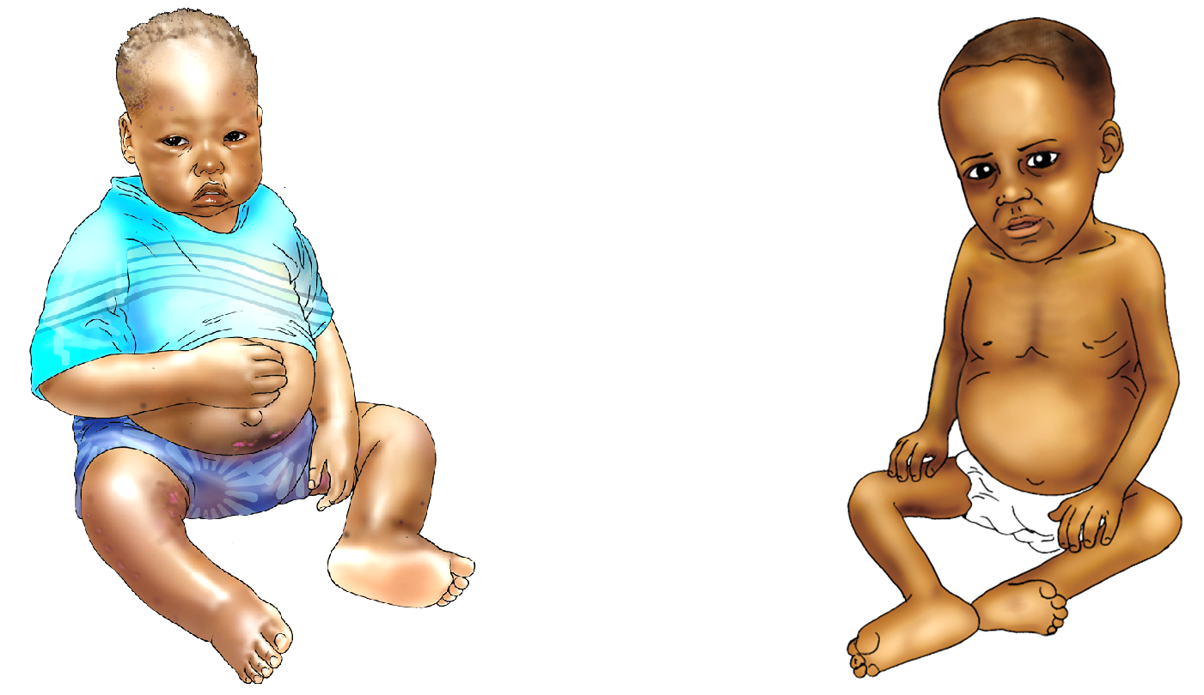
KWASHIORKOR AND MARASMUS
1.15
  Kwashiorkor Marasmus
Source: University Research Co., LLC (URC). 2009. Comprehensive Nutrition Care for People Living with HIV/AIDS: Facility-Based Health Providers Manual. Bethesda, MD: URC.

Slide 23
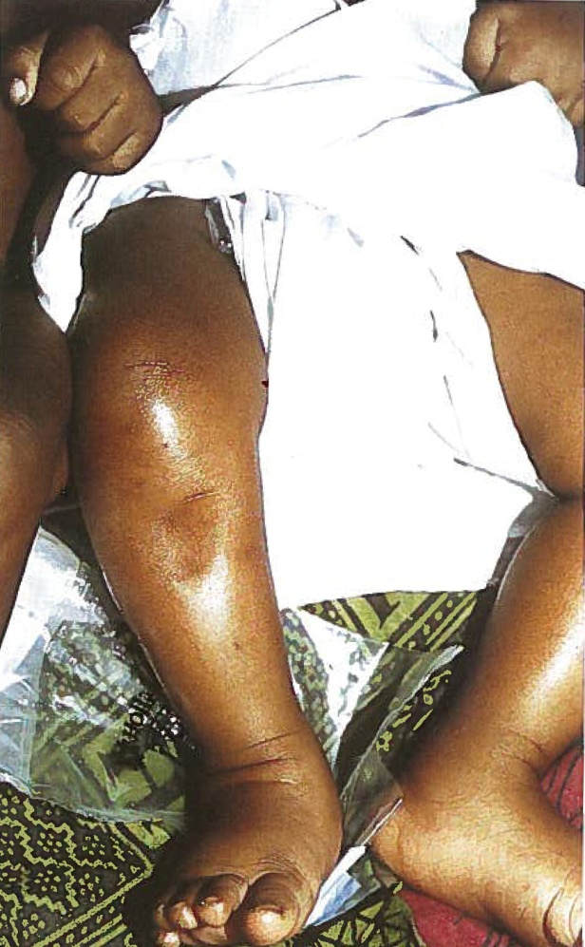
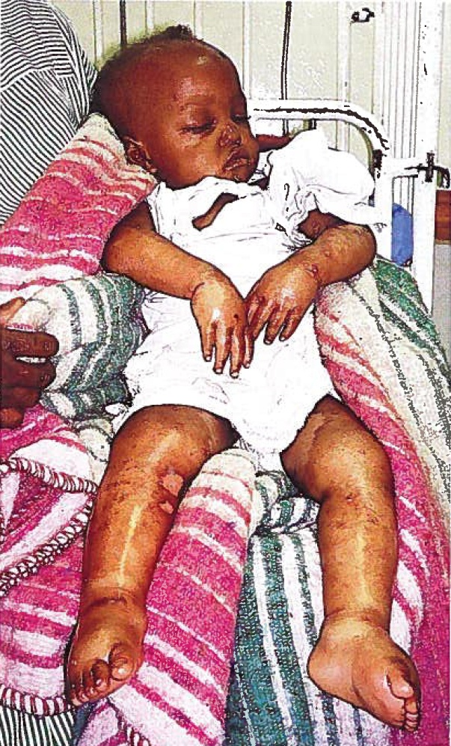
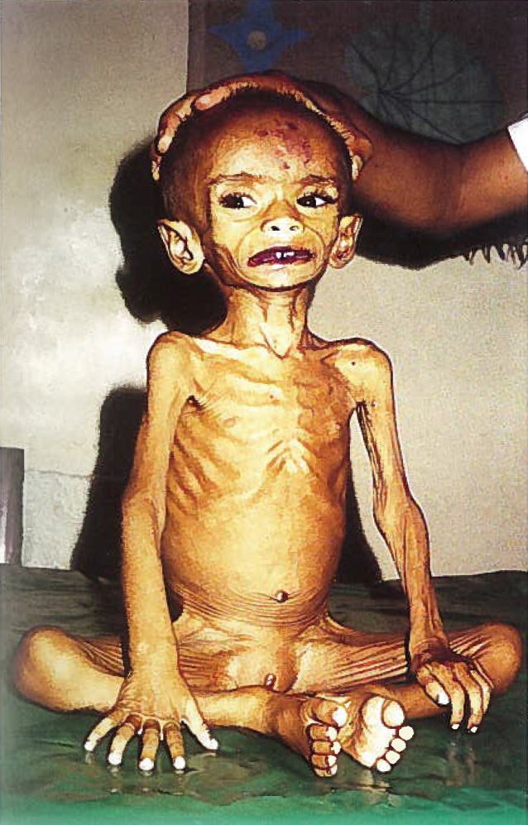
CLINICAL FEATURES OF MALNUTRITION (2)
1.16
Pitting edema in both legs (kwashiorkor)
Edema and flaking skin (kwashiorkor)
Wasting (marasmus)
Photos: WHO. 2002. Training course on the management of severe malnutrition. Geneva: WHO.

Slide 24
CONSEQUENCES OF MALNUTRITION
1.17
        Increased risk of infections
        Poor physical growth and brain development
        Weakened immunity and increased morbidity and mortality
        Faster disease progression in people with HIV and TB
        Increased risk of mother-to-child transmission of HIV
        Reduced drug effectiveness and adherence
        Increased burden of poverty and disease
        Decreased educational and economic prospects
        Increased health and education costs
        Increased risk of chronic diseases (e.g., type 2 diabetes from overnutrition)
Notes:
24

Slide 25
VICIOUS CYCLE OF MALNUTRITION AND INFECTION
1.18
Poor nutritional status
Weight loss, growth faltering, muscle wasting, micronutrient deficiencies
Impaired appetite and digestion
Increased nutrient needs because of nutrient loss and malabsorption
Weakened immune system
Poor ability to resist and fight infections
Infection
Increased vulnerability to infection, more frequent, severe, and longer-lasting infections
Source: Adapted from Food and Agriculture Organization of the United Nations (FAO). 2002. Living Well with HIV/AIDS: A Manual on Nutritional Care and Support for People Living with HIV/AIDS. Rome.
Notes:
25

Slide 26
GOOD NUTRITION AND INFECTION
1.19
Good nutritional status
Weight maintained, no deficiencies
Nutritional needs met
Ability to manage symptoms and medication side effects
Stronger
immune system to fight infections
Nutrition interventions
Reduced vulnerability to infections
Fewer infections and shorter duration of infections
Source: Adapted from Food and Agriculture Organization of the United Nations (FAO). 2002. Living Well with HIV/AIDS: A Manual on Nutritional Care and Support for People Living with HIV/AIDS. Rome.

Slide 27
ENERGY REQUIREMENTS OF PLHIV
1.20
HIV-infected adult in early/asymptomatic stage:
10% more energy
HIV-infected adult in late/symptomatic stage:
20% more energy
HIV-infected child
  Asymptomatic: 10% more energy
  Symptomatic: 20%–30% more energy
  Losing weight or acutely malnourished:
  50%–100% more energy
  Source: WHO. 2003. Nutrient Requirements of People Living with HIV/AIDS: Report of a Technical Consultation, Geneva, 13–15 May 2003. Geneva: WHO.
Notes:
27

Slide 28
NUTRIENT REQUIREMENTS
OF PLHIV
1.21
Protein: As for HIV-negative people, 12%–15% of energy intake, 50–80 g/day or 1 g/kg of ideal weight
Fat: As for HIV-negative people, no more than 35% of total energy needs, but people on ART or with persistent diarrhea might need to eat less fat
Micronutrients: As for HIV-negative people, 1 Recommended Dietary Allowance [RDA] through diet. If diet is insufficient, HIV-positive children and pregnant/postpartum women might need multiple micronutrient supplements
  Source: WHO. 2003. Nutrient Requirements of People Living with HIV/AIDS: Report of a Technical Consultation, Geneva, 13–15 May 2003. Geneva: WHO.
Notes:
28

Slide 29
NUTRITION AND TB
1.22
        TB reduces appetite and increases energy expenditure,
        causing wasting.
        Underweight people are at risk of developing active TB.
        Poor nutritional status may speed up progression from TB infection to active TB.
        Protein loss in TB patients can cause nutrient malabsorption.
        Increased energy expenditure and tissue breakdown increase micronutrient needs in people with TB.
        Poor appetite makes it difficult to eat enough to meet the increased micronutrient needs required with TB.

Slide 30
HIV-TB CO-INFECTION
1.23
        In southern Africa, people without HIV have a 10% risk of TB over a lifetime. PLHIV have a 10% risk over a year.
        PLHIV are more vulnerable to TB, and it is more difficult to treat TB in PLHIV.
        HIV increases the risks of TB infection, latent TB becoming active, and relapse after treatment.
        PLHIV are up to 50 times more likely to develop active TB than people without HIV.
        30% of PLHIV with TB die within 1 year of diagnosis and initial treatment.
        TB speeds HIV progression and increases mortality.

Slide 31
PREVENTING AND MANAGING MALNUTRITION (1)
1.24
Food
        Eating a balanced diet using a variety of local foods
        Optimal feeding of vulnerable groups
        Food modification (e.g., fermenting, germinating)
        Food fortification (adding micronutrients to foods)
        Improved household food production
        Economic strengthening support to improve food security
        Food support
        Improved institutional feeding
Notes:
31

Slide 32
PREVENTING AND MANAGING MALNUTRITION (2)
1.25
Health services
        Integration of nutrition into routine health services
        Micronutrient supplementation
        Treating malnutrition with specialized food products
        Deworming
        Growth monitoring and promotion
Behavior change
        Nutrition counseling and education
Notes:
32

Slide 33
CRITICAL NUTRITION ACTIONS
1.26
Get weighed regularly and have weight recorded.
Eat a variety of foods and eat more nutritious foods.
Drink plenty of boiled or treated water.
Avoid practices that can lead to infection and poor nutrition.
Maintain good hygiene and sanitation.
Get exercise as often as possible.
Get infections treated early.
Take all medications as directed by your doctor.
Manage symptoms and medication side effects through diet.
Attend scheduled follow-up visits.
Notes:
33

Slide 34
NUTRITION SERVICES IN HEALTH CARE FACILITIES
1.27
        Nutrition assessment
        Nutrition counseling and education
        Demonstration of how to prepare nutritious food
        Prescription of specialized food products for acutely malnourished clients
        Micronutrient supplementation
        Deworming
        Referral to community economic strengthening, livelihood, and food security services
Notes:
34

Slide 35
2.1
Nutrition Assessment
Nutrition Assessment,
Counseling, and Support (NACS)
2

Slide 36
LEARNING OBJECTIVES
2.2
Explain the importance of nutrition assessment.
Take and interpret anthropometric measurements accurately.
Do simple clinical and dietary assessment.
4. Explain the importance of biochemical assessment.
Classify nutritional status correctly based on assessment.
Explain the importance of recording client nutrition information.

Slide 37
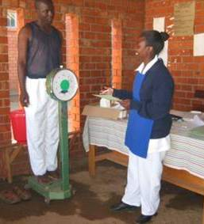
IMPORTANCE OF
NUTRITION ASSESSMENT
2.3
        Identifies people at risk of undernutrition for action before they become severely malnourished
        Measures changes in nutritional status to monitor progress
        Determines what interventions clients need
        Identifies needs for nutrition counseling
Photo: Wendy Hammond
Notes:
37

Slide 38
TYPES OF NUTRITION ASSESSMENT
2.4
        Anthropometric
        Biochemical
        Clinical
        Dietary
Notes:
38

Slide 39
CLASSIFICATIONS OF
NUTRITIONAL STATUS
2.5
        SAM with medical complications or no appetite
        SAM with appetite and no medical complications
        MAM for children under 5
        Moderate malnutrition for older children, adolescents, and adults
        Normal nutritional status
        Overweight
        Obesity
Notes:
39

Slide 40
ANTHROPOMETRY
2.6
Measurement of the size, weight, and proportions of the human body

Slide 41
TYPES OF ANTHROPOMETRIC MEASUREMENT
2.7
        Head circumference
        Weight
        Height
        Mid-upper arm circumference (MUAC)
        Body mass index (BMI)
Measurements presented as indexes
        BMI-for-age
        Weight-for-age z-score (WAZ)
        Height-for-age z-score (HAZ)

Slide 42
WEIGHT-FOR-HEIGHT
2.8
        Used to assess nutritional status in children from birth to 59 months of age
        Measured against WHO growth standards
        Written as a z-score

Slide 43
Z-SCORES
2.9
Undernutrition
Overnutrition

Slide 44
WHZ CUTOFFS
2.10
< –3 | ≥ –3 to < –2 | ≥ –2 to ≤ +2 | > +2 to ≤ +3 | > +3
SAM | MAM | Normal nutritional status | Overweight | Obesity
Undernutrition |  |  | Overnutrition

Slide 45
BODY MASS INDEX (BMI)
2.11
        A reliable indicator of body fatness in adults
        Calculated as weight (kg)
        height (m)²
        Not accurate in pregnant women; women up to 6 months postpartum; or adults with edema, whose weight gain is not linked to nutritional status. For these groups, use MUAC.

Slide 46
BMI-FOR-AGE
2.12
        Can be used to find nutritional status for children and adolescents 5–18 years of age
< –3 | ≥ –3 to < –2 | ≥ –2 to ≤ +1 | > +1 to ≤ +2 | > +2
SAM | MAM | Normal nutritional status | Overweight | Obesity

Slide 47
BIOCHEMICAL TESTS USED IN NUTRITION ASSESSMENT
2.13
        Serum protein (albumin level, various enzymes)
        Blood-forming nutrients (iron, folic acid, vitamins B6 and B12)
        Water-soluble vitamins (B6 and B12, C, folacin, niacin, riboflavin, thiamine)
        Fat-soluble vitamins (A, D, E, and K)
        Minerals (calcium, chloride, iodine, iron, potassium, sodium)
        Blood lipids (cholesterol, triglycerides)
        Carbohydrates (fructose, glucose)

Slide 48
CLINICAL NUTRITION ASSESSMENT
2.14
        Check for signs of malnutrition.
        Check for medical complications.
        Check for growth/weight changes.
        Find out what medications the client is taking.

Slide 49
SIGNS OF MALNUTRITION
2.15
        Bilateral pitting edema
        In children, baggy skin on buttocks
        Hair color changes
        Skin lesions
        Mouth sores or thrush
        Dry, flaky skin

Slide 50
MEDICAL COMPLICATIONS
2.16
        Bilateral pitting edema grade +++
        High fever (> 39º C)
        Persistent diarrhea, nausea, or vomiting
        Lethargy or unconsciousness
        Hypothermia
        Hypoglycemia
        Convulsions
        Severe anemia
        Severe dehydration
        Rapid breathing/chest in-drawing
        Extensive skin lesions
        Opportunistic infections (OIs)

Slide 51
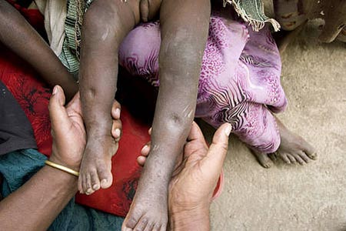
BILATERAL PITTING EDEMA
2.17
Photo: Save the Children/United Kingdom
Photo: Nicky Dent
Notes:
51

Slide 52
CRITERIA FOR INPATIENT TREATMENT OF SAM
2.18
        Bilateral pitting edema grade +++
OR SAM WITH ANY OF THE FOLLOWING:
        Medical complications
        No appetite (failed an appetite test)
        In outpatient care for 2 months and no weight gain or weight loss or worsening edema
        Inability of caregiver to provide home care
        Inability of caregiver to return in 1 week for follow-up
Notes:
52

Slide 53
CRITERIA FOR OUTPATIENT TREATMENT OF SAM
2.19
        Bilateral pitting edema grade + or ++
OR SAM WITH ALL OF THE FOLLOWING:
        Appetite (passed an appetite test)
        Clinical wellness and alertness
        No medical complications
        Caregiver willing and able to provide home care
        Caregiver ability to return for follow-up
        Enough RUTF supply in stock
Notes:
53

Slide 54
FACTORS THAT AFFECT FOOD INTAKE
2.20
Food access
Food availability
Symptoms
Medications
Smoking
Alcohol
Drug abuse
Food taboos
Stigma
Depression
Preparation time
Fuel
Family support

Slide 55
3.1
Nutrition Education and Counseling
Nutrition Assessment,
Counseling, and Support (NACS)
3

Slide 56
LEARNING OBJECTIVES
3.2
Define counseling.
Demonstrate communication skills needed for effective counseling.
Counsel clients on maintaining a healthy weight.
Counsel clients on managing symptoms through diet.

Slide 57
PRINCIPLES OF NUTRITION EDUCATION
3.3
        Choose topics that are timely and relevant to most of the audience.
        Focus on one topic at a time.
        Use language that everyone can understand.
        Invite questions and comments.
        Use pictures and demonstrations if possible.
        Limit talks to 15 minutes.

Slide 58
CRITICAL NUTRITION ACTIONS
3.4
Get weighed regularly and have weight recorded.
Eat a variety of foods and eat more nutritious foods.
Drink plenty of boiled or treated water.
Avoid practices that can lead to infection and poor nutrition.
Maintain good hygiene and sanitation.
Get exercise as often as possible.
Get infections treated early.
Take all medications as directed by your doctor.
Manage symptoms and medication side effects through diet.
Attend scheduled follow-up visits.
Notes:
58

Slide 59
WHAT IS COUNSELING?
3.5
        It is not the same as giving advice, which is directive.
        It is not the same as education, which is conveying information from an expert to a group of people.
        Counseling is an interactive, collaborative process between a client and a trained counselor.
Notes:
59

Slide 60
A COUNSELOR . . .
3.6
          Does not make judgments
          Does more listening than talking
          Helps someone make an informed decision to solve a problem
          Recognizes a client as an equal partner in making changes
          Makes suggestions based on a client’s personal circumstances, needs, desires, and constraints
          Respects a client’s thoughts, ideas, and concerns
Notes:
60

Slide 61
WHAT INFLUENCES BEHAVIOR?
3.7
          Beliefs, opinions, and needs
          Personal habits and preferences
          Family pressure
          Financial constraints
          Gender expectations
          Culture, the media, and social status
          Health status
          Perceived risk in making a change
Notes:
61

Slide 62
COUNSELING SKILLS
3.8
          Greet the client.
          Listen while the client is talking.
          Try to understand the problem from the client’s point of view, not YOUR point of view.
          Ask questions that require more than a “yes” or “no” answer to find out more information.
          Reflect back what the client says.
          Avoid judging the client.
          Negotiate a simple, doable action to try.
Notes:
62

Slide 63
KEEP IN MIND WHEN COUNSELING:
3.9
The client’s problem or need
The desired behavior
Barriers to the desired behavior
Encouragement a client needs to adopt the desired behavior
Notes:
63

Slide 64
4.1
Food and Water Safety and Hygiene
Nutrition Assessment,
Counseling, and Support (NACS)
4

Slide 65
LEARNING OBJECTIVES
4.2
Describe how infections from unsafe food and water contribute to malnutrition.
Explain how to make food and water safe.
Counsel clients on food and water safety and hygiene.

Slide 66
WHERE DO GERMS LIVE?
4.3
        In human and animal feces
        In soil (1 teaspoon of soil contains more than 1 billion germs)
        On all living things
        In contaminated food and water

Slide 67
IMPORTANCE OF SAFE FOOD AND WATER FOR PLHIV
4.4
        PLHIV have weak immune systems that cannot fight germs easily.
        They get more severe symptoms of illness and have a hard time recovering.
        Food- and water-borne infections can reduce appetite and nutrient absorption, causing weight loss.
Notes:
67

Slide 68
HYGIENE AND SANITATION
4.5
        Hygiene is keeping the body clean to maintain health and prevent disease.
        Sanitation is keeping the environment (including food and water) healthy to prevent human contact with waste and microorganisms that cause disease.

Slide 69
KEEPING FOOD AND WATER SAFE
4.6
        Keep food safe by preparing, cooking, and storing food properly to prevent contamination and food-borne illness.
        Keep water safe by treating and storing water properly to prevent contamination and water-borne illness.

Slide 70
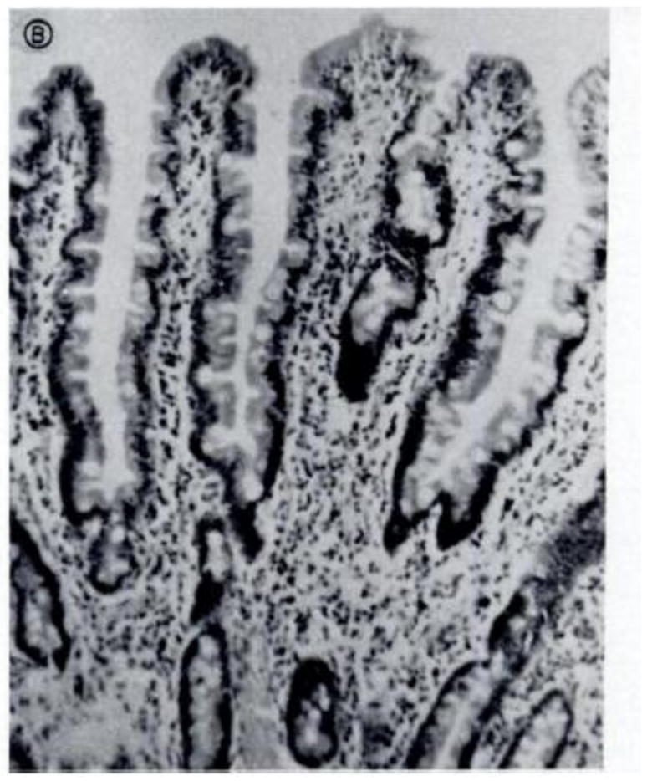
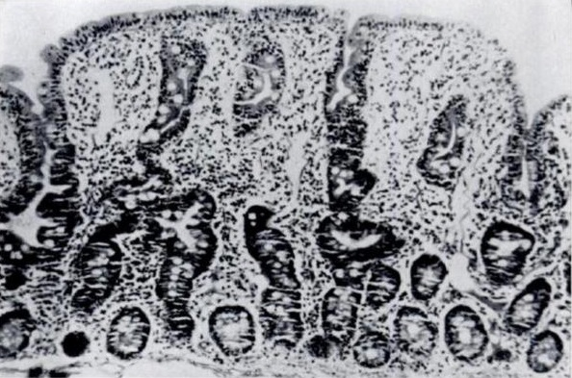
ENVIRONMENTAL ENTEROPATHY
4.7
Normal intestine
Intestine of a malnourished adult
Source: Korpe, P.S. and Petri, W.S. 2012. “Environmental Enteropathy: Critical Implications of a Poorly Understood Condition.” Trends in Molecular Medicine 18(6): 328–36.

Slide 71
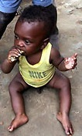

FECAL DISEASE TRANSMISSION TO BABIES
4.8
Fluids (water, laundry)
Photo: http://www.intercare.org.uk/
Fingers
Feces
Food
Flies
Floors
Fields
Photo: http://www.Bizjournals.com
Notes:
71

Slide 72
GROUP WORK
4.9
Group 1: Wash hands correctly.
Group 2: Keep surroundings clean.
Group 3: Boil, filter, or chlorinate water for drinking and food preparation.
Group 4: Separate raw and cooked foods.
Group 5: Cook food thoroughly.
Group 6: Store food safely.

Slide 73
5.1
Nutrition Care for Pregnant and Postpartum Women
Nutrition Assessment,
Counseling, and Support (NACS)
5

Slide 74
LEARNING OBJECTIVES
5.2
Explain nutrition requirements during pregnancy and lactation.
Counsel pregnant and postpartum women on nutrition.

Slide 75
ENERGY NEEDS IN PREGNANCY AND LACTATION
5.3
        To meet demands for good fetal growth and development and milk production:
        200–285 extra kcal/day (based on activity level) if pregnant
        500 extra kcal/day if lactating
        Plus 10% if HIV positive and asymptomatic
        Plus 20–30% if HIV positive and symptomatic
Notes:
75

Slide 76
PROTEIN NEEDS IN PREGNANCY
5.4
        About 70 g per day, equivalent to two glasses of milk, 140 g of chicken, and two cups of yogurt
        Protein-rich foods: Pulses (chickpeas, lentils, beans), oil seeds (pumpkin, sunflower, melon), and animal-source foods (meat, fish, eggs, milk)
        Animal-source food provides more bio-available protein than plant-source food.

Slide 77
ANEMIA
5.5
        50% caused by iron deficiency
        Low Hb concentration in blood reduces the oxygen-carrying capacity of red blood cells.
    < 11.0 g/dl in children 6–59 months old
    < 11.5 g/dl in children 5–11 years old
    < 12.0 g/dl in children 12–14 years old
    < 11.0 g/dl in pregnant women
    < 12.0 g/dl in non-pregnant women
    < 13.0 g/dl in men

Slide 78
ANEMIA SIGNS AND SYMPTOMS
5.6
        Pale conjunctiva, gums, nails, and skin
        Breathlessness
        Rapid pulse
        Palpitations
        Headaches
        Edema
        Fatigue, weakness, dizziness, and drowsiness

Slide 79
ANEMIA PREVENTION
5.7
        Take iron or iron/folate supplements.
        Sleep under insecticide-treated nets and take antimalarials.
        Wear shoes and dispose of feces safely.
        Get dewormed in the second trimester of pregnancy and every 6 months if not pregnant.
        Space births 18 months or more apart.
        Eat iron-rich foods and vitamin C-rich foods to help absorb iron.
        Avoid drinking tea and coffee with meals, as both reduce iron absorption.

Slide 80
NUTRITION ACTIONS DURING PREGNANCY AND LACTATION
5.8
        Rest more, especially in the third trimester.
        Eat a variety of foods, especially foods rich in protein and micronutrients such as iron and vitamin C.
        Take iron/folic acid supplements.
        Use iodized salt.
        Maintain food and water safety and hygiene.
        Prevent and get prompt treatment for malaria.
        Get dewormed.
Notes:
80

Slide 81
6.1
Nutrition Care for Infants and Young Children
Nutrition Assessment,
Counseling, and Support (NACS)
6

Slide 82
LEARNING OBJECTIVES
6.2
Explain the causes and consequences of stunting.
Describe how HIV can be transmitted from mother to child.
Describe the risks and benefits of different infant feeding practices.
Counsel pregnant women and mothers on exclusive breastfeeding and complementary feeding.
Counsel caregivers on feeding children over 6 months old.

Slide 83
STUNTING PREVALENCE IN _________ [country]
6.3
                __ % moderate stunting
                (height-for-age z-score –3 to < –2)
                __% severe stunting
                (height-for-age z-score < –3)
Notes:
83

Slide 84
CAUSES OF STUNTING
6.4
Household and family factors |  | Poor infant feeding practices | Infection
Poor maternal nutrition Adolescent pregnancy Preterm birth Infection Hypertension | Poor sanitation Contaminated food and water Unsafe food storage and preparation Inadequate child stimulation Food insecurity Unequal household food distribution of | Delayed initiation of breastfeeding Mixed feeding (feeding infants < 6 months old other foods and liquids + breast milk) Early weaning Poor dietary diversity Low energy content of complementary foods Low intake of animal-source foods Inadequate feeding during and after illness | Diarrhea Parasites Respiratory infections Malaria Reduced appetite

Slide 85
EXCLUSIVE BREASTFEEDING
6.5
Initiate breastfeeding within 1 hour of birth and feed the baby colostrum.
Position and attach the baby properly to the breast.
Breastfeed on demand, day and night.
Get treated immediately for breast problems.
Feed breast milk ONLY, no other liquids or foods.
Breastfeed exclusively for 6 months and continue breastfeeding for 2 years or longer.

Slide 86
RISK OF MOTHER-TO-CHILD TRANSMISSION OF HIV
6.6
        Without any interventions: 15%–45%
        With interventions: < 5%
Notes:
86

Slide 87
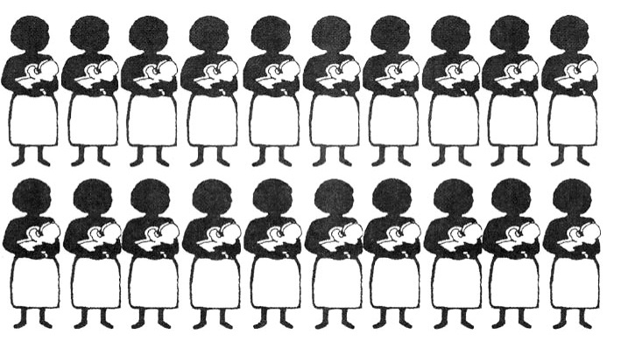
RISK OF TRANSMITTING HIV FROM MOTHER TO CHILD
6.7
Notes:
87

Slide 88
INFANT FEEDING FOR
HIV-POSITIVE MOTHERS
6.8
        [Summarize the national policy recommendations.]
Notes:
88

Slide 89
RISK FACTORS FOR MOTHER-TO-CHILD TRANSMISSION OF HIV
6.9
        Breast infections
        Non-adherence to ARVs
        Mixed feeding
        Opportunistic infections in the mother
        Rapid weaning
Notes:
89

Slide 90
COMPLEMENTARY FEEDING
6.10
As children get older:
F More frequent feeding
A Increased amount of food
D Increased density of foods (more solid foods, foods from all food groups)
U Use of food (increased variety, good hygiene and safe food preparation)
A Active feeding

Slide 91
7.1
Nutrition and Antiretroviral Therapy
Nutrition Assessment,
Counseling, and Support (NACS)
7

Slide 92
LEARNING OBJECTIVES
7.2
        Describe the interaction between ARVs and food and the effects of ARVs on nutrition.
        Counsel PLHIV on managing drug side effects and drug-food interactions through diet.

Slide 93
ART AND NUTRITION
7.3
        Some ARVs have to be taken without food, and others have to be taken with food.
        Some ARVs affect nutrient availability, absorption, and utilization.
        Some foods reduce the effectiveness of ARVs.
        ART can change the way the body uses fat, protein, and energy, and can cause changes in body composition (lipodystrophy, fat redistribution).
Notes:
93

Slide 94
DRUG ADHERENCE
7.4
        Drugs are prescribed in doses proven to be most effective in treating diseases.
        They are not effective if not taken as directed.
        HIV can become resistant to ARVs if doses are missed. This means stronger drugs will be needed, possibly with stronger side effects. There is a limited number of ARVs available.
Notes:
94

Slide 95
DRUG-FOOD PLANS
7.5
        Guide clients on how to mix drugs and food to minimize side effects and maximize drug effectiveness.
        Explain the dosage and possible side effects of drugs.
        Help clients take drugs correctly.
Notes:
95

Slide 96
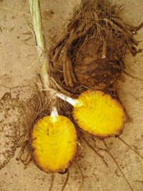

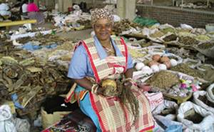
FALSE ADVERTISING OF HIV CURES
7.6
Nutrition supplements sold as HIV treatment
Photo: wb3.indo-work.com
Photo: positivenation.co.uk
False claims that a compound called Rooperol in the African potato can fight HIV
Photo: napwa.org.au
Notes:
96

Slide 97
8.1
Nutrition Support
Nutrition Assessment,
Counseling, and Support (NACS)
8

Slide 98
LEARNING OBJECTIVES
8.2
Describe the purpose and types of specialized food products.
List the entry and exit criteria for receiving specialized food products.
Prescribe, store, record, and report on NACS commodities.

Slide 99
COMPONENTS OF NACS
8.3
        Nutrition assessment
        Nutrition education and counseling
        Nutrition support (specialized food products for malnourished clients, micronutrient supplements, point-of-use water purification, referral to economic strengthening support)

Slide 100

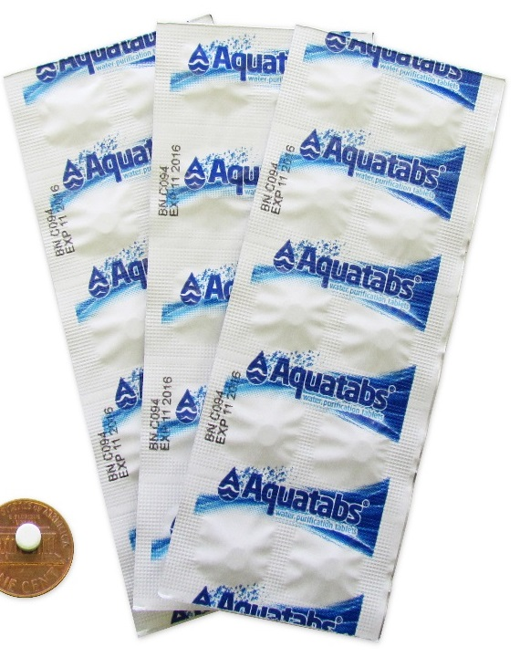

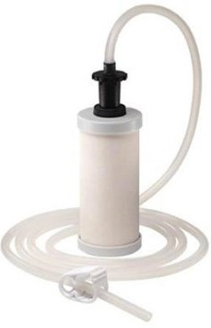
POINT-OF-USE WATER PURIFICATION PRODUCTS
8.4
Water purification tablets
Floculant/disinfectant mixture
Siphon filter
Chlorine solution
Notes:
100

Slide 101
SPECIALIZED FOOD PRODUCTS
8.5
        Nutritionally dense, fortified products to treat acute malnutrition
        Prescribed as medicine in health facilities based on clear enrollment and exit criteria and only for a limited time
        Individual rations for malnourished clients
        Not to be shared with family members

Slide 102
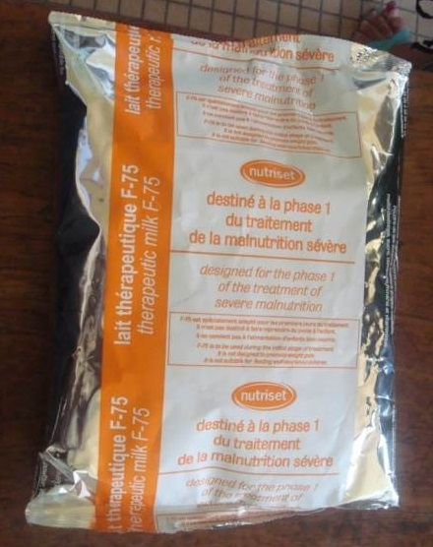
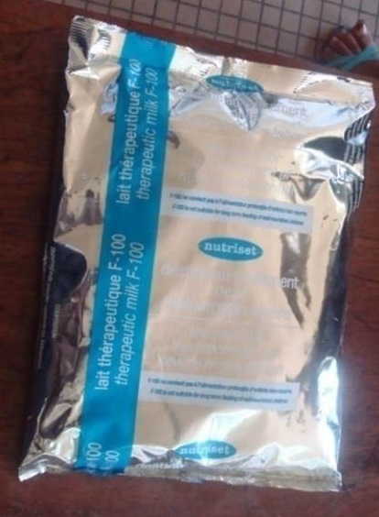
TYPES OF SPECIALIZED FOOD PRODUCTS
8.6
        Therapeutic milks for inpatient treatment of SAM (must be mixed with water)

Slide 103
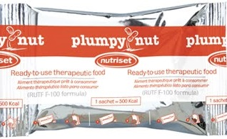


TYPES OF SPECIALIZED FOOD PRODUCTS, cont.
8.7
        RUTF for inpatient and outpatient treatment of SAM
        RUSF and FBF for outpatient treatment of moderate malnutrition

Slide 104
WARNING: SPECIALIZED FOOD PRODUCTS AND BABIES
8.8
        Do NOT give specialized food products (except for F-75 and F-100) or supplementary foods to babies under 6 months of age.
        They are NOT appropriate or nutritionally adequate for small babies.
Notes:
104

Slide 105
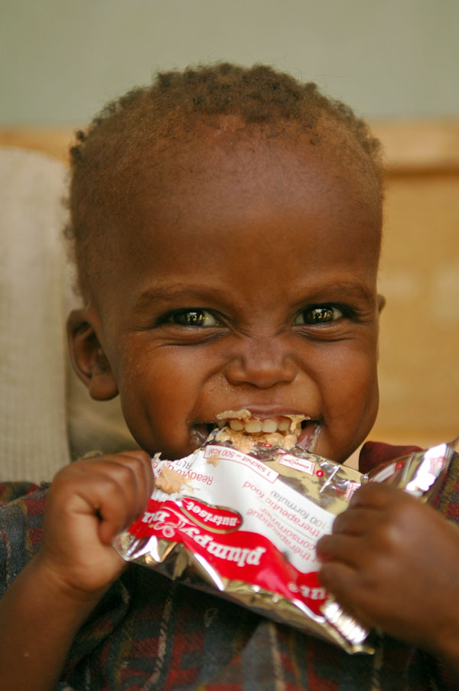
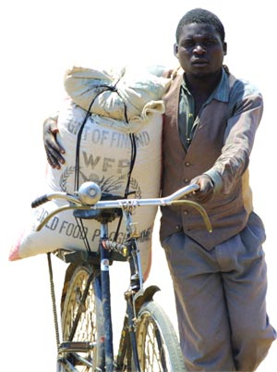
SPECIALIZED FOOD PRODUCTS
VS. FOOD SUPPORT
8.9
        Specialized food products are prescribed as medicine to treat acute malnutrition in malnourished people identified through nutrition, health, or vulnerability assessments.
Photo: Julie Pudlowski
        Food support aims to improve household food security by giving rations, often of staple foods.
Photo: WFP

Slide 106
NACS SUPPLY CHAIN MANAGEMENT
8.10
        Procurement, transport, storage, and distribution of commodities, including specialized food products
        To ensure availability of commodities when needed, avoid expired commodities and minimize wastage
SUPPLIER
WAREHOUSE
HEALTH FACILITIES
CLIENTS
Notes:
106

Slide 107
STORING SPECIALIZED FOOD PRODUCTS
8.11
        Store products in a well-lit, ventilated room; protect from dampness and pests.
        Store them away from chemicals, insecticides, and other supplies.
        Store them away from direct sunlight.
        Keep them on pallets at least 10 cm off the floor and at least 30 cm away from the walls.
Notes:
107

Slide 108
STORING SPECIALIZED FOOD PRODUCTS (cont.)
8.12
        Store packets with arrows pointing up and expiry date and product name clearly visible.
        Limit access to authorized people.
        Use FIFO (first in/expired, first out): Put new stock behind existing stock and never use expired products.
        Separate damaged/expired items for disposal.
Notes:
108

Slide 109
9.1
Health Facility-Community Linkages
Nutrition Assessment,
Counseling, and Support (NACS)
9

Slide 110
LEARNING OBJECTIVES
9.2
Explain the importance of following up with malnourished clients to ensure that they recover from malnutrition and are not lost to follow-up.
Refer clients to medical or community support services.
Receive clients needing medical care referred from the community.

Slide 111
CONTINUUM OF CARE
9.3
Comprehensive care from the health facility to the home to link:
          Prevention
          Treatment
          Follow-up

Slide 112
COMMUNITY NUTRITION INTERVENTIONS
9.4
          Check people for bilateral pitting edema.
          Show people how to make nutritious meals and how to make food and water safe.
          Counsel people on IYCF and eating a balanced diet.
          Counsel people on managing symptoms and drug side effects through diet, taking medicines as prescribed, and attending follow-up visits.

Slide 113
COMMUNITY CASE-FINDING
9.5
          Growth monitoring and measuring MUAC to find malnourished people in the community
          Referring them to health facilities for treatment before they become so malnourished that they need expensive inpatient care

Slide 114
HOME-BASED CARE
9.6
          Care and support outside the hospital for people with prolonged illness and for their families as part of the continuum of care

Slide 115
FOOD SECURITY
9.7
        Always having enough safe and nutritious food for an active and healthy life:
          Enough nutritious food is available.
          People have enough money to buy or grow nutritious food.
          People can use the nutrients in food (good care and feeding, safe food preparation and storage, a balanced diet, fair distribution of food to all people in the household).
          There are no droughts, floods, or political instability that could cause food scarcity or high prices.

Slide 116
GOVERNMENT OR COMMUNITY SERVICES AND SUPPORT
9.8
        Inpatient SAM treatment
        Government grants
        Food support
        Income-generating activities
        Savings and lending groups
        Agriculture tools and seeds
        Microcredit
        Training
        Cash or food for work
        HIV counseling and testing
        Psychosocial counseling
        PLHIV support groups
        Home visits

Slide 117
10.1
NACS Monitoring and Reporting
Nutrition Assessment,
Counseling, and Support (NACS)
10

Slide 118
LEARNING OBJECTIVES
10.2
Explain the purpose of collecting NACS data.
Understand NACS indicators.
Complete NACS data collection and reporting forms accurately.
Interpret nutrition data.
Explain the requirements for quality NACS services.

Slide 119
PURPOSE OF COLLECTING
NACS DATA
10.3
        To determine needed treatment
        To evaluate client progress
        To report on work done
        To monitor stocks
        To inform other services of client needs
        To improve services
        To inform resource allocation

Slide 120
CHALLENGES IN COLLECTING AND REPORTING NACS DATA
10.4
Time/workload
Poor data that are useless for decision making
Unclear responsibility
Lack of standard tools
No feedback from higher levels
Clients registered in more than one facility
Clients lost to follow-up or defaulting

Slide 121
WAYS TO ADDRESS NACS DATA CHALLENGES
10.5
Time/workload: Task shifting, practice
Poor data: Accurate data
Unclear responsibility: Allocate and share
Lack of tools: Request from programs or MOH
No feedback: Ask the in-charge to coordinate with the MOH for feedback on reports
Clients registered in more than one facility: Write client ID numbers on all forms
Loss to follow-up/defaulting: Have community volunteers track clients

Slide 122



WHAT IS AN INDICATOR?
10.6
To “indicate” means “to show.”
An indicator is something that points to or shows something.
It’s a way to measure change or progress toward a goal.
It’s a way to say “how much,” “how many,” “how large,” or “to what extent.”

Slide 123
SAMPLE NACS INDICATORS
10.7
        # and % of clients who received nutrition assessment
        # and % of clients who received nutrition counseling
        # and % of malnourished clients
        # and % of clinically malnourished clients who received specialized food products
        # of health care providers trained in NACS

Slide 124
11.1
Site Practice Visit
Nutrition Assessment,
Counseling, and Support (NACS)
11

Slide 125
LEARNING OBJECTIVES
11.2
Assess and classify the nutritional status of actual clients.
Counsel clients on improving their nutritional status, if appropriate.
Complete NACS data collection forms.
Discuss the experience and identify challenges and opportunities.

Slide 126
12.1
NACS Action Plans
Nutrition Assessment,
Counseling, and Support (NACS)
12

Slide 127
LEARNING OBJECTIVES
12.2
Describe national expectations regarding NACS implementation and reporting.
Make action plans to integrate NACS into or strengthen NACS in routine health services in the workplace.

Slide 128
SMART OBJECTIVES
12.3
Specific: What area will be improved?
Measurable: How much will be achieved?
Assignable: Who will do it?
Realistic: What result(s) can be achieved with available resources?
Time-bound: When will the result(s) be achieved?

