Slide 1
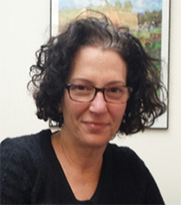
Elizabeth Marino-Costello
MS, RD, FADA
Senior Program Manager,
Academic & Career Advisor, Graduate Science Programs.
Feed the Future Nutrition Innovation Lab at the Friedman School of Nutrition Science and Policy, Tufts University

Slide 2
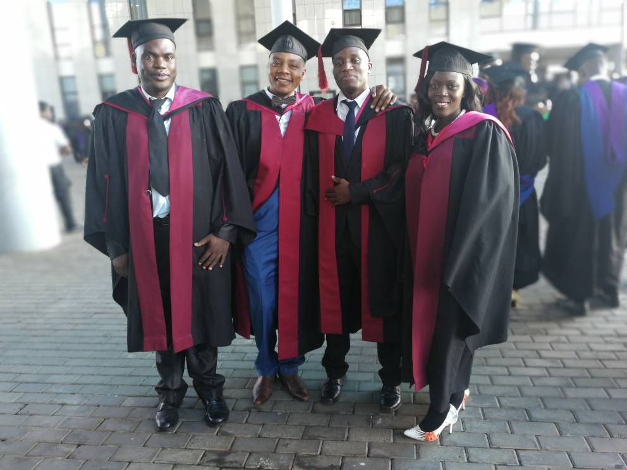
Nutrition Capacity Development to Meet National Priorities
Elizabeth Marino-Costello, MS.RD, FAND
Senior Program Manager, Tufts University
Photo Credit: LUANAR
Notes:
Very first registered dietitians in Malawi as of March 2018. Capped by the President of Malawi and many other supporters in attendance. Pleased to say that Malawi is one of 4 countries in Africa that has a dietetics program. But, how did we get to this point?

Slide 3
Nutrition Capacity Development to Meet National Priorities
Elizabeth Marino-Costello, MS.RD, FAND
Senior Program Manager, Tufts University
Photo Credit: LUANAR
Notes:
Very first registered dietitians in Malawi as of March 2018. Capped by the President of Malawi and many other supporters in attendance. Pleased to say that Malawi is one of 4 countries in Africa that has a dietetics program. But, how did we get to this point?

Slide 4
U.S. Government Partners
Notes:
Highlight the role core implementing partners LUANAR, Tufts and College of Medicine
Highlight the role of MoH who have been very supportive and have given assurance that our graduates will be employed in clinical services
and other key stakeholders that include Baylor College of Medicine, Fanta FHI 360, Blantyre Adventist Hospital, SANE who have supported by precepting students and hosting them in rotations

Slide 5
AGENDA
Tufts University Nutrition Innovation Lab-Malawi Connection
Registered Dietitian (RD)-Value Added
Process to Registered Dietitian Graduation
The Medical Science Behind the RD Training
First Year Impact in Malawi
Notes:
How is Tufts involved in these activities with Malawi government
Definition and scope of work of the dietitian- why is this a big deal?
What was the process we undertook to get to the graduation?
What is the training entail for an RD around the world?
After the very first year, what have the students already accomplished and how has the program’s impacted hospitals?

Slide 6
Tufts University-Malawi Connection
Develop and implement nation’s 1st dietetics program
Develop 1st National Food Composition table
Integrate nutrition into Medical School curriculum
USAID Malawi Country Development Cooperation Strategy and The Ministry of Health Strategic Initiative
Notes:
Tufts University award in 2010
Management Entity
Research on links among nutrition, health, and agricultural productivity
“Develop country level capacity. We responded with 3 capacity building activities that have been undertaken since 2012
Support the strategies outlined in the
We are not alone in this endeavor. This could not even be possible if not for the many partners listed on this slide.

Slide 7
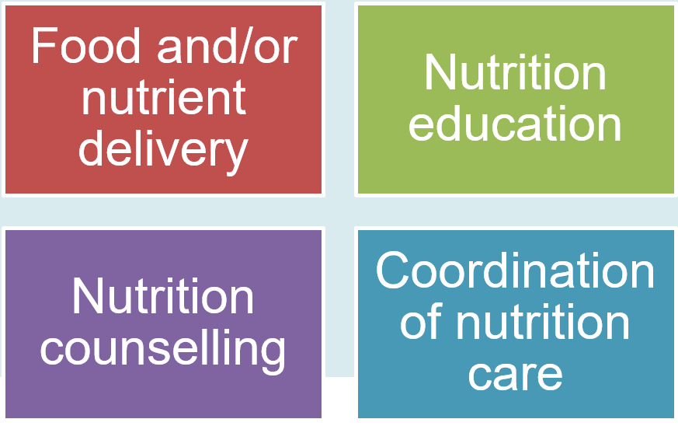
Registered Dietitian (RD)-Value Added
Registered Dietitian: A medical professional qualified to assess, diagnose and treat dietary and nutrition related problems at an individual and public-health level.
Scope of work:
Notes:
Health professional based on ethical standards
Scientific background
Only one that can translate therapeutic evidence of food into the meal itself.

Slide 8
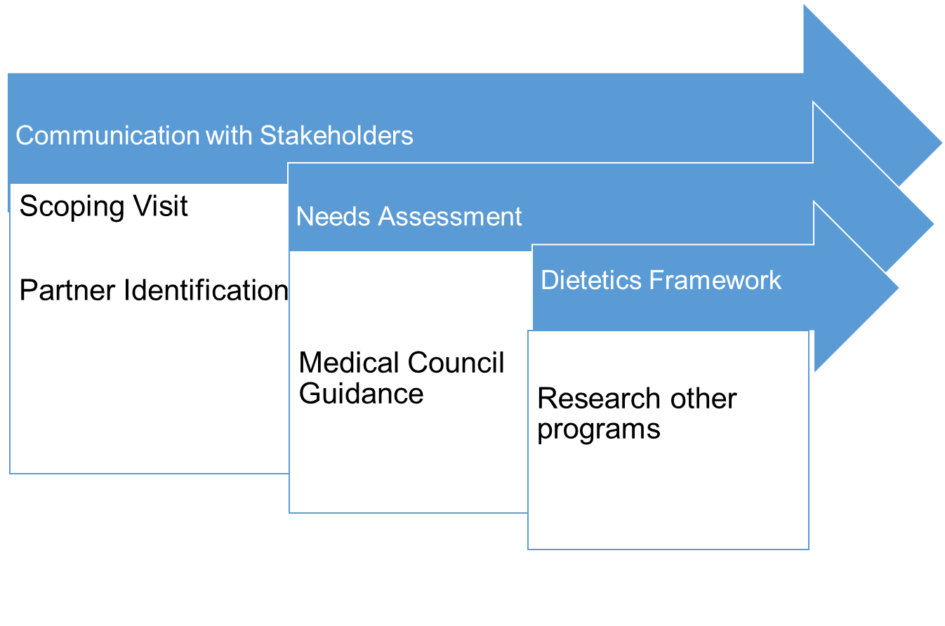
Process to RD Graduation
Notes:
Chose this specific diagram to emphasize the ongoing updates and communication with various stakeholders
Partner involvement from the start with the needs assessment
What are other countries teaching dietitians? Literature, conferences, and live meetings in South Africa.

Slide 9
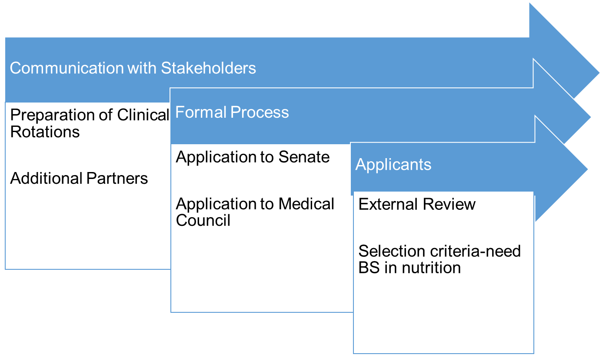
Process to RD Graduation (ii)
Notes:
Constant and ongoing updates and communication with various stakeholders
Partner involvement from the start with the needs assessment
What are other countries teaching dietitians? Literature, conferences, and live meetings in South Africa for example.

Slide 10
Malawi Ministry of Health in CAPE TOWN
Objectives
Understand how dietitians are integrated into clinical services
Outcomes
Created positions
Notes:
Working on job creation in the government hospitals same time as program creation.

Slide 11
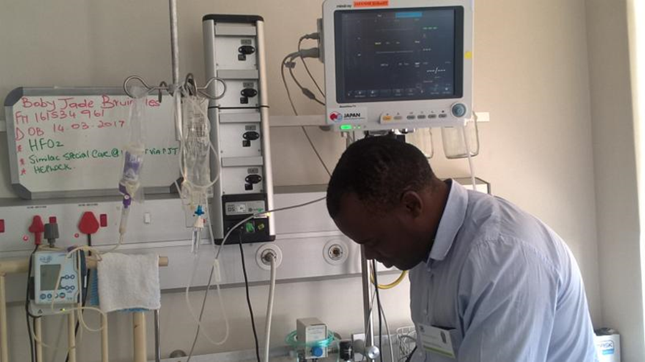
Medical Science Behind RD Training
Didactic Training at LUANAR and the College of Medicine Malawi
Nutritional Biochemistry
Statistics & Epidemiology
Advanced medical nutrition therapy
Counseling
Ethics
Master Science Degree –Launch 2018
Clinical Rotations
1200 hours
Adult
Pediatric
Critical Care
Notes:
_____________# credits Appreciate the training:
Competencies before moving on to next rotation
Actual bedside care and charting
Feedback from dietitian and medical

Slide 12
First Year RD impact
286 health professionals trained
200+ Inpatients managed
17 formal presentations
5
Registered Dietitians
5 Therapeutic menus
526 individuals screening in communities
16 Standardized recipes
Notes:
Key outcomes of supervised practice
The impact of the program is that a program that a fully fledged program is running and with all the support and inter we have received

Slide 13
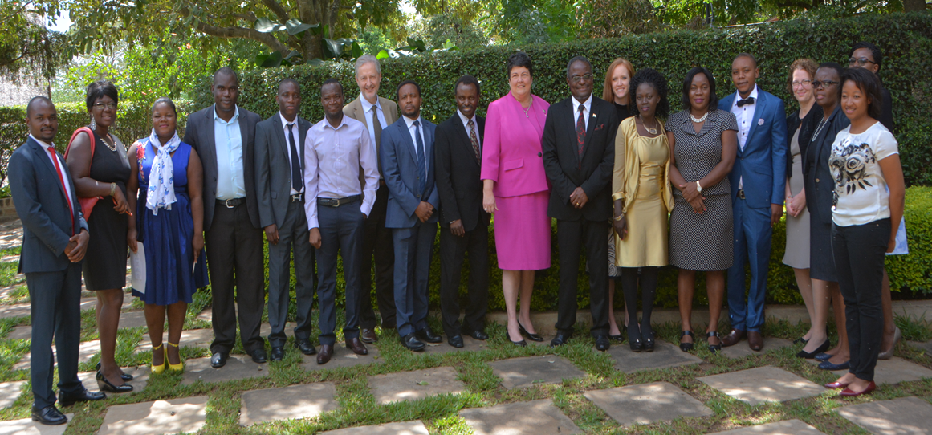
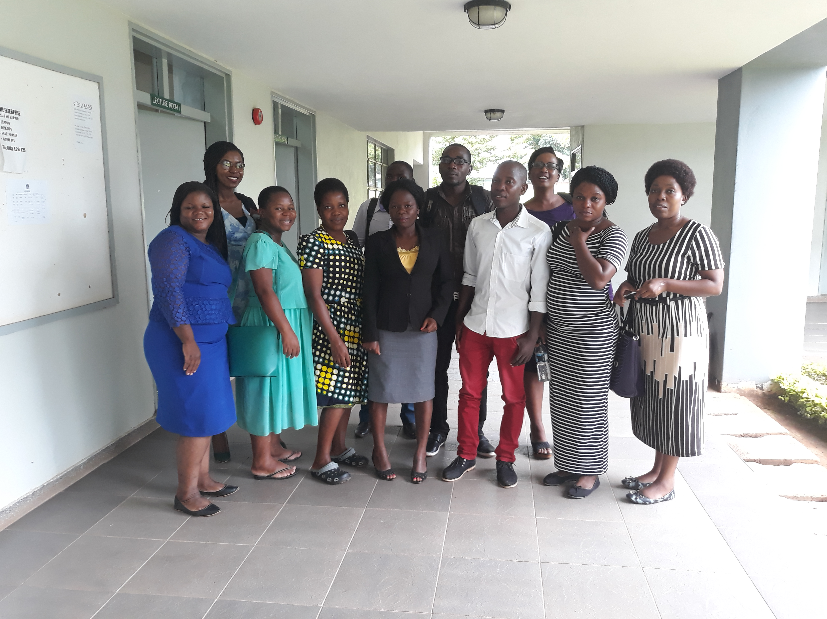
2nd Cohort
Set to begin coursework end of April 2018
1st Cohort
Graduated in February 2018

Slide 14
Notes:
To insert your implementing partner institutional logo, go to View >> Slide Master, and replace the gray box with your logo, placing it to the right of the USAID logo at the bottom. No text or partner logos can be placed within the upper blue banner.

